Slide 1


Slide 2
DISCLAIMER
This slide deck in its original and unaltered format is for educational purposes and is current as of February 2023. All materials contained herein reflect the views of the faculty, and not those of AXIS Medical Education, the CME provider, or the commercial supporter. Participants have an implied responsibility to use the newly acquired information to enhance patient outcomes and their own professional development. The information presented in this activity is not meant to serve as a guideline for patient management. Any procedures, medications, or other courses of diagnosis or treatment discussed or suggested in this activity should not be used by clinicians without evaluation of their patients’ conditions and possible contraindications on dangers in use, review of any applicable manufacturer’s product information, and comparison with recommendations of other authorities.

Slide 3
DISCLOSURE OF UNLABELED USE
This activity may contain discussion of published and/or investigational uses of agents that are not indicated by the FDA. The planners of this activity do not recommend the use of any agent outside of the labeled indications.
The opinions expressed in the activity are those of the faculty and do not necessarily represent the views of the planners. Please refer to the official prescribing information for each product for discussion of approved indications, contraindications, and warnings.
USAGE RIGHTS
This slide deck is provided for educational purposes and individual slides may be
used for personal, non-commercial presentations only if the content and references
remain unchanged. No part of this slide deck may be published in print or
electronically as a promotional or certified educational activity without prior written
permission from AXIS. Additional terms may apply. See Terms of Service on
www.axismeded.com for details.

Slide 4
Learning Objectives
Upon completion of this activity, participants should be better able to:
Integrate ADCs into treatment plans for patients with HER2+ MBC across lines of therapy based on evidence-based guideline recommendations and the latest clinical efficacy and safety data
Assess data on the evolving role of HER2-low expression status and how this emerging subtype may impact treatment decisions
Formulate mitigation strategies for identifying and managing treatment-related adverse events associated with HER2-directed antibody drug conjugates
Implement strategies to improve team-based care coordination and communication within the oncology care team, with other specialists, and with patients

Slide 5
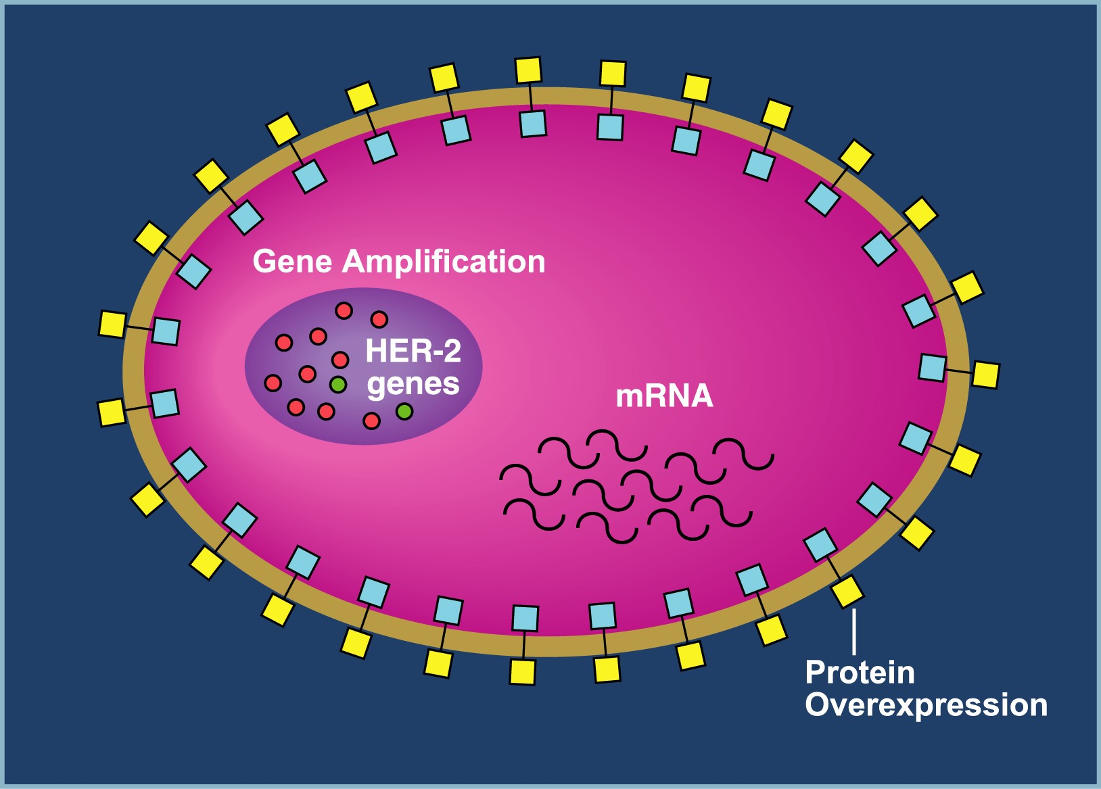
HER2+ Breast Cancer
1980s: HER2+ breast cancer denoted an aggressive phenotype with increased risk for recurrence and death; median survival 2-3 years; very difficult to treat
  1982-1984: Oncogene for HER2/neu discovered
  1986: ERBB2/HER2 cloned; mutated gene stimulates excess cell growth and division
Better understanding of molecular mechanisms underlying pathogenesis of HER2+ disease has generated targeted therapy options to combat this poor-prognosis disease
1989-2020: Deaths per year from breast cancer decreased 42% due to advances in early detection and better treatment
NCI SEER, 2022.
Notes:
National Cancer Institute. SEER*Explorer. 2022. Breast Cancer – Long-term trends in SEER age-adjusted mortality rates, 1975-2020, by sex, all races, all ages. https://seer.cancer.gov/explorer/

Slide 6
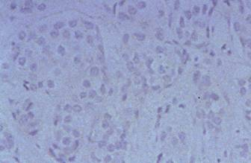
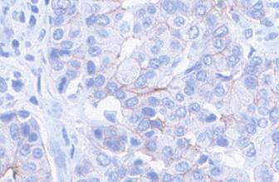
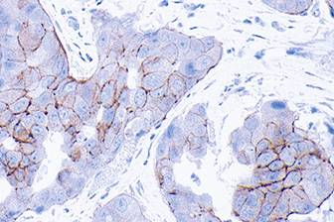
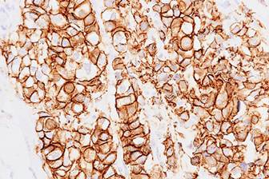
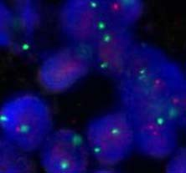
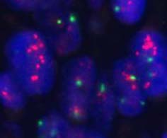
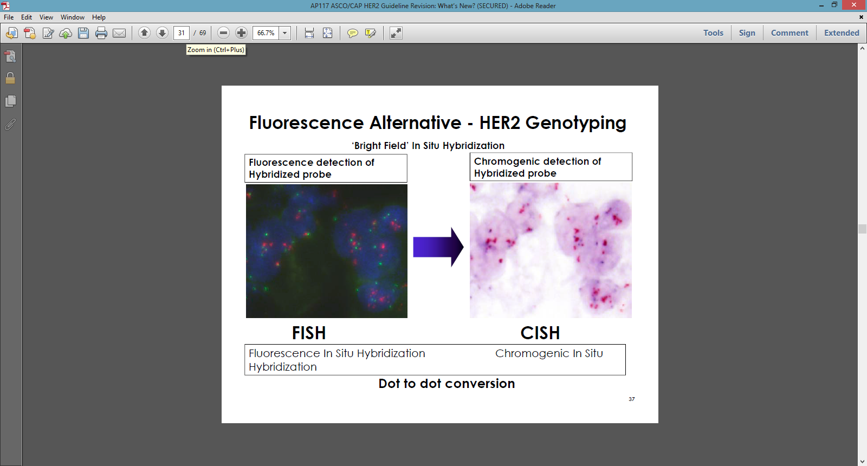
Clinically Validated and FDA-Approved Methods of HER2 Detection: IHC and in situ Hybridization
IHC Detects HER2 Protein Overexpression
‘0’ (negative)
‘1+’ (negative)
‘2+’ (equivocal)
‘3+’ (positive)
-ISH Detects HER2 Gene Amplification
HER2 gene no amplification
FISH negative
HER2 gene amplification FISH positive
CISH positive
Fluorescent -ISH
Chromogenic -ISH
“Bright-Field”
FISH, fluorescence in situ hybridization; IHC, immunohistochemistry; ISH, in situ hybridization.
Murthy et al. Indian J Pathol Microbiol. 2011;54(3):532-538. Reproduced with permission of Murthy et al in the format of electronic publication via Copyright Clearance Center.
Notes:
Key Point
The current clinically validated and FDA-approved methods for testing HER2 overexpression in breast cancer are immunohistochemistry (IHC), and gene amplification by fluorescence in situ hybridization (FISH) and chromogenic in situ hybridization (CISH).
Additional Comments
Presence of HER2/neu amplification determines a patient’s eligibility for anti-HER2 targeted therapy.
Key Considerations
Because HER2 test results inform treatment decisions, the need for accurate testing is paramount.
Reference
Murthy SS, Sandhya DG, Ahmed F, et al. Assessment of HER2/Neu status by fluorescence in situ hybridization in immunohistochemistry-equivocal cases of invasive ductal carcinoma and aberrant signal patterns: a study at a tertiary cancer center. Indian J Pathol Microbiol. 2011;54(3):532-538.

Slide 7
Breast Cancer: 2018 ASCO/CAP Guidelines for Evaluation of HER2 Protein Expression by IHC
HER2 testing (invasive component) by validated IHC assay
Batch controls and on-slide controls show appropriate staining
Circumferential membrane staining that is complete, intense, and in >10%
of tumor cells
No staining is observed
OR
Membrane staining that is faint/barely perceptible and in
≤10% of tumor cells
Weak-to-moderate complete membrane staining observed in
>10% of tumor cells
Incomplete membrane staining that is faint/barely perceptible and in >10% of tumor cells
IHC 3+
positive
IHC 2+
equivocal
IHC 1+
negative
IHC 0
negative
Must order reflex test (same specimen using ISH)
or order a new test (new specimen if available, using IHC or ISH)
ASCO, American Society of Clinical Oncology; CAP, College of American Pathologists; ISH, in situ hybridization.
Wolff et al. Arch Pathol Lab Med. 2018;142:1364-1382.
Notes:
Wolff AC, Hale Hammond ME, Allison KH, et al. Human epidermal growth factor receptor 2 testing in breast cancer: American Society of Clinical Oncology/College of American Pathologists clinical practice guideline focused update. Arch Pathol Lab Med. 2018;142:1364-1382.

Slide 8
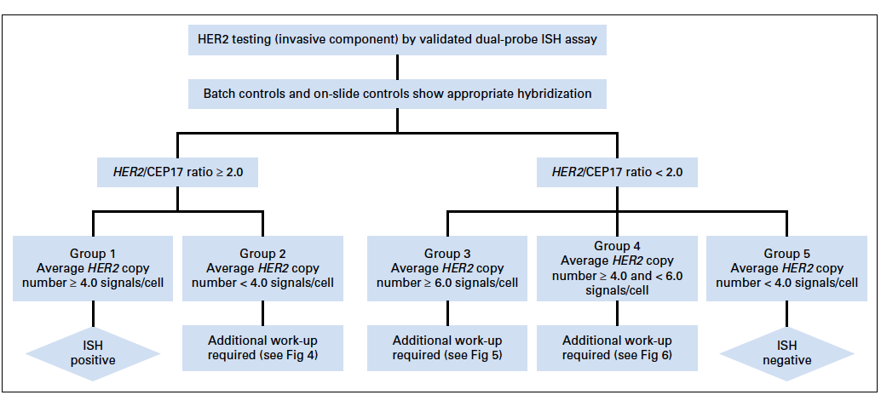
Algorithm for Evaluation of HER2 Gene Amplification With ISH Assay Using Dual-Probe (HER2 Gene) Assay
Wolff et al. Arch Pathol Lab Med. 2018;142:1364-1382.
Notes:
Wolff AC, Hale Hammond ME, Allison KH, et al. Human epidermal growth factor receptor 2 testing in breast cancer: American Society of Clinical Oncology/College of American Pathologists clinical practice guideline focused update. Arch Pathol Lab Med. 2018;142:1364-1382.

Slide 9
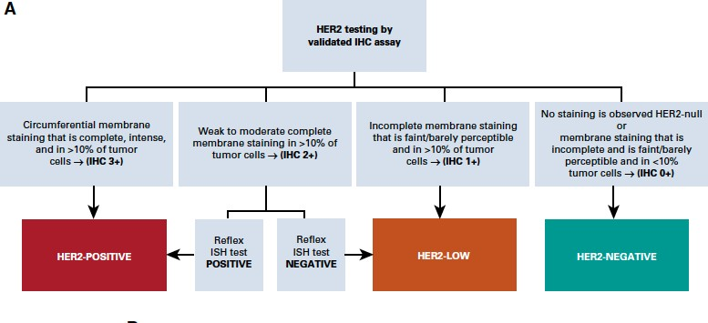
Definition of HER2-Low Breast Cancer
Tarantino et al. J Clin Oncol. 2020;38:1951-1962.
Notes:
Tarantino P, Hamilton E, Tolaney SM, et al. HER2-low breast cancer: pathological and clinical landscape. J Clin Oncol. 2020;38:1951-1962.

Slide 10
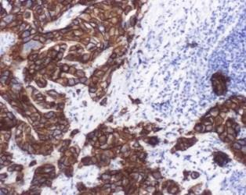
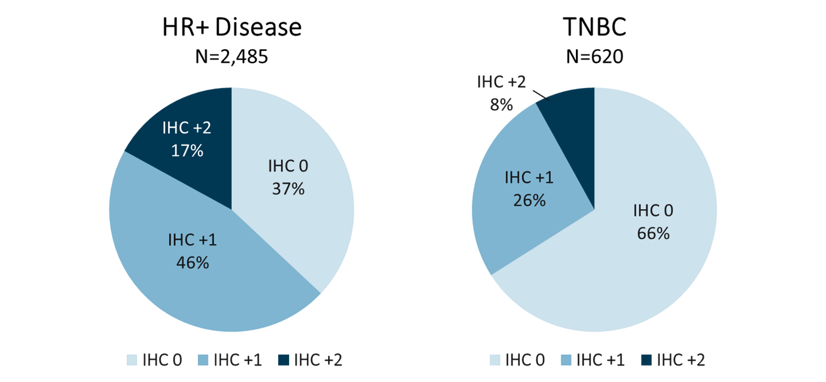
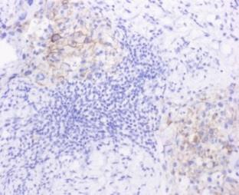
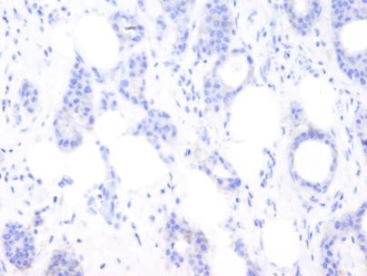
Prevalence of HER2-Low Breast Cancer
(IHC 1+/2+, FISH negative)
HER2 IHC Examples
HER2+
HER2-low
HER2-
63% HER2 Low
34% HER2 Low
HR, hormone receptor; TNBC, triple-negative breast cancer.
Schettini et al. Ann Oncol. 2020;31(suppl 2):S24. Reproduced with permission of Schettini F, et al in the format of electronic publication via Copyright Clearance Center.
Notes:
Schettini F, Chgic N, Braso-Maristany F, et al. Clinical, pathological and gene expression features of HER2-low breast cancer. Ann Oncol. 2020;31(suppl 2):S24.

Slide 11
Metastatic HER2+ Breast Cancer:
The Journey Begins
In the metastatic setting, a pivotal phase III trial compared first-line chemotherapy (doxorubicin/epirubicin and cyclophosphamide or paclitaxel) plus trastuzumab vs chemotherapy alone in HER2+ patients
Trastuzumab plus chemotherapy was associated with a significant improvement in:
  Time to disease progression (7.4 mo vs 4.6 mo)
  Objective response rate (50% vs 32%)
  1-year survival (25.1 mo vs 20.3 mo) compared with chemotherapy alone
Evidence also suggested that in women with advanced HER2+ breast cancer, survival is better with up-front use of trastuzumab plus chemotherapy than it is with sequential administration (ie, with trastuzumab reserved for the time of disease progression on an initial chemotherapy regimen)
Based on these results, the FDA approved trastuzumab for first-line therapy in HER2+ metastatic breast cancer in 1998
Slamon et al. N Engl J Med. 2001;344:783-792.
Notes:
Slamon DJ, Leyland-Jones B, Shak S, et al. Use of chemotherapy plus a monoclonal antibody against HER2 for metastatic breast cancer that overexpresses HER2. N Engl J Med. 2001;344:783-792.

Slide 12
Timeline of FDA Approvals for HER2+ Breast Cancer
1998 | 2007-2008 | 2012 | 2013 | 2017 | 2019 | 2020
Trastuzumab (metastatic) | Lapatinib (metastatic) | Pertuzumab (metastatic) | T-DM1 (metastatic) | Neratinib (adjuvant) | T-DM1 (adjuvant) | Tucatinib (metastatic)
 | Trastuzumab (adjuvant) |  | Pertuzumab (neoadjuvant) | Pertuzumab (adjuvant) | Trastuzumab deruxtecan (metastatic) | Neratinib (metastatic)
 |  |  |  |  |  | Margetuximab (metastatic)
T-DM1, ado-trastuzumab emtansine.
FDA, 2023.
Notes:
Drugs@FDA. FDA-approved drugs. Accessed January 22, 2023. https://www.accessdata.fda.gov/scripts/cder/daf/index.cfm?event=reportsSearch.process

Slide 13
NCCN Guidelines®: HER2+ MBC (ER-/PR-)
Setting | Regimen | NCCN Category of Preference (Category of Evidence)
First-line | Pertuzumab + trastuzumab + docetaxel | Preferred regimen (1)
 | Pertuzumab + trastuzumab + paclitaxel | Preferred regimen (2A)
Second-line | Fam-trastuzumab deruxtecan-nxki (T-DXd) | Preferred regimen (1) (May be considered in the first-line setting as an option for select patients, ie, those with rapid progression within 6 months of neoadjuvant or adjuvant therapy [12 months for pertuzumab-containing regimens])
 | Ado-trastuzumab emtansine (T-DM1) | Other recommended regimen (2A)
Third-line and beyond | Tucatinib + trastuzumab + capecitabine | Other recommended regimen (1) (May be used as a third- or fourth-line option; preferred in patients with both systemic and CNS progression in the third-line or beyond; and it may be given in the second-line setting)
 | Trastuzumab + docetaxel or vinorelbine | Other recommended regimen (2A)
 | Trastuzumab + paclitaxel ± carboplatin | Other recommended regimen (2A)
 | Capecitabine + trastuzumab or lapatinib | Other recommended regimen (2A)
 | Trastuzumab + lapatinib (without cytotoxic therapy) | Other recommended regimen (2A)
 | Trastuzumab + other agents | Other recommended regimen (2A)
 | Neratinib + capecitabine | Other recommended regimen (2A)
 | Margetuximab-cmkb + chemotherapy (capecitabine, eribulin, gemcitabine, or vinorelbine) | Other recommended regimen (2A)
NCCN, National Comprehensive Cancer Network; ER, estrogen receptor; PR, progesterone receptor.
NCCN Clinical Practice Guidelines in Oncology (NCCN Guidelines®) for Breast Cancer. V.4.2022.
Notes:
https://www.nccn.org/professionals/physician_gls/pdf/breast.pdf

Slide 14
OS in Patients With Advanced HER2+ MBC
CLEOPATRA End-of-Study Results
(Median Follow-Up: ~100 months)
Median OS
with TP-based initial therapy:
57.1 months
OS, %
P<.0001
Landmark OS at 8 years 37%, 235 events (58%)
Pertuzumab + trastuzumab + docetaxel
Placebo + trastuzumab + docetaxel
Landmark OS at 8 years 23%, 280 events (69%)
Time, months
No. at Risk (number censored)
Pertuzumab | 402 (0) | 371 (14) | 318 (23) | 269 (32) | 228 (41) | 188 (48) | 165 (50) | 150 (54) | 137 (56) | 120 (59) | 71 (102) | 20 (147) | 0 (167)
Placebo | 406 (0) | 350 (19) | 289 (30) | 230 (36) | 181 (41) | 149 (48) | 115 (52) | 96 (53) | 88 (53) | 75 (57) | 44 (84) | 11 (115) | 1 (125)
OS, overall survival; TP, trastuzumab/pertuzumab.
Swain et al. Lancet Oncol. 2020;21:519-530.
Notes:
Swain SM, Miles D, Kim S-B, et al. Pertuzumab, trastuzumab, and docetaxel for HER2-positive metastatic breast cancer (CLEOPATRA): end-of-study results from a double-blind, randomised, placebo-controlled, phase 3 study. Lancet Oncol. 2020;21:519-530.

Slide 15
PERTAIN Study Design
Optional: taxane
+ trastuzumab
AI + trastuzumab
HER2+
ER+
First-line MBC
N=250
AI + trastuzumab
R
Optional: taxane
+ trastuzumab
+ pertuzumab
AI + trastuzumab
+ pertuzumab
AI + trastuzumab + pertuzumab
Primary endpoint: PFS
Key secondary endpoints: OS, ORR, CBR, DOR, time to response, safety, and QoL
AI, aromatase inhibitor; CBR, clinical best response; DOR, duration of response; ORR, overall response rate; PFS, progression-free survival; QoL, quality of life.
ClinicalTrials.gov. https://clinicaltrials.gov/ct2/show/NCT01491737
Notes:
A study of pertuzumab in combination with trastuzumab plus an aromatase inhibitor in participants with metastatic human epidermal growth factor receptor 2 (HER2)-positive and hormone receptor-positive advanced breast cancer (PERTAIN). ClinicalTrials.gov identifier: NCT01491737. Updated October 28, 2020. Accessed February 22, 2023. https://clinicaltrials.gov/ct2/show/NCT01491737

Slide 16
PERTAIN: PFS
PERTAIN met its primary PFS endpoint
Median PFS (ITT Population)
19 months (trastuzumab and pertuzumab + AI)
vs 16 months (trastuzumab + AI)
Patients Who Did Not Receive
Induction Chemotherapy
Change in Median PFS: +9.3 months
 | Pertuzumab + Trastuzumab (n = 129) | Trastuzumab (n = 129)
Events, n (%) | 74 (57.4) | 92 (71.3)
Median PFS, mo | 18.89 | 15.80
95% Cl | 14.09 to 27.66 | 11.04 to 18.56
Δ, mo | 3.09
HR (95% Cl) | 0.65 (0.48 to 0.89)
P | .007
 | Pertuzumab + Trastuzumab (n = 54) | Trastuzumab (n = 56)
Events, n (%) | 29 (53.9) | 43 (76.8)
Median PFS, mo | 21.72 | 12.45
95% Cl | 12.42 to 32.95 | 6.21 to 18.53
Δ, mo | 9.27
HR (95% Cl) | 0.55 (0.34 to 0.88)
P | .0111
Median follow-up: 31 months
Median follow-up: 31 months
PFS, %
PFS, %
Median
Median
Pertuzumab + trastuzumab
Trastuzumab
Pertuzumab + trastuzumab
Trastuzumab
Time, months
Time, months
No. at Risk
Pertuzumab + trastuzumab | 129 | 123 | 121 | 116 | 114 | 107 | 102 | 91 | 89 | 84 | 81 | 77 | 74 | 71 | 69 | 65 | 62 | 58 | 55 | 53 | 48 | 46 | 43 | 39 | 37 | 36 | 33 | 28 | 28 | 26 | 21 | 16 | 13 | 13 | 12 | 10 | 7 | 5 | 4 | 3 | 1 | 1 | 0
Trastuzumab | 129 | 122 | 116 | 108 | 104 | 93 | 90 | 81 | 80 | 75 | 73 | 67 | 64 | 61 | 60 | 56 | 54 | 47 | 47 | 39 | 36 | 33 | 32 | 29 | 26 | 26 | 23 | 18 | 15 | 14 | 12 | 10 | 9 | 8 | 6 | 5 | 3 | 2 | 1 | 1 | 1 | 1 | 0
54 | 50 | 50 | 47 | 46 | 42 | 39 | 36 | 34 | 33 | 33 | 31 | 31 | 29 | 28 | 27 | 25 | 25 | 24 | 24 | 24 | 22 | 20 | 20 | 19 | 16 | 15 | 14 | 14 | 12 | 12 | 11 | 10 | 6 | 4 | 4 | 4 | 3 | 3 | 2 | 1 | 0 | 0 | 0 | 0
56 | 52 | 49 | 42 | 39 | 35 | 35 | 34 | 34 | 32 | 31 | 28 | 27 | 25 | 25 | 23 | 22 | 19 | 19 | 15 | 15 | 14 | 12 | 11 | 9 | 7 | 7 | 7 | 6 | 5 | 5 | 5 | 4 | 4 | 3 | 3 | 3 | 1 | 1 | 1 | 1 | 1 | 1 | 1 | 0
ITT, intention-to-treat.
Rimawi et al. J Clin Oncol. 2018;36:2826-2835.
Notes:
Rimawi M, Ferrero J-M, Haba-Rodriguez J, et al. First-line trastuzumab plus an aromatase inhibitor, with or without pertuzumab, in human epidermal growth factor receptor 2-positive and hormone receptor-positive metastatic or locally advanced breast cancer (PERTAIN): a randomized, open-label phase II trial. J Clin Oncol. 2018;36:2826-2835.

Slide 17
EMILIA and TH3RESA: 2nd-line Therapy With T-DM1 After Progression on HER2-Targeted Agents for HER2+ MBC
EMILIA: Randomized phase 3 study of lapatinib + capecitabine vs T-DM1 for HER2+ MBC with progression on trastuzumab + taxane (N=991)
TH3RESA: Randomized phase 3 study of physician’s choice vs T-DM1 for HER2+ MBC with progression on a taxane, lapatinib, and ≥2 HER2-targeted regimens including trastuzumab (N=602)
Median OS,
Months
Median OS,
Months
Lapatinib + Cape
T-DM1
25.1
30.9
Physician’s choice
T-DM1
15.8
22.7
100
85.2%
100
80
64.7%
80
78.4%
60
60
OS (%)
51.8%
OS (%)
40
40
20
20
HR: 0.68 (95% CI: 0.55-0.85; P<.001)*
HR: 0.68 (95% CI: 0.54-0.85; P=.0007)
0
0
32
38
40
0
2
4
6
8
10
12
14
16
18
20
22
24
26
28
30
32
34
36
Patients at Risk, n (censored)
Physician’s
choice
T-DM1
0
2
4
6
8
10
12
14
16
18
20
22
24
26
28
30
34
36
Patients at Risk, n
Lapatinib
+ cape
T-DM1
Months
Months
496
495
471
485
453
474
435
457
204
242
159
197
133
164
110
136
86
111
63
86
45
62
27
38
17
28
7
13
4
5
198 (0)
404 (0)
150 (28)
368 (17)
122 (31)
321 (29)
107 (33)
280 (35)
80 (34)
226 (43)
66 (36)
192 (44)
59 (37)
167 (45)
39 (45)
132 (66)
16 (68)
54 (138)
1 (80)
12 (172)
0
0
403
439
297
349
368
418
240
293
*Efficacy stopping boundary: HR of 0.73 or P=.0037.
Cape, capecitabine.
Verma et al. N Engl J Med. 2012;367:1783-1791; Krop et al. Lancet Oncol. 2017;18:743-754.
Notes:
Verma S, Miles D, Gianni L, et al. Trastuzumab emtansine for HER2-positive advanced breast cancer. N Engl J Med 2012;367:1783-1791.
Krop IE, Kim S-E, Martin AG, et al. Trastuzumab emtansine versus treatment of physician's choice in patients with previously treated HER2-positive metastatic breast cancer (TH3RESA): final overall survival results from a randomised open-label phase 3 trial. Lancet Oncol 2017;18:743-754.

Slide 18
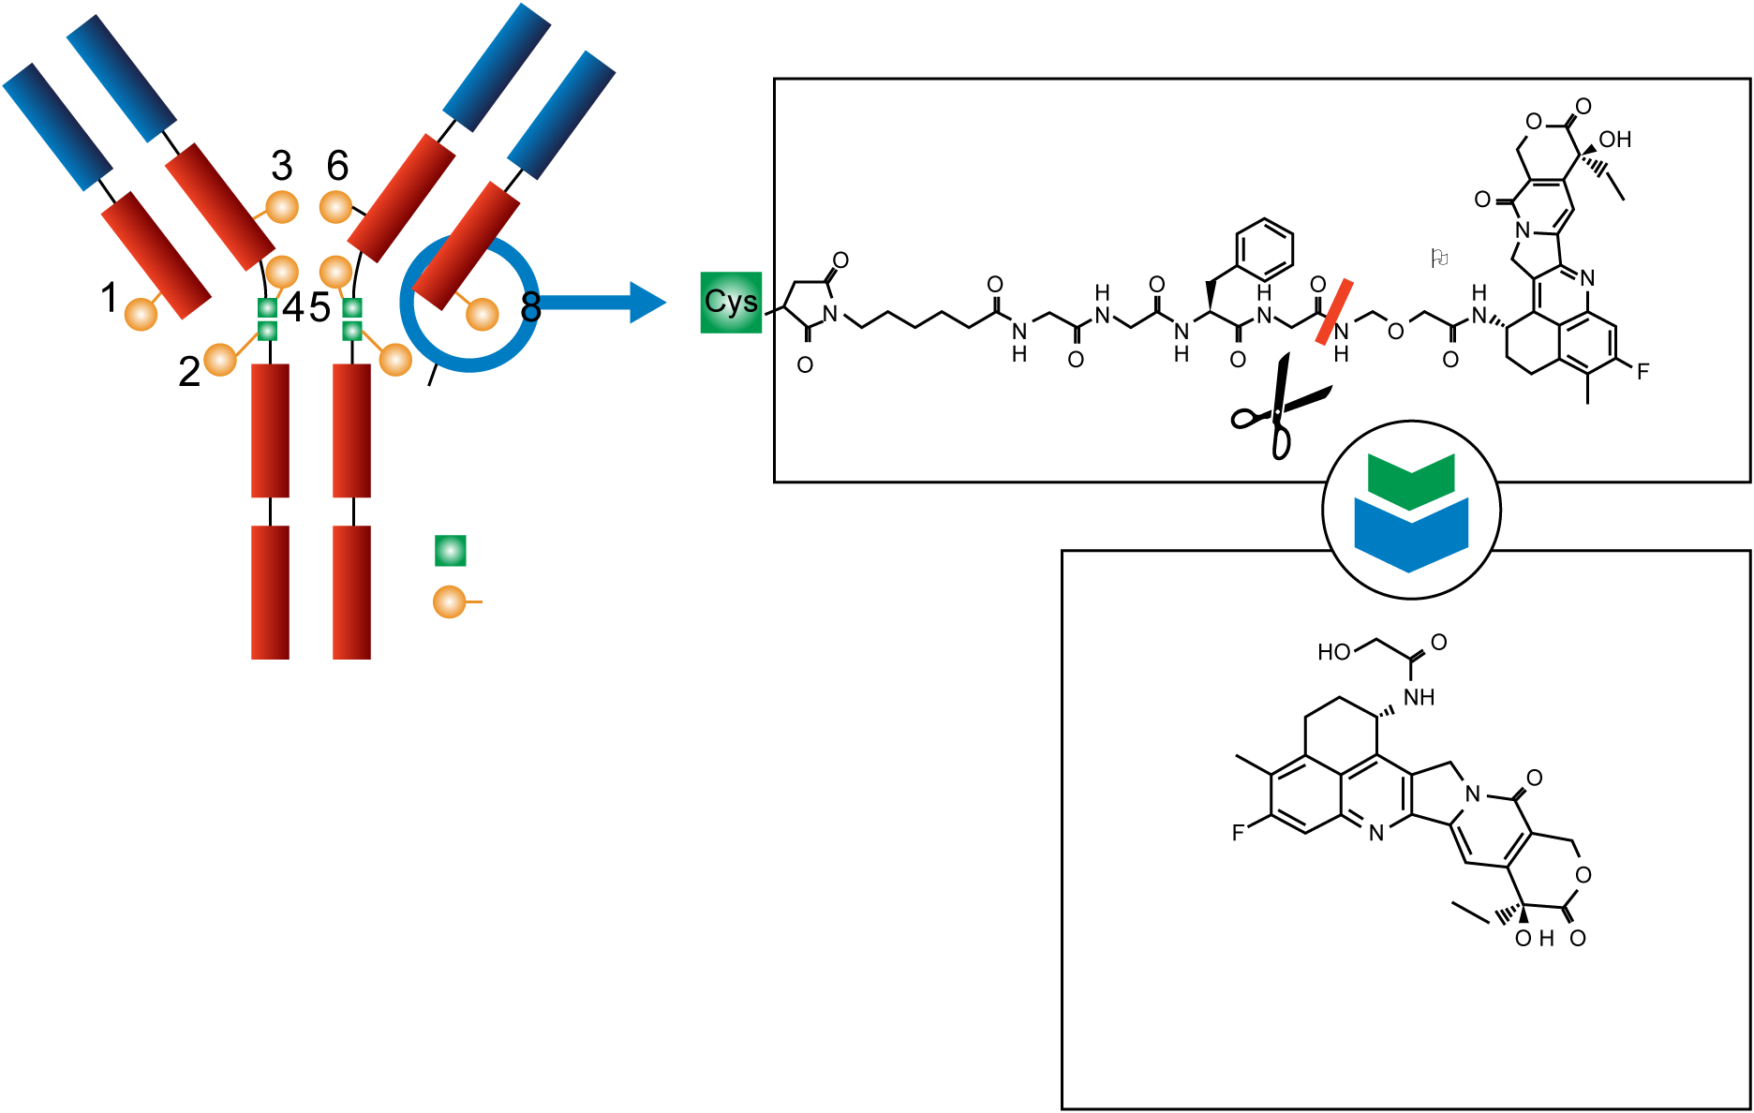
Trastuzumab Deruxtecan (T-DXd; DS8201a): A Novel HER2 ADC
Proprietary drug linker
 | T-DXd | T-DM1
Antibody | Trastuzumab Anti-HER2 mAb | Trastuzumab
Payload | Topoisomerase I inhibitor | Tubulin inhibitor
DAR | 7-8 | 3.5
Membrane Permeability | Yes (bystander effect) | No
7
Cysteine residue
Drug linker
Conjugation chemistry
The linker is connected to cysteine
residue of the antibody
Payload (DXd)
Exatecan derivative
DAR, drug-to-antibody ratio.
Nakada et al. Chem Pharm Bull (Tokyo). 2019;67:173-185; Pondé et al. Curr Treat Options Oncol. 2019;20:37. Permission requested from Chem Pharm Bull.
Notes:
Nakada T, Sugihara K, Jikoh T, et al. The latest research and development into the antibody-drug conjugate, [fam-] trastuzumab deruxtecan (DS-8201a), for HER2 cancer therapy. Chem Pharm Bull (Tokyo). 2019;67:173-185.
Ponde N, Aftimos P, Piccart M. Antibody-drug conjugates in breast cancer: a comprehensive review. Curr Treat Options Oncol. 2019;20:37.

Slide 19
T-DXd vs T-DM1 in HER2+ MBC, Results From the Randomized Phase 3 DESTINY-Breast03 Study: Study Design and Patients
Key Eligibility Criteria
HER2+ unresectable or MBCª
Previous treatment with trastuzumab and taxane in advanced/metastatic setting^{b}
Clinically stable, treated brain metastases allowed
Patient Characteristics | Patient Characteristics | T-DXd (n=261) | T-DM1 (n=263)
Median age, years (range) | Median age (range), years | 54.3 (27.9-83.1) | 54.2 (20.2-83.0)
Region, Asia |  | 57.1 | 60.8
HER2 status (IHC,^{c} %) | 3+ | 89.7 | 88.2
 | 2+ (ISH amplified) | 9.6 | 11.4
 | 1+/NE/not examined | 0.4/0.4/0 | 0/0.4/0
ECOG PS, % | 0/1/Missing | 59.0/40.6/0.4 | 66.5/33.1/0.4
Brain metastases, % | Yes/No | 23.8/76.2 | 19.8/80.2
Visceral disease, % | Yes/No | 70.5/29.5 | 70.3/29.7
Prior lines of therapy in the metastatic setting (includes rapid progressors as one line of treatment), n (%) | 0 | 2 (0.8) | 3 (1.1)
 | 1 | 130 (49.8) | 123 (46.8)
 | 2 | 56 (21.5) | 65 (24.7)
 | 3 | 35 (13.4) | 35 (13.3)
 | 4 | 15 (5.7) | 19 (7.2)
 | ≥5 | 23 (8.8) | 18 (6.8)
Prior trastuzumab, % |  | 99.6 | 99.6
Prior pertuzumab, % |  | 62.1 | 60.1
R
A
N
D
O
M
I
Z
E
D
T-DXd
5.4 mg/kg Q3W
1:1
T-DM1
3.6 mg/kg Q3W
Primary endpoint: PFS by BICR
Secondary endpoints: OS, ORR (BICR and investigator),
DOR (BICR), PFS (investigator), safety
ª HER2+ is defined as IHC 3+ or IHC 2+/ISH+ based on central confirmation. ^{b} Progression during or <6 months after completing adjuvant therapy involving trastuzumab and taxane. ^{c} HER2 status as evaluated by central lab.
BICR, blinded independent committee review; ECOG PS, Eastern Cooperative Oncology Group performance status; NE, not estimable; T-DXd, trastuzumab deruxtecan.
Cortés et al. Ann Oncol. 2021;32(suppl 5):S1283-S1346; Cortés et al. N Engl J Med. 2022;386(12):1143-1154.
Notes:
Cortes J, Kim S, Chung W, et al. Trastuzumab deruxtecan (T-DXd) vs trastuzumab emtansine (T-DM1) in patients (Pts) with HER2+ metastatic breast cancer (mBC): Results of the randomized phase III DESTINY-Breast03 study. Ann Oncol. 2021;32(suppl 5):S1283-S1346.
Cortes J, Kim S-B, Chung W-P. Trastuzumab deruxtecan versus trastuzumab emtansine for breast cancer. N Engl J Med. 2022;386(12):1143-1154.

Slide 20
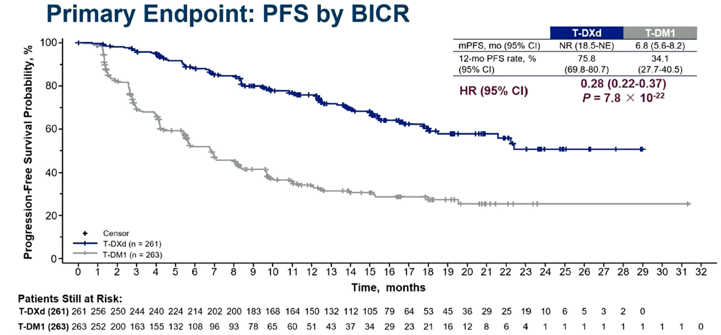
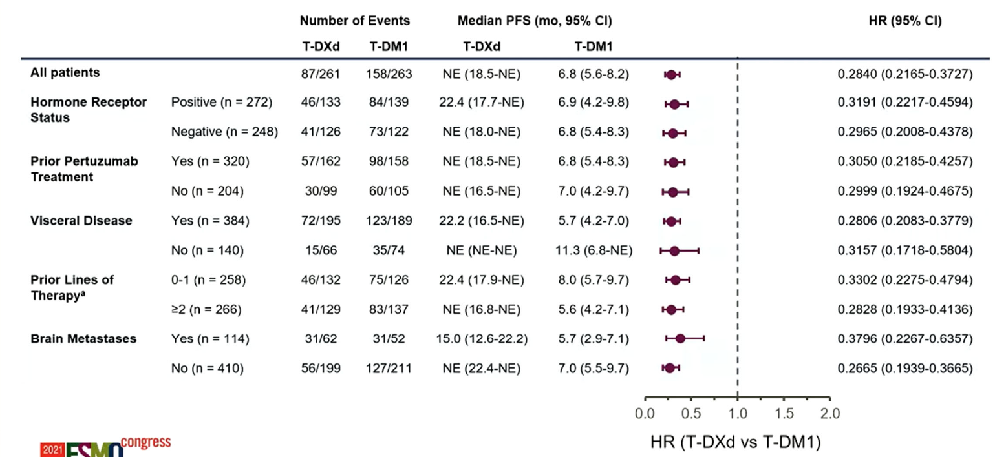
T-DXd vs T-DM1 in HER2+ MBC, Results From the Randomized Phase 3 DESTINY-Breast03 Study: PFS
Primary Endpoint: PFS Assessed by BICR
PFS in Key Subgroups
 | T-DXd | T-DM1
mPFS, months (95% CI) | NR (18.5-NE) | 6.8 (5.6-8.2)
12-month PFS rate, % (95% CI) | 75.8 (69.8-80.7) | 34.1 (27.7-40.5)
HR (95% CI) | 0.28 (0.22-0.37) P = 7.8 x 10⁻²²
Median PFS follow-up was 15.5 months for T-DXd and 13.9 months for T-DM1 (P<0.001)
A consistent PFS benefit was seen across key patient subgroups
mPFS, median progression-free survival.
Cortés et al. Ann Oncol. 2021;32(suppl 5):S1283-S1346; Hurvitz et al, SABCS 2021. Abstract GS3-01; Cortés et al. N Engl J Med. 2022;386(12):1143-1154.
Notes:
Cortes J, Kim S, Chung W, et al. Trastuzumab deruxtecan (T-DXd) vs trastuzumab emtansine (T-DM1) in patients (Pts) with HER2+ metastatic breast cancer (mBC): Results of the randomized phase III DESTINY-Breast03 study. Ann Oncol. 2021;32(suppl 5):S1283-S1346.
Hurvitz S, Kim S-B, Chung W-P, et al. Trastuzumab deruxtecan (T-DXd; DS-8201a) vs. trastuzumab emtansine (T-DM1) in patients (pts) with HER2+ metastatic breast cancer (mBC): subgroup analyses from the randomized phase 3 study DESTINY-Breast03. SABCS 2021, GS3-01.
Cortes J, Kim S-B, Chung W-P. Trastuzumab deruxtecan versus trastuzumab emtansine for breast cancer. N Engl J Med. 2022;386(12):1143-1154.

Slide 21
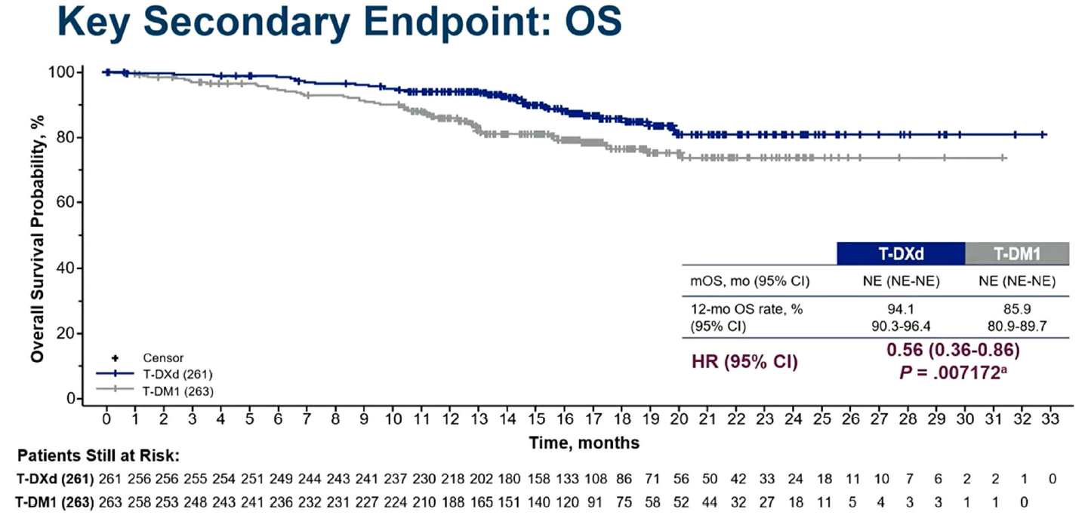
T-DXd vs T-DM1 in HER2+ MBC, Results From the Randomized Phase 3 DESTINY-Breast03 Study: OS and ORR
Secondary Endpoint: OS
Efficacy Endpoints | T-DXd (n=261) | T-DM1 (n=263)
Confirmed ORR n (%)^{b} [95% CI] | 208 (79.7) [74.3-84.4] | 90 (34.2) [28.5-40.3]
 | P<.0001
CR, n (%) | 42 (16.1) | 23 (8.7)
PR, n (%) | 166 (63.6) | 67 (25.5)
SD, n (%) | 44 (16.9) | 112 (42.6)
PD, n (%) | 3 (1.1) | 46 (17.5)
Not evaluable, n (%) | 6 (2.3) | 15 (5.7)
CR+PR+SD (DCR), n (%) | 252 (96.6) | 202 (76.8)
 | T-DXd | T-DM1
mOS, mo (95% CI) | NE (NE-NE) | NE (NE-NE)
12-month OS rate, % (95% CI) | 94.1 (90.3-96.4) | 85.9 (80.9-89.7)
HR (95% CI) | 0.56 (0.36-0.86) P=.007172ª
ªP=.007172 but does not cross prespecified boundary of P<.000265. ^{b}Based on BICR.
CR, complete response; DCR, disease control rate; mOS, median overall survival; PD, progressive disease; PR, partial response; SD, stable disease.
Cortés et al. Ann Oncol. 2021;32(suppl 5):S1283-S1346; Hurvitz et al, SABCS 2021. Abstract GS3-01; Cortés et al. N Engl J Med. 2022;386(12):1143-1154.
Notes:
Cortes J, Kim S, Chung W, et al. Trastuzumab deruxtecan (T-DXd) vs trastuzumab emtansine (T-DM1) in patients (Pts) with HER2+ metastatic breast cancer (mBC): Results of the randomized phase III DESTINY-Breast03 study. Ann Oncol. 2021;32(suppl 5):S1283-S1346.
Hurvitz S, Kim S-B, Chung W-P, et al. Trastuzumab deruxtecan (T-DXd; DS-8201a) vs. trastuzumab emtansine (T-DM1) in patients (pts) with HER2+ metastatic breast cancer (mBC): subgroup analyses from the randomized phase 3 study DESTINY-Breast03. SABCS 2021, GS3-01.
Cortes J, Kim S-B, Chung W-P. Trastuzumab deruxtecan versus trastuzumab emtansine for breast cancer. N Engl J Med. 2022;386(12):1143-1154.

Slide 22
DESTINY-Breast03: Updated Results
Efficacy Endpoints | T-DXd (n=261) | T-DM1 (n=263)
Median duration of study follow-up | 28.4 months | 26.5 months
Median PFS by BICR | 28.8 months | 6.8 months
HR | 0.33
nominal p | <0.0001
Median OS | NR (95% CI 40.5 months–NE) | NR (95% CI 34.0 months–NE)
OS events, n (%) | 72 (28%) | 97 (37%)
HR | 0.64
p | 0.0037
Grade 3 or worse treatment-emergent adverse events, n (%) | 145 (56%) | 135 (52%)
Adjudicated drug-related interstitial lung disease or pneumonitis, n (%) | 39 (15%) | 8 (3%)
HR, hazard ratio; NR, not reached.
Hurvitz et al. Lancet. 2022;401(10371):P105-P117.
Notes:
Hurvitz S, Hegg R, Chung W-P, et al. Trastuzumab deruxtecan versus trastuzumab emtansine in patients with HER2-positive metastatic breast cancer: updated results from DESTINY-Breast03, a randomised, open-label, phase 3 trial. Lancet. 2022;401(10371):P105-P117.

Slide 23
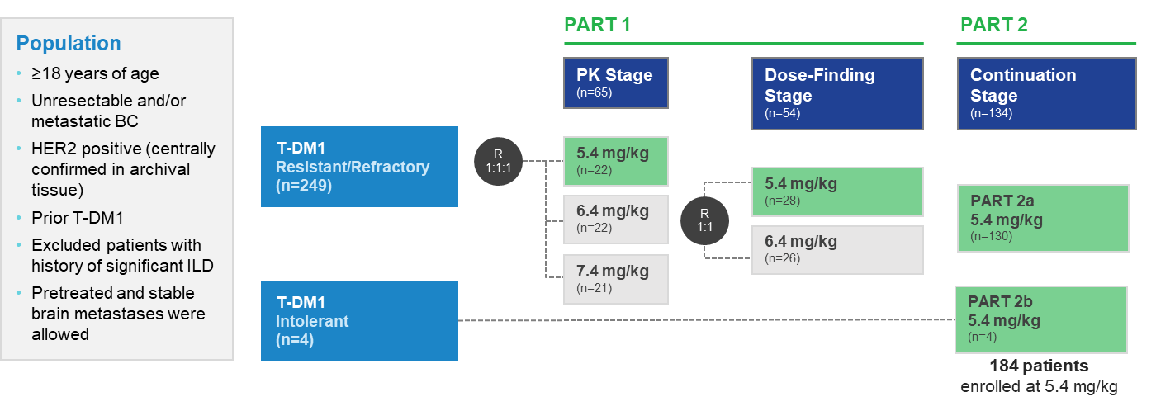
Phase 2 DESTINY-Breast01: Study Design
T-DXd in Third-Line Setting, Previously Treated With T-DM1
An Open-Label Multicenter Phase 2 Study of T-DXd^{1,2}
Endpoints
Primary: confirmed ORR by independent central imaging facility review per RECIST v1.1
Secondary: investigator-assessed ORR, DCR, DOR, CBR, PFS, OS, PK, and safety
Median Duration of Follow-Up
August 1, 2019, data cutoff: 11.1 months (range, 0.7-19.9 mo)¹
June 8, 2020, data cutoff: 20.5 months (range, 0.7-31.4 mo)²
March 26, 2021, data cutoff: 26.5 months (range, 0.7-39.1 mo)³
ªAll 184 patients received ≥1 dose of T-DXd. ^{b}HER2 status was centrally assessed on the most recent archival tissue according to the ASCO-CAP guidelines.
BC, breast cancer; CBR, clinical benefit rate; ILD, interstitial lung disease; ORR, objective response rate; PK, pharmacokinetics.
1. Modi et al. N Engl J Med. 2020;382(7):610-621; Modi et al, SABCS 2020 Virtual. Poster Spotlight PD3-06. 3. Manich et al. Ann Oncol. 2021;32(5):S485-S486.
Notes:
Modi S, Saura C, Yamashita T, et al. Trastuzumab deruxtecan in previously treated HER2-positive breast cancer. N Engl J Med. 2020;382(7):610-621.
Modi S, et al. Updated results from DESTINY-Breast01, a phase 2 trial of trastuzumab deruxtecan (T-DXd) in HER2-positive metastatic breast cancer. Presented at the 2020 San Antonio Breast Cancer Symposium; December 8-11; 2020. Virtual. Poster Spotlight PD3-06.
Manich C, Modi S, Krop I, et al. Trastuzumab deruxtecan (T-DXd) in patients with HER2-positive metastatic breast cancer (MBC): updated survival results from a phase 2 trial (DESTINY-Breast01). Ann Oncol. 2021;32(5):S485-S486.

Slide 24
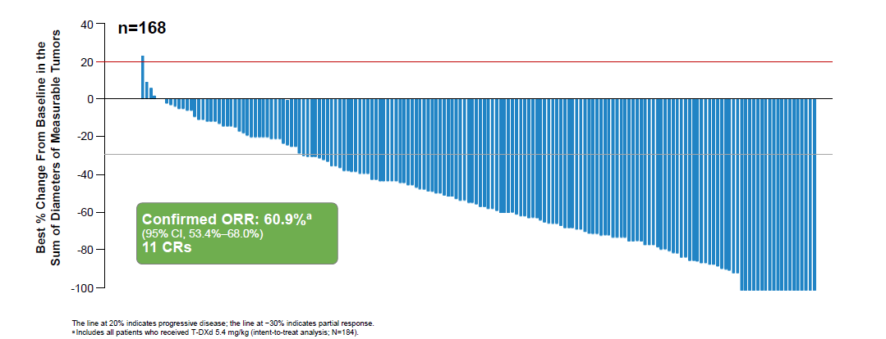
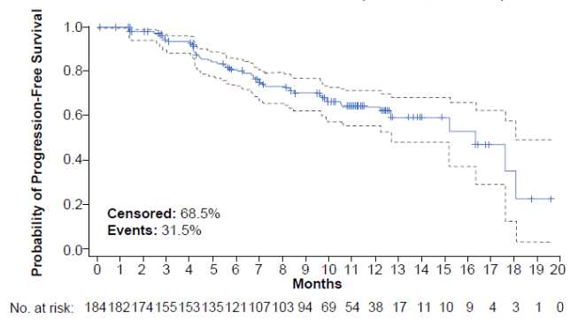
Phase 2 DESTINY-Breast01 Study: T-DXd Efficacy
Best Change in Tumor Size
Endpoint (N = 184) | Result
Confirmed ORR (primary endpoint) | 60.9% (n = 112)
CR | 6.0% (n = 11)
PR | 54.9% (n = 101)
DCR (CR+PR+SD) | 97.3%
Median PFS, months | 16.4
Median OS, months | Not reached
Median DoR, months | 14.8
Median prior lines of cancer therapy | 6 (range, 2-27)
Progression-Free Survival
Median follow-up: 11.1 months.
Krop et al, SABCS 2019. Abstract GS1-03; Modi et al. N Engl J Med. 2020;382:610-621.
Notes:
Krop IE, Saura C, Yamashita T, et al. [Fam-] trastuzumab deruxtecan (T-DXd; DS-8201 in subjects with HER2-positive metastatic breast cancer (MBC) previously treated with T-DM1: A phase 2, multicenter, open-label study (DESTINY-Breast01). Poster presented at: San Antonio Breast Cancer Symposium; December 11, 2019; San Antonio, TX. Abstract GS1-03.
Modi S, Saura C, Tamashita T, et al. Trastuzumab deruxtecan in previously treated HER2-positive breast cancer. N Engl J Med. 2020;382:610-621.

Slide 25
Phase 3 DESTINY-Breast02: Study Design
T-DXd in Third-Line Setting, Previously Treated With T-DM1
R
A
N
D
O
M
I
Z
A
T
I
O
N
HER2+ Unresectable and/or MBC Third-Line and After T-DM1
Trastuzumab deruxtecan
5.4 mg/kg IV q3w
(n=400)
T-DM1-treated BC
Archived sample HER2+ (central)
2:1
Investigator’s choice of trastuzumab + capecitabine or
lapatinib + capecitabine
(n=200)
No prior capecitabine; any number prior treatments
Primary endpoint:
PFS based on blinded, independent central review using RECIST v1.1 criteria
IV, intravenously; q3w, every 3 weeks; T-DM1, trastuzumab emtansine.
ClinicalTrials.gov. https://clinicaltrials.gov/ct2/show/NCT03523585; Krop et al, SABCS 2022. Abstract GS2-01.
Notes:
A Phase 3, multicenter, randomized, open-label, active-controlled study of trastuzumab deruxtecan (DS-8201a), an anti-HER2-antibody drug conjugate, versus treatment of investigator's choice for HER2-positive, unresectable and/or metastatic breast cancer subjects previously treated with T-DM1 (DESTINY-Breast02]. ClinicalTrials.gov identifier: NCT03523585. Updated August 12, 2022. Accessed February 22, 2023. https://clinicaltrials.gov/ct2/show/NCT03523585
Krop IE, Park YH, Kim S-B, et al. Trastuzumab deruxtecan vs physician’s choice in patients with HER2+ unresectable and/or metastatic breast cancer previously treated with trastuzumab emtansine: primary results of the randomized, phase 3 study DESTINY-Breast02. Poster presented at: San Antonio Breast Cancer Symposium; December 7, 2022; San Antonio, TX. Abstract GS2-01.

Slide 26
Phase 3 DESTINY-Breast02: Efficacy
Efficacy Endpoints | T-DXd (n=406) | TPC (n=202)
Median follow-up | 21.5 months | 18.6 months
Median PFS | 17.8 months | 6.9 months
HR | 0.3589
P | <.000001
Median OS | 39.2 months | 26.5 months
HR | 0.6575
P | .0021
Confirmed ORR by BICR | 69.7% | 29.2%
P | <.001
TPC, treatment of physician’s choice.
Krop et al, SABCS 2022. Abstract GS2-01.
Notes:
Krop IE, Park YH, Kim S-B, et al. Trastuzumab deruxtecan vs physician’s choice in patients with HER2+ unresectable and/or metastatic breast cancer previously treated with trastuzumab emtansine: primary results of the randomized, phase 3 study DESTINY-Breast02. Poster presented at: San Antonio Breast Cancer Symposium; December 7, 2022; San Antonio, TX. Abstract GS2-01.

Slide 27
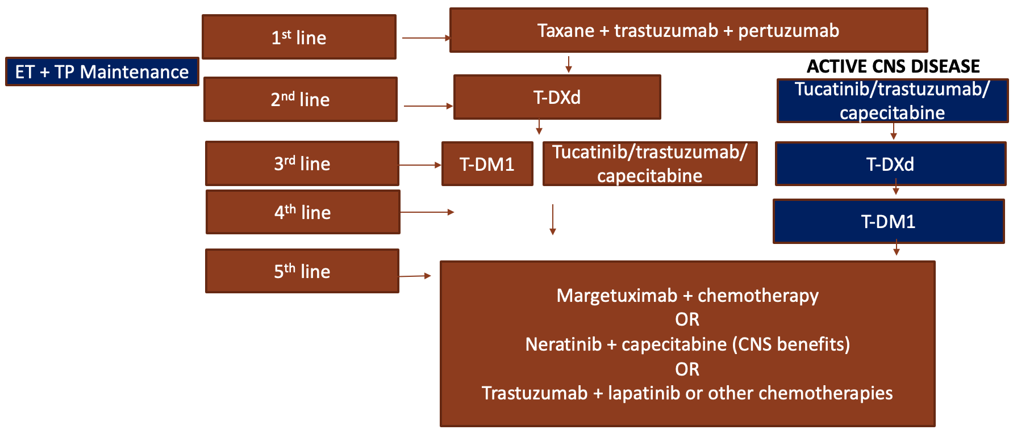
Post-ESMO 2021 Approach to Therapy
CNS, central nervous system; ESMO, European Society for Medical Oncology; ET, endocrine therapy.
Adapted from Modi et al. N Engl J Med;2020;382(7):610-621; Gennari et al. Ann Oncol. 2021;32(12):1475-1495.
Notes:
Modi S, Saura C, Yamashita T, et al. Trastuzumab deruxtecan in previously treated HER2-positive breast cancer. N Engl J Med. 2020;382(7):610-621.
Gennari A, Andre F, Barrios CH, et al. ESMO Clinical Practice Guideline for the diagnosis, staging and treatment of patients with metastatic breast cancer. Ann Oncol. 2021;32(12):1475-1495.

Slide 28
Evolution of HER2-Low Between Primary and MBC
Primary Tumor
Metastatic Tumor
19% HER2+
18% HER2+
42%
HER2-low
50%
HER2-low
39%
HER2-neg
32%
HER2-neg
HER2-low enriched in MBC compared with primary (50% vs 42%, P =.02)
Late relapsers had higher relative increase compared with early relapsers
Tarantino et al. J Clin Oncol. 2020;38:1951-1962.
Notes:
Tarantino Pl, Hamilton E, Tolaney SM, et al. HER2-low breast cancer: pathological and clinical landscape. J Clin Oncol. 2020;38:1951-1962.

Slide 29
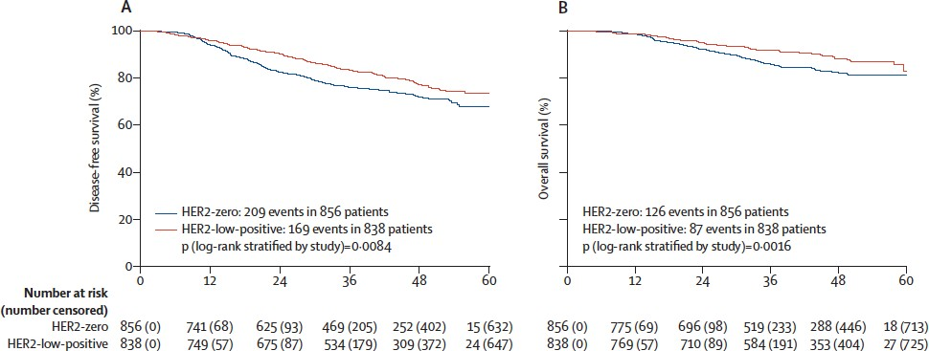
Does HER2-Low Status Affect Prognosis?
Denkert et al. Lancet Oncol. 2021;22:1151-1161.
Notes:
Denkert C, Seither F, Schneeweiss A, et al. Clinical and molecular characteristics of HER2-low-positive breast cancer: pooled analysis of individual patient data from four prospective, neoadjuvant clinical trials. Lancet Oncol. 2021;22:1151-1161.

Slide 30
Results From the Phase 3 DESTINY-Breast04 Trial of Trastuzumab Deruxtecan in HER2-Low MBC: Study Design and Patients
Key Eligibility Criteria
HER2-low (IHC 1+ or IHC 2+/ISH-) unresectable and/or MBC
≥1 prior line of chemotherapy in the metastatic setting or disease recurrence ≤6 months after adjuvant therapy
≥1 line of endocrine therapy if HR+ MBC
Patient Characteristics |  | HR+ |  | All Patients
 |  | T-DXd (n=331) | TPC (n=163) | T-DXd (n=373) | TPC (n=184)
Median age (range), years |  | 57 (32-80) | 56 (28-80) | 58 (32-80) | 56 (28-80)
HER2 status (IHC), n (%) | 1+ | 193 (58) | 95 (58) | 215 (58) | 106 (58)
 | 2+/ISH- | 138 (42) | 68 (42) | 158 (42) | 78 (42)
HR positive,^{c} n (%) |  | 328 (99) | 162 (99) | 333 (89) | 166 (90)
ECOG PS, n (%) | 0 | 187 (56) | 95 (58) | 200 (54) | 105 (57)
 | 1 | 144 (44) | 68 (42) | 173 (46) | 79 (43)
Metastases at baseline, n (%) | Brain | 18 (5) | 7 (4) | 24 (6) | 8 (4)
Liver mets at baseline, n (%) | Liver | 247 (75) | 116 (71) | 266 (71) | 123 (67)
Lung metastases at baseline, n (%) | Lung | 98 (30) | 58 (36) | 120 (32) | 63 (34)
Prior lines of chemo (MBC setting) | Median (range) | 1 (0-3) | 1 (0-2) | 1 (0-3) | 1 (0-2)
 | ≥3, n (%) | 3 (0.9) | 0 | 6 (1.6) | 0
Prior lines of endocrine therapy (MBC setting) | Median (range) | 2 (0-7) | 2 (0-6) | 2 (0-7) | 2 (0-6)
 | ≥3, n (%) | 88 (27) | 44 (27) | 90 (24) | 45 (24)
Prior targeted cancer therapy, n (%) | Targeted | 259 (78) | 132 (81) | 279 (75) | 140 (76)
 | CDK4/6i | 233 (70) | 115 (71) | 239 (64) | 119 (65)
RANDOMIZED
T-DXd
5.4 mg/kg Q3W
(n=373)
2:1
TPC
Capecitabine, eribulin, gemcitabine, paclitaxel, or Nab-paclitaxelª
(n=184)
N=557
Primary endpoint: PFS by BICR (HR+)
Key secondary endpoints^{b}: PFS by BICR (all patients), OS (HR+ and all patients)
Data cutoff: January 11, 2022.
ªTPC was administered according to the label. ^{b}Other secondary endpoints included ORR (BICR and INV), DOR (BICR), PFS (INV), and safety. Efficacy in the HR- cohort was an exploratory endpoint. ^{c}HR status was based on data collected using interactive web/voice response system at randomization, which includes mis-stratified patients.
Modi et al. J Clin Oncol. 2022;40(17):LBA3; Modi et al. N Engl J Med. 2022;387:9-20.
Notes:
Modi S, Jacot W, Tamashita T, et al. Trastuzumab deruxtecan in previously treated HER2-low advanced breast cancer. N Engl J Med. 2022;387:9-20.
Modi S, Jacot W, Tamashita T, et al. Trastuzumab deruxtecan (T-DXd) versus treatment of physician’s choice (TPC) in patients (pts) with HER2-low unresectable and/or metastatic breast cancer (mBC): Results of DESTINY-Breast04, a randomized, phase 3 study. J Clin Oncol. 2022;40(17):LBA3.

Slide 31
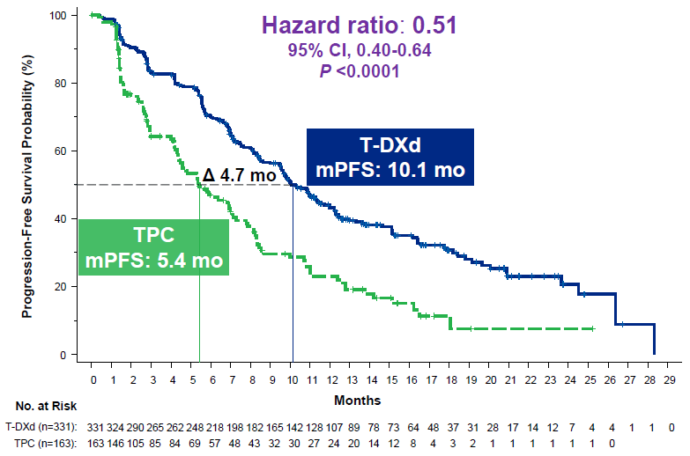
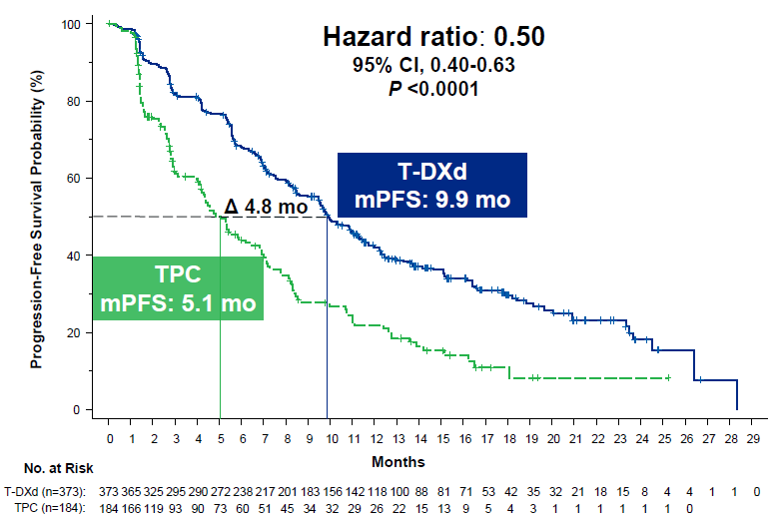
Results From the Phase 3 DESTINY-Breast04 Trial of Trastuzumab Deruxtecan in HER2-Low MBC: Efficacy
PFS in HR+
PFS in All Patients
PFS benefit with T-DXd was similar across subgroups according to baseline characteristics and stratification factors (not shown)
PFS | HR+ |  | All Patients
 | T-DXd (n = 331) | TPC (n = 163) | T-DXd (n=373) | TPC (n = 184)
Median PFS, months | 10.1 | 5.4 | 9.9 | 5.1
HR (95% CI); P value | 0.51 (0.40-0.64); <.0001 |  | 0.50 (0.40-0.63); <.0001
Modi et al. J Clin Oncol. 2022;40(17):LBA3.
Notes:
Modi S, Jacot W, Tamashita T, et al. Trastuzumab deruxtecan (T-DXd) versus treatment of physician’s choice (TPC) in patients (pts) with HER2-low unresectable and/or metastatic breast cancer (mBC): Results of DESTINY-Breast04, a randomized, phase 3 study. J Clin Oncol. 2022;40(17):LBA3.

Slide 32
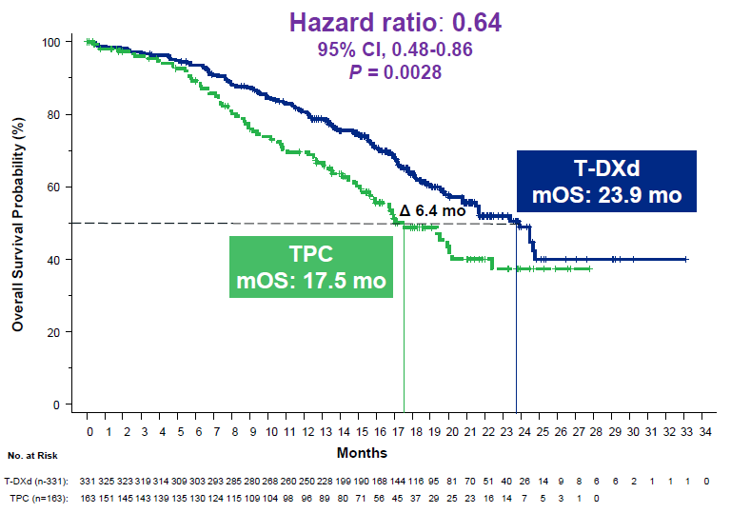
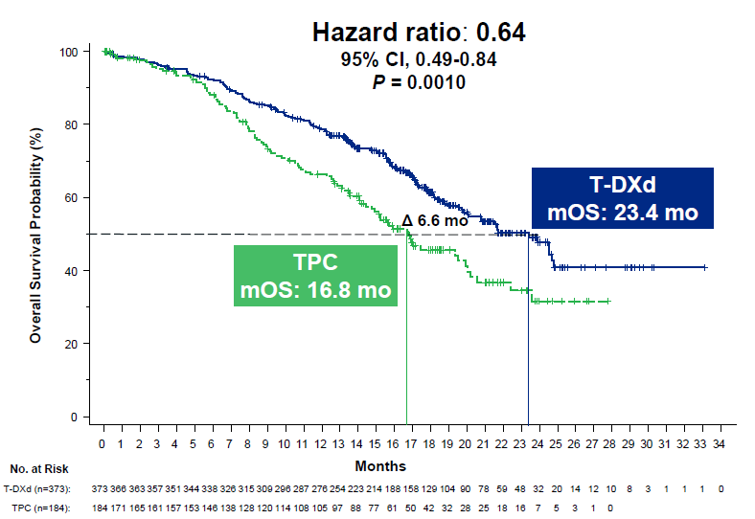
Results From the Phase 3 DESTINY-Breast04 Trial of Trastuzumab Deruxtecan in HER2-Low MBC: Efficacy (cont.)
OS in HR+
OS in All Patients
Response | HR+ |  | HR-
 | T-DXd (n=333) | TPC (n=166) | T-DXd (n=40) | TPC (n=18)
Confirmed ORR, % | 52.6 | 16.3 | 50.0 | 16.7
CR | 3.6 | 0.6 | 2.5 | 5.6
PR | 49.2 | 15.7 | 47.5 | 11.1
PD | 7.8 | 21.1 | 12.5 | 33.3
NE | 4.2 | 12.7 | 7.5 | 5.6
CBR, % | 71.2 | 34.3 | 62.5 | 27.8
Median DOR, months | 10.7 | 6.8 | 8.6 | 4.9
OS | HR+ |  | All Patients
 | T-DXd (n = 331) | TPC (n = 163) | T-DXd (n = 373) | TPC (n = 184)
Median OS, months | 23.9 | 17.5 | 23.4 | 16.8
HR (95% CI); P value | 0.64 (0.48-0.86); .0028 |  | 0.64 (0.49-0.84); .0010
Modi et al. J Clin Oncol. 2022;40(17):LBA3.
Notes:
Modi S, Jacot W, Tamashita T, et al. Trastuzumab deruxtecan (T-DXd) versus treatment of physician’s choice (TPC) in patients (pts) with HER2-low unresectable and/or metastatic breast cancer (mBC): Results of DESTINY-Breast04, a randomized, phase 3 study. J Clin Oncol. 2022;40(17):LBA3.

Slide 33
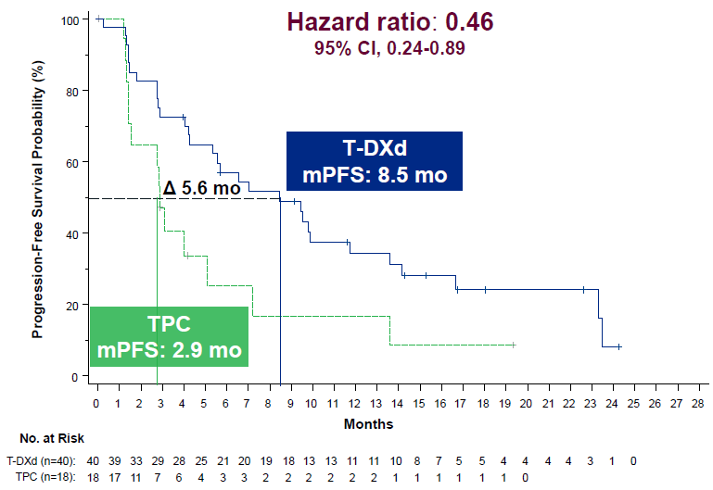
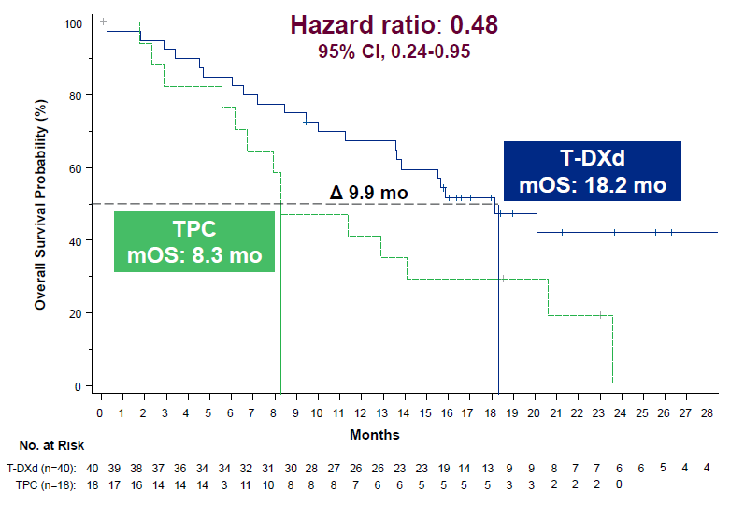
Results From the Phase 3 DESTINY-Breast04 Trial of Trastuzumab Deruxtecan in HER2-Low MBC: Efficacy (cont.)
PFS in HR-
OS in HR-
PFS | HR-
 | T-DXd (n=40) | TPC (n=18)
Median PFS, months | 8.5 | 2.9
HR (95% CI) | 0.46 (0.24-0.89)
OS | HR-
 | T-DXd (n=40) | TPC (n=18)
Median OS, months | 18.2 | 8.3
HR (95% CI) | 0.48 (0.24-0.95)
Modi et al. J Clin Oncol. 2022;40(17):LBA3.
Notes:
Modi S, Jacot W, Tamashita T, et al. Trastuzumab deruxtecan (T-DXd) versus treatment of physician’s choice (TPC) in patients (pts) with HER2-low unresectable and/or metastatic breast cancer (mBC): Results of DESTINY-Breast04, a randomized, phase 3 study. J Clin Oncol. 2022;40(17):LBA3.

Slide 34
Trastuzumab Deruxtecan FDA Approved for HER2-Low MBC: August 2022
Trastuzumab deruxtecan FDA approved for adult patients with unresectable or metastatic HER2-low (IHC 1+ or IHC 2+/ISH‑) breast cancer who have received a prior chemotherapy in the metastatic setting or developed disease recurrence during or within 6 months of completing adjuvant chemotherapy
Based on DESTINY-Breast04 trial
Recommended dose: 5.4 mg/kg given as an intravenous infusion once every 3 weeks (21-day cycle) until disease progression or unacceptable toxicity
FDA.gov. https://www.fda.gov/drugs/resources-information-approved-drugs/fda-approves-fam-trastuzumab-deruxtecan-nxki-her2-low-breast-cancer/
Notes:
FDA.gov. FDA approves fam-trastuzumab deruxtecan-nxki for HER2-low breast cancer. August 5, 2022. Accessed January 22, 2023. https://www.fda.gov/drugs/resources-information-approved-drugs/fda-approves-fam-trastuzumab-deruxtecan-nxki-her2-low-breast-cancer/

Slide 35
Primary Results From the Phase 3 TROPiCS-02 Trial of Sacituzumab Govitecan in HR+/HER2- Advanced BC: Study Design and Patients
Key Eligibility Criteria
HR+/HER2- MBC (or locally recurrent inoperable) with PD after
  ≥1 endocrine therapy, taxane, and CDK4/6i in any setting
  ≥2 to ≤4 lines of chemotherapy for metastatic disease
  Measurable disease by RECIST 1:1
Patient Characteristics |  | SG (n=272) | TPC (n=271)
Median age (range), y |  | 57 (29-86) | 55 (27-78)
ECOG PS, n (%) | 0 | 116 (43) | 126 (46)
 | 1 | 156 (57) | 145 (54)
Visceral mets at baseline, n (%) |  | 259 (95) | 258 (95)
Liver mets, n (%) |  | 229 (84) | 237 (87)
Median time from initial MBC diagnosis to randomization (range), months |  | 48.5 (1.2-243.8) | 46.6 (3.0-248.8)
Prior chemotherapy in (neo)adjuvant setting, n (%) |  | 173 (64) | 184 (68)
Prior endocrine therapy use in the metastatic setting ≥6 months, n (%) |  | 235 (86) | 234 (86)
Prior CDK4/6i, n (%) | ≤12 months | 161 (59) | 166 (61)
 | >12 months | 106 (39) | 102 (38)
 | Unknown | 5 (2) | 3 (1)
Median prior chemotherapy regimens in the metastatic setting (range), n |  | 3 (0-8) | 3 (1-5)
Sacituzumab govitecan (SG)
10 mg/kg IV, days 1 and 8
every 21 days
(n=272)
RANDOMIZED
Until PD or unacceptable toxicity
1:1
Physician’s choice (TPC)
Capecitabine, vinorelbine, gemcitabine, or eribulin
(n=271)
N = 543
Primary endpoint: PFS by BICR
Secondary endpoints: OS, ORR, DOR, CBR by LIR and BICR, PRO, safety
LIR, local investigator review; PRO, patient-reported outcomes; SG, sacituzumab govitecan.
Rugo et al. J Clin Oncol. 2022;40(17):LBA1001.
Notes:
Rugo H, Bardia A, Marme F, et al. Primary results from TROPiCS-02: A randomized phase 3 study of sacituzumab govitecan (SG) versus treatment of physician’s choice (TPC) in patients (Pts) with hormone receptor–positive/HER2-negative (HR+/HER2-) advanced breast cancer. J Clin Oncol. 2022;40(17):LBA1001.

Slide 36
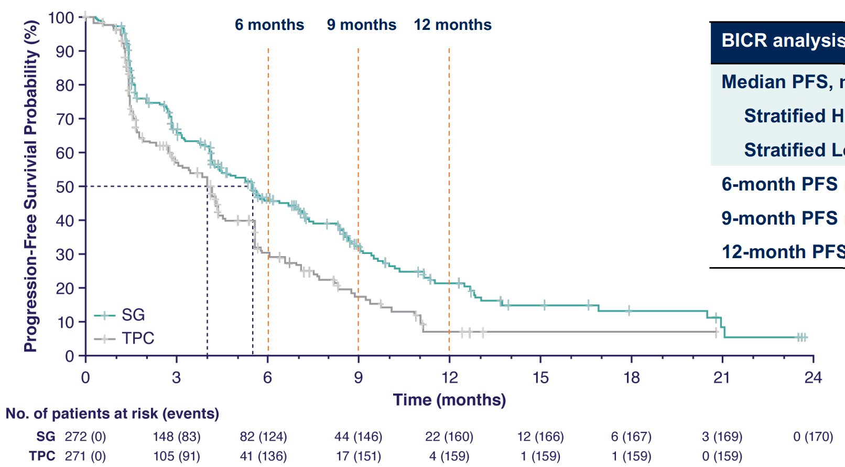
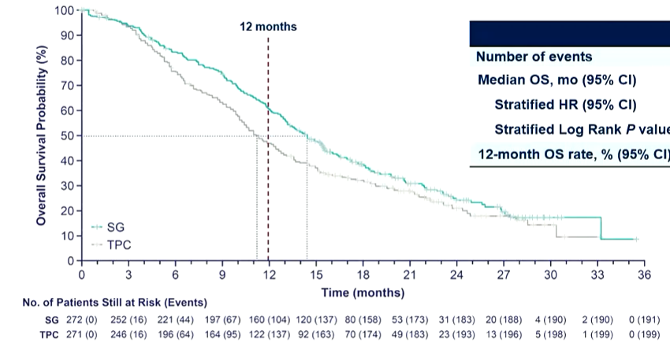
Primary Results From the Phase 3 TROPiCS-02 Trial of Sacituzumab Govitecan in HR+/HER2− Advanced BC: Efficacy
BICR-Assessed PFS in the ITT Population
OS in the ITT Population (Second Interim Analysis)
PFS Analysis | SG (n = 272) | TPC (n = 271)
Median PFS, mo (95% CI) | 5.5 (4.2-7.0) | 4.0 (3.1-4.4)
Stratified HR (95% CI) | 0.66 (0.53-0.83)
Stratified Log Rank P value | .0003
6-month PFS rate, % (95% CI) | 46.1 (39.4-52.6) | 30.3 (23.6-37.3)
9-month PFS rate, % (95% CI) | 32.5 (25.9-39.2) | 17.3 (11.5-24.2)
12-month PFS rate, % (95% CI) | 21.3 (15.2-28.1) | 7.1 (2.8-13.9)
OS Analysis | SG (n = 272) | TPC (n = 271)
Number of Events | 191 | 199
Median OS, mo (95% CI) | 14.4 (13.0-15.7) | 11.2 (10.1-12.7)
Stratified HR (95% CI) | 0.79 (0.65-0.96)
Stratified Log Rank P value | .020
12-month OS rate, % (95% CI) | 61 (55-66) | 47 (41-53)
SG resulted in a 34% reduction in the risk of PD/death
SG resulted in PFS and OS benefit consistent across all subgroup analysis, including patients with
  ≥3 prior chemotherapy regimens in the metastatic setting
  Visceral metastases
  Endocrine therapy for MBC ≥6 months
Rugo et al. J Clin Oncol. 2022;40(17):LBA1001.
Notes:
Rugo H, Bardia A, Marme F, et al. Primary results from TROPiCS-02: A randomized phase 3 study of sacituzumab govitecan (SG) versus treatment of physician’s choice (TPC) in patients (Pts) with hormone receptor–positive/HER2-negative (HR+/HER2-) advanced breast cancer. J Clin Oncol. 2022;40(17):LBA1001.

Slide 37
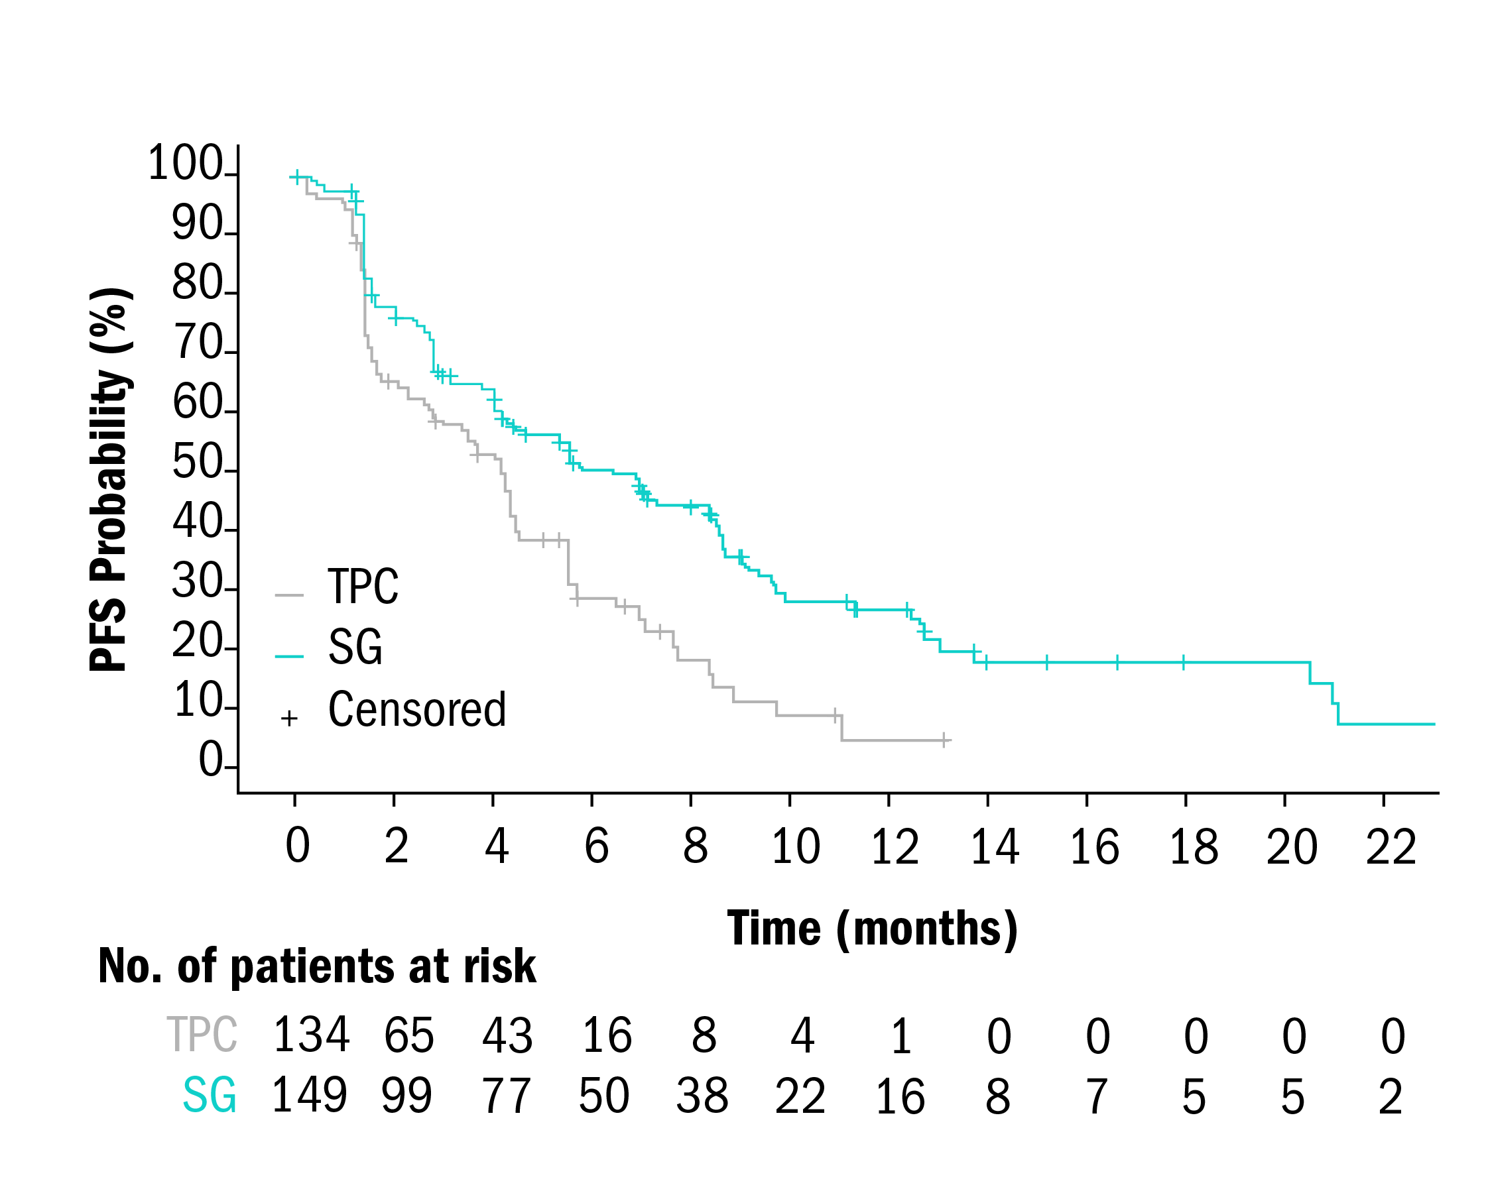

Primary Results From the Phase 3 TROPiCS-02 Trial of Sacituzumab Govitecan in HR+/HER2- Advanced BC: PFS and ORR by HER2 Status
 | SG (n=149) | TPC (n=134)
Median PFS, mo | 6.4 | 4.2
HR (95% CI) | 0.58 (0.42–0.79), P<0.001
BICR Analysis |  | ITT |  | HER2-low |  | HER2 IHC0
BICR Analysis |  | SG (n=272) | TPC (n=271) | SG (n=149) | TPC (n=134) | SG (n=101) | TPC (n=116)
ORR, n (%) |  | 57 (21) | 38 (14) | 38 (26) | 16 (12) | 16 (16) | 17 (15)
Odds ratio (95% CI) |  | 1.63 (1.04-2.55) |  | 2.52 (1.33-4.78) |  | 1.10 (0.52-2.30)
Best overall response, n (%) | CR | 2 (1) | 0 | 2 (1) | 0 | 0 | 0
 | PR | 55 (20) | 38 (14) | 36 (24) | 16 (12) | 16 (16) | 17 (15)
 | SD | 142 (52) | 106 (39) | 73 (49) | 61 (46) | 56 (55) | 39 (34)
 | SD ≥6 months | 35 (13) | 21 (8) | 18 (12) | 10 (7) | 15 (15) | 8 (7)
 | PD | 58 (21) | 76 (28) | 29 (19) | 36 (27) | 23 (23) | 38 (33)
 | NE | 15 (6) | 51 (19) | 9 (6) | 21 (16) | 6 (6) | 22 (19)
CBR,^{b} n (%) |  | 92 (34) | 59 (22) | 56 (38) | 26 (19) | 31 (31) | 25 (22)
Odds ratio (95% CI) |  | 1.84 (1.25-2.69) |  | 2.50 (1.46-4.30) |  | 1.61 (0.87-2.97)
Median DOR, months (95% CI) |  | 7.4 (6.5-8.6) | 5.6 (3.8-7.9) | 7.4 (5.8-8.9) | 4.1 (2.8-6.1) | 8.1 (4.1-NE) | 6.1 (2.8-8.3)
HER2-low
 | SG (n=101) | TPC (n=116)
Median PFS, mo | 5.0 | 3.4
HR (95% CI) | 0.72 (0.51–1.00), P=0.05
HER2 IHC0
ªNot formally tested because OS at interim analysis was not statistically significant. ^{b}CBR is defined as the percentage of patients with a confirmed best overall response of CR, PR, and SD ≥6 months.
Rugo et al. J Clin Oncol. 2022;40(17):LBA1001; Schmid et al. Ann Oncol. 2022;33:S88-S121.
Notes:
Rugo H, Bardia A, Marme F, et al. Primary results from TROPiCS-02: A randomized phase 3 study of sacituzumab govitecan (SG) versus treatment of physician’s choice (TPC) in patients (Pts) with hormone receptor–positive/HER2-negative (HR+/HER2-) advanced breast cancer. J Clin Oncol. 2022;40(17):LBA1001.
Schmid P, Cortes J, Rugo HS, et al. Sacituzumab govitecan (SG) efficacy in hormone receptor-positive/human epidermal growth factor receptor 2-negative (HR+/HER2–) metastatic breast cancer (MBC) by HER2 immunohistochemistry (IHC) status in the phase III TROPiCS-02 study. Ann Oncol. 2022;33:S88-S121.

Slide 38
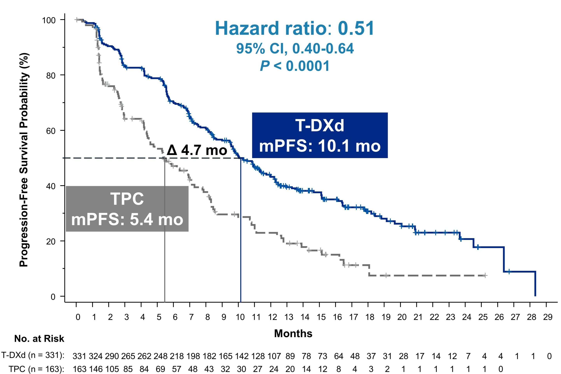
DESTINY-Breast04 and TROPiCS-02:
HR+/HER2-Low MBC
DESTINY-Breast04
T-DXd (HER2 IHC 1+, IHC 2+/ISH-)¹
TROPiCS-02
Sacituzumab govitecan (HER2 IHC 1+, IHC 2+/ISH-)²
 | T-DXd | TPC
No. of patients | 331 | 163
Median no. prior CT in MBC | 1 | 1
 | SG | TPC
No. of patients | 149 | 134
Median no. prior CT in MBC | 3 | 3
SG
mPFS: 6.4
Hazard ratio: 0.51
95% CI, 0.40-0.64
P<.0001
HER2-low
Hazard ratio: 0.58
95% CI, 0.42-0.79
P<.001
TPC
mPFS: 4.2
CT, chemotherapy.
1. Modi et al. J Clin Oncol. 2022;40(17):LBA3. 2. Rugo et al. J Clin Oncol. 2022;40(17):LBA1001.
Notes:
Modi S, Jacot W, Tamashita T, et al. Trastuzumab deruxtecan (T-DXd) versus treatment of physician’s choice (TPC) in patients (pts) with HER2-low unresectable and/or metastatic breast cancer (mBC): Results of DESTINY-Breast04, a randomized, phase 3 study. J Clin Oncol. 2022;40(17):LBA3.
Rugo H, Bardia A, Marme F, et al. Primary results from TROPiCS-02: A randomized phase 3 study of sacituzumab govitecan (SG) versus treatment of physician’s choice (TPC) in patients (Pts) with hormone receptor–positive/HER2-negative (HR+/HER2-) advanced breast cancer. J Clin Oncol. 2022;40(17):LBA1001.

Slide 39
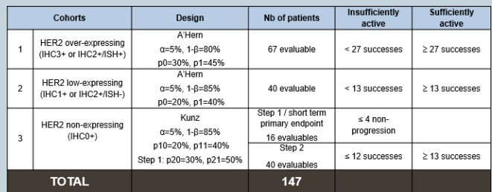
DAISY: Trastuzumab Deruxtecan for Advanced Breast Cancer Patients, Regardless of HER2 Status
A phase II study with biomarkers analysis
Primary Endpoint
Confirmed best objective response in
each cohort (investigator-assessed)
Secondary Endpoints
BOR by central review
DOR, CBR, PFS, OS
Safety
COHORT 1
HER2 IHC3+ or IHC2+/ISH+
Resistant to taxanes, trastuzumab, and TDM-1
MBC
≥1 chemotherapy regimen in metastatic setting
Metastatic biopsy at study entry
N=186
COHORT 2
HER2 IHC2+/ISH- or IHC1+
Resistant to anthracyclines and taxanes. If HR+, also resistant to CDK4/6 inhibitors and HT
DS-8201a IV, 5.4 mg/kg
Day 1 each 21-day cycle
Post-enrollment central HER2 status* of metastatic baseline biopsy determined the final cohort
COHORT 3 HER2 IHC0+
Resistant to anthracyclines and taxanes. If HR+, also resistant to CDK4/6
N=179 evaluable for safety
N=177 evaluable for efficacy
*According to ASCO 2018 and GEFPICS recommendations.
ASCO, American Society of Clinical Oncology; BOR, best overall response; GEFPICS, Groupe d'Etude des Facteurs Pronostiques et Immunohistochimiques dans le Cancer du Sein.
Dieras et al. Cancer Res. 2022;82(Suppl4):PD8-02.
Notes:
Diéras V, Deluche E, Lusque A, et al. Abstract PD8-02: trastuzumab deruxtecan (T-DXd) for advanced breast cancer patients (ABC), regardless HER2 status: a phase II study with biomarkers analysis (DAISY). Cancer Res. 2022;82(Suppl4):PD8-02.

Slide 40
DAISY: Results
Median follow-up: 15.6 months
 | Total | Cohort 1 (HER2 over-expressing) | Cohort 2 (HER2 low-expressing) | Cohort 3 (HER2 non-detected)
BOR confirmed n/N [95%CI] | 86 / 177 (48.6%) [41.0-56.2] | 48 / 68 (70.6%) [58.3-81.0] | 27 / 72 (37.5%) [26.4-49.7] | 11 / 37 (29.7%) [15.9-47.0]
Median DOR (mo) | 8.5 [6.5-9.8] | 9.7 [6.8-13] | 7.6 [4.2-9.2] | 6.8[2.8-NR]
Median PFS (mo) [95%CI] | 7.0 [6.0-8.7] | 11.1 [8.5-14.4] HR+=11 TNBC =12.2 | 6.7 [4.4-8.3] HR+=6.9 TNBC=3.5 | 4.2 [2.0-5.7] HR+=4.5 TNBC=2.1
Cohort 3
≥13/40 confirmed BOR needed to declare success
Dieras et al. Cancer Res. 2022;82:PD8.02.
Notes:
Diéras V, Deluche E, Lusque A, et al. Abstract PD8-02: trastuzumab deruxtecan (T-DXd) for advanced breast cancer patients (ABC), regardless HER2 status: a phase II study with biomarkers analysis (DAISY). Cancer Res. 2022;82(Suppl4):PD8-02.

Slide 41
Immunotherapy for HER2+ Breast Cancer
 | PANACEA¹ | KATE-2² | NCT02649686³ | JAVELIN Sol Tum⁴
Study design | Phase 1b to 2, single-arm | Phase 2, randomized | Phase 1 | Phase 1b
Patient Population | HER2+ ABC, progressed during trastuzumab-based therapy | HER2+ ABC, previously treated with trastuzumab and a taxane | HER2+ ABC, previously treated with trastuzumab and taxanes | MBC refractory to or progressing after standard-of-care therapy
N HER2+ pts (PD-L1+) | 52 (40) | 202 (84) | 15 (0) | 26
Treatments | Pembrolizumab + trastuzumab | Atezolizumab + T-DM1 vs placebo + T-DM1 | Durvalumab + trastuzumab | Avelumab
ORR | 15% of PD-L1-positive pts No objective responses among PD-L1-pts | 54% vs 33% in PD-L1-positive pts; 39% vs 50% in PD-L1-negative pts | 0/15 | 0/26
Median PFS | 2.7 months (90% CI 2.6-4.0) in PD-L1-positive 2.5 months (90% CI 4.9-9.8) in PD-L1-negative | 8.2 vs 6.8 months in ITT (HR 0.82, 95% CI 0.55-1.23) 8.5 vs 4.1 months in PD-L1-positive (HR 0.60, 95% CI 0.32-1.1) | -- | --
Median OS | Not reached (90% CI 13.1 to NR) in PD-L- positive 7.0 months (90% CI 4.9-9.8) in PD-L1-negative | Not reached in ITT (HR 0.74, 95% CI 0.42-1.30) Not reached in PD-L1-positive (HR 0.55, 95% CI 0.22-1.38) | -- | --
Low antitumor efficacy in unselected heavily pretreated patients with HER2+ MBC: Signal in PD-L1+
ABC, advanced breast cancer; PD-L1, programmed death ligand 1.
1. Loi et al. Lancet Oncol. 2019;20:371-382. 2. Emens et al. Lancet Oncol. 2020;21:1283-1295.
3. Azambuja et al, ESMO Virtual Plenary 2021. 4. Dirix et al. Breast Cancer Res Treat. 2018;167:671-686.
Notes:
Loi S, Biobbie-Hurder A, Gombos A, et al. Pembrolizumab plus trastuzumab in trastuzumab-resistant, advanced, HER2-positive breast cancer (PANACEA): a single-arm, multicentre, phase 1b-2 trial. Lancet Oncol. 2019;20:371-382.
Emens, et al. Trastuzumab emtansine plus atezolizumab versus trastuzumab emtansine plus placebo in previously treated, HER2-positive advanced breast cancer (KATE2): a phase 2, multicentre, randomised, double-blind trial. Lancet Oncol. 2020;21:1283-1295.
Azambuja et al, ESMO Virtual Plenary 2021.
Dirix LY, Takacs I, Jerusalem G, et al. Avelumab, an anti-PD-L1 antibody, in patients with locally advanced or metastatic breast cancer: a phase 1b JAVELIN Solid Tumor study. Breast Cancer Res Treat. 2018;167:671-686.

Slide 42
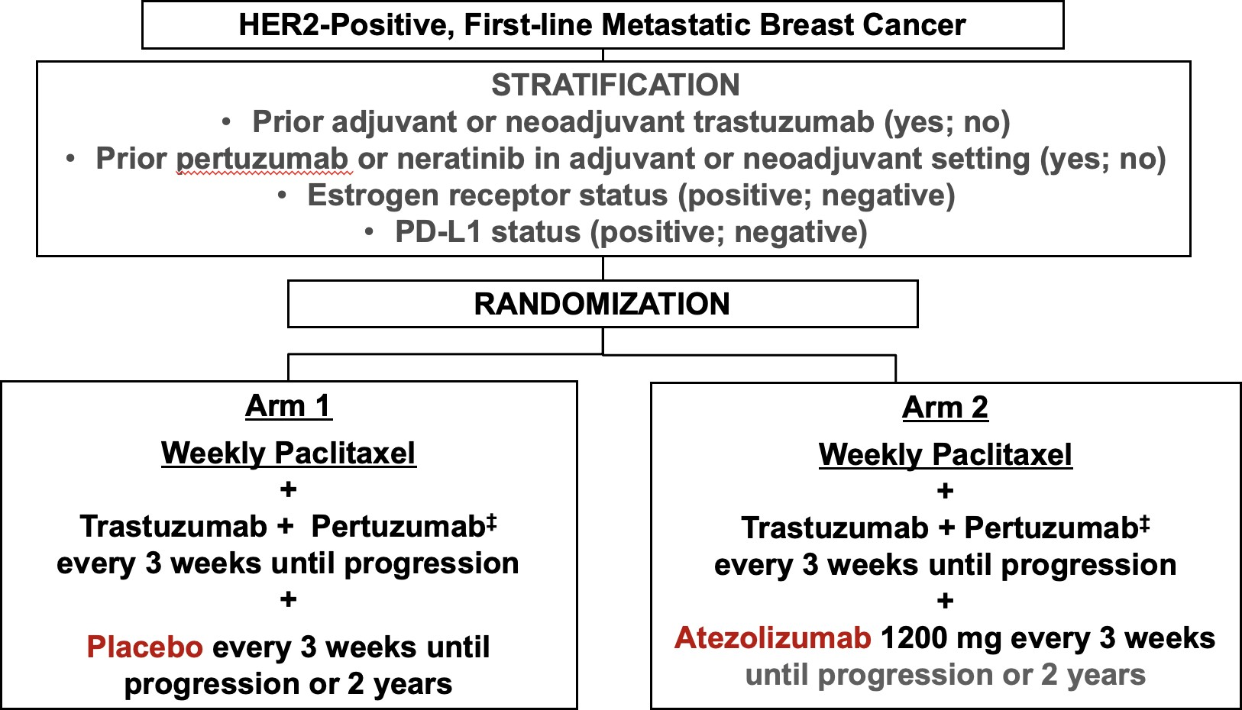
NRG BR-004: THP ± Atezolizumab for First-Line HER2+ BC
Accrual ended early: patients unblinded
THP, docetaxel/trastuzumab/pertuzumab.
ClinicalTrials.gov. https://clinicaltrials.gov/ct2/show/NCT03199885. Permission requested.
Notes:
A randomized, double-blind, phase III trial of taxane/trastuzumab/pertuzumab with atezolizumab or placebo in first-line HER2-positive metastatic breast cancer. ClinicalTrials.gov identifier: NCT03199885. Updated February 13, 2023. Accessed February 22, 2023. https://clinicaltrials.gov/ct2/show/NCT03199885

Slide 43
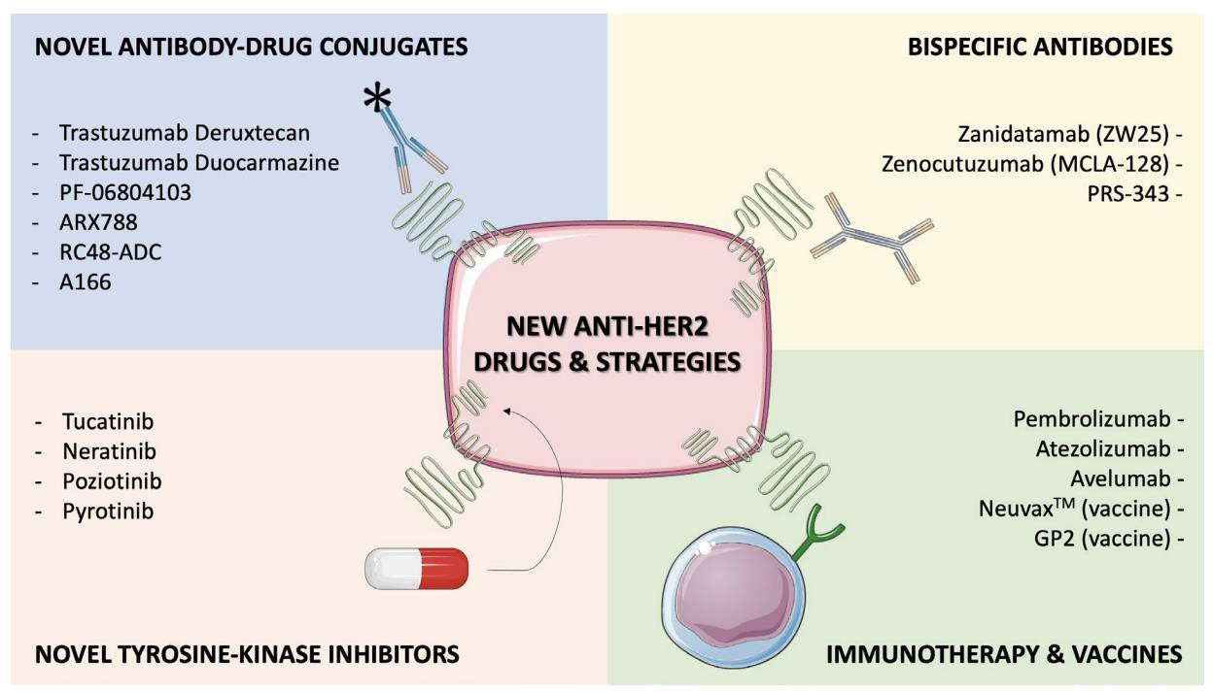










Novel Treatment Strategies for HER2+ Breast Cancer
Tarantino et al. Explor Target Antitumor Ther. 2021;2:139-155. Open Access.
Notes:
Tarantino P, Morgani S, Curigliano G, et al. Targeting HER2 in breast cancer: new drugs and paradigms on the horizon. Explor Target Antitumor Ther. 2021;2:139-155.

Slide 44






Select ADCs in Development for HER2+
Breast Cancer
ADC | Target | Antibody | Payload | DAR | Clinical Program
SYD985¹ | HER2 | Trastuzumab | Duocarmycin | 2.8 | Phase 3
ARX788² | HER2 | ND | Amberstatin269 | 2 | Phase 1 /2 MBC
RC48 (disitamab)³ | HER2 | Hertuzumab | MMAE | 4 | Phase 3
A166⁴ | HER2 | Trastuzumab | Duostatin-5 | ND | Phase 1 /2 BC
ZW49⁵ | HER2 | Bispecific | Auristatin | 2 | Phase 1
ALT-P7 (HM2-MMAE)⁶ | HER2 | HM2 | MMAE | ND | Phase 1 MBC
ClinicalTrials.gov. https://clinicaltrials.gov/ct2/show/NCT03262935; 2. ClinicalTrials.gov. https://clinicaltrials.gov/ct2/show/NCT04829604;
3. ClinicalTrials.gov. https://clinicaltrials.gov/ct2/show/NCT03052634; 4. ClinicalTrials.gov. https://clinicaltrials.gov/ct2/show/NCT03602079;
5. ClinicalTrials.gov. https://clinicaltrials.gov/ct2/show/NCT03821233; 6. ClinicalTrials.gov. https://clinicaltrials.gov/ct2/show/NCT03281824.
Notes:
A multi-centre, open-label, randomized clinical trial comparing the efficacy and safety of the antibody-drug conjugate SYD985 to physician's choice in patients with HER2-positive unresectable locally advanced or metastatic breast cancer (TULIP). ClinicalTrials.gov identifier: NCT03262935. Updated October 21, 2022. Accessed February 22, 2023. https://clinicaltrials.gov/ct2/show/NCT03262935
A global, phase 2 study of ARX788 in HER2-positive metastatic breast cancer patients who were previously treated with T-DXd (ACE-Breast-03). ClinicalTrials.gov identifier: NCT04829604. Updated October 26, 2022. Accessed February 22, 2023. https://clinicaltrials.gov/ct2/show/NCT04829604
A phase Ib study to evaluate the efficacy, safety and pharmacokinetics of RC48-ADC for injection in subjects with advanced breast cancer with HER2 positive or HER2 low expression. ClinicalTrials.gov identifier: NCT03052634. Updated January 11, 2022. Accessed February 22, 2023. https://clinicaltrials.gov/ct2/show/NCT03052634
A phase I-II, FIH study of A166 in locally advanced/metastatic solid tumors expressing human epidermal growth factor receptor 2 (HER2) or are HER2 amplified that did not respond or stopped responding to approved therapies. ClinicalTrials.gov identifier: NCT03602079. Updated July 12, 2022. Accessed February 22, 2023. https://clinicaltrials.gov/ct2/show/NCT03602079
A phase 1 study of ZW49 in patients with locally advanced (unresectable) or metastatic HER2-expressing cancers. ClinicalTrials.gov identifier: NCT03821233. Updated February 13, 2023. Accessed February 22, 2023. https://clinicaltrials.gov/ct2/show/NCT03821233
Open-label, dose increase and phase I study of ALT-P7 to determine safety, tolerability, pharmacokinetics for HER2 positive metastatic breast cancer patients who have progressed on previous trastuzumab-based therapy. ClinicalTrials.gov identifier: NCT03281824. Updated January 18, 2022. Accessed February 22, 2023. https://clinicaltrials.gov/ct2/show/NCT03281824

Slide 45
TULIP: Phase III Trial Design
HER2+ LABC or MBC
≥2 therapies for
metastatic disease, or T-DM1 for metastatic disease Treated brain mets are allowed
N=437
SYD985 treatment
1.2 mg/kg IV every 21 days
N=291
Continue treatment until progression or unacceptable toxicity
R 2:1
Physician's choice treatment
N=146
Stratification factors
Region (EU + Singapore vs North America)
Number of prior treatment lines for LMBC/MBC (1 to 2 vs >2)
Prior treatment with pertuzumab (yes vs no)
Physician’s choice
Lapatinib + capecitabine
Trastuzumab + capecitabine
Trastuzumab + vinorelbine
Trastuzumab + eribulin
LABC, locally advanced breast cancer.
Manich et al. Ann Oncol. 2021;32:S1283-S1346.
Notes:
Manich C, O’Shaughnessy J, Aftimos PG, et al. Primary outcome of the phase III SYD985.002/TULIP trial comparing [vic-]trastuzumab duocarmazine to physician’s choice treatment in patients with pre-treated HER2-positive locally advanced or metastatic breast cancer. Ann Oncol. 2021;32:S1283-S1346.

Slide 46
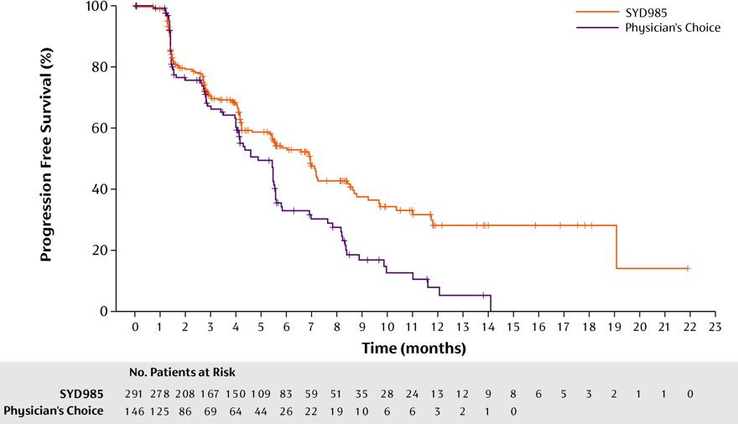















TULIP: Centrally Reviewed PFS
FAS | SYD985 (N=291) | Physician’s Choice (N=146)
Median PFS (95% CI) months | 7.0 (5.4; 7.2) | 4.9 (4.0; 5.5)
Events | 140 (48.1%) | 86 (58.9%)
HR (95% CI) | 0.64 (0.49; 0.84); P = .002
Manich et al. Ann Oncol. 2021;32:S1283-S1346.
Notes:
Manich C, O’Shaughnessy J, Aftimos PG, et al. LBA15 - Primary outcome of the phase III SYD985.002/TULIP trial comparing [vic-]trastuzumab duocarmazine to physician’s choice treatment in patients with pre-treated HER2-positive locally advanced or metastatic breast cancer. Ann Oncol. 2021;32(Suppl_5):S1283-S1346.

Slide 47
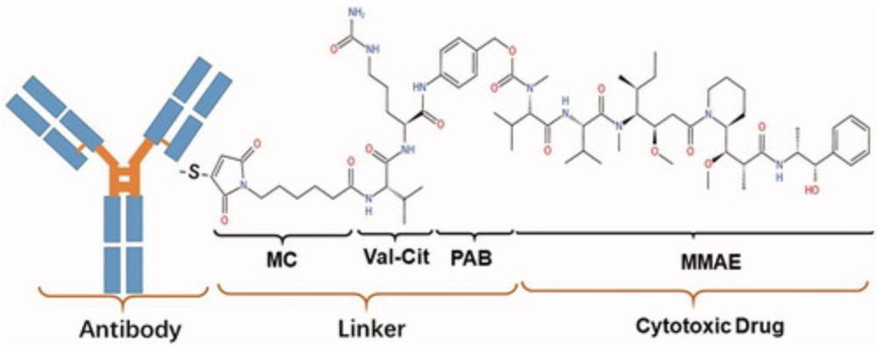
Disitamab Vedotin (RC48)
Hertuzumab: mAb against a different epitope and better molecular affinity than trastuzumab
Protease-cleavable linker
MMAE payload
DAR 4:1
Bystander effect: YES
Conditional approval in China for platinum-refractory HER2+ advanced urothelial cancer
FDA granted breakthrough therapy designation for mUC in 2020
mAb, monoclonal antibody; MMAE, monomethyl auristatin E; mUC, metastatic urothelial cancer.
Jiang et al. Toxicol Lett. 2020;324:30-37; Deeks. Drugs. 2021;81:1929-1935. Open Access.
Notes:
Jiang J, Li S, Shan X, et al. Preclinical safety profile of disitamab vedotin: a novel anti-HER2 antibody conjugated with MMAE. Toxicol Lett. 2020;324:30-37.
Deeks ED. Disitamab vedotin: first approval. Drugs 2021;81:1929-1935.

Slide 48
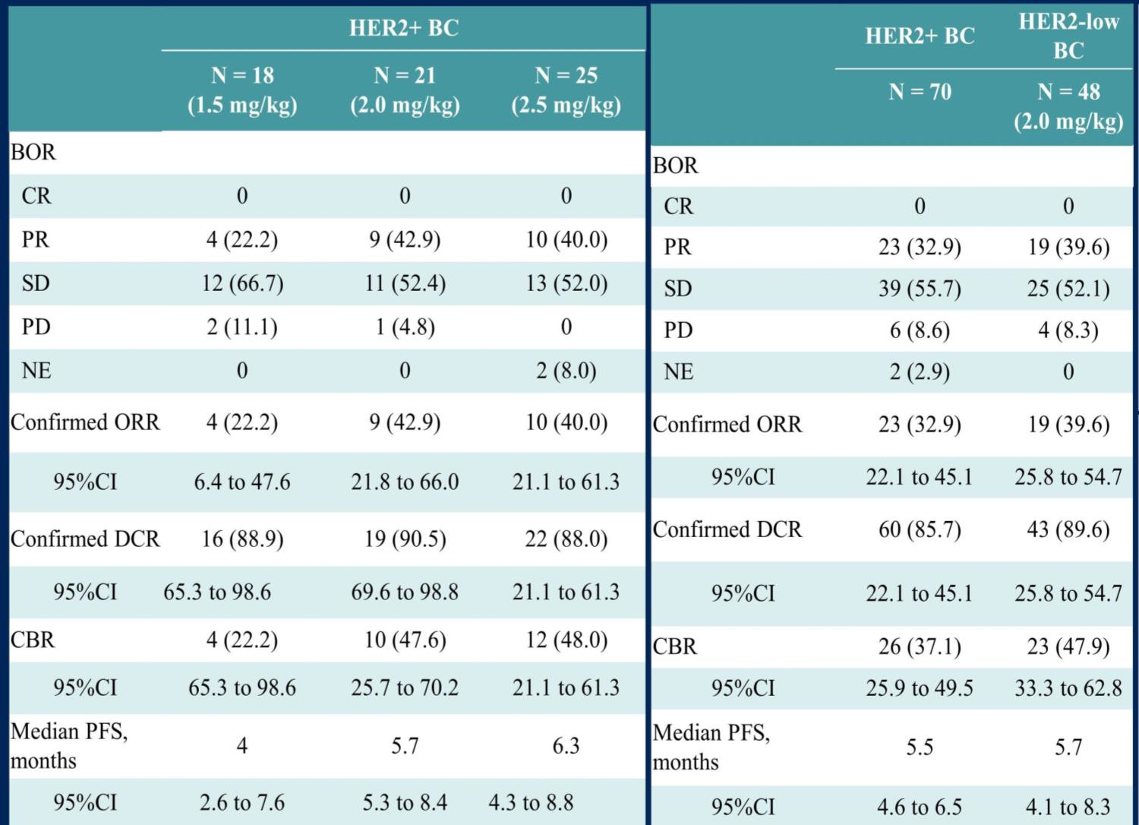
RC48 Phase 1: Efficacy
Key Patient Characteristics
70% prior anti-HER2 therapy
35% ER+
40% in ER+ cohort had prior HT 89% visceral mets
BOR, best overall response; HT, hormone therapy.
Wang et al. J Clin Oncol. 2021;39(5):1022.
Notes:
Wang J, Liu Y, Zhang Q, et al. RC48-ADC, a HER2-targeting antibody-drug conjugate, in patients with HER2-positive and HER2-low expressing advanced or metastatic breast cancer: A pooled analysis of two studies. J Clin Oncol. 2021;39(5):1022.

Slide 49

























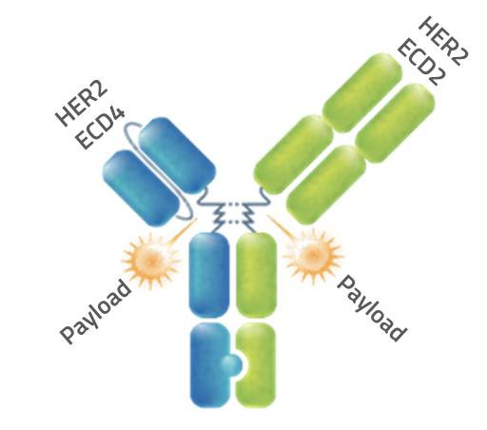



ZW49: Bispecific HER2 ADC
Ongoing Phase 1 FIH
HER2-targeting bispecific antibody
(ECD4 and ECD2)
  Ab sequence identical to zanidatamab (ZW25)
Proprietary auristatin toxin covalently linked via a protease cleavable valine-citrulline linker
Average DAR=2
Enhanced internalization and toxin-mediated cytotoxicity/immunogenic cell death
Prior T, P, TDM-1
Med 6 prior lines
ESMO 2022 Preliminary results in 77 patients (DE+DX)
MTD not reached, RP2D (2.5 mg/kg Q3wk, weekly TBD)
2 DLTs for G2 keratitis
43% keratitis (mainly G1 to 2), with prophylaxis
No ILD reported
~ 20% required dose reductions
cORR in 29 pts at 25 mg/kg Q3wk
  1 in 8 (13%) in HER2+ MBC
  9 in 29 (31%) in all HER2+
ZW-49
Ab, antibody; cORR, confirmed overall response rate; DE+DX, dose escalation/expansion; DLT, dose-limiting toxicity; FIH, first in human; GEA, gastroesophageal adenocarcinoma; MTD, maximum tolerated dose; P, pertuzumab; RD, recommended dose; RP2D, dose level chosen by sponsor; T, trastuzumab.
Jhaveri et al. Ann Oncol. 2022;33(suppl 7:S197-S224.
Notes:
Jhaveri K, Han J, Doran E, et al. Preliminary results from a phase I study using the bispecific, human epidermal growth factor 2 (HER2)-targeting antibody-drug conjugate (ADC) zanidatamab zovodotin (ZW49) in solid cancers. Ann Oncol. 2022;33(suppl 7:S197-S224.

Slide 50
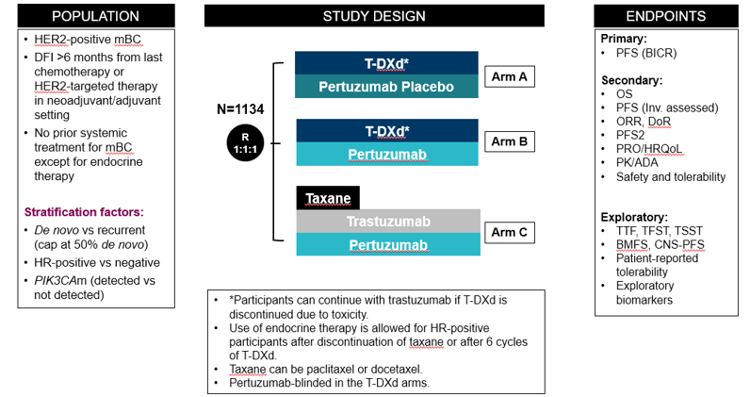
DESTINY-Breast09: T-DXd ± Pertuzumab vs THP in
First-line HER2+ MBC
NCT04784715
ADA, anti-drug antibody; BMFS, brain metastases-free survival; DFI, disease-free interval; HRQoL, health-related quality of life; Inv, investigator; PD, pharmacodynamic; PFS2, time to second progression or death; TFST, time to first subsequent treatment or death; TSST, time to second subsequent treatment or death; TTF, time from randomization to discontinuation of treatment.
ClinicalTrials.gov. https://clinicaltrials.gov/ct2/show/NCT04784715.
Notes:
Phase III study of trastuzumab deruxtecan (T-DXd) with or without pertuzumab versus taxane, trastuzumab and pertuzumab in HER2-positive, first-line metastatic breast cancer (DESTINY-Breast09). ClinicalTrials.gov identifier: NCT04784715. Updated January 17, 2023. Accessed February 22, 2023. https://clinicaltrials.gov/ct2/show/NCT04784715

Slide 51
HER2CLIMB-04: Phase 2 Trial of Tucatinib + T-DXd in HER2+ LABC and MBC With or Without Brain Metastases
HER2CLIMB-04 Study Design
Post-Safety Lead-In (N = 60)
Safety Lead-In (N=10)
Cohort A
(n=30)
Patients without a history
of brain metastases
Primary endpoint
cORR per RECIST v1.1 by INV assessment
Secondary endpoints
PFS, DOR, DCR by Inv assessment per RECIST v1.1
OS
Safety
Tucatinib
300 mg orally twice daily
+ trastuzumab deruxtecan
5.4 mg/kg
on day 1 of each 21-day cycle
HER2+
Unresectable LABC or mBC
SMC reviewª
1:1
Cohort B
(n=30)
Patients with a history
of brain metastases
ªIf there are no safety signals in the safety lead-in, 50 additional patients will be enrolled in the postsafety lead-in.
SMC, study monitoring committee.
Krop et al. J Clin Oncol. 2021;39(suppl15):TPS1097.
Notes:
Krop IE, Ramos J, Zhang C, et al. HER2CLIMB-04: Phase 2 open label trial of tucatinib plus trastuzumab deruxtecan in patients with HER2+ unresectable locally advanced or metastatic breast cancer with and without brain metastases (trial in progress). J Clin Oncol. 2021;39(suppl15):TPS1097.

Slide 52
DESTINY-Breast06: Phase 3 T-DXd vs TPC in Chemo-naïve MBC
Patient Population
Advanced/Metastatic HR+ Breast cancer after progression on ≥2 prior ETs
No prior chemotherapy in the metastatic setting
Low HER2: IHC >0 <1+ or 1+ or 2+ (determined based on central IHC assessment of archival tissue collected at time of diagnosis of metastatic disease or later)
N=425
T-DXd
(5.4 mg/kg q3w)
R
1:1
Investigator’s choice
chemotherapy*
N=425
*Chemotherapy options: capecitabine, paclitaxel, nAb-paclitaxel.
ClinicalTrials.gov. https://clinicaltrials.gov/ct2/show/NCT04494425.
Notes:
A phase 3, randomized, multi-center, open-label study of trastuzumab deruxtecan (T-DXd) versus investigator's choice chemotherapy in HER2-low, hormone receptor positive breast cancer patients whose disease has progressed on endocrine therapy in the metastatic setting (DESTINY-Breast06). ClinicalTrials.gov identifier: NCT044944425. Updated February 13, 2023. Accessed February 22, 2023. https://clinicaltrials.gov/ct2/show/NCT04494425

Slide 53
Adverse Event Management of Antibody-Drug Conjugates

Slide 54
Toxicities from Established Therapy
Trastuzumab and pertuzumab
  Cardiac dysfunction
    Generally predictable, risk factors understood, preventive strategies
    Can occur with any HER2-targeted agent
  Rare infusion-related reactions
  Diarrhea: generally exacerbated by chemotherapy
    Antidiarrheal therapy
  Rash: uncommon
    Topical immunosuppression, ultraviolet protection

Slide 55
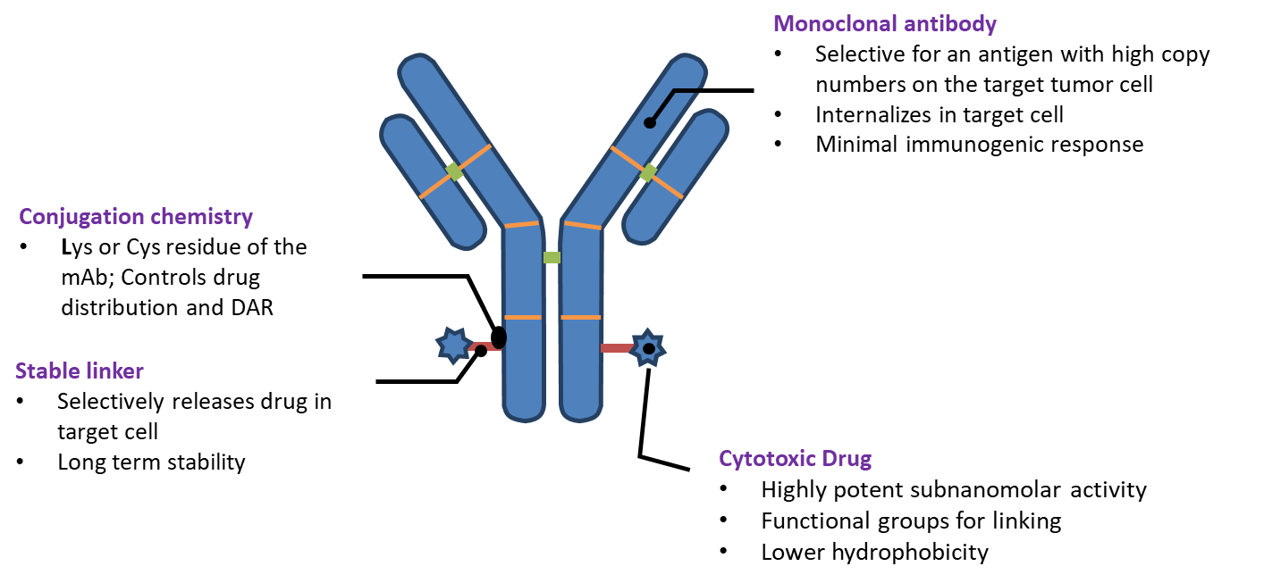




ADCs Consist of Numerous Elements, Including the Monoclonal Antibody, Conjugated Drug, and Stable Linker
ADC, antibody drug conjugate; Cys, cysteine; DAR, drug-to-antibody ratio: Lys, lysine; mAb, monoclonal antibody.
Nakada T, et al. Chem Pharm Bull. 2019;67(3):173-185. Permission requested from Chem Pharm Bull.
Notes:
Nakada T, Sugihara K, Jikoh T, et al. The latest research and development into the antibody-drug conjugate, [fam-] trastuzumab deruxtecan (DS-8201a), for HER2 cancer therapy. Chem Pharm Bull (Tokyo) 2019;67(3):173-185.

Slide 56
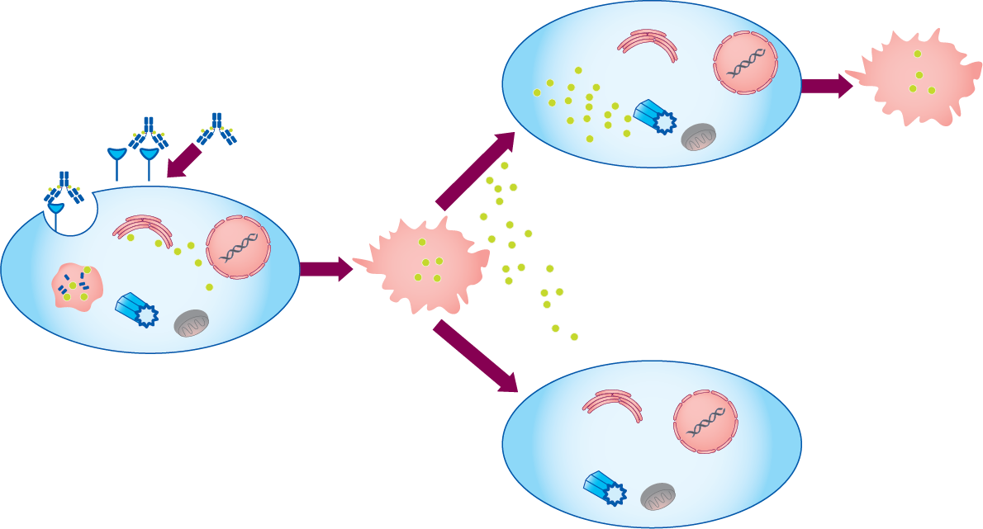





































ADC Technology Enables Tumor-specific Targeting
ADC, antibody-drug conjugate.
Adapted from: Trail PA, et al. Pharmacol Ther. 2018;181:126-142. Reproduced with permission of Trail PA, et al in the format of electronic publication via Copyright Clearance Center.
Notes:
Trail PA, Dubowchik GM, Lowinger TB. Antibody-drug conjugates for treatment of breast cancer: novel targets and diverse approaches in ADC design. Pharmacol Ther. 2018;181:126-142.

Slide 57
On-Target and Off-Target Toxicities of ADCs
On-Target
Off-Target
Cytotoxic effect on (noncancer) cells that express the target antigen
Mechanism of action is likely related to/may be the same as effect on cancer cells
Cytotoxic effect on (noncancer) cells that do NOT express the target antigen (or have minimal expression)
A few potential mechanisms of off-target toxicity have been described
ADC, antibody-drug conjugate.

Slide 58
Established ADCs for HER2+ Breast Cancer
ADC Attributes | T-DM1 | T-DXd
Approval | 2013: second-line MBC 2019: post-neoadjuvant | 2019: third-line and later MBC 2022: second-line MBC
Payload MoA | Anti-microtubule | Topoisomerase 1 inhibitor
Drug-to-antibody ratio | ~ 3.5:1 | ~8:1
Tumor-selective cleavable linker? | No | Yes
Bystander antitumor effect | No | Yes
ADC, antibody-drug conjugate; MBC, metastatic breast cancer; MoA, mechanism of action; T-DM1, trastuzumab emtansine; T-DXd, trastuzumab deruxtecan.
Nakada T et al. Chem Pharm Bull (Tokyo). 2019;67:173-85; Ogitani Y, et al. Clin Cancer Res. 2016;22:5097-108; Trial PA et al. Pharmacol Ther. 2018;181:126-42; Ogitani Y. et al. Cancer Sci. 2016;107:1039-46; LoRusso PM, et al. Clin Cancer Res. 2011;17:6437-47.
Notes:
Nakada T, Sugihara K, Jikoh T, et al. The latest research and development into the antibody-drug conjugate, [fam-] trastuzumab deruxtecan (DS-8201a), for HER2 cancer therapy. Chem Pharm Bull (Tokyo) 2019;67(3):173-185.
Ogitani Y, Aida T, Hagihara K, et al. DS-8201a, a novel HER2-targeting ADC with a novel DNA topoisomerase I inhibitor, demonstrates a promising antitumor efficacy with differentiation from T-DM1. Clin Cancer Res. 2016;22:5097-5108.
Trail PA, Dubowchik GM, Lowinger TB. Antibody drug conjugates for treatment of breast cancer: novel targets and diverse approaches in ADC design. Pharmacol Ther. 2018;181:126-142.
Ogitani Y, Hagihara K, Oitate M, et al. Bystander killing effect of DS-8201a, a novel anti-human epidermal growth factor receptor 2 antibody-drug conjugate, in tumors with human epidermal growth factor receptor 2 heterogeneity. Cancer Sci. 2016;107:1039-1046.
LoRusso P, Weiss D, Guardino E, et al. Trastuzumab emtansine: a unique antibody-drug conjugate in development for human epidermal growth factor receptor 2-positive cancer. Clin Cancer Res. 2011;17:6437-6447.

Slide 59
EMILIA: Adverse Events with T-DM1 vs
Lapatinib + Capecitabine
Adverse Event, % | Lapatinib + Capecitabine (n = 488) |  | T-DM1 (n = 490)
 | All Grades | Grade ≥ 3 | All Grades | Grade ≥ 3
Any | 98 | 57 | 96 | 41
Diarrhea | 80 | 21 | 23 | 2
Hand-foot syndrome | 58 | 16 | 1 | 0
Vomiting | 29 | 5 | 19 | 1
Neutropenia | 9 | 4 | 6 | 2
Hypokalemia | 9 | 4 | 9 | 2
Fatigue | 28 | 4 | 35 | 2
Nausea | 45 | 3 | 39 | 1
Mucosal inflammation | 19 | 2 | 7 | <1
Anemia | 8 | 2 | 10 | 3
Increased AST | 9 | 1 | 22 | 4
Increased ALT | 9 | 1 | 17 | 3
Thrombocytopenia | 3 | <1 | 28 | 13
Adverse events of grade ≥3 with an incidence of ≥ 2% in either group.
ALT, alanine aminotransferase; AST, aspartate aminotransferase.
Verma et al. N Engl J Med. 2012;367:1783-1791.
Notes:
Verma A, Miles D, Gianni L, et al. Trastuzumab emtansine for HER2-positive advanced breast cancer N Engl J Med. 2012;367:1783-1791.

Slide 60
Toxicities from T-DM1 Therapy
Mild nausea
  Symptomatic
Thrombocytopenia, transaminitis
  Dose reduction, delay
Peripheral neuropathy
  Dose reduction
Most common (≥25%) in MBC:
  Fatigue
  Nausea
  Musculoskeletal pain
  Hemorrhage
  Thrombocytopenia
  Headache
  Increased transaminases
  Constipation
  Epistaxis
Warning/Precaution | Monitoring | Management
Hepatoxicity | Monitor hepatic function (serum transaminases and bilirubin) prior to initiation and prior to each dose | Dose modifications or permanently discontinue
Cardiac toxicity | Assess LVEF prior to initiation and at regular intervals (eg, every 3 months) during treatment | Withhold dose or discontinue
Pulmonary toxicity | Monitor for sign and symptoms (dyspnea, cough, fatigue, and pulmonary infiltrates) | Permanently discontinue for ILD/pneumonitis
Infusion-related reactions | Monitor for signs and symptoms during and after infusion | Slow or interrupt infusion Administer appropriate medical therapy Permanently discontinue for life threating IRR
Hemorrhage | Use with caution, additional monitoring when concomitant use of anticoagulation and antiplatelet therapy
Thrombocytopenia | Monitor platelet counts prior initiation and prior to each dose | Dose modifications
Neurotoxicity | Monitor for sign and symptoms on an ongoing basis | Withhold dose temporarily for Grade 3/4 peripheral neuropathy until resolution to Grade ≤2
Embryo-fetal toxicity | Advise patients of risk and need for contraception
ILD, interstitial lung disease; LVEF, left ventricular ejection fraction.
KADCYLA Prescribing Information, 2022.
Notes:
KADCYLA (ado-trastuzumab emtansine) Prescribing Information, 2022.

Slide 61
Special Considerations: T-DM1 and Hepatotoxicity
Permanently discontinue treatment in patients with serum transaminases >3 × ULN and concomitant total bilirubin >2 × ULN
In clinical trials, cases of nodular regenerative hyperplasia (NRH) of the liver have been identified from liver biopsies (5 cases out of 1,624, 1 of which was fatal). Two of these five cases of NRH were observed in EMILIA and 2 were observed in KATHERINE.
  Diagnosis can be confirmed only by histopathology
  NRH should be considered in all patients with clinical symptoms of portal hypertension and/or cirrhosis-like pattern seen on the computed tomography scan of the liver but with normal transaminases and no manifestations of cirrhosis. Upon NRH diagnosis, treatment must be permanently discontinued
ULN, upper limit of normal.
KADCYLA Prescribing Information, 2022.
Notes:
KADCYLA (ado-trastuzumab emtansine) Prescribing Information, 2022.

Slide 62
Similar Rates of All Grade and Grade ≥3 Drug-related TEAEs Between Arms, with no Grade 4/5 ILD/Pneumonitis
Drug-related TEAEs in ≥20% of Patients
Adverse Events of Special Interest
System Organ Class Preferred term, n (%) | T-DXd (n=257) |  | T-DM1 (n=261)
 | Any Grade | Grade ≥3 | Any Grade | Grade ≥3
Blood and lymphatic system disorders
Neutropenia* | 110 (42.8) | 49 (19.1) | 29 (11.1) | 8 (3.1)
Anaemia† | 78 (30.4) | 15 (5.8) | 37 (14.2) | 11 (4.2)
Leukopenia‡ | 77 (30.0) | 17 (6.6) | 20 (7.7) | 1 (0.4)
Thrombocytopenia§ | 64 (24.9) | 18 (7.0) | 135 (51.7) | 65 (24.9)
Gastrointestinal disorders
Nausea | 187 (72.8) | 17 (6.6) | 72 (27.6) | 1 (0.4)
Vomiting | 113 (44.0) | 4 (1.6) | 15 (5.7) | 1 (0.4)
Diarrhoea | 61 (23.7) | 1 (0.4) | 10 (3.8) | 1 (0.4)
Constipation | 58 (22.6) | 0 | 25 (9.6) | 0
General disorders
Fatigue¶ | 115 (44.7) | 13 (5.1) | 77 (29.5) | 2 (0.8)
Investigations
AST increased | 60 (23.3) | 2 (0.8) | 97 (37.2) | 13 (5.0)
ALT increased | 50 (19.5) | 4 (1.6) | 71 (27.2) | 12 (4.6)
Metabolism and nutrition disorders
Decreased appetite | 67 (26.1) | 3 (1.2) | 33 (12.6) | 0
Skin and subcutaneous tissue disorders
Alopecia** | 93 (36.2) | 1 (0.4) | 6 (2.3) | 0
Adjudicated as drug-related ILD/pneumonitis,†† n (%)
n (%) | Grade 1 | Grade 2 | Grade 3 | Grade 4 | Grade 5 | Any Grade
T-DXd (n=257) | 7 (2.7) | 18 (7.0) | 2 (0.8) | 0 | 0 | 27 (10.5)
T-DM1 (n=261) | 4 (1.5) | 1 (0.4) | 0 | 0 | 0 | 5 (1.9)
Most drug-related TEAEs were gastrointestinal or hematologic in nature
There were no Grade 4 or 5 adjudicated drug-related ILD/pneumonitis events observed with T-DXd
Adverse events were managed according to the protocol. *This category includes the preferred terms neutrophil count decreased and neutropenia. †This category includes the preferred terms haemoglobin decreased, red blood cell count decreased, anemia, and haematocrit decreased. ‡This category includes the preferred terms white blood cell count decreased and leukopenia. §This category includes platelet count decreased and thrombocytopenia. ¶This category includes the preferred terms fatigue, asthenia, and malaise. **Grade 1 alopecia: T-DXd=26.5%, T-DM1=2.3%; Grade 2: T-DXd=9.3%. ††Patients with prior history of ILD/pneumonitis requiring steroids were excluded.
ALT, alanine transaminase; AST, aspartate aminotransferase; HER2, human epidermal growth factor receptor 2; ILD, interstitial lung disease; T-DM1, trastuzumab emtansine; T-DXd, trastuzumab deruxtecan; TEAE, treatment-emergent adverse event.
Cortes et al. Ann Oncol. 2021;32(suppl 5):S1283-S1346.
Notes:
Cortes J, Kim S, Chung W, et al. Trastuzumab deruxtecan (T-DXd) vs trastuzumab emtansine (T-DM1) in patients (Pts) with HER2+ metastatic breast cancer (mBC): results of the randomized phase III DESTINY-Breast03 study. Ann Oncol. 2021;32(suppl 5):S1283-S1346.

Slide 63
Common Signs of ILD
If any of the symptoms below arise, experts recommend contacting the healthcare team
Dry, hacking cough that does not produce phlegm
Shortness
of breath
Extreme fatigue and weakness
Labored breathing which can be either fast or shallow
Unexplained
weight loss
No
appetite
Mild
chest pain
Bleeding in
the lungs
ILD, interstitial lung disease.

Slide 64
ILD Diagnosis and Evaluation
Diagnosis of Exclusion with Highly Variable Presentation
Promptly Investigate Evidence of ILD/Pneumonitis
Differential diagnosis
  Opportunistic infections
  Pulmonary metastatic disease
  Lymphangitic spread of cancer
  Diffuse alveolar hemorrhage
  Cardiogenic pulmonary edema
Evaluation may include
  High-resolution computed tomography (CT)
  Pulmonary consultation
  Blood culture and complete blood count (CBC)
  Consider bronchoscopy
  Arterial blood gases if clinically indicated
The Key to Diagnosis and Treatment of ILD/Pneumonitis Is Early Recognition of Signs and Symptoms
CBC, complete blood cell; CT, computed tomography; ILD, interstitial lung disease.
ENHERTU Prescribing Information, 2021; Modi et al. N Engl J Med. 2020;382(7):610-621.
Notes:
Investigation may be prompted by incidental findings on routine scans when checking for progression or symptomatic findings; diagnosis of ILD/pneumonitis requires exclusion of other causes.
ENHERTU (fam-trastuzumab deruxtecan-nxki) Prescribing Information, 2021.
Modi S, Saura C, Yamashita T, et al. Trastuzumab deruxtecan in previously treated HER2-positive breast cancer [supplementary appendix]. N Engl J Med. 2020;382(7):610-621.

Slide 65
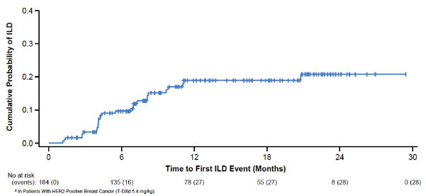
Warnings and Precautions: ILD/Pneumonitis Monitoring and Management
ILD, n (%) | T-DXd 5.4 mg/kg (N=184)
 | Grade 1 | Grade 2 | Grade 3 | Grade 4 | Grade 5 | Any grade/ Total
Aug 2019 data cutoff | 5 (2.7) | 15 (8.2) | 1 (0.5) | 0 | 4 (2.2) | 25 (13.6)
June 2020 data cutoff | 6 (3.3) | 16 (8.7) | 1 (0.5) | 0 | 5 (2.7) | 28 (15.2)
Cumulative Probability of Adjudicated
Drug-related Any-grade ILD
Interrupt trastuzumab deruxtecan and initiate
corticosteroid treatment if ILD/pneumonitis is suspected
Promptly investigate Evidence of ILD Evaluate patients with suspected ILD by radiographic imaging Consider consultation with a pulmonologist | For Asymptomatic ILD (Grade 1) Consider corticosteroid treatment (eg, ≥0.5 mg/kg prednisone or equivalent) Withhold T-DXd until recovery to Grade 0 If resolved in ≤28 days from date of onset, maintain dose If resolved in >28 days since onset, reduce dose 1 level
 | For Symptomatic ILD (Grade ≥2) Promptly initiate corticosteroid treatment (eg, ≥1 mg/kg prednisone or equivalent) Permanently discontinue T-DXd
ILD, interstitial lung disease; T-DXd, trastuzumab deruxtecan.
ENHERTU Prescribing Information, 2021; Modi et al. N Engl J Med. 2020;382(7):610-621.
Notes:
ENHERTU (fam-trastuzumab deruxtecan-nxki) Prescribing Information, 2021.
Modi S, Saura C, Yamashita T, et al. Trastuzumab deruxtecan in previously treated HER2-positive breast cancer [supplementary appendix]. N Engl J Med. 2020;382(7):610-621.

Slide 66
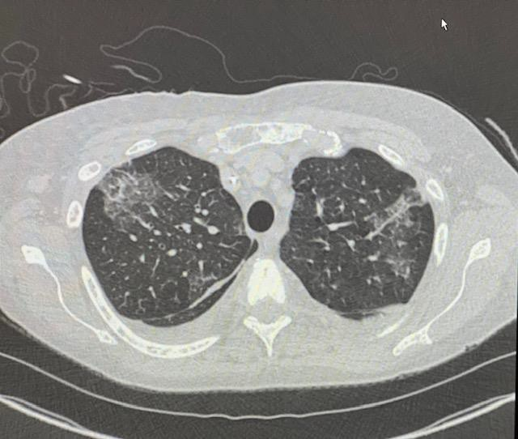
ILD with Trastuzumab Deruxtecan
Image provided by Jennifer McKenna, RN, MSN, AOCNP. Permission requested from the author

Slide 67






ILD Management for T-DXd
12% incidence, of which 7% were symptomatic and 0.8% were Grade 5
Monitoring
Advise patients to immediately report cough, dyspnea, fever, and/or any new or worsening respiratory symptoms
Promptly investigate evidence of ILD
Evaluate patients with suspected ILD by
radiographic imaging
Consider consultation with a pulmonologist
Confirm
Evaluations should include:
  High-resolution CT scan
  Pulmonologist consultation
  Blood culture and CBC
  Consider bronchoscopy
  PFTs and pulse oximetry
Dose Interruption/ Discontinuation
For Grade 1 (asymptomatic):
  Delay dose until recovery (Grade 0)
For Grade ≥2 (symptomatic):
  Permanently discontinue
!
Dose Modification
Initial dose
reduction:
4.4 mg/kg
Final dose
reduction:
3.2 mg/kg
Resume Therapy
(Grade 1 Only)
If resolved in ≤28 days from date of onset
  Maintain dose
If resolved in >28 days from date of onset
  Reduce dose 1 level
Corticosteroid Treatment
For grade 1 (asymptomatic):
  Consider corticosteroid treatment as soon
  as ILD is suspected
    eg, ≥0.5 mg/kg prednisolone or equivalent
For grade ≥ 2 (symptomatic):
  Promptly initiate corticosteroid treatment as soon as ILD/pneumonitis is suspected
    eg, ≥1 mg/kg prednisolone or equivalent
Do not
re-escalate the
T-DXd dose after a dose reduction
is made
CBC, complete blood count; CT, computed tomography; ILD, interstitial lung disease; PFT, pulmonary function test; T-DXd, trastuzumab deruxtecan.
Powell CA, et al. ESMO Open. 2022;7:100554; ENHERTU Prescribing Information, 2021.
Notes:
Powell CA, Modi S, Iwata J, et al. Pooled analysis of drug-related interstitial lung disease and/or pneumonitis in nine trastuzumab deruxtecan monotherapy studies. ESMO Open. 2022;7(4):100554.
ENHERTU (fam-trastuzumab deruxtecan-nxki) Prescribing Information, 2021.

Slide 68
T-DXd Package Insert Black Box Warning
ILD and pneumonitis, including fatal cases, have been reported
Monitor for and promptly investigate signs and symptoms including cough, dyspnea, fever, and other new or worsening respiratory symptoms
Permanently discontinue in all patients with Grade 2 or higher ILD/pneumonitis
Advise patients of the risk and the need to immediately report symptoms
Severity | Treatment Modification
Asymptomatic ILD/pneumonitis (Grade 1) | Interrupt T-DXd until resolved to Grade 0, then: If resolved in 28 days of less from date of onset, maintain dose If resolved in greater than 28 days from date of onset, reduce dose on level Consider corticosteroid treatment as soon as ILD/pneumonitis is suspected
Symptomatic ILD/pneumonitis (Grade 2 or greater) | Permanently discontinue T-DXd Promptly initiate corticosteroid treatment as soon as ILD/pneumonitis is suspected
ENHERTU Prescribing Information, 2021.
Notes:
ENHERTU (fam-trastuzumab deruxtecan-nxki) Prescribing Information, 2021.

Slide 69
Toxicities from T-DXd Therapy
Most common (≥20%) in MBC:
  Nausea
  Decreased white blood cell count
  Decreased hemoglobin
  Decreased neutrophil count
  Decreased lymphocyte count
  Fatigue
  Decreased platelet count
  Increased AST
  Vomiting
  Increased ALT
  Alopecia
  Increased blood alkaline phosphatase
  Constipation
  Musculoskeletal pain
  Decreased appetite
  Hypokalemia
  Diarrhea
  Respiratory infection
Warning/Precaution | Monitoring | Management
ILD | Monitor for and promptly investigate signs and symptoms (cough, dyspnea, fever, and other new or worsening respiratory symptoms) Advise patients of the risk and to immediately report symptoms | Evaluate patients with suspected ILD by radiographic imaging Consider consultation with a pulmonologist For asymptomatic (Grade 1) ILD, consider corticosteroid treatment (eg, ≥0.5 mg/kg/day prednisolone or equivalent). Withhold until recovery For symptomatic (Grade ≥2) ILD, promptly initiate systemic corticosteroid treatment (eg, ≥1 mg/kg/day prednisolone or equivalent) and continue for at least 14 days followed by gradual taper for at least 4 weeks Permanently discontinue in all patients with Grade 2 or higher ILD/pneumonitis
Neutropenia | Monitor CBCs prior to initiation and prior to each dose, and as clinically indicated | Dose interruption or reduction
Left ventricular dysfunction | Assess LVEF prior to initiation and at regular intervals during treatment as clinically indicated | Treatment interruption or discontinuation Permanently discontinue if LVEF of less than 40% or absolute decrease from baseline of greater than 20% is confirmed Permanently discontinue in patients with symptomatic congestive heart failure
Embryo-fetal toxicity | Advise patients of risk and need for contraception
ALT, alanine aminotransferase; AST, aspartate aminotransferase; ILD, interstitial lung disease; LVEF, left ventricular ejection fraction; MBC, metastatic breast cancer; T-DXd, trastuzumab deruxtecan.
ENHERTU Prescribing Information, 2021.
Notes:
ENHERTU (fam-trastuzumab deruxtecan-nxki) Prescribing Information, 2021.

Slide 70
FDA-approved ADCs with Reported Ocular Toxicity
ADC | Tumor Type | Antibody Target | Chemotherapy Payload | Findings
Belantamab mafodotin* | Multiple myeloma | BCMA | Auristatin F/MMAF | 72%-77% of patients reported microcyst-like epithelial changes
Tisotumab vedotin | Cervical cancer | Tissue factor (TF) | Auristatin E/MMAE | Ocular events: 60%, including conjunctival AEs, dry eye, corneal AEs, blepharitis
Enfortumab vedotin | Urothelial cancer | Nectin-4 | Auristatin E/MMAE | Ocular events: 40%, including dry eye, keratitis, blurred vision
Trastuzumab deruxtecan | HER2+/HER2-low breast cancer | HER2 | Topoisomerase I inhibitor | 11% of patients reported dry eye
Trastuzumab emtansine | HER2+ breast cancer | HER2 | Maytansine/DM1 | Conjunctivitis, photophobia, dry eye, increased lacrimation, blurred or impaired vision reported in <10% of patients
Gemtuzumab ozogamicin | CD33+ AML | CD33 | Calicheamicin | 1 reported case of ocular bleeding in elderly patient with AML
Polatuzumab vedotin | DLBCL | CD79b | Auristatin E/MMAE | 1.2% of patients reported blurred vision
*Being withdrawn from the market as of Nov 2022.
AEs, adverse events; AML, acute myeloid leukemia; BCMA, B-cell maturation antigen; DLBCL, diffuse large B-cell lymphoma; MMAE, monomethylauristatin E; MMAF, monomethylauristatin F.
Piccaluga et al, 2004; BLENREP Prescribing Information, 2020; TIVDAK Prescribing Information, 2021; PADCEV Prescribing Information, 2022;
ENHERTU Prescribing Information, 2021; KADCYLA Prescribing Information, 2022; POLIVY Prescribing Information, 2020.
Notes:
Piccaluga PP, Martinelli G, Rondoni M et al. First experience with gemtuzumab ozogamicin plus cytarabine as continuous infusion for elderly acute myeloid leukaemia patients. Leuk Res. 2004;28:987-990.
BLENREP (belantamab mafodotin-blmf) Prescribing Information, 2020.
TIVDAK (tisotumab vedotin) Prescribing Information, 2021.
PADCEV (enfortumab vedotin) Prescribing Information, 2022.
ENHERTU (fam-trastuzumab deruxtecan-nxki) Prescribing Information, 2021.
KADCYLA (ado-trastuzumab emtansine) Prescribing Information, 2022.
POLIVY (polatuzumab vedotin-piiq) Prescribing Information, 2020.

Slide 71
HER2-directed Therapies: AE Concerns
HER2-directed antibodies
  Cardiac toxicity and monitoring
  Infusion reactions
Small molecule TKIs
  Gastrointestinal toxicity: diarrhea
  Skin toxicity
ADCs
  T-DM1: thrombocytopenia, neuropathy, elevated LFTs
  T-DXd: nausea/vomiting, fatigue, ILD
ADC, antibody drug conjugate; AE, adverse events; GI, gastrointestinal; ILD, interstitial lung disease; LFTs, liver function tests; T-DM1, trastuzumab emtansine; T-DXd, trastuzumab deruxtecan; TKIs, tyrosine kinase inhibitors.

Slide 72






















Managing Breast Cancer Requires an
Interprofessional Approach
Many experts make up the interprofessional team
Members of the team depend on the patient’s needs
Other potential members of the team
OT, pathologist, mental health professional, rad oncs, social worker, cardiologist, endocrinologist, geriatrician, financial counselor, genetic counselor, or sexual health professional
Success depends on interprofessional collaboration
Members must collaborate on patient education and treatment decisions with a patient-centered approach
NP, nurse practitioner; OT, occupational therapist; PA, physician’s assistant; RN, registered nurse; rad oncs, radiation oncologists.
Brausi M, et al. Crit Rev Oncol Hematol. 2020;148:102861; Gillessen S, et al. Eur Urol. 2018;73:178-211; Geerts PAF, et al. J Multidiscip Healthc, 2021;14:1311-1324; Lively A. et al. PLoS One. 2020;15:e0228571.
Notes:
Brausi M, Hoskin P, Andritsch E, et al. ECCO essential requirements for quality cancer care: prostate cancer. Crit Rev Oncol Hematol. 2020;148:102861.
Gillessen S, Attard G, Beer TM, et al. Management of patients with advanced prostate cancer: the report of the Advanced Prostate Cancer Consensus Conference APCCC 2017. Eur Urol. 2018;73:178-211.
Geerts PAF, van der Weijden T, Savelberg W, et al. The next step toward patient-centeredness in multidisciplinary cancer team meetings: an interview study with professionals J Multidiscip Healthc. 2021;14:1311-1324.
Lively A, Minard LV, Scott S, Deal H, Lambourne T, Giffin J. Exploring the perspectives of healthcare professionals in delivering optimal oncology medication education. PLoS One. 2020;15:e0228571.

Slide 73
Key Takeaways
Several targeted agents available for HER2+ breast cancer
Nomenclature for breast cancer has remarkably changed with the FDA-approval of a novel antibody drug conjugate, trastuzumab deruxtecan, for HER2-low breast cancer (IHC 1+ or IHC 2+/ISH‑)
Appropriate management and recognition of toxicities is an important part of being able to ensure that patients get the benefit from these highly efficacious agents
Understanding mechanisms of resistance and biomarkers for response will be critical going forward, especially as some of the most efficacious novel therapies are moved into the earlier stage setting
Identifying how to optimally sequence therapies in the metastatic setting will be of utmost importance

