Slide 1
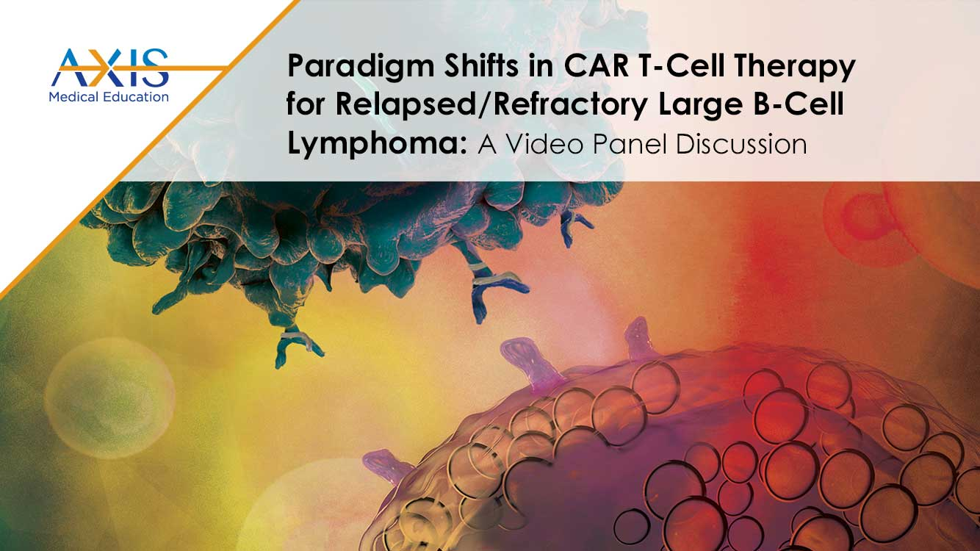
Paradigm Shifts in CAR T-Cell Therapy for Relapsed/Refractory Large B-Cell Lymphoma
A Video Panel Discussion

Slide 2
DISCLAIMER
This slide deck in its original and unaltered format is for educational purposes and is current as of January 2023. All materials contained herein reflect the views of the faculty, and not those of AXIS Medical Education, the CME provider, or the commercial supporter. Participants have an implied responsibility to use the newly acquired information to enhance patient outcomes and their own professional development. The information presented in this activity is not meant to serve as a guideline for patient management. Any procedures, medications, or other courses of diagnosis or treatment discussed or suggested in this activity should not be used by clinicians without evaluation of their patients’ conditions and possible contraindications on dangers in use, review of any applicable manufacturer’s product information, and comparison with recommendations of other authorities.

Slide 3
DISCLOSURE OF UNLABELED USE
This activity may contain discussion of published and/or investigational uses of agents that are not indicated by the FDA. The planners of this activity do not recommend the use of any agent outside of the labeled indications.
The opinions expressed in the activity are those of the faculty and do not necessarily represent the views of the planners. Please refer to the official prescribing information for each product for discussion of approved indications, contraindications, and warnings.
USAGE RIGHTS
This slide deck is provided for educational purposes and individual slides may be
used for personal, non-commercial presentations only if the content and references
remain unchanged. No part of this slide deck may be published in print or
electronically as a promotional or certified educational activity without prior written
permission from AXIS. Additional terms may apply. See Terms of Service on
www.axismeded.com for details.

Slide 4
Disclosure of Conflicts of Interest
Caron A. Jacobson, MD, reported a financial interest/relationship or affiliation in the form of Consultant: Kile/Gilead; Novartis Pharmaceuticals Corp; BMS/Celgene; Miltenyi; Ipsen Pharmaceuticals; bluebird bio, Inc; Epizyme; Morphosys; AstraZeneca Pharmaceuticals LP; Instil Bio; Abintus Bio; Caribou Bio; and ImmPACT.
Notes:
Caron A. Jacobson, MD
Assistant Professor of Medicine
Harvard Medical School, Dana-Farber Cancer Institute
Boston, MA

Slide 5
Learning Objectives
Upon completion of this activity, participants should be better able to:
Differentiate factors among various CAR T-cell therapies
Identify patients with LBCL with early relapse from or refractory to frontline chemoimmunotherapy, eligible for CAR T-cell therapy
Compare and contrast the trial designs and outcomes for the phase 3 studies TRANSFORM, ZUMA-7, and BELINDA among others such as the phase 2 PILOT trial
Identify patients who may be appropriate for undergoing CAR T-cell therapy in the outpatient setting
Develop strategies for successful team-based management, care coordination, and communication as it pertains to adverse event recognition and management

Slide 6
What strikes you as the most important clinical pearls from the ZUMA-7, TRANSFORM, and BELINDA clinical trials?

Slide 7
Will CAR T-Cells Produce Better Results Earlier in the Course of Treatment and Can They Replace Auto-Transplant?
ZUMA-7
Axi-cel
High Risk DLBCL
Refractory to first-line treatment
Relapsed within
12 months of
first-line treatment
CAR T
BELINDA
Tisa-cel
Salvage/Auto Transplant
TRANSFORM
Liso-cel
Axi-cel, axicabtagene ciloleucel; DLBCL, diffuse large B-cell lymphoma; Liso-cel, lisocabtagene maraleucel; Tisa-cel, tisagenlecleucel.
Notes:
Locke FL, Miklos DB, Jacobson CA, et al. Axicabtagene Ciloleucel as Second-Line Therapy for Large B-Cell Lymphoma. N Engl J Med. 2022;386(7):640-654.
Kamdar M, Solomon SR, Arnason JE, et al. Lisocabtagene maraleucel versus standard of care with salvage chemotherapy followed by autologous stem cell transplantation as second-line treatment in patients with relapsed or refractory large B-cell lymphoma (TRANSFORM): results from an interim analysis of an open-label, randomised, phase 3 trial. Lancet. 2022;399(10343):2294-2308.
Bishop MR, Dickinson M, Purtill D, et al. Second-Line Tisagenlecleucel or Standard Care in Aggressive B-Cell Lymphoma. N Engl J Med. 2022;386(7):629-639.

Slide 8
ZUMA-7, TRANSFORM, BELINDA Results
Second-Line Treatment
 | ZUMA-7 | TRANSFORM | BELINDA
Product | Axi-cel vs SOC | Liso-cel vs SOC | Tisa-cel vs SOC
ORR (%) | 83% vs 50% | 86% vs 48% | 75% vs 68%
CR (%) | 65% vs 32% | 66% vs 39% | 46% vs 44%
mEFS | 8.3 vs 2.0 mo | 10.1 vs 2.3 mo | 3.0 vs 3.0 mo
EFS rate | 2-year: 40.5% vs 16.3% | 12-month: 44.5% vs 23.7% | ---
mPFS | 14.7 vs 3.7 mo | 14.8 vs 5.7 mo | ---
PFS rate | 2-year: 46% vs 27% | 12-month: 52.3% vs 33.9% | ---
mOS | NR vs 35.1 mo | NR vs 16.4 mo | ---
OS rate | --- | 12-month: 79.1% vs 64.2% | ---
Locke et al. N Engl J Med. 2022;386(7):640-654; Kamdar et al. Lancet. 2022;399(10343):2294-2308; Bishop et al. N Engl J Med. 2022;386(7):629-639.
Axi-cel, axicabtagene ciloleucel; CR, complete response; EFS, event-free survival; Liso-cel, lisocabtagene maraleucel; mOS, median overall survival; mPFS, median progression-free survival; NR, not reached; ORR, overall response rate; SOC standard of care; Tisa-cel, tisagenlecleucel.
Notes:
Locke FL, Miklos DB, Jacobson CA, et al. Axicabtagene Ciloleucel as Second-Line Therapy for Large B-Cell Lymphoma. N Engl J Med. 2022;386(7):640-654.
Kamdar M, Solomon SR, Arnason JE, et al. Lisocabtagene maraleucel versus standard of care with salvage chemotherapy followed by autologous stem cell transplantation as second-line treatment in patients with relapsed or refractory large B-cell lymphoma (TRANSFORM): results from an interim analysis of an open-label, randomised, phase 3 trial. Lancet. 2022;399(10343):2294-2308.
Bishop MR, Dickinson M, Purtill D, et al. Second-Line Tisagenlecleucel or Standard Care in Aggressive B-Cell Lymphoma. N Engl J Med. 2022;386(7):629-639.

Slide 9
Do you think the current data from ZUMA-7 and TRANSFORM/PILOT will change the current standard of care for high-risk patients who are either primary refractory or have early relapse after front-line therapy?
Can you highlight any noteworthy differentiation points among approved CAR T-cell therapies that may help inform treatment selection?

Slide 10
ZUMA-7, TRANSFORM, BELINDA:
Key Similarities and Differences Second-Line Treatment
 | ZUMA-7 | TRANSFORM | BELINDA
Product | Axi-cel | Liso-cel | Tisa-cel
Patient Population | primary refractory, early relapsed | primary refractory, early relapsed, PMBCL; upper age limit 75 years | primary refractory, early relapsed
Trial Numbers | 359 | 184 | 322
Timing of apheresis | after enrollment | prior to enrollment | prior to enrollment
Comparator | SOC (curative) | SOC (curative) | SOC (curative)
Bridging therapy | Corticosteroids | Chemotherapy | Chemotherapy
LD chemotherapy | FC | FC | FC or bendamustine
Crossover | Off protocol | On protocol | On protocol
Primary endpoint | EFS (definition different) | EFS (definition different) | EFS (definition different)
EFS definition | Time from randomization to: earliest date of disease progression as per Lugano Classification (2014) commencement of new lymphoma therapy or death from any cause as determined by blinded central review At day 150 | Time from randomization to: death from any cause PD, failure to achieve a CR or PR or start of new antineoplastic therapy due to efficacy concerns 9-12 weeks | Time from date of randomization to: date of first documented PD/SD at or after the Week 12+/-1 assessment, as assessed by BIRC per Lugano criteria or death due to any cause, at any time At 12 weeks
Secondary endpoints | OS | OS | OS
Locke et al. N Engl J Med. 2022;386(7):640-654; Kamdar et al. Lancet. 2022;399(10343):2294-2308; Bishop et al. N Engl J Med. 2022;386(7):629-639.
Axi-cel, axicabtagene ciloleucel; BIRC, blinded independent review committee; CR, complete response; EFS, event-free survival; FC, fludarabine and cyclosphosphamide; Liso-cel, lisocabtagene maraleucel; LD, low-dose; OS, overall survival; PMBCL, primary mediastinal large B-cell lymphoma; PD, progressive disease; PR, partial response; SD, stable disease; SOC, standard of care; Tisa-cel, tisagenlecleucel.
Notes:
Locke FL, Miklos DB, Jacobson CA, et al. Axicabtagene Ciloleucel as Second-Line Therapy for Large B-Cell Lymphoma. N Engl J Med. 2022;386(7):640-654.
Kamdar M, Solomon SR, Arnason JE, et al. Lisocabtagene maraleucel versus standard of care with salvage chemotherapy followed by autologous stem cell transplantation as second-line treatment in patients with relapsed or refractory large B-cell lymphoma (TRANSFORM): results from an interim analysis of an open-label, randomised, phase 3 trial. Lancet. 2022;399(10343):2294-2308.
Bishop MR, Dickinson M, Purtill D, et al. Second-Line Tisagenlecleucel or Standard Care in Aggressive B-Cell Lymphoma. N Engl J Med. 2022;386(7):629-639.

Slide 11
Randomized Trials:
Unanswered Questions
What to do if a patient starts and is responding to salvage therapy before CAR consult?
Should patients receive bridging therapy? What type?
What to do if a patient responds to bridging therapy?
What to do if a patient relapses after CAR T-cells? Salvage/auto or alternative options?

Slide 12
ZUMA-7, TRANSFORM, BELINDA: EFS
ZUMA-7: axi-cel
TRANSFORM: liso-cel
BELINDA: tisa-cel
Locke et al Blood 2021;138:2; Kamdar et al Blood 2021;138:91; Bishop et al Blood 2021;138:LBA6.
axi-cel, axicabtagene ciloleucel; EFS, event-free survival; liso-cel, lisocabtagene maraleucel; SOC standard of care; tisa-cel, tisagenlecleucel.
Notes:
Locke FL, Miklos DB, Jacobson CA, et al. Axicabtagene Ciloleucel as Second-Line Therapy for Large B-Cell Lymphoma. N Engl J Med. 2022;386(7):640-654.
Kamdar M, Solomon SR, Arnason JE, et al. Lisocabtagene maraleucel versus standard of care with salvage chemotherapy followed by autologous stem cell transplantation as second-line treatment in patients with relapsed or refractory large B-cell lymphoma (TRANSFORM): results from an interim analysis of an open-label, randomised, phase 3 trial. Lancet. 2022;399(10343):2294-2308.
Bishop MR, Dickinson M, Purtill D, et al. Second-Line Tisagenlecleucel or Standard Care in Aggressive B-Cell Lymphoma. N Engl J Med. 2022;386(7):629-639.

Slide 13
Who is at risk for relapsed/refractory disease or for salvage/ASCT failure?
What clinical features or patient characteristics help you to identify patients at high risk of progression?

Slide 14
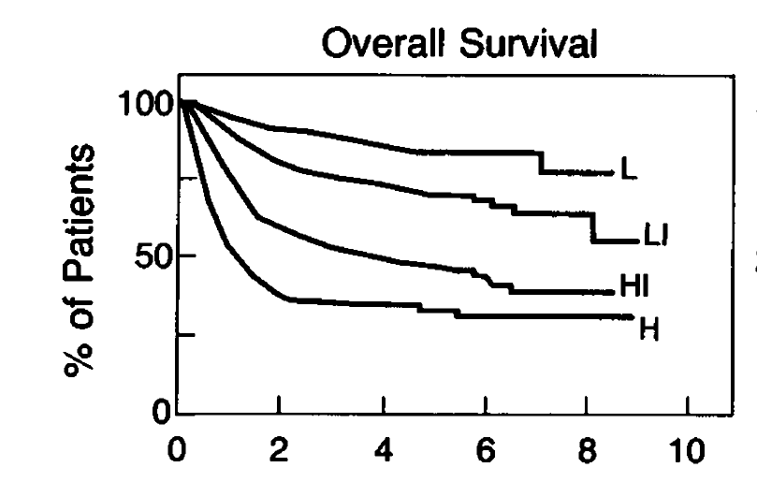
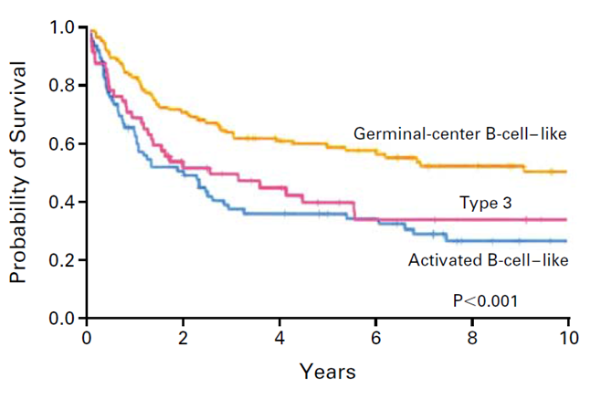
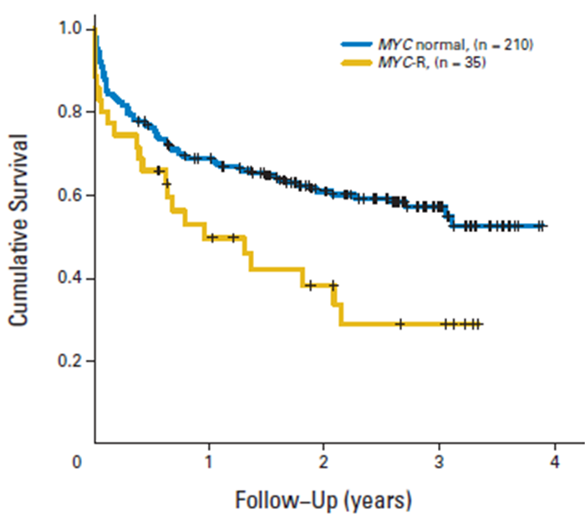
LBCL: How Can We Determine Who Will Be Refractory or Will Relapse?
International Prognostic Index
GEP/Genomic Classification
Double/Triple Hit Cytogenetics
  Age >60
  Stage III/IV
  Elevated LDH
  Performance status >1
  Extranodal sites >1
GEP, genome expression profiling; LBCL, large B-cell lymphoma; LDH, lactate dehydrogenase.
International Non-Hodgkin’s Lymphoma Prognostic Factors Project, N Engl J Med. 1993;329:987; Ziepert et al. J Clin Oncol. 2010;28:2373;
Rosenwald et al. N Engl J Med. 2002;346:1937; Chapuy et al Nat Med. 2018;24:679-690. Barrans et al. J Clin Oncol. 2021;28:3360-3365.
Notes:
International Non-Hodgkin’s Lymphoma Prognostic Factors Project. A predictive model for aggressive non-Hodgkin's lymphoma. N Engl J Med 1993;329:987.
Ziepert M, Hasenslever D, Kuhnt E, et al. Standard International prognostic index remains a valid predictor of outcome for patients with aggressive CD20+ B-cell lymphoma in the rituximab era. J Clin Oncol 2010;28:2373.
Rosenwald A, Wright G, Chan WC, et al. The use of molecular profiling to predict survival after chemotherapy for diffuse large-B-cell lymphoma. N Engl J Med. 2002;346:1937.
Chapuy B, Stewart C, Dunford AJ, et al. Molecular subtypes of diffuse large B cell lymphoma are associated with distinct pathogenic mechanisms and outcomes. Nat Med. 2018;24:679-690.
Barrans S, Crouch S, Smith A, et al. Rearrangement of MYC is associated with poor prognosis in patients with diffuse large B-cell lymphoma treated in the era of rituximab. J Clin Oncol. 2021;28:3360-3365.

Slide 15
How do you evaluate patients for CAR T-cell therapy not eligible for ASCT due to age, fitness or comorbidities?

Slide 16
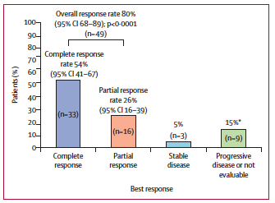
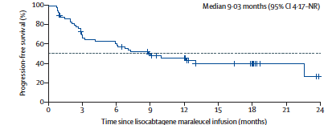
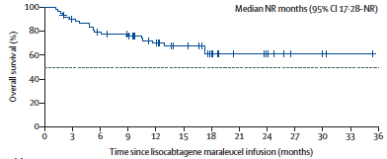
PILOT Study:
Liso-cel in Second-line Transplant Ineligible
CRS any/high grade: 38%/2%
ICANS any/high grade: 31%/5%
Sehgal et al. Lancet Oncol. 2022;23:1066-1077.
CRS, cytokine release syndrome; ICANS, immune effector cell-associated neurotoxicity syndrome; Liso-cel, lisocabtagene maraleucel; NR, not reached.
Notes:
Sehgal A, Hoda D, Riedell PA, et al. Lisocabtagene maraleucel as second-line therapy in adults with relapsed or refractory large B-cell lymphoma who were not intended for haematopoietic stem cell transplantation (PILOT): an open-label, phase 2 study. Lancet Oncol. 2022;23:1066-1077.

Slide 17
What are the predictors of response and toxicity following CD19 CAR T-cells?

Slide 18
Predictors of Response and Toxicity
Improved Response
Increased Toxicity
Low tumor burden, low lactate dehydrogenase
Low pretreatment inflammatory markers
Absence of medical comorbidities
Lack of need for bridging therapy
High tumor burden
Elevated pre-treatment lactate dehydrogenase
High pretreatment inflammatory markers
? High pretreatment monocyte levels
PATIENT
PRE-TREATMENT
Proportion of CCR7+ and other early memory T cells in the CAR product
Faster doubling time in vitro
Higher CAR T-cell peak to tumor burden ratio
High peak CAR T-cell levels
High peak cytokine levels
Markers of disseminated intravascular coagulation (including fibrinogen levels)
Early cytokine release syndrome
T CELLS
POST-TREATMENT
Low tumor myeloid-derived suppressor cells
High tumor-infiltrating lymphocytes
Absence of MYC overexpression
Absence of CD58 mutations
TUMOR

Slide 19
What are the risks/benefits of inpatient vs outpatient CAR T-cell delivery?
What recommendations would you suggest for successful outpatient management?

Slide 20
Outpatient CAR T-Cell Therapy
Most outpatient experience with use of 4-1BB CAR T-cell therapies
Patients without bulky disease, organ dysfunction, or progressive lymphoma symptoms may be considered for outpatient CAR T-cell administration
  Older patients still eligible for outpatient infusion
Patients generally need to stay within 1 hour driving distance AND have a 24-hour caregiver until Day 28
Criteria for admission will be center dependent, but many admit for first fever
Outpatient infusion is more cost effective, associated with shorter hospital stays, and with no negative clinical impact
Additional experience with CD28 CAR T-cell therapy needed

Slide 21
Short-term Monitoring:
Days to Weeks From Infusion
If outpatient, patients are:
If inpatient:
Housed near treating center for 4 weeks
Instructed how to take vital signs and monitor for neurologic toxicity and given tools (eg, thermometers) for assessing and recording these data
Scheduled to return to the treating center daily for at least 7 days for labs and review of vital signs/labs
Admitted at the onset of fever and/or confusion until resolution of CRS
and/or NT
Patient is admitted for up to 7 days or until the resolution of CRS and/or NT
After discharge, patients remain within
2 hours of the treating center for up to 4 weeks and abstain from driving for up to 8 weeks following CAR T-cell infusion due to a low risk of recurrent CRS and/or NT
Patients are monitored for ongoing cytopenias, hydration status; first response assessment at 4 weeks
CRS, cytokine release syndrome; NT, neurotoxicity.

Slide 22
Can you discuss how you approach team-based care coordination and communication?

Slide 23
CAR T-Cell Patient Journey
Patient identification
(meets FDA label)
Referral to CAR T-cell specialist
T-cell collection
Close monitoring
+/- bridging therapy
LBCL 2+ or 3+L
MCL 2+L
FL 3+L
No age cut-off
No requirement for CD19+
CAR centers will have variable eligibility criteria so best to refer and let them decide
Patients can be CAR candidates who are not auto-transplant candidates
The earlier the referral the better!
Eligibility evaluation
Insurance authorization
Consent and education
LD chemotherapy
and T-cell infusion
Is the patient experiencing significant symptoms or at risk for organ function impairment?
Bridging could include steroids, palliative RT, chemotherapy, and/or newer targeted agents
LD chemo mostly outpatient
(i.e Flu/Cy x 3 days)
CAR infusion can be inpatient or outpatient
Post-CAR monitoring involves daily labs, close vital sign monitoring, and exams for at least 7 days to assess for CRS/NT
Patients remain within 2 hours of CAR center for 4 weeks after CAR T-cell infusion
Monitor for late CRS/NT and/or ongoing cytopenias
First response assessment often at 4-week mark
Acute post-CAR monitoring
Long-term post-CAR
monitoring
CRS, cytokine release syndrome; FDA, Food and Drug Administration; FL, follicular lymphoma; Flu/Cy, fludarabine/cyclophosphamide; LBCL, large B-cell lymphoma; LD, low-dose; MCL, mantle cell lymphoma; NT, neurotoxicity; RT, radiation therapy.

Slide 24
Long-term CAR T-Cell Toxicities
B-cell aplasia/
hypogammaglobulinemia
Cytopenias
Infections
~ 40%-50% B-NHL patients s/p CD19 CARs will NOT have IgG recovery by 24 months
Immunoglobulin levels should be monitored following therapy
Grade ≥3 cytopenias unresolved by Day 30 post-treatment occur in 25%-30% of patients
Median time to recovery: 6 months
Blood counts should be monitored following therapy
Occurred in 35%-50% of patients treated with approved agents in pivotal trials
Median time to infection:
  1 month for bacterial infections
  2-3 months for viral and fungal infections
B-NHL, B-cell non-Hodgkin lymphoma; IgG, Immunoglobulin G; s/p, status post.

Slide 25
When preparing patients for CAR T-cell therapy what are some specific elements that you discuss with patients/caregivers?

Slide 26
CAR T-Cell Patient Identification:
Early ID and Referral Matters!
Long-term remission is associated with fitter patients, with lower tumor burden and fitter T cells, so early referral can optimize outcome for a multitude of reasons
Toxicity risk is also minimized in patients with lower pretreatment tumor burden and lower levels of inflammation
Patients with borderline organ function and comorbid conditions may do less well but they still do better than expected with other available therapies
  Non-autologous transplant patients may still be good CAR T-cell candidates
ID and refer patients early and let the treating center evaluate eligibility to ensure optimal outcomes

Slide 27
Take-Home Points
Relapsed LBCL is still curable!
Late relapsing, transplant eligible patients should get salvage chemo and ASCT (if chemosensitive)
Early relapsing or transplant ineligible patients should get CAR T-cells
Third-line patients should get CAR T-cells
Patients who relapse after CAR T-cells or patients who are transplant and/or CAR ineligible have increasing options for palliation or bridging to alloSCT (if eligible)
Ongoing studies moving all of these treatments into earlier (and even front-line) settings will turn the sequencing of therapies for LBCL on its head
The FDA has approved axi-cel and liso-cel as second-line treatment of LBCL
ASCT, autologous stem cell transplant; axi-cel, axicabtagene ciloleucel; B, bendamustine; FDA, Food and Drug Administration; LBCL, large B-cell lymphoma; liso-cel, lisocabtagene maraleucel; R, rituximab; SCT, stem cell transplantation.

