Slide 1


Slide 2
DISCLAIMER
This slide deck in its original and unaltered format is for educational purposes and is current as of September 2024. All materials contained herein reflect the views of the faculty, and not those of AXIS Medical Education, the CME provider, or the commercial supporter. Participants have an implied responsibility to use the newly acquired information to enhance patient outcomes and their own professional development. The information presented in this activity is not meant to serve as a guideline for patient management. Any procedures, medications, or other courses of diagnosis or treatment discussed or suggested in this activity should not be used by clinicians without evaluation of their patients’conditions and possible contraindications and/or dangers in use, review of any applicable manufacturer’s product information, and comparison with recommendations of other authorities.

Slide 3
DISCLOSURE OF UNLABELED USE
This activity may contain discussion of published and/or investigational uses of agents that are not indicated by the FDA. The planners of this activity do not recommend the use of any agent outside of the labeled indications.
The opinions expressed in the activity are those of the faculty and do not necessarily represent the views of the planners. Please refer to the official prescribing information for each product for discussion of approved indications, contraindications, and warnings.
USAGE RIGHTS
This slide deck is provided for educational purposes and individual slides may be
used for personal, non-commercial presentations only if the content and references
remain unchanged. No part of this slide deck may be published in print or
electronically as a promotional or certified educational activity without prior written
permission from AXIS. Additional terms may apply. See Terms of Service on
www.axismeded.com for details.

Slide 4
Learning Objectives
Upon completion of this activity, participants should be better able to:
Apply emerging data and guideline recommendations to accurately define HER2 status in breast cancer patients, thereby improving the identification of patients eligible for appropriate targeted ADC treatments
Evaluate recent and emerging data on the efficacy of ADCs in terms of progression-free survival, objective response rate, and quality of life for patients with HR+ mBC across the HER2-expression continuum
Evaluate how recent clinical trial results impact ADC selection and sequencing for patients with metastatic breast cancer across the HER2-expression continuum
Employ team-based strategies to identify, mitigate, and manage potential treatment-related AEs in patients receiving ADC therapies for mBC

Slide 5
Navigating HER2
Expression in Breast Cancer:
Applying Emerging Data and Guidelines for Targeted ADC Treatment Eligibility

Slide 6
Traditional View of HER2-Positive Breast Cancer
Tumors lacking ERBB2 overexpression or amplification are collectively defined as HER2 negative
HER2
Positive
HER2 Negative
Notes:
Wolff AC, Hale Hammond ME, Allison KH, et al. Human epidermal growth factor receptor 2 testing in breast cancer: American Society of Clinical Oncology/College of American Pathologists Clinical Practice Guideline Focused Update. J Clin Oncol. 2018;36(20):2105-2122.
Tolaney S, Curigliano G. Debate: Is HER2-low a separate entity? Abstract presented at: The 2022 San Antonio Breast Cancer Symposium; San Antonio, TX; December 7, 2022.
Traditionally we have viewed HER2-positive disease as a subtype that is defined by overexpression or amplification of HER2 and have thought if it as either positive or negative, without anything in between.

Slide 7
Expanding the Use of HER2 ADCs to
HER2-Low Breast Cancer
HER2-positive BC 15%
HER2-low BC 45%-55%
HER2-0 BC 30%-40%
Notes:
Tarantino P, Hamilton E, Tolaney SM, et al. HER2-low breast cancer: pathological and clinical landscape. J Clin Oncol. 2020;38(17):1951-1962.
The clinical development of novel anti-HER2 agents such as ADCs for HER2-low breast cancer expands the treatment armamentarium for a subgroup of patients not traditionally considered candidates for HER2-targeted therapy, thereby expanding these therapies to a much larger number of patients with breast cancer.

Slide 8
Expanding the Targetability to HER2 Low and “Ultralow”
HER2 IHC categories within HR+, HER2-negative (HER2-) mBC (per ASCO/CAP)
DESTINY-Breast06 patient population:
~85% of HR+, HER2– mBC
HER2-low
~60–65%
HER2-ultralow
~20–25%
Notes:
Curigliano G, Hu X, Dent RA, et al. Trastuzumab deruxtecan (T-DXd) vs physician’s choice of chemotherapy (TPC) in patients (pts) with hormone receptor-positive (HR+), human epidermal growth factor receptor 2 (HER2)-low or HER2-ultralow metastatic breast cancer (mBC) with prior endocrine therapy (ET): Primary results from DESTINY-Breast06 (DB-06). Abstract presented at: American Society of Clinical Oncology Annual Meeting; Chicago, Illinois; May 31-June 4, 2024. Abstract LBA1000.
When thinking about HER2 expression, we’ve seen our definitions of HER2 expression really evolve particularly over the past year, and this has really changed the way we think about which patients can be eligible for HER2-directed therapies. Initially, we had thought of HER2 being either positive or negative, and then we’ve evolved into classifying it as either HER2-positive, HER2-low, or negative. And now, we’ve started to introduce this idea of HER2-ultralow . And so, in essence, the way that we have divided HER2 expression has grouped patients into being what I call HER2-null, meaning having absolutely no HER2 expression on the cell surface, or HER2-ultralow, which means you have 1 to 10% faint staining of HER2 on the cell, or HER2-low, which means you have HER2 IHC 1+ or 2+ staining and are not FISH amplified or HER2-positive where you’re HER2 IHC 3+ or 2+ and FISH amplified.

Slide 9
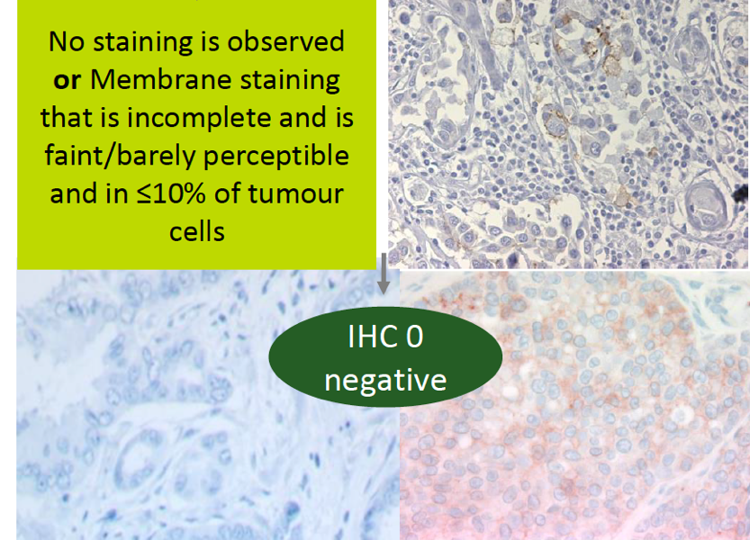
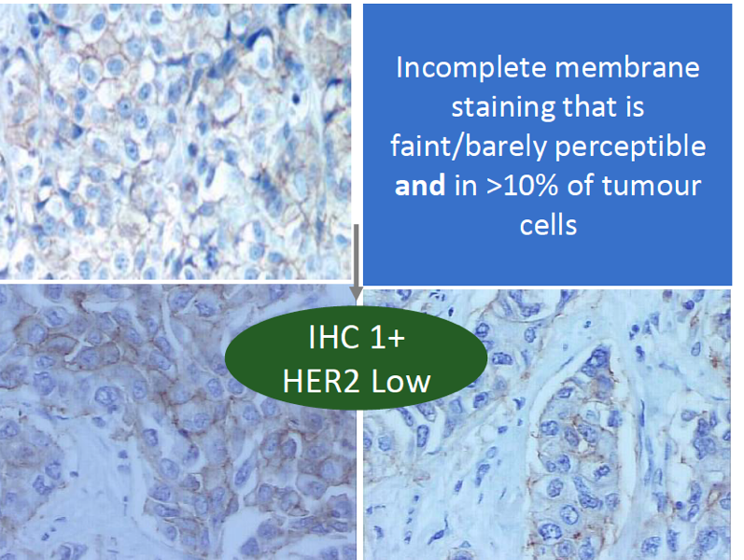
Low Concordance Among Pathologists Between HER2 0 & HER2 1+
In a recent study among 18 experienced pathologists, there was only 26% concordance between the designation of HER2 0 and HER2 1+
Importantly, HER2 0 does not mean absence of HER2, as it also includes tumors with “ultralow” expression
No staining is observed
or
Membrane staining
that is incomplete and faint/barely perceptible and in ≤10% of
tumor cells
Incomplete membrane staining that is faint/barely perceptible and in >10% of
tumor cells
IHC 0
HER2 negative
IHC 1+
HER2 low
Notes:
Fernandez AI, Liu M, Bellizzi A, et al. Examination of low ERBB2 protein expression in breast cancer tissue. JAMA Oncol. 2022;8(4):1-4.
In this study using a current standard ERBB2 IHC assay, the scoring accuracy for ERBB2 IHC in the low range (0 and 1+) was poor. This inaccuracy in the real world could lead to misassignment of many patients for treatment with T-DXd.

Slide 10
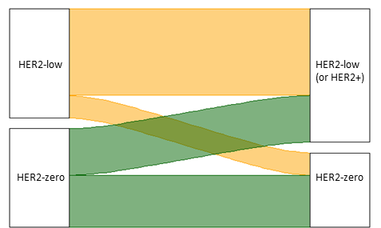
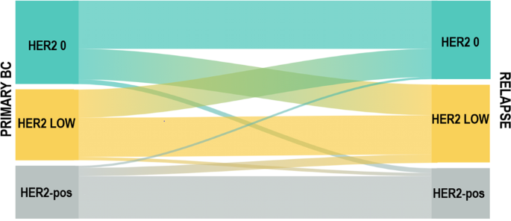
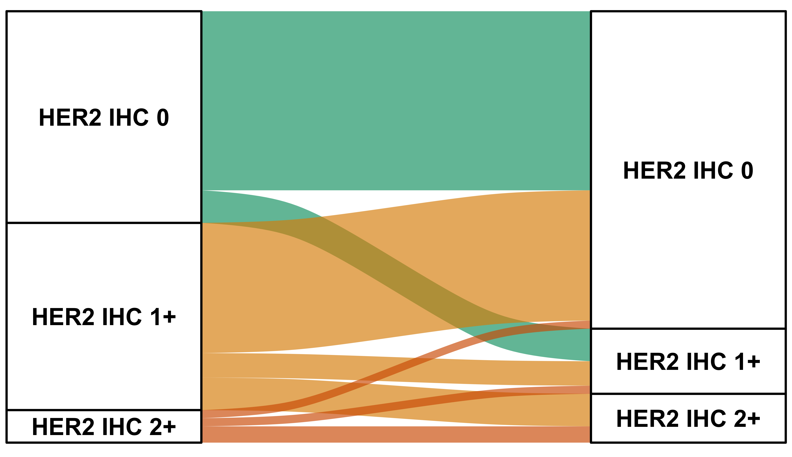
HER2 Low Is Unstable
Multiple studies have confirmed the instability of HER2-low expression between primary and metastatic tumors
The reason is unclear, but may be multifactorial: (pre)analytical factors, HER2 expression heterogeneity, biologic evolution of the disease
Matched paired primary-met TNBC
Notes:
Tarantino P, Gandini S, Nicolò E, et al. Evolution of low HER2 expression between early and advanced-stage breast cancer. Eur J Cancer. 2022;163:35-43.
Miglietta F, Griguolo G, Bottosso M, et al. Evolution of HER2-low expression from primary to recurrent breast cancer. NPJ Breast Cancer. 2021;7(1):137.
Garrido-Castro AC, Ngo LD, Richardson ET, et al. Dynamics of HER2-low expression in triple-negative breast cancer. Abstract presented at: The 2022 San Antonio Breast Cancer Symposium; San Antonio, TX; December 7, 2022. Abstract HER2-10.
I think another challenge is that HER2 expression is not stable. So, for example, if you look at expression on a primary tumor, and you compare expression to a metastatic tumor, you can see that they’re not always consistent. You can have a primary tumor that’s HER2-low and a metastatic recurrence that’s HER2-0. You can have a primary tumor that’s HER2-0 that becomes HER2-low, and so I think this is a big challenge for us because it means that HER2 expression is constantly evolving over time, even in the metastatic setting. If you were to biopsy patients over time, you can see sometimes it’s low, sometimes it’s 0, and can go back to low again, telling us that this is a dynamic expression.

Slide 11
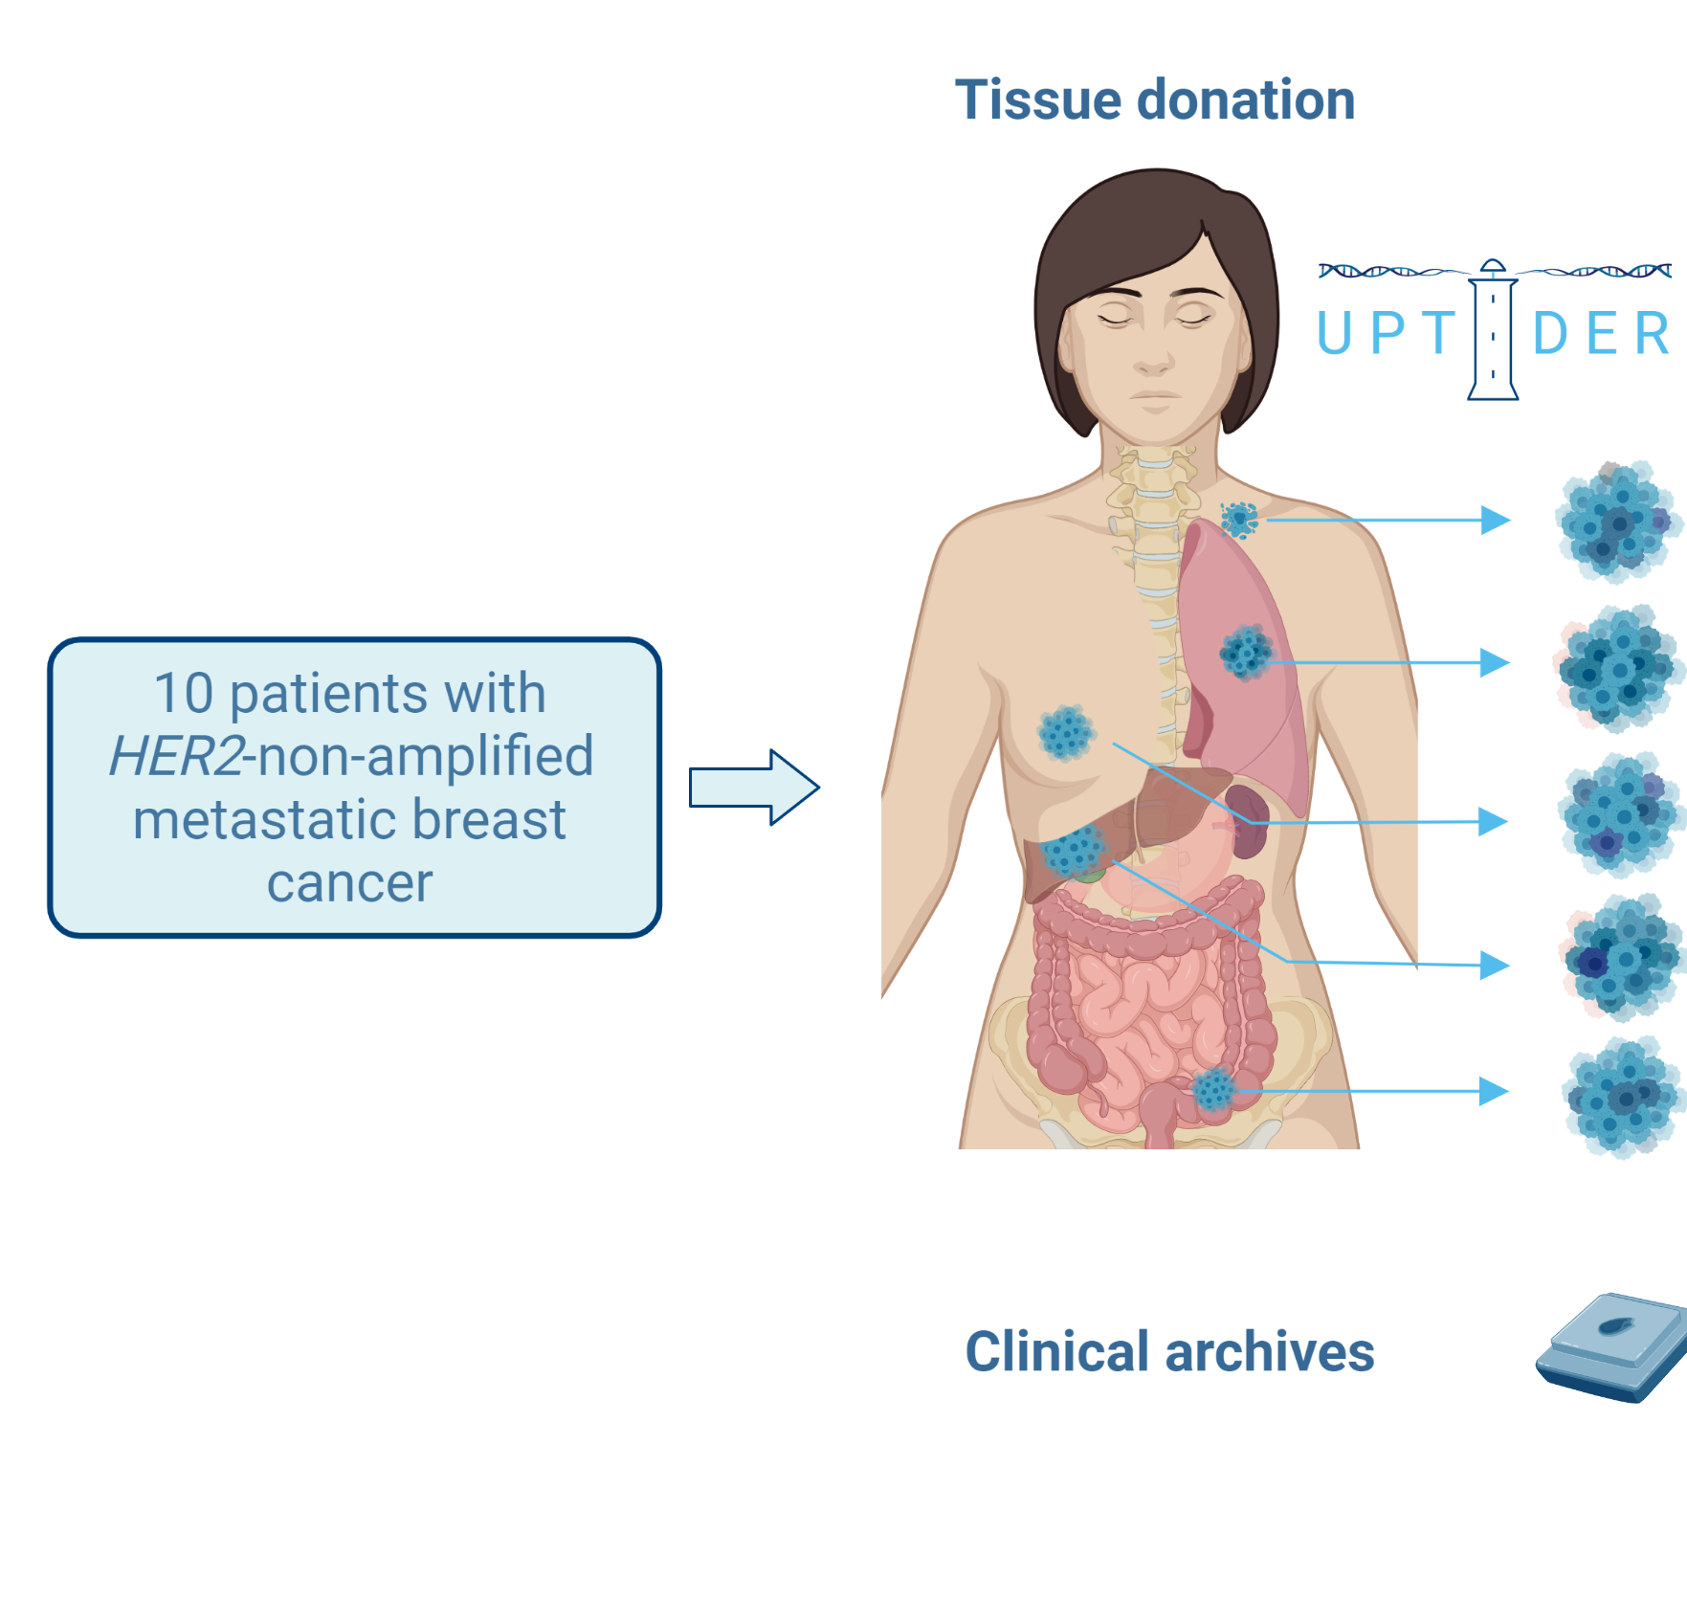
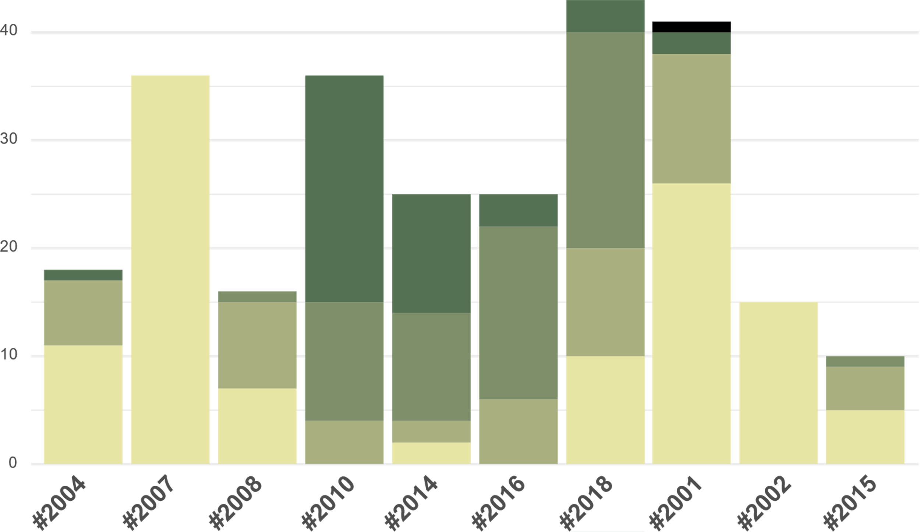
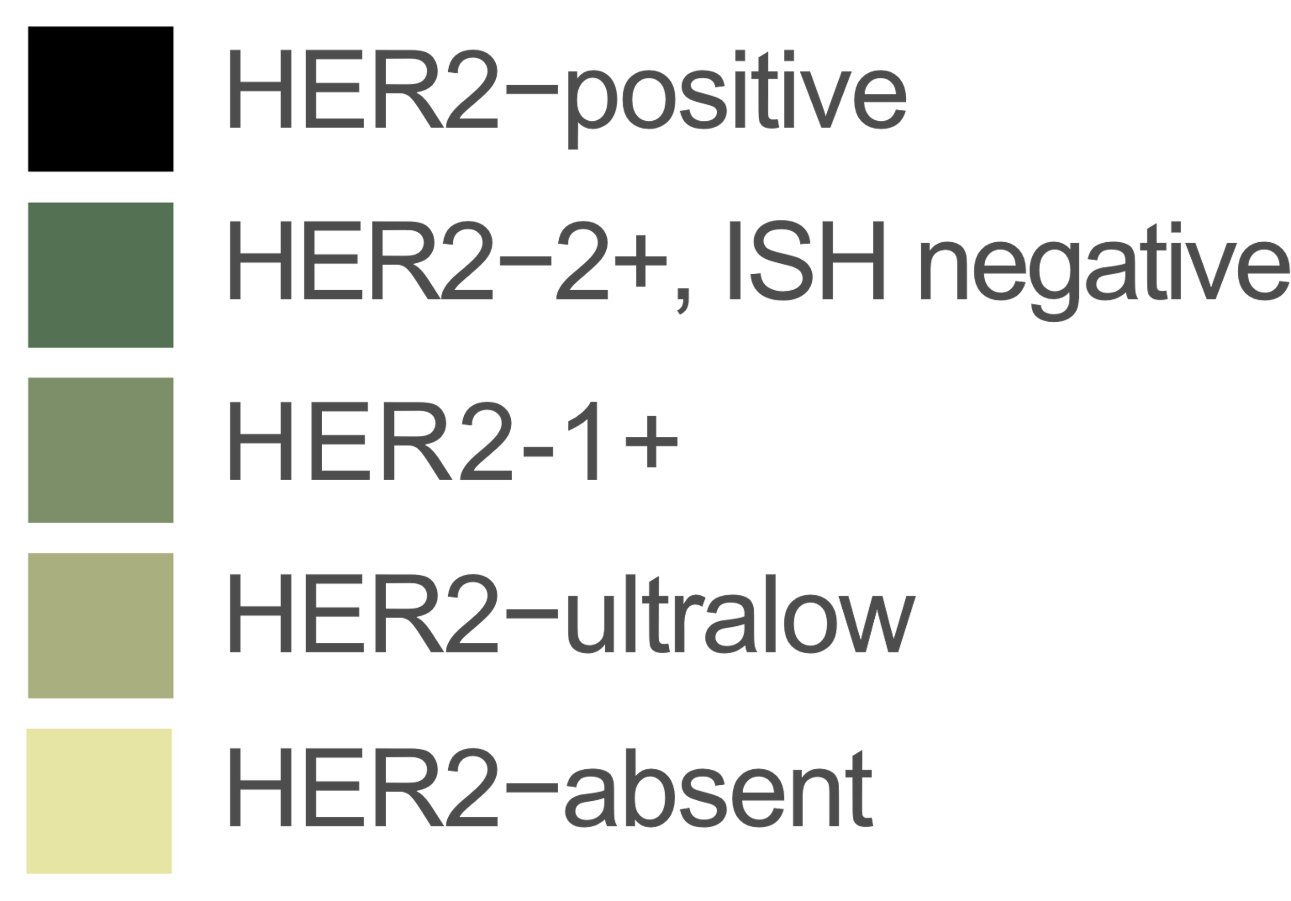
Discordance Seen Within a Patient With Tissue From Different Locations at the Same Timepoint
Lesions per patient
ER-positive
ER-negative
HER2-status of different metastases was highly variable within one patient, with HER2-low and zero lesions in 8/10 patients
Notes:
Geukens T, De Schepper M, Richard F, et al. Inter-lesion heterogeneity of HER2-status in metastatic breast cancer: possible implications for treatment with anti-HER2 antibody-drug conjugates. Abstract presented at: The 2022 San Antonio Breast Cancer Symposium; San Antonio, TX; December 7, 2022. Abstract HER2-16.
Important inter-lesion heterogeneity in terms of HER2-low status was observed in patients with primary ER-positive/HER2-non-amplified breast cancer participating to our post-mortem tissue donation program. This observed heterogeneity is unlikely to be due to post-mortem changes in HER2 expression. HER2-low status was found in at least one distant lesion in all patients, complicating therapeutic decision-making based on a single biopsy. Of note, IHC 1+ and 2+ scores varied between metastases of each patient too, making assessment on a single biopsy less reliable for stratification in clinical trials.

Slide 12
A Practical Definition of HER2-Low Breast Cancer?
Given the complexities of assessing HER2-low and some suggestion of activity of T-DXd irrespective of timepoint of tissue collection, a practical definition of HER2 low is:
  HER2 nonamplified tumor that showed HER2-low expression on any prior specimen in the course of disease
Primary
Tumor
1st Metastatic
Biopsy
53%
44%
= 81% HER2 low according to the practical definition
21%
47%
16%
Notes:
Tarantino P, Gandini S, Nicolò E, et al. Evolution of low HER2 expression between early and advanced-stage breast cancer. Eur J Cancer. 2022;163:35-43.
HER2-low expression is dynamic in breast cancer and may be enriched in the advanced-stage setting. No prognostic significance was demonstrated for HER2-low expression.

Slide 13
ADC Efficacy in HR+ Metastatic Breast Cancer: Insights Across the HER2-Expression Continuum

Slide 14
Overall Survival in Patients With Advanced
HER2+ mBC
CLEOPATRA End-of-Study Results
(median follow-up ~100 months)
Median OS
with TP-based initial therapy:
57.1 months vs 40.8 months
in the control arm
OS, %
P < .0001
Landmark OS at 8 years 37%, 235 events (58%)
Pertuzumab + trastuzumab + docetaxel
Placebo + trastuzumab + docetaxel
Landmark OS at 8 years 23%, 280 events (69%)
Time Since Randomization, mo
No. at Risk (number censored)
Pertuzumab | 402 (0) | 371 (14) | 318 (23) | 269 (32) | 228 (41) | 188 (48) | 165 (50) | 150 (54) | 137 (56) | 120 (59) | 71 (102) | 20 (147) | 0 (167)
Placebo | 406 (0) | 350 (19) | 289 (30) | 230 (36) | 181 (41) | 149 (48) | 115 (52) | 96 (53) | 88 (53) | 75 (57) | 44 (84) | 11 (115) | 1 (125)
Notes:
Swain SM, Miles D, Kim SB, et al. Pertuzumab, trastuzumab and docetaxel for HER2-positive metastatic breast cancer (CLEOPATRA): end-of-study results from a double-blind, randomised, placebo-controlled, phase 3 study. Lancet Oncol. 2020;21(4):519-530.
Our analysis shows that the previously observed improvements in overall survival with pertuzumab, trastuzumab, and docetaxel versus placebo, trastuzumab, and docetaxel were maintained after a median of more than 8 years of follow-up. The long-term safety and cardiac safety profiles of pertuzumab, trastuzumab, and docetaxel were maintained in the overall safety population and within crossover patients. HER2-targeted therapy has changed the natural history of HER2-positive metastatic breast cancer, with the dual blockade of pertuzumab and trastuzumab, with docetaxel, demonstrating an 8-year landmark overall survival rate of 37%.

Slide 15
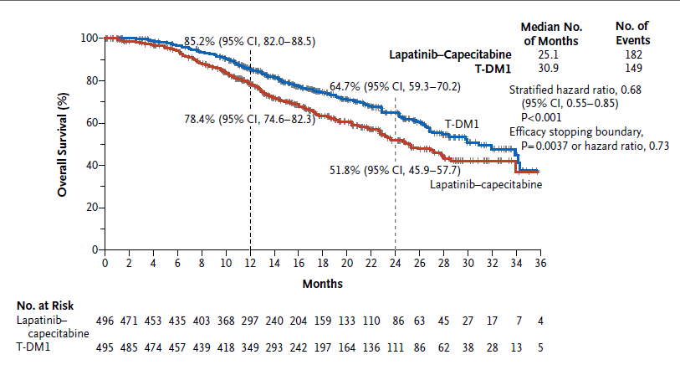
EMILIA TRIAL: T-DM1 Superior to Capecitabine + Lapatinib in Patients With HER2-Positive Advanced Breast Cancer
Notes:
Verma S, Miles D, Gianni L, et al. Trastuzumab emtansine for HER2-positive advanced breast cancer. N Engl J Med. 2012;367(19):1783-1791.
T-DM1 significantly prolonged progression-free and overall survival with less toxicity than lapatinib plus capecitabine in patients with HER2-positive advanced breast cancer previously treated with trastuzumab and a taxane.

Slide 16
HER2CLIMB-02 Study Design
HER2+ LA/MBC with progression after trastuzumab and taxane in any settingª
ECOG PS ≤1
Previously treated stable, progressing, or untreated brain metastases not requiring immediate local therapy
Tucatinib (TUC) + T-DM1
Tucatinib 300 mg PO BID and
T-DM1 3.6 mg/kg IV
Outcomes
Primary
PFS by investigator assessment per RECIST v1.1
Key Secondary (hierarchical)
OS
PFS in patients with brain metastases
cORR per RECIST v1.1
OS in patients with brain metastases
N≈460
R
1:1
Stratification factors:
Line of treatment for metastatic disease
(1L vs other)
Hormone receptor status (positive vs negative)
Presence or history of brain metastases (yes vs no)
ECOG PS (0 vs 1)
Placebo (PBO) + T-DM1
Placebo PO BID and
T-DM1 3.6 mg/kg IV
The primary analysis for PFS was planned after ≈331 PFS events to provide 90% power for hazard ratio of 0.7.
The first of two interim analysis for OS was planned at the time of the primary PFS analysis, if the PFS result was significantly positive.^{b}
1L, first-line; BID, twice daily; cORR, confirmed objective response rate; ECOG PS, Eastern Cooperative Oncology Group performance status; EGFR, epidermal growth factor receptor; HER2, human epidermal growth factor receptor 2; IV, intravenously; LA/MBC, locally advanced or metastatic breast cancer; OS, overall survival; PBO, placebo; PFS, progression-free survival; PO, orally; R, randomization; RECIST, Response Evaluation Criteria in Solid Tumors; T-DM1, trastuzumab emtansine; T-DXd, trastuzumab deruxtecan; TKIs, tyrosine kinase inhibitors; TUC, tucatinib.
ClinicalTrials.gov. NCT03975647. https://www.clinicaltrials.gov/study/NCT03975647. Hurvitz S, et al. SABCS 2023. Abstract GS01-10.
Notes:
A study of tucatinib vs. placebo in combination with ado-trastuzumab emtansine (T-DM1) for patients with advanced or metastatic HER2+ breast cancer. ClinicalTrials.gov identifier: NCT03975647. Updated January 9, 2024. https://www.clinicaltrials.gov/study/NCT03975647
Hurvitz SA, Loi S, O’Shaughnessy J, et al. HER2CLIMB-02: randomized, double-blind phase 3 trial of tucatinib and trastuzumab emtansine for previously treated HER2-positive metastatic breast cancer. Abstract presented at: The 2023 San Antonio Breast Cancer Symposium; San Antonio, TX; December 5, 2023. Abstract GS01-10.
In HER2CLIMB-02, patients were eligible for enrollment in the trial if they had HER2-positive locally advanced unresectable or metastatic breast cancer that progressed after trastuzumab and a taxane in any setting. Patients were also allowed if they had previously treated stable, progressing, or untreated brain metastases not requiring immediate local therapy.

Slide 17
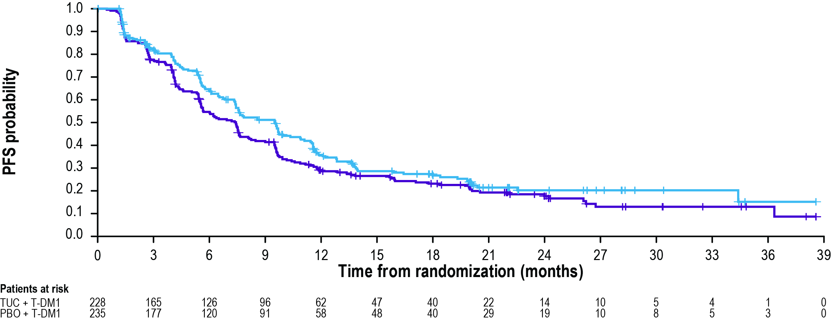
HER2CLIMB-02: Progression-Free Survival
 | TUC + T-DM1 (N=228) | PBO + T-DM1 (N=235)
# of events | 151 | 182
Median PFS (95% CI) | 9.5 months (7.4, 10.9) | 7.4 months (5.6, 8.1)
 | HR (95% CI): 0.76 (0.61, 0.95) P=0.0163
Notes:
A study of tucatinib vs. placebo in combination with ado-trastuzumab emtansine (T-DM1) for patients with advanced or metastatic HER2+ breast cancer. ClinicalTrials.gov identifier: NCT03975647. Updated January 9, 2024. https://www.clinicaltrials.gov/study/NCT03975647
Hurvitz SA, Loi S, O’Shaughnessy J, et al. HER2CLIMB-02: randomized, double-blind phase 3 trial of tucatinib and trastuzumab emtansine for previously treated HER2-positive metastatic breast cancer. Abstract presented at: The 2023 San Antonio Breast Cancer Symposium; San Antonio, TX; December 5, 2023. Abstract GS01-10.
The median time to disease progression or death was 9.5 months for patients in the tucatinib arm and 7.4 months for patients in the placebo arm (HR=0.76), with tucatinib plus T-DM1 reducing the risk of disease progression or death by 24.1%.

Slide 18
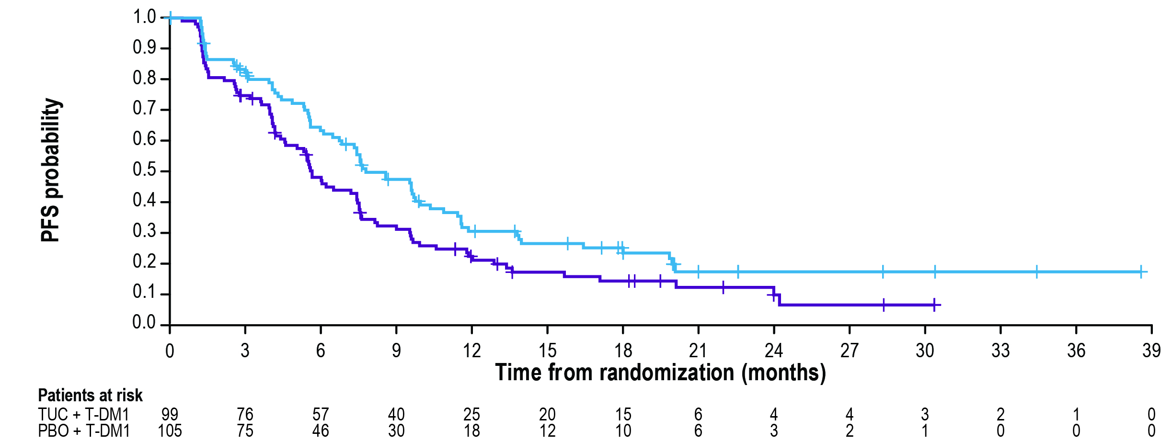
HER2CLIMB-02: PFS in Patients with Brain Metastasesª
 | TUC + T-DM1 (N=99) | PBO + T-DM1 (N=105)
# of events | 70 | 85
Median PFS (95% CI) | 7.8 months (6.7, 10.0) | 5.7 months (4.6, 7.5)
 | HR (95% CI): 0.64 (0.46, 0.89)
Date of data cutoff: June 29, 2023.
ªThe outcome was not formally tested.
HR, hazard ratio; PBO, placebo; PFS, progression-free survival; T-DM1, trastuzumab emtansine; TUC, tucatinib.
ClinicalTrials.gov. NCT03975647. https://www.clinicaltrials.gov/study/NCT03975647. Hurvitz S, et al. SABCS 2023. Abstract GS01-10.
Notes:
A study of tucatinib vs. placebo in combination with ado-trastuzumab emtansine (T-DM1) for patients with advanced or metastatic HER2+ breast cancer. ClinicalTrials.gov identifier: NCT03975647. Updated January 9, 2024. https://www.clinicaltrials.gov/study/NCT03975647
Hurvitz SA, Loi S, O’Shaughnessy J, et al. HER2CLIMB-02: randomized, double-blind phase 3 trial of tucatinib and trastuzumab emtansine for previously treated HER2-positive metastatic breast cancer. Abstract presented at: The 2023 San Antonio Breast Cancer Symposium; San Antonio, TX; December 5, 2023. Abstract GS01-10.
Additionally, in patients who had brain metastases at baseline, the investigators found that the median time to disease progression or death was 7.8 months for those in the tucatinib arm and 5.7 months for those treated in the placebo arm, with tucatinib plus T-DM1 reducing the risk of disease progression or death by 36.1%.

Slide 19
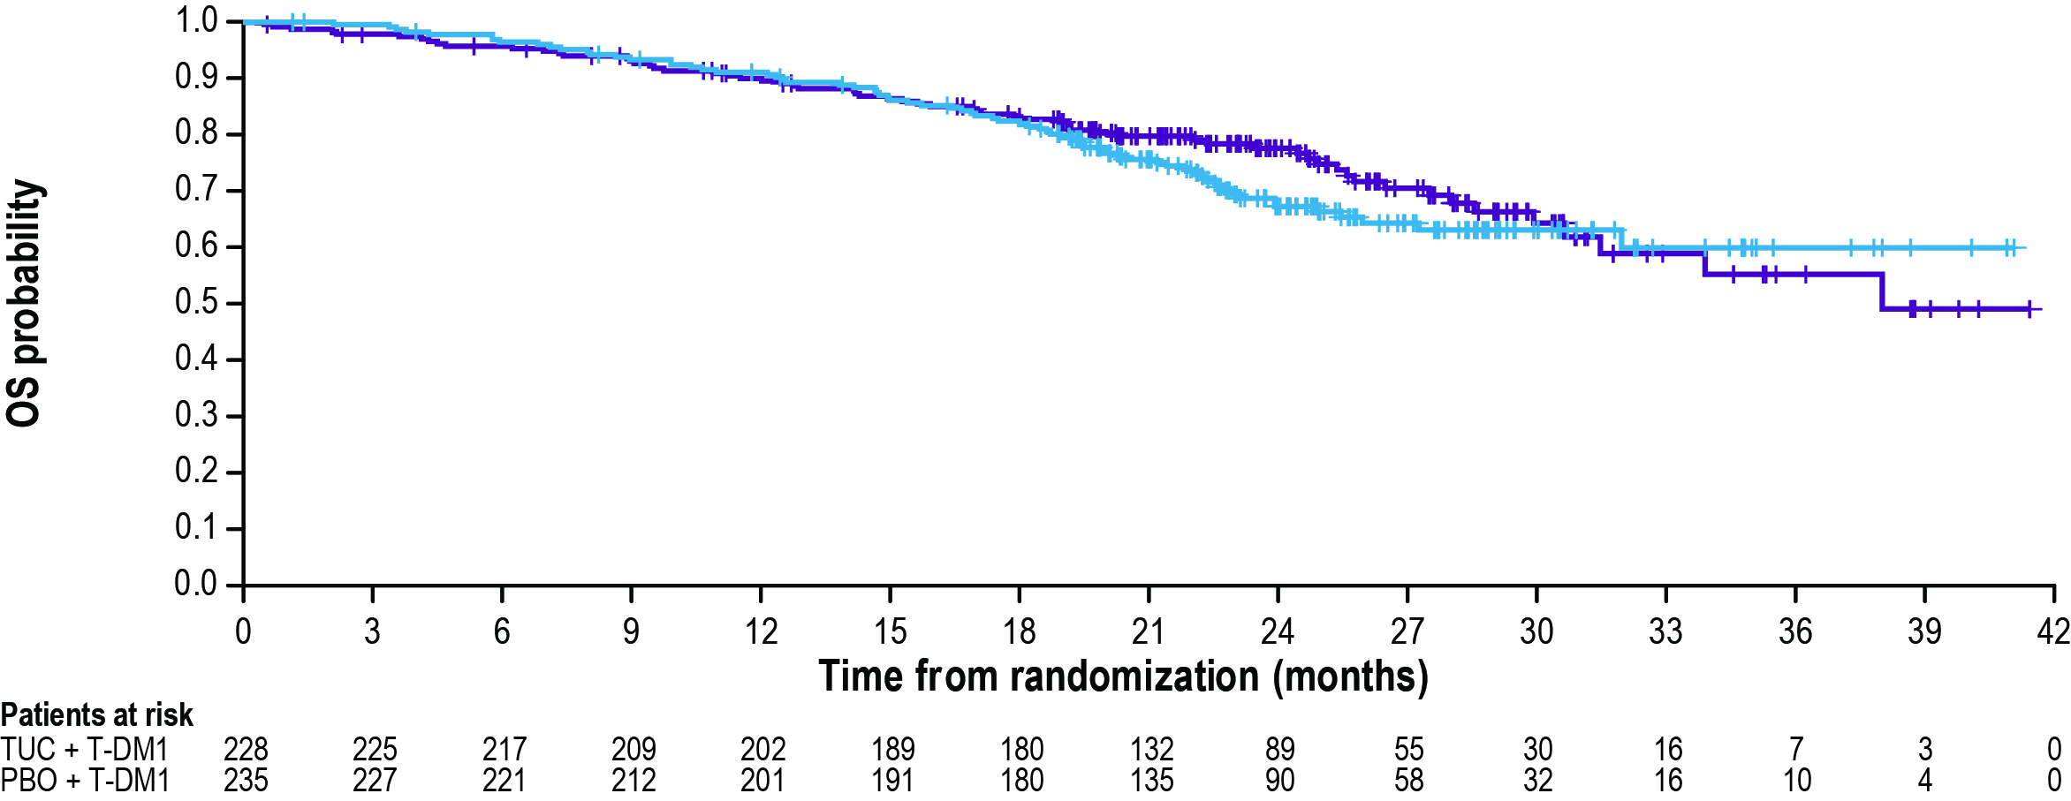
HER2CLIMB-02: Overall Survival
 | TUC + T-DM1 (N=228) | PBO + T-DM1 (N=235)
# of events | 71 | 63
Median OS (95% CI) | NR (NR, NR) | 38.0 months (31.5, NR)
 | HR (95% CI)ª 1.23 (0.87, 1.74)
Median follow-up was 24.4 months. As of data cutoff, 134 out of 253 (53%) prespecified events for the OS final analysis were observed.
Interim OS results did not meet the prespecified crossing boundary of P = 0.0041.
Notes:
A study of tucatinib vs. placebo in combination with ado-trastuzumab emtansine (T-DM1) for patients with advanced or metastatic HER2+ breast cancer. ClinicalTrials.gov identifier: NCT03975647. Updated January 9, 2024. https://www.clinicaltrials.gov/study/NCT03975647
Hurvitz SA, Loi S, O’Shaughnessy J, et al. HER2CLIMB-02: randomized, double-blind phase 3 trial of tucatinib and trastuzumab emtansine for previously treated HER2-positive metastatic breast cancer. Abstract presented at: The 2023 San Antonio Breast Cancer Symposium; San Antonio, TX; December 5, 2023. Abstract GS01-10.
Overall survival data were immature at the time of analysis. Median OS was not reached in the experimental arm and was 38.0 months in the control arm (HR 1.23, 95% CI:0.87-1.74).

Slide 20
HER2CLIMB-02: Adverse Events of Interest
Hepatic TEAEs
Diarrhea
Grade ≥3 hepatic TEAEs greater in TUC + T-DM1 arm (28.6% vs 7.3%), primarily due to AST/ALT elevations
No Hy’s law cases were identified
85% of all-grade hepatic TEAEs in TUC + T-DM1 arm resolved or returned to grade 1, with median of 22 days to resolutionª
Grade ≥3 events reported in 4.8% of TUC +
T-DM1 arm and 0.9% of PBO + T-DM1 arm
Dose modifications Due to Hepatic TEAEs
Dose modifications Due to Diarrhea
 | TUC + T-DM1 (N=231) n (%) | PBO + T-DM1 (N=233) n (%)
TUC/PBO dose holds | 76 (32.9) | 26 (11.2)
TUC/PBO dose reductions | 46 (19.9) | 12 (5.2)
Treatment discontinuation
TUC/PBO | 16 (6.9) | 5 (2.1)
T-DM1 | 18 (7.8) | 5 (2.1)
 | TUC + T-DM1 (N=231) n (%) | PBO + T-DM1 (N=233) n (%)
TUC/PBO dose holds | 9 (3.9) | 2 (0.9)
TUC/PBO dose reductions | 9 (3.9) | 1 (0.4)
Treatment discontinuation
TUC/PBO | 1 (0.4) | 0
T-DM1 | 0 | 0
Notes:
A study of tucatinib vs. placebo in combination with ado-trastuzumab emtansine (T-DM1) for patients with advanced or metastatic HER2+ breast cancer. ClinicalTrials.gov identifier: NCT03975647. Updated January 9, 2024. https://www.clinicaltrials.gov/study/NCT03975647
Hurvitz SA, Loi S, O’Shaughnessy J, et al. HER2CLIMB-02: randomized, double-blind phase 3 trial of tucatinib and trastuzumab emtansine for previously treated HER2-positive metastatic breast cancer. Abstract presented at: The 2023 San Antonio Breast Cancer Symposium; San Antonio, TX; December 5, 2023. Abstract GS01-10.
The types of adverse events were consistent with previous reporting. Grade ≥3 AEs of interest included hepatic TEAEs (28.6% vs 7.3%) and diarrhea (4.8% vs 0.9%).

Slide 21
Characteristic Differences Between T-DXd and T-DM1
HER2 Targeting ADCs with similar mAB Backbone
Trastuzumab deruxtecan
(T-DXd)¹
T-DXd^{1-4,a} | ADC Attributes | T-DM1³⁻⁵
Topoisomerase I inhibitor | Payload MoA | Anti-microtubule
~8:1 | Drug-to-antibody ratio | ~3.5:1
Yes | Tumor-selective cleavable linker? | No
Yes | Evidence of bystander anti-tumor effect? | No
Trastuzumab emtansine
(T-DM1)⁵
Notes:
Nakada T, Sugihara K, Jikoh T, et al. The latest research and development into the antibody-drug conjugate, [fam-] trastuzumab deruxtecan (DS-8201a), for HER2 cancer therapy. Chem Pharm Bull (Tokyo). 2019;67(3):173-185.
Ogitani Y, Aida T, Hagihara K, et al. DS-8201a, A novel HER2-targeting ADC with a novel DNA topoisomerase I inhibitor, demonstrates a promising antitumor efficacy with differentiation from T-DM1. Clin Cancer Res. 2016;22(20):5097-5108.
Trail PA, Dubowchik GM, Lowinger TB. Antibody drug conjugates for treatment of breast cancer: Novel targets and diverse approaches in ADC design. Pharmacol Ther. 2018;181:126-142.
Ogitani Y, Hagihara K, Oitate M, et al. Bystander killing effect of DS-8201a, a novel anti-human epidermal growth factor receptor 2 antibody-drug conjugate, in tumors with human epidermal growth factor receptor 2 heterogeneity. Cancer Sci. 2016;107(7):1039-1046.
LoRusso PM, Weiss D, Guardino E, et al. Trastuzumab emtansine: a unique antibody-drug conjugate in development for human epidermal growth factor receptor 2-positive cancer. Clin Cancer Res. 2011;17(20):6437-6447.
Cortés J, Kim S, Chung W. Trastuzumab deruxtecan (T-DXd) vs trastuzumab emtansine (T-DM1) in patients (Pts) with HER2+ metastatic breast cancer (mBC): Results of the randomized phase III DESTINY-Breast03 study. Abstract presented at: European Society for Medical Oncology Congress 2021; Paris, France; September 18, 2021. Abstract LBA1.
T-DXd contains a topoisomerase I inhibitor as the payload and has a higher drug-to-antibody ration compared with T-DM1. T-DXd also has tumor-selective cleavable linker and evidence of bystander anti-tumor effect.

Slide 22
Updated OS Analysis of DESTINY-Breast03 Randomized, Open-Label, Multicenter Study (NCT03529110)
T-DXd
5.4 mg/kg Q3W
(n = 261)
Primary endpoint
PFS (BICR)
Key secondary endpoint
OS
Secondary endpoints
ORR (BICR and investigator)
DoR (BICR)
Safety
Patients (N = 524)
Unresectable or metastatic HER2-positive breast cancer
Previously treated with trastuzumab and a taxane in metastatic or (neo)adjuvant setting with recurrence within 6 months of therapy
R
1:1
T-DM1
3.6 mg/kg Q3W
(n = 263)
Stratification factors
Hormone receptor status
Prior treatment with pertuzumab
History of visceral disease
Notes:
Cortés J, Hurvitz SA, Im SA, et al. Trastuzumab deruxtecan versus trastuzumab emtansine in HER2-positive metastatic breast cancer: long-term survival analysis of the DESTINY-Breast03 trial. Nat Med. 2024;30:2208–2215.
Patients with HER2+ mBC previously treated with trastuzumab and a taxane in either the metastatic setting or (neo)adjuvant setting with progression within 6 months of therapy, who could have received pertuzumab, were randomly assigned 1:1 to receive T-DXd 5.4 mg/kg every 3 weeks (Q3W) or T-DM1 3.6 mg/kg Q3W until disease progression. The primary endpoint was PFS by blinded independent central review (BICR). The key secondary endpoint was OS (80% powered at 2-sided significance level of 5%); other secondary endpoints included objective response rate (ORR), duration of response (DoR), PFS based on investigator assessment, and safety.

Slide 23
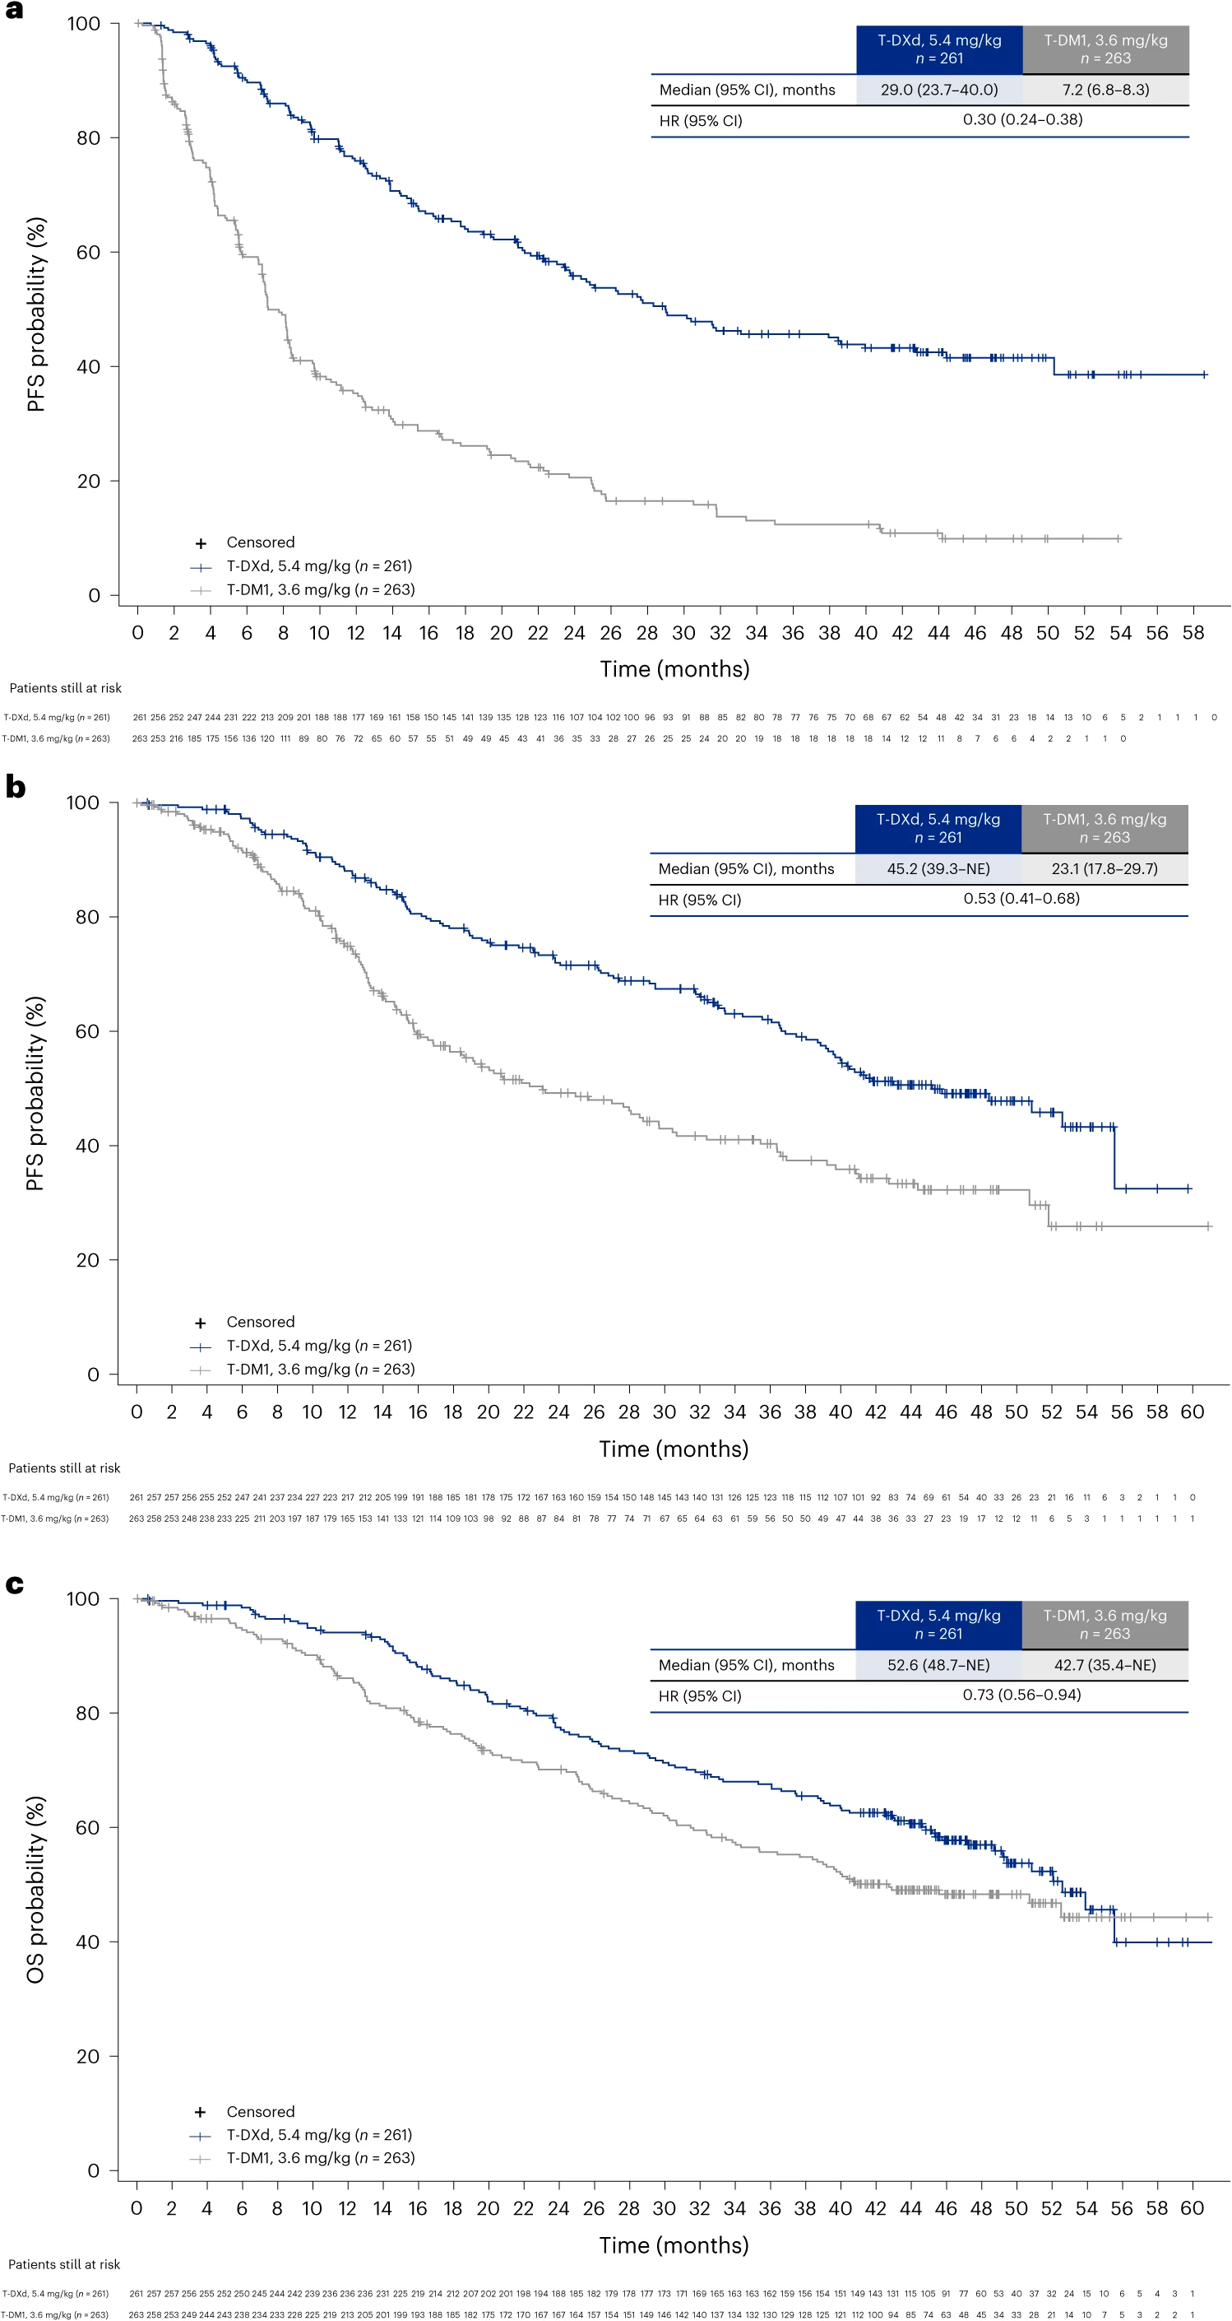
Updated Primary Endpoint: PFS by BICR
Notes:
Cortés J, Hurvitz SA, Im SA, et al. Trastuzumab deruxtecan versus trastuzumab emtansine in HER2-positive metastatic breast cancer: long-term survival analysis of the DESTINY-Breast03 trial. Nat Med. 2024;30:2208–2215.
Median PFS by BICR was 29.0 months (95% CI, 23.7-40.0 months) with T-DXd, compared with 7.2months (95% CI, 6.8-8.3 months) with T-DM1; HR, 0.30.

Slide 24
Key Secondary Endpoint: Overall Survival
Notes:
Cortés J, Hurvitz SA, Im SA, et al. Trastuzumab deruxtecan versus trastuzumab emtansine in HER2-positive metastatic breast cancer: long-term survival analysis of the DESTINY-Breast03 trial. Nat Med. 2024;30:2208–2215.
Median OS was 52.6 vs 42.7 months (HR 0.73; 95% CI: 0.56–0.94) with T-DXd vs T-DM1.

Slide 25
Adjudicated Drug-Related Interstitial Lung Disease/Pneumonitis
 | Grade 1 | Grade 2 | Grade 3 | Grade 4 | Grade 5 | Any Grade
T-DXd (n = 257) | 11 (4.3) | 30 (11.7) | 2 (0.8) | 0 | 0 | 43 (16.7)
T-DM1 (n = 261) | 5 (1.9) | 3 (1.1) | 1 (0.4) | 0 | 0 | 9 (3.4)
Adjudicated drug-related ILD/pneumonitis rates were similar to other mBC trials
with T-DXd
With longer treatment exposure and follow-up, the ILD/pneumonitis rate increased from 10.5% in the PFS interim analysis to 16.7%
The overall incidence of grade 3 events (0.8%) was the same as in the PFS interim analysis
There were no adjudicated drug-related grade 4 or 5 events
Notes:
Cortés J, Hurvitz SA, Im SA, et al. Trastuzumab deruxtecan versus trastuzumab emtansine in HER2-positive metastatic breast cancer: long-term survival analysis of the DESTINY-Breast03 trial. Nat Med. 2024;30:2208–2215.
Drug-related interstitial lung disease/pneumonitis, as evaluated by an independent adjudication committee, was experienced by 43 pts (16.7%) in the T-DXd arm and 9 pts (3.4%) in the T DM1 arm; no adjudicated drug-related grade 4 or 5 events were observed in pts who received T-DXd.

Slide 26
DESTINY-Breast04: Study Design
An Open-Label, Multicenter, Phase 3 Study (NCT03734029)
T-DXd
5.4 mg/kg Q3W
(n = 373)
Patientsª
HER2-Low (IHC 1+ vs IHC 2+/ISH−), unresectable, and/or mBC treated with 1-2 prior lines of chemotherapy in the metastatic setting
HR+ disease considered endocrine refractory
Primary endpoint
PFS by BICR (HR+)
Key secondary endpoints^{d}
PFS by BICR (all patients)
OS (HR+ and all patients)
R
2:1
HR+ ≈ 480
HR− ≈ 60
TPC
Capecitabine, eribulin, gemcitabine, paclitaxel,
nab-paclitaxel^{c}
(n = 184)
Stratification factors
Centrally assessed HER2 status^{b} (IHC 1+ vs IHC 2+/ISH−)
1 vs 2 prior lines of chemotherapy
HR+ (with vs without prior treatment with CDK4/6 inhibitor) vs HR−
Notes:
Modi S, Jacot W, Yamashita T, et al. Trastuzumab deruxtecan in previously treated HER2-low advanced breast cancer. N Engl J Med. 2022;387(1):9-20.
We saw data evolve from DESTINY-Breast04; this was a registration trial comparing T-DXd to treatment of physician’s choice chemotherapy in patients who had tumors that were HER2-low, and the primary endpoint was focused on those patients who also had hormone receptor-positive disease. There was a small subset of patients included who had triple-negative breast cancer that was also HER2-low, and the study was designed for patients who had received one or two lines of chemotherapy in the metastatic setting. And the primary endpoint was to compare the progression-free survival of T-DXd compared to treatment of physician’s choice chemo in those patients with hormone receptor-positive HER2-low breast cancer.

Slide 27
DESTINY-Breast04: Prior Therapies
 | Hormone receptor-positive | Full analysis set | All patients
 | T-DXd (n = 331) | TPC (n = 163) | T-DXd (n = 373) | TPC (n = 184)
Lines of systemic therapy (metastatic setting)
Number of lines, median (range) | 3 (1-9) | 3 (1-8) | 3 (1-9) | 3 (1-8)
Number of lines, n (%)
1 | 23 (7) | 14 (9) | 39 (10) | 19 (10)
2 | 85 (26) | 41 (25) | 100 (27) | 53 (29)
≥3 | 223 (67) | 108 (66) | 234 (63) | 112 (61)
Lines of chemotherapy (metastatic setting)
Number of lines, median (range) | 1 (0-3) | 1 (0-2) | 1 (0-3) | 1 (0-2)
Number of lines, n (%)
0 | 1 (0.3) | 1 (0.6) | 1 (0.3) | 1 (0.5)
1 | 203 (61.3) | 93 (57.1) | 221 (59.2) | 100 (54.3)
2 | 124 (37.5) | 69 (42.3) | 145 (38.9) | 83 (45.1)
≥3 | 3 (0.9) | 0 | 6 (1.6) | 0
Lines of endocrine therapy (metastatic setting)
Number of lines, median (range) | 2 (0-7) | 2 (0-6) | 2 (0-7) | 2 (0-6)
Number of lines, n (%)
0 | 28 (8) | 17 (10) | 60 (16) | 34 (18)
1 | 105 (32) | 49 (30) | 108 (29) | 51 (28)
2 | 110 (33) | 53 (33) | 115 (31) | 54 (29)
≥3 | 88 (27) | 44 (27) | 90 (24) | 45 (24)
Prior targeted cancer therapy, n (%)
Targeted therapy | 259 (78) | 132 (81) | 279 (75) | 140 (76)
CDK4/6 inhibitor | 233 (70) | 115 (71) | 239 (64) | 119 (65)
Notes:
Modi S, Jacot W, Yamashita T, et al. Trastuzumab deruxtecan in previously treated HER2-low advanced breast cancer. N Engl J Med. 2022;387(1):9-20.
The demographic and clinical characteristics of the patients at baseline were similar in the two trial groups and were largely representative of the overall population of patients with HER2-negative breast cancer. Patients in both groups had a median of three lines of treatment for metastatic disease.

Slide 28
DESTINY-Breast04: PFS in HR+ and All Patients
Hormone receptor-positive
All patients
Hazard ratio: 0.51
95% CI, 0.40-0.64
P <0.0001
Hazard ratio: 0.50
95% CI, 0.40-0.63
P <0.0001
100
100
80
80
T-DXd
mPFS: 10.1 mo
T-DXd
mPFS: 9.9 mo
60
Δ 4.7 mo
60
Δ 4.8 mo
Progression-Free Survival Probability (%)
Progression-Free Survival Probability (%)
40
TPC
mPFS: 5.4 mo
40
TPC
mPFS: 5.1 mo
20
20
0
0
0
1
2
3
4
5
6
7
8
9
10
11
12
13
14
15
16
17
18
19
20
21
22
23
24
25
26
27
28
29
0
1
2
3
4
5
6
7
8
9
10
11
12
13
14
15
16
17
18
19
20
21
22
23
24
25
26
27
28
29
No. at Risk
Months
No. at Risk
Months
T-DXd (n=331):
T-DXd (n=373):
373
365
325
295
290
272
238
217
201
183
156
142
118
100
331
324
290
265
262
248
218
198
182
165
142
128
107
89
78
73
64
48
37
31
28
17
14
12
7
4
4
1
1
0
TPC (n=184):
184
166
119
88
81
71
53
42
35
32
21
18
15
8
4
4
1
1
0
TPC (n=163):
163
146
105
85
84
69
57
48
43
32
30
27
24
20
14
12
8
4
3
2
1
1
1
1
1
1
0
93
90
73
60
51
45
34
32
29
26
22
15
13
9
5
4
3
1
1
1
1
1
1
0
Notes:
Modi S, Jacot W, Yamashita T, et al. Trastuzumab deruxtecan in previously treated HER2-low advanced breast cancer. N Engl J Med. 2022;387(1):9-20.
In the hormone receptor-positive cohort, the median progression-free survival was 10.1 months in the trastuzumab deruxtecan group and 5.4 months in the physician's choice group (hazard ratio for disease progression or death, 0.51; P<0.001). Among all patients, the median progression-free survival was 9.9 months in the trastuzumab deruxtecan group and 5.1 months in the physician's choice group (hazard ratio for disease progression or death, 0.50; P<0.001).

Slide 29
DESTINY-Breast04: OS in HR+ and All Patients
Hormone receptor-positive
All patients
Hazard ratio: 0.64
95% CI, 0.48-0.86
P = 0.0028
Hazard ratio: 0.64
95% CI, 0.49-0.84
P = 0.0010
100
100
80
80
T-DXd
mOS: 23.9 mo
T-DXd
mOS: 23.4 mo
60
60
Δ 6.6 mo
Overall Survival Probability (%)
Δ 6.4 mo
Overall Survival Probability (%)
40
TPC
mOS: 17.5 mo
40
TPC
mOS: 16.8 mo
20
20
0
0
0
1
2
3
4
5
6
7
8
9
10
11
12
13
14
15
16
17
18
19
20
21
22
23
24
25
26
27
28
29
30
31
32
33
34
0
1
2
3
4
5
6
7
8
9
10
11
12
13
14
15
16
17
18
19
20
21
22
23
24
25
26
27
28
29
30
31
32
33
34
No. at Risk
Months
No. at Risk
Months
T-DXd (n=373):
373
366
363
357
351
344
338
326
315
309
296
287
276
254
223
214
188
158
104
T-DXd (n-331):
331
325
323
129
90
78
59
48
32
20
14
12
10
8
3
1
1
1
0
319
314
309
303
293
285
280
268
260
250
228
199
190
168
144
95
81
70
51
40
26
14
9
8
6
6
2
1
1
1
0
116
TPC (n=184):
171
165
161
157
153
146
138
128
120
114
108
105
163
151
145
184
97
88
77
61
50
42
32
28
25
18
16
7
5
3
1
0
143
139
135
130
124
115
109
TPC (n=163):
104
98
96
89
80
71
56
45
37
29
25
23
16
14
7
5
3
1
0
PFS by blinded independent central review.
HR, hormone receptor; OS, overall survival; T-DXd, trastuzumab deruxtecan; TPC, treatment of physician’s choice.
Modi S, et al. N Engl J Med. 2022;387(1):9-20.
Notes:
Modi S, Jacot W, Yamashita T, et al. Trastuzumab deruxtecan in previously treated HER2-low advanced breast cancer. N Engl J Med. 2022;387(1):9-20.
It also resulted in a significant improvement in overall survival, again favoring T-DXd over standard chemotherapy, where OS improved from about 17 months to 24 months in the hormone receptor-positive population with a hazard ratio that was consistent with 0.64 and was also consistent in the ITT population with the same hazard ratio.

Slide 30
DESTINY-Breast04: PFS and OS in HR− (Exploratory Endpoints)
Hormone receptor-negative
100
Hazard ratio: 0.46
95% CI, 0.24-0.89
100
Hazard ratio: 0.48
95% CI, 0.24-0.95
80
80
T-DXd
mPFS: 8.5 mo
T-DXd
mOS: 18.2 mo
60
Δ 5.6 mo
60
Δ 9.9 mo
Progression-Free Survival Probability (%)
Overall Survival Probability (%)
TPC
mOS: 8.3 mo
40
40
20
TPC
mPFS: 2.9 mo
20
0
0
0
1
2
3
4
5
6
7
8
9
10
11
12
13
14
15
16
17
18
19
20
21
22
23
24
25
26
27
28
0
1
2
3
4
5
6
7
8
9
10
11
12
13
14
15
16
17
18
19
20
21
22
23
24
25
26
27
28
No. at Risk
Months
No. at Risk
Months
T-DXd (n=40):
40
39
33
29
28
25
21
20
19
18
13
13
11
11
10
8
7
5
5
4
4
4
4
3
1
0
T-DXd (n=40):
40
39
38
37
36
34
34
32
31
30
28
27
26
26
23
23
19
14
13
9
9
8
7
7
6
6
5
4
4
TPC (n=18):
18
17
11
7
6
4
3
3
2
2
2
2
2
2
1
1
1
1
1
1
0
TPC (n=18):
18
17
16
14
14
14
3
11
10
8
8
8
7
6
6
5
5
5
5
3
3
2
2
2
0
For efficacy in the hormone receptor negative cohort, hormone receptor status is based on data from the electronic data capture corrected for mis-stratification.
HR, hormone receptor; OS, overall survival; PFS, progression-free survival; T-DXd, trastuzumab deruxtecan; TPC, treatment of physician’s choice.
Modi S, et al. N Engl J Med. 2022;387(1):9-20.
Notes:
Modi S, Jacot W, Yamashita T, et al. Trastuzumab deruxtecan in previously treated HER2-low advanced breast cancer. N Engl J Med. 2022;387(1):9-20.
The median progression-free survival in the hormone receptor–negative cohort was 8.5 months (95% CI, 4.3 to 11.7) in the trastuzumab deruxtecan group and 2.9 months (95% CI, 1.4 to 5.1) in the physician’s choice group (hazard ratio, 0.46; 95% CI, 0.24 to 0.89). The median overall survival in the hormone receptor–negative cohort was 18.2 months (95% CI, 13.6 to not evaluable) in the trastuzumab deruxtecan group and 8.3 months (95% CI, 5.6 to 20.6) in the physician’s choice group (hazard ratio, 0.48; 95% CI, 0.24 to 0.95).

Slide 31
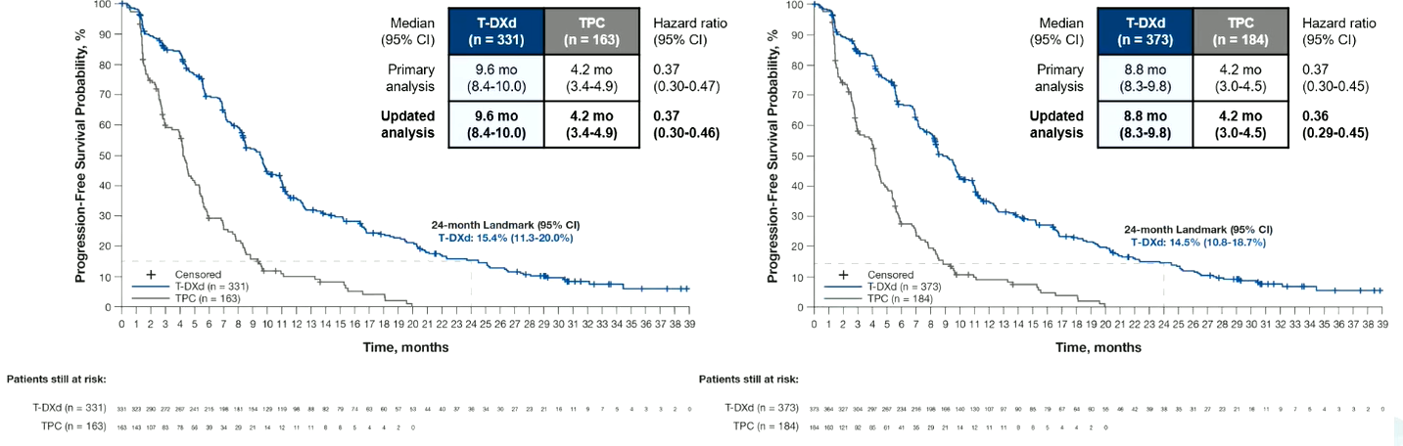
DESTINY-Breast04: Updated PFS Analysis
Median of 2 prior lines of ET and 1 prior line of chemo
HR+ Cohort
All Patients
Notes:
Modi S, Jacot W, Iwata H, et al. Trastuzumab deruxtecan (T-DXd) versus treatment of physician’s choice (TPC) in patients (pts) with HER2-low unresectable and/or metastatic breast cancer (mBC): Updated survival results of the randomized, phase III DESTINY-Breast04 study. Abstract presented at: European Society for Medical Oncology Congress; Madrid, Spain; October 20-24, 2023. Abstract 376O.
Results from the 32-month median follow-up for DESTINY-Breast04 confirms the sustained clinically meaningful improvement in PFS for T-DXd vs TPC previously demonstrated in HER2-low mBC, regardless of HR status. We saw that T-DXd was associated with a significant improvement in PFS, going from around 4 to almost 10 months. This was true both in the HR+ population but also in the ITT population, which added in that triple-negative subgroup of patients.

Slide 32
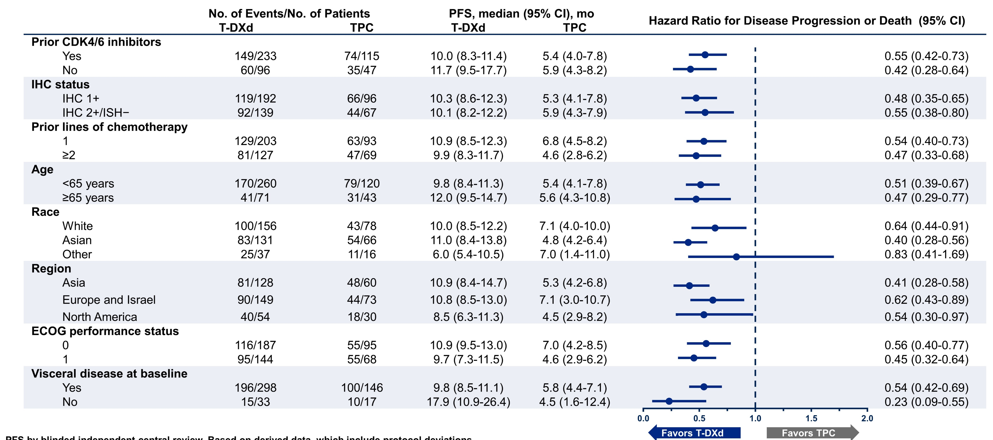
DESTINY-Breast04: Subgroup Analysis: PFS in HR+
Notes:
Modi S, Jacot W, Yamashita T, et al. Trastuzumab deruxtecan in previously treated HER2-low advanced breast cancer. N Engl J Med. 2022;387(1):9-20.
Subgroup analysis showed that the PFS benefit provided by T-DXd was observed in all HR+ patient groups.

Slide 33
DESTINY-Breast04: Confirmed Objective Response Rate
Hormone receptor-positive
Hormone receptor-negative
52.6%ª
50.0%
 |  | Complete Response
 |  | Partial Response
3.6
2.5
Percentage
49.2
16.3%
47.5
16.7%
0.6
5.6
15.7
11.1
T-DXd (n = 333)
TPC (n = 166)
T-DXd (n = 40)
TPC (n = 18)
Progressive disease, %
Not evaluable, %
Clinical benefit rate,^{b} %
Duration of response, months
7.8 | 21.1 | 12.5 | 33.3
4.2 | 12.7 | 7.5 | 5.6
71.2 | 34.3 | 62.5 | 27.8
10.7 | 6.8 | 8.6 | 4.9
Notes:
Modi S, Jacot W, Yamashita T, et al. Trastuzumab deruxtecan in previously treated HER2-low advanced breast cancer. N Engl J Med. 2022;387(1):9-20.
The percentage of patients with a confirmed objective response in the hormone receptor–positive cohort was 52.6% (95% CI, 47.0 to 58.0) in the trastuzumab deruxtecan group and 16.3% (95% CI, 11.0 to 22.8) in the physician’s choice group. The median duration of response was 10.7 months in the trastuzumab deruxtecan group and 6.8 months in the physician’s choice group. The percentage of patients with a confirmed objective response among all patients was 52.3% (95% CI, 47.1 to 57.4) in the trastuzumab deruxtecan group and 16.3% (95% CI, 11.3 to 22.5) in the physician’s choice group. The corresponding percentages in the hormone receptor–negative cohort were 50.0% (95% CI, 33.8 to 66.2) and 16.7% (95% CI, 3.6 to 41.4).

Slide 34
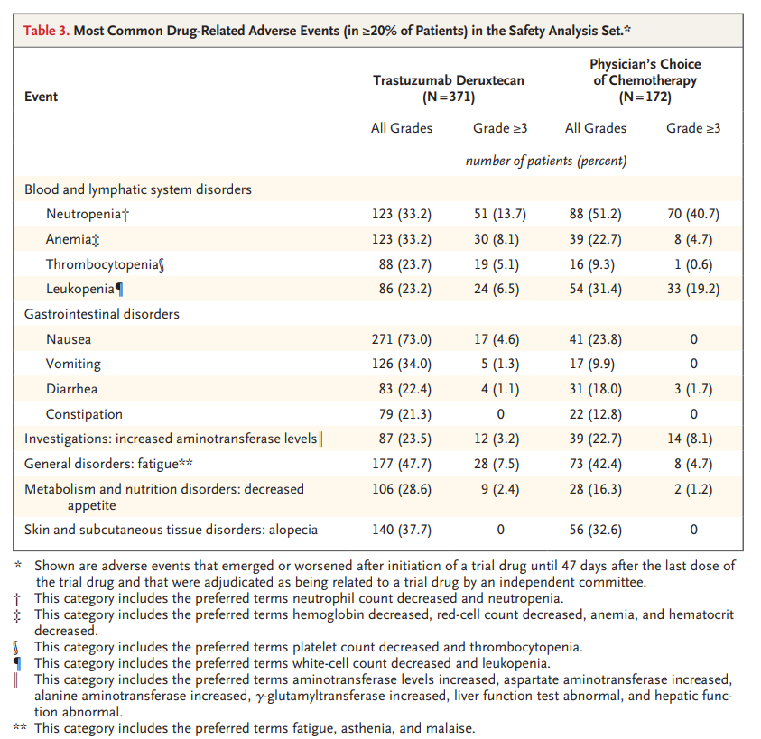
DESTINY-Breast04: Safety
Most Common Drug-Related Adverse Events
(in ≥20% of Patients) in the Safety Analysis Set
Grade ≥3 AEs occurred in 52.6% of patients receiving T-DXd vs. 67.4% physician’s choice of chemotherapy
ILD/pneumonitis occurred in 12.1% of patient receiving T-DXd (0.8% Grade 5)
LV dysfunction reported in 17 patients receiving T-DXd (4.6%)
  Grade 3 events reported in 1.5% of patients
Notes:
Modi S, Jacot W, Yamashita T, et al. Trastuzumab deruxtecan in previously treated HER2-low advanced breast cancer. N Engl J Med. 2022;387(1):9-20.
Adverse events of grade 3 or higher occurred in 52.6% of the patients who received trastuzumab deruxtecan and 67.4% of those who received the physician's choice of chemotherapy. Adjudicated, drug-related interstitial lung disease or pneumonitis occurred in 12.1% of the patients who received trastuzumab deruxtecan; 0.8% had grade 5 events.

Slide 35
DESTINY-Breast06: Study Design
DESTINY-Breast06: a phase 3, randomized, multicenter, open-label study (NCT04494425)
PATIENT POPULATION
HR+ mBC
HER2-low (IHC 1+ or IHC 2+/ISH−) or HER2-ultralow (IHC 0 with membrane staining)*
Chemotherapy naïve in the mBC setting
Prior lines of therapy
≥2 lines of ET ± targeted therapy for mBC
OR
1 line for mBC AND
Progression ≤6 months of starting first-line ET + CDK4/6i
OR
Recurrence ≤24 months of starting adjuvant ET
ENDPOINTS
Primary
PFS (BICR) in HER2-low
Key secondary
PFS (BICR) in ITT (HER2-low + ultralow)
OS in HER2-low
OS in ITT (HER2-low + ultralow)
T-DXd
5.4 mg/kg Q3W
(n=436)
R
1:1
HER2-low = 713
HER2-ultralow = 153†
TPC
(n=430)
Other secondary
PFS (INV) in HER2-low
ORR (BICR/INV) and DOR (BICR/INV) in HER2-low and ITT (HER2-low + ultralow)
Safety and tolerability
Patient-reported outcomes‡
Options:
capecitabine,
nab-paclitaxel,
paclitaxel
Stratification factors
Prior CDK4/6i use (yes vs no)
HER2 expression (IHC 1+ vs IHC 2+/ISH− vs IHC 0 with membrane staining)
Prior taxane in the non-metastatic setting (yes vs no)
Notes:
Study of trastuzumab deruxtecan (T-DXd) vs investigator’s choice chemotherapy in HER2-low, hormone receptor positive, metastatic breast cancer (DB-06). ClinicalTrials.gov identifier: NCT04494425. Updated July 12, 2024. https://clinicaltrials.gov/study/NCT04494425
Curigliano G, Hu X, Dent RA, et al. Trastuzumab deruxtecan (T-DXd) vs physician’s choice of chemotherapy (TPC) in patients (pts) with hormone receptor-positive (HR+), human epidermal growth factor receptor 2 (HER2)-low or HER2-ultralow metastatic breast cancer (mBC) with prior endocrine therapy (ET): Primary results from DESTINY-Breast06 (DB-06). Abstract presented at: American Society of Clinical Oncology Annual Meeting; Chicago, Illinois; May 31-June 4, 2024. Abstract LBA1000.
Bardia A, Hu X, Dent R, et al. Trastuzumab deruxtecan after endocrine therapy in metastatic breast cancer. N Engl J Med. 2024;391(22):2110-2122.
DESTINY-Breast06 looked to answer this question. It took patients who had progressed on endocrine therapy in the metastatic setting, either one or two lines of endocrine treatment, but had not received any chemotherapy , and randomized them to get T-DXd or treatment of physician’s choice chemotherapy. And a study was primarily designed to assess PFS in HER2-low disease but also included an exploratory group of 150 patients who had HER2-ultralow disease that were included in a secondary analysis with ITT.

Slide 36
PFS (BICR) in HER2-Low: Primary Endpoint
Median of 2 prior lines of ET, 90% with prior CDK4/6i, no prior chemo,
85% had visceral disease, 70% relapsed
1.0
Hazard ratio 0.62
95% CI 0.51–0.74
P < 0.001
0.8
T-DXd
mPFS: 13.2 mo
0.6
Probability of PFS
0.4
TPC
mPFS: 8.1 mo
Δ 5.1 mo
0.2
0
0
3
6
9
12
15
18
21
24
27
30
33
36
39
Time from randomization (months)
No. at risk
T-DXd
359
310
265
213
163
131
72
49
28
17
10
6
1
0
354
254
192
118
85
65
37
19
10
6
2
1
1
TPC
0
Notes:
Curigliano G, Hu X, Dent RA, et al. Trastuzumab deruxtecan (T-DXd) vs physician’s choice of chemotherapy (TPC) in patients (pts) with hormone receptor-positive (HR+), human epidermal growth factor receptor 2 (HER2)-low or HER2-ultralow metastatic breast cancer (mBC) with prior endocrine therapy (ET): Primary results from DESTINY-Breast06 (DB-06). Abstract presented at: American Society of Clinical Oncology Annual Meeting; Chicago, Illinois; May 31-June 4, 2024. Abstract LBA1000.
Bardia A, Hu X, Dent R, et al. Trastuzumab deruxtecan after endocrine therapy in metastatic breast cancer. N Engl J Med. 2024;391(22):2110-2122.
When you looked at PFS in a HER2-low group, you saw a significant improvement going from 8 to 13 months. So, really suggesting that T-DXd’s outperforming either capecitabine or taxane-based therapy as a first chemotherapy in metastatic hormone receptor-positive breast cancer.

Slide 37
PFS and OS in HER2-Ultralow: Prespecified Exploratory Analyses
PFS (BICR)
n=152
OS*
n=152
1.0
Hazard ratio 0.78
95% CI 0.50–1.21
1.0
Hazard ratio 0.75
95% CI 0.43–1.29
84.0%, T-DXd
0.8
0.8
TPC, 78.7%
T-DXd
mPFS: 13.2 mo
0.6
0.6
Probability of PFS
Probability of OS
0.4
TPC
mPFS: 8.3 mo
0.4
0.2
Δ 4.9 mo
0.2
12-month OS rate
0
0
0
3
6
9
12
15
18
21
24
27
30
0
3
6
9
12
15
21
24
24
27
30
33
36
39
Time from randomization (months)
Time from randomization (months)
No. at risk
76
64
53
44
35
24
9
6
3
3
0
T-DXd
76
76
70
66
63
49
36
28
23
15
6
0
0
0
TPC
76
52
32
24
18
14
7
6
3
1
0
76
69
68
62
55
45
25
17
15
9
4
3
1
0
PFS improvement with T-DXd vs TPC in HER2-ultralow was consistent with results in HER2-low
Notes:
Curigliano G, Hu X, Dent RA, et al. Trastuzumab deruxtecan (T-DXd) vs physician’s choice of chemotherapy (TPC) in patients (pts) with hormone receptor-positive (HR+), human epidermal growth factor receptor 2 (HER2)-low or HER2-ultralow metastatic breast cancer (mBC) with prior endocrine therapy (ET): Primary results from DESTINY-Breast06 (DB-06). Abstract presented at: American Society of Clinical Oncology Annual Meeting; Chicago, Illinois; May 31-June 4, 2024. Abstract LBA1000.
Bardia A, Hu X, Dent R, et al. Trastuzumab deruxtecan after endocrine therapy in metastatic breast cancer. N Engl J Med. 2024;391(22):2110-2122.
When looking at the ultralow patients, again, remember this is a small subset, it’s only about 150 patients, and it was an exploratory endpoint, but you can see that the PFS looks really identical to the HER2-low population where, again, the PFS improved from about 8 to 13 months with a hazard ratio in this case that was around 0.8.

Slide 38
OS in HER2-Low and ITT: Key Secondary Endpoints (~40% Maturity)
HER2-low*
n=713
ITT (HER2-low + HER2-ultralow)
N=866
1.0
1.0
87.6%, T-DXd
Hazard ratio 0.83
95% CI 0.66–1.05
P=0.1181†
87.0%, T-DXd
Hazard ratio 0.81
95% CI 0.65–1.00‡
0.8
TPC, 81.7%
0.8
TPC, 81.1%
0.6
0.6
Probability of OS
Probability of OS
0.4
0.4
0.2
0.2
12-month OS rate
12-month OS rate
0
0
0
3
6
9
12
15
18
21
24
27
30
33
36
39
42
45
0
3
6
9
12
15
18
21
24
27
30
33
36
39
42
45
Time from randomization (months)
Time from randomization (months)
No. at risk
T-DXd
359
354
341
324
309
279
198
140
96
53
32
16
7
2
0
0
436
431
412
391
373
329
235
169
120
69
39
16
7
2
0
0
354
TPC
333
319
298
273
247
185
126
86
53
23
6
2
1
1
0
430
402
387
360
328
292
210
143
101
62
27
9
3
1
1
0
20.1% of patients in the TPC group received T-DXd
post treatment discontinuation (HER2-low)
17.9% of patients in the TPC group received T-DXd
post treatment discontinuation (ITT)
Notes:
Curigliano G, Hu X, Dent RA, et al. Trastuzumab deruxtecan (T-DXd) vs physician’s choice of chemotherapy (TPC) in patients (pts) with hormone receptor-positive (HR+), human epidermal growth factor receptor 2 (HER2)-low or HER2-ultralow metastatic breast cancer (mBC) with prior endocrine therapy (ET): Primary results from DESTINY-Breast06 (DB-06). Abstract presented at: American Society of Clinical Oncology Annual Meeting; Chicago, Illinois; May 31-June 4, 2024. Abstract LBA1000.
Bardia A, Hu X, Dent R, et al. Trastuzumab deruxtecan after endocrine therapy in metastatic breast cancer. N Engl J Med. 2024;391(22):2110-2122.
The overall survival data is still immature, and while numerically there is a trend towards T-DXd having a better OS, it is still not yet statistically significant with a hazard ratio of 0.83. So, these data from DESTINY-Breast06 really established T-DXd as a first-line chemotherapy option for patients with hormone receptor-positive HER2-low disease and potentially suggests also, this could be an option for those patients who have HER2-ultralow breast cancer as well.

Slide 39
Adverse Events of Special Interest
Adjudicated as drug-related interstitial lung disease / pneumonitis
n (%) | Grade 1 | Grade 2 | Grade 3 | Grade 4 | Grade 5 | Any grade
T-DXd (n=434) | 7 (1.6) | 36 (8.3) | 3 (0.7) | 0 | 3 (0.7) | 49 (11.3)
TPC (n=417) | 0 | 1 (0.2) | 0 | 0 | 0 | 1 (0.2)
Left ventricular dysfunction
n (%) | Grade 1 | Grade 2 | Grade 3 | Grade 4 | Grade 5 | Any grade
Ejection fraction decreased
T-DXd (n=434) | 1 (0.2) | 31 (7.1) | 3 (0.7) | 0 | 0 | 35 (8.1)
TPC (n=417) | 0 | 11 (2.6) | 1 (0.2) | 0 | 0 | 16 (3.8)
Cardiac failure
T-DXd (n=434) | 0 | 0 | 0 | 0 | 0 | 0
TPC (n=417) | 0 | 1 (0.2) | 1 (0.2) | 1 (0.2) | 0 | 3 (0.7)
On January 27, 2025, T-DXd was approved by the FDA for patients with HR+, HER2-low or HER2-ultralow MBC who have progressed on ≥1 line of endocrine therapy.
Notes:
Curigliano G, Hu X, Dent RA, et al. Trastuzumab deruxtecan (T-DXd) vs physician’s choice of chemotherapy (TPC) in patients (pts) with hormone receptor-positive (HR+), human epidermal growth factor receptor 2 (HER2)-low or HER2-ultralow metastatic breast cancer (mBC) with prior endocrine therapy (ET): Primary results from DESTINY-Breast06 (DB-06). Abstract presented at: American Society of Clinical Oncology Annual Meeting; Chicago, Illinois; May 31-June 4, 2024. Abstract LBA1000.
Bardia A, Hu X, Dent R, et al. Trastuzumab deruxtecan after endocrine therapy in metastatic breast cancer. N Engl J Med. 2024;391(22):2110-2122.
Adjudicated interstitial lung disease/pneumonitis occurred in 49 (11.3%; 0.7% Grade 3/4, 0.7% Grade 5) vs 1 (0.2% Grade 2) pts receiving T-DXd vs TPC.

Slide 40
Sacituzumab Govitecan
Humanized Anti-TROP2 Antibody
Targets TROP2, an antigen expressed in
many epithelial cancers
Antibody type: hRS7 IgG1κ
SN-38 Payload (Topoisomerase I Inhibitor)
Delivers up to 136-fold more SN-38 to tumors than parent compound irinotecan
Unique chemistry improves solubility, selectively delivers
SN-38 to tumor
Linker for SN-38
High drug-to-antibody ratio (7.6:1)
pH-sensitive linker
for rapid release of payload at or inside tumor
HO
N
O
N
O
O
O
]
H
H
O
O
[
O
N
O
Lys-N
CH₂O
SN-38
7
O
O
N
N
N
O
H
O
N
N
S
Anti–TROP2 mAb
O
Bystander effect: In acidic tumor microenvironment,
SN-38 is released from anti-TROP2 antibody, diffuses into neighboring cells
Notes:
Goldenberg DM, Sharkey RM. Antibody-drug conjugates targeting TROP-2 and incorporating SN-38: A case study of anti-TROP-2 sacituzumab govitecan. MAbs. 2019;11(6):987-995.
Goldenberg DM, Cardillo TM, Govindan SV, Rossi EA, Sharkey RM. Trop-2 is a novel target for solid cancer therapy with sacituzumab govitecan (IMMU-132), an antibody-drug conjugate (ADC). Oncotarget. 2015;6(26):22496-22512.
TRODELVY (sacituzumab govitecan-hziy). Prescribing information. Gilead Sciences; 2023.
Kopp A, Hofsess S, Cardillo TM, Govindan SV, Donnell J, Thurber GM. antibody-drug conjugate sacituzumab govitecan drives efficient tissue penetration and rapid intracellular drug release. Mol Cancer Ther. 2023;22(1):102-111.
Sacituzumab govitecan is a humanized anti-TROP2 antibody with a topoisomerase I inhibitor payload. It has high drug-to-antibody ration and a pH-sensitive linker for rapid release of payload at or inside tumor cells.

Slide 41
TROPiCS-02 Phase 3 trial: Expanding the Benefit of Sacituzumab Govitecan to HR+ Disease
Notes:
Tolaney SM, Bardia A, Marmé F, et al. Final overall survival (OS) analysis from the phase 3 TROPiCS-02 study of sacituzumab govitecan (SG) in patients (pts) with hormone receptor–positive/HER2-negative (HR+/HER2–) metastatic breast cancer (mBC). Abstract Presented at: American Society of Clinical Oncology Annual Meeting; Chicago, Illinois; June 2-6, 2023. Abstract 1003.
The TROPiCS-02 study looked at patients who had 2 to 4 prior lines of chemotherapy for metastatic hormone receptor-positive disease and randomized them to get sacituzumab or treatment of physician’s choice chemotherapy. Eligible patients with HR+/HER2– mBC who received prior taxane, ET, CDK4/6 inhibitor, and 2-4 prior lines of CT were randomly assigned 1:1 to receive SG (10 mg/kg IV d1 and 8, every 21 d) or TPC until disease progression or unacceptable toxicity. The primary endpoint was progression-free survival by blinded independent central review per RECIST v1.1. Key secondary endpoints included OS and safety.

Slide 42
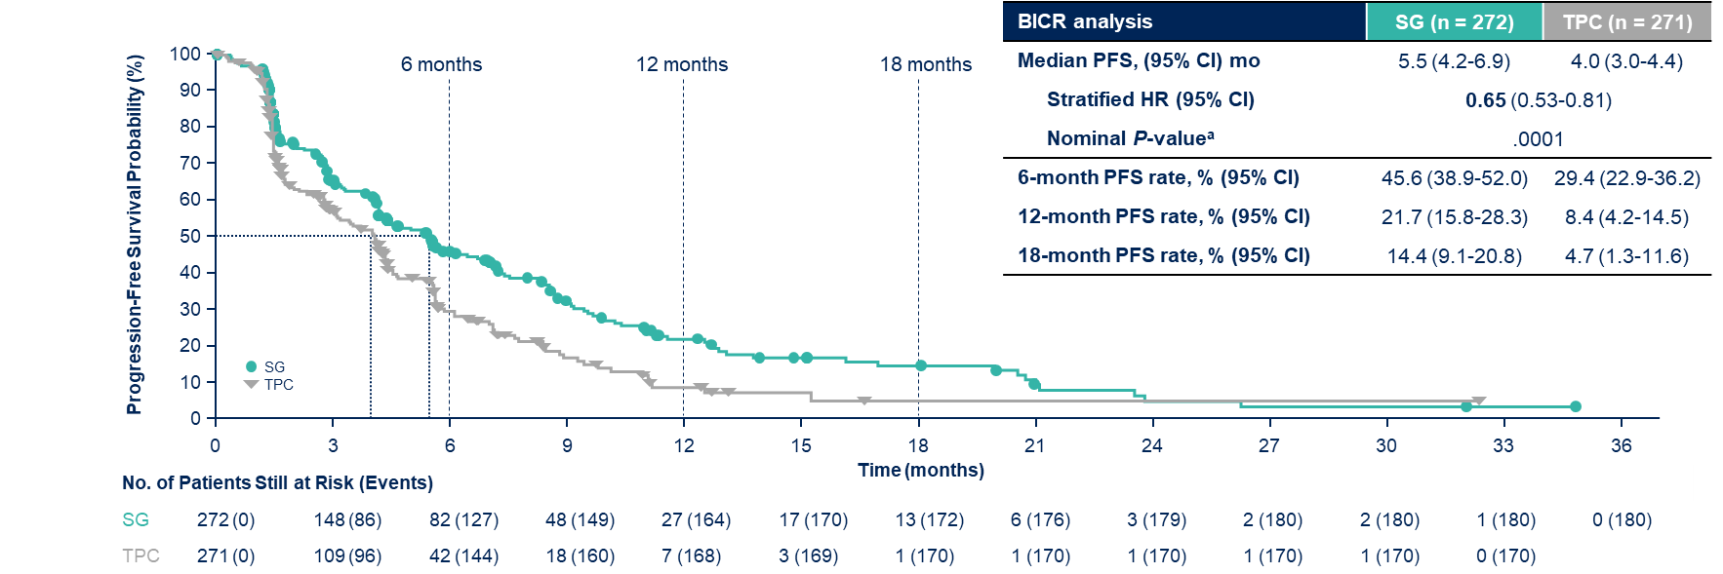
TROPiCS-02: PFS
Median of 3 prior lines of chemotherapy, 100% had received prior CDK4/6 inhibitors, 95% had visceral disease
BICR, blinded independent central review; CDK, cyclin-dependent kinase; HR, hazard ratio; PFS, progression-free survival; SG, sacituzumab govitecan; TPC, treatment of physician’s choice.
Tolaney SM, et al. ASCO 2023. Abstract 1003. Rugo HS, et al. Lancet. 2023;402(10411):1423-1433.
Notes:
Tolaney SM, Bardia A, Marmé F, et al. Final overall survival (OS) analysis from the phase 3 TROPiCS-02 study of sacituzumab govitecan (SG) in patients (pts) with hormone receptor–positive/HER2-negative (HR+/HER2–) metastatic breast cancer (mBC). Abstract Presented at: American Society of Clinical Oncology Annual Meeting; Chicago, Illinois; June 2-6, 2023. Abstract 1003.
Rugo HS, Bardia A, Marmé F, et al. Overall survival with sacituzumab govitecan in hormone receptor-positive and human epidermal growth factor receptor 2-negative metastatic breast cancer (TROPiCS-02): a randomised, open-label, multicentre, phase 3 trial. Lancet. 2023;402(10411):1423-1433.
Sacituzumab govitecan was associated with a significant improvement in progression-free survival with a hazard ratio of 0.65 (median: 5.5 months vs 4.0 months; P = .0001).

Slide 43
TROPiCS-02: OS
Median of 3 prior lines of chemo
SG continued to demonstrate improvement in OS vs TPC at longer follow-up, with 21% reduction in risk of death and a higher proportion of patients remaining alive at each landmark
Notes:
Tolaney SM, Bardia A, Marmé F, et al. Final overall survival (OS) analysis from the phase 3 TROPiCS-02 study of sacituzumab govitecan (SG) in patients (pts) with hormone receptor–positive/HER2-negative (HR+/HER2–) metastatic breast cancer (mBC). Abstract Presented at: American Society of Clinical Oncology Annual Meeting; Chicago, Illinois; June 2-6, 2023. Abstract 1003.
Rugo HS, Bardia A, Marmé F, et al. Overall survival with sacituzumab govitecan in hormone receptor-positive and human epidermal growth factor receptor 2-negative metastatic breast cancer (TROPiCS-02): a randomised, open-label, multicentre, phase 3 trial. Lancet. 2023;402(10411):1423-1433.
Sacituzumab govitecan was also associated with a significant improvement in overall survival with a hazard ratio of 0.79 (median: 14.5 months vs 11.2 months; P = .01). The final OS analysis of the TROPiCS-02 study confirms the clinically meaningful OS benefit of SG over single-agent CT in pts with pretreated, endocrine-resistant HR+/HER2–mBC. This improvement was independent of HER2-low status. This analysis reinforces SG as an effective and safe treatment for this pt population with limited treatment options.

Slide 44
TROPiCS-02: Safety
Drug-Related TEAEs in ≥20% of Patients¹
TEAEs Associated With/Leading to²:
SG
n = 268
TPC
n = 249
n (%) | SG (n = 268) | TPC (n = 249)
Treatment discontinuation | 17 (6) | 11 (4)
Dose reductions | 90 (34) | 82 (33)
Treatment-related death§ | 1 (<1) | 0
Neutropenia†
Anaemia‡
Diarrhea
Nausea
Alopecia
Fatigue
Asthenia
SG, all grades
TPC, all grades
No events of ILD in the SG arm (vs 1% in the TPC arm)¹
No TRAEs of cardiac failure or left ventricular dysfunction in either arm^{1,2}
SG, grade ≥3
TPC, grade ≥3
Patients (%)
Neutropenia and diarrhea were the most common TRAEs*
Notes:
1. Rugo HS, Bardia A, Marmé F, et al. Sacituzumab govitecan in hormone receptor-positive/human epidermal growth factor receptor 2-negative metastatic breast cancer. J Clin Oncol. 2022;40(29):3365-3376.
2. Rugo HS, Bardia A, Marmé F, et al. Overall survival with sacituzumab govitecan in hormone receptor-positive and human epidermal growth factor receptor 2-negative metastatic breast cancer (TROPiCS-02): a randomised, open-label, multicentre, phase 3 trial. Lancet. 2023;402(10411):1423-1433.
Key grade ≥3 treatment-related adverse events (SG v chemotherapy) were neutropenia (51% v 38%) and diarrhea (9% v 1%). The safety profile of sacituzumab govitecan was consistent with previous studies (including the TROPiCS-02 primary analysis and the ASCENT trial). One fatal adverse event (septic shock caused by neutropenic colitis) was determined to be related to sacituzumab govitecan treatment.

Slide 45
TROPION-Breast01 Phase 3 Trial
On January 17, 2025, Dato-DXd was approved by the FDA for patients with HR+/HER2- MBC who have received prior endocrine therapy and chemotherapy.
Notes:
Bardia A, Jhaveri K, Im S, et al. Datopotamab deruxtecan (Dato-DXd) vs chemotherapy in previously-treated inoperable or metastatic hormone receptor-positive, HER2-negative (HR+/HER2–) breast cancer (BC): Primary results from the randomised phase III TROPION-Breast01 trial. Abstract presented at: European Society for Medical Oncology Congress; Madrid, Spain; October 20-24, 2023. Abstract LBA11.
Bardia A, Jhaveri K, Im S, et al. Datopotamab deruxtecan versus chemotherapy in previously treated inoperable/metastatic hormone receptor–positive human epidermal growth factor receptor 2–negative breast cancer: primary results from TROPION-Breast01. J Clin Oncol. 2025;43(3):285-296.
TROPION-Breast01 met the co-primary endpoint of PFS. Pts receiving Dato-DXd had statistically significant and clinically meaningful improvement in PFS compared with ICC, along with a favorable and manageable safety profile. Results support Dato-DXd as a novel treatment option for pts with inoperable or metastatic HR+/HER2-BC who have received 1–2 prior lines of CT.

Slide 46
Sequencing Strategies in HR+ Metastatic Breast Cancer:
Leveraging ADCs Across the
HER2 Continuum

Slide 47
Treatment Sequencing in HR+ and HER2-Low or HER2-Ultralow MBC With No Germline BRCA1/2 Mutation
Exhaust endocrine treatment strategies
HR+ and HER2-low
or HER2-ultralow
MBC
Second line
T-DXd or SG or Dato-DXd or chemo
First line
T-DXd or chemo
1L T-DXd preferred for patients with:
  Symptomatic disease
  Extensive visceral disease burden
  Short PFS on AI+CDK4/6i
Notes:
I typically will think about treating patients who have HER2-ultralow or low metastatic hormone receptor-positive breast cancer with T-DXd either as their first chemotherapy based on the DESTINY-Breast06 results or as their second chemotherapy. And I make that decision about whether to use it first or second based on clinical characteristics.
And that does take into account understanding if they’ve had symptomatic disease, in which case maybe you want to turn to T-DXd given the higher response rate. Someone who has extensive visceral involvement. Someone who may be rapidly progressed through upfront AI/CDK in less than 6 months. For someone who had rapid recurrence on adjuvant endocrine therapy and then blew through their first lines of endocrine treatment quite quickly. Those are patients that I think have quite aggressive disease, and those are patients for whom I would really think about T-DXd as the first chemotherapy option for that patient.

Slide 48
Landscape of ADCs in HER2-Negative MBC: ASCO 2024
Notes:
Garrido-Castro A, Zakon DB, Jin Q, et al. Clinical outcomes in early-stage TNBC according to HER2-low status. Abstract presented at: San Antonio Breast Cancer Symposium; San Antonio, TX; December 5-9, 2023. Abstract PO3-03-05.
Curigliano G, Hu X, Dent RA, et al. Trastuzumab deruxtecan (T-DXd) vs physician’s choice of chemotherapy (TPC) in patients (pts) with hormone receptor-positive (HR+), human epidermal growth factor receptor 2 (HER2)-low or HER2-ultralow metastatic breast cancer (mBC) with prior endocrine therapy (ET): Primary results from DESTINY-Breast06 (DB-06). Abstract presented at: American Society of Clinical Oncology Annual Meeting; Chicago, Illinois; May 31-June 4, 2024. Abstract LBA1000.
Bardia A, Hu X, Dent R, et al. Trastuzumab deruxtecan after endocrine therapy in metastatic breast cancer. N Engl J Med. 2024;391(22):2110-2122.
Modi S, Jacot W, Iwata H, et al. Trastuzumab deruxtecan (T-DXd) versus treatment of physician’s choice (TPC) in patients (pts) with HER2-low unresectable and/or metastatic breast cancer (mBC): Updated survival results of the randomized, phase III DESTINY-Breast04 study. Abstract presented at: European Society for Medical Oncology Congress; Madrid, Spain; October 20-24, 2023. Abstract 376O.
Bardia A, Jhaveri K, Im S, et al. Datopotamab deruxtecan versus chemotherapy in previously treated inoperable/metastatic hormone receptor–positive human epidermal growth factor receptor 2–negative breast cancer: primary results from TROPION-Breast01. J Clin Oncol. 2025;43(3):285-296.
Rugo HS, Bardia A, Marmé F, et al. Overall survival with sacituzumab govitecan in hormone receptor-positive and human epidermal growth factor receptor 2-negative metastatic breast cancer (TROPiCS-02): a randomised, open-label, multicentre, phase 3 trial. Lancet. 2023;402(10411):1423-1433.
Tolaney SM, Bardia A, Marmé F, et al. Final overall survival (OS) analysis from the phase 3 TROPiCS-02 study of sacituzumab govitecan (SG) in patients (pts) with hormone receptor–positive/HER2-negative (HR+/HER2–) metastatic breast cancer (mBC). Abstract Presented at: American Society of Clinical Oncology Annual Meeting; Chicago, Illinois; June 2-6, 2023. Abstract 1003.
Bardia A, Hurvitz SA, Tolaney SM, et al. Sacituzumab govitecan in metastatic triple-negative breast cancer. N Engl J Med. 2021;384(16):1529-1541.
And so, again, just to put this into framework for all of our options for hormone receptor-positive disease, we do have T-DXd also as a second-line option. Obviously, we saw that in DESTINY-Breast04, and we don’t yet know if it matters if you give T-DXd first or second because we don’t yet have mature overall survival data from DESTINY-Breast 06. And there are going to be lots of patients who cross over from the control arm in DB06 to get T-DXd. And so this could help us understand if it matters giving T-DXd earlier versus later. But for now, again, I would prioritize it for people with more aggressive disease. And then remember sacituzumab govitecan could be used subsequently to T-DXd, or if someone does not have any HER2 expression should be the first ADC that that patient receives based on TROPiCS-02.

Slide 49
Treatment Algorithm for HR+/HER2- MBC
1L
AI or fulvestrant + CDK4/6 inhibitor
PI3K and ESR1 wild-type
ESR1 mut
PI3K pathway altered
2L
AI or fulvestrant ± everolimus
AI or fulvestrant ± abemaciclib
Elacestrant
(if CDK4/6i >12m)
Fulvestrant + capivasertib
AI or fulvestrant + alpelisib
(if PIK3CA mut)
AI or fulvestrant or tamoxifen
± targeted therapy
(if not previously received)
Elacestrant
(if ESR1m)
Olaparib or talazoparib
(if BRCAm)
T-DXd
(if HER2 IHC 0+, 1+, or 2+/ISH-)
Chemotherapy
(eg, capecitabine, paclitaxel)
3L
Chemotherapy (eg, capecitabine, paclitaxel, eribulin)
T-DXd
(if HER2 IHC 0+, 1+, or 2+/ISH-)
Dato-DXd
Sacituzumab govitecan
Biomarker positive*
(BRCAm, TMB-H, MSI-H/dMMR, NTRK fusion, RET fusion)
4L+
Notes:
So, to kind of just put this into perspective with an overall algorithm for metastatic hormone receptor-positive breast cancer, generally we treat with endocrine therapy and CDK4/6 upfront. Post that treatment, we usually get genomic information to understand optimal targeted therapy for the second-line setting, including trying to understand if they have ESR1 or PI3K pathway alterations to understand if they’re candidates for oral SERD or candidates for either AKT or PI3 kinase inhibition. And then post-endocrine therapy, we’re usually turning towards chemotherapy at either capecitabine, taxane, or T-DXd if they have some HER2 expression, and then moving on to subsequent chemotherapy or ADC with sacituzumab, but not to forget that it’s important to know if patients have germline BRCA alterations to think about PARP inhibition for them.

Slide 50
TBCRC-064: TReatment of ADC-Refractory Breast CancEr With Dato-DXd or T-DXd (TRADE-DXd)
Notes:
Understanding how these ADCs work in sequence is going to take us more prospective data. There is a trial called TRADE-DXd, which should be activating soon, which will be sequencing T-DXd and DATO-DXd either one first, then the other, or vice versa, and this will help us understand how these agents work one after the other.

Slide 51
Monitoring and Managing Adverse Events:
Navigating ADCs in
Breast Cancer Treatment

Slide 52
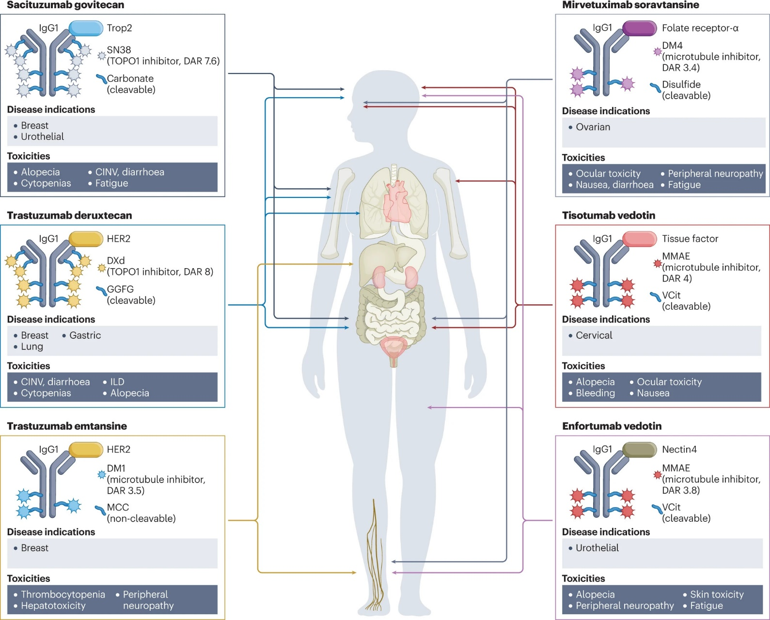
Toxicities of ADCs Can Resemble Their Chemotherapy Payload
Notes:
Tarantino P, Ricciuti B, Pradhan SM, et al. Optimizing the safety of antibody–drug conjugates for patients with solid tumours. Nat Rev Clin Oncol. 2023;20(8):558–576.
Considering the intended rationale behind the design of ADCs, which is to achieve targeted delivery of cytotoxic molecules by linking them to antibodies targeting tumour-specific antigens, ADCs would be expected to be less toxic than conventional chemotherapy. However, most ADCs are still burdened by off-target toxicities that resemble those of the cytotoxic payload as well as on-target toxicities and other poorly understood and potentially life-threatening adverse effects.

Slide 53
Management of ILD: The 5 “S” Rules
Notes:
Tarantino P, Tolaney SM. Detecting and Managing T-DXd-Related Interstitial Lung Disease: The Five "S" Rules. JCO Oncol Pract. 2023;19(8):526-527.
1. Screen: Careful patient selection is warranted before initiating T-DXd to optimize the monitoring strategies based on the baseline risk. Screening continues during treatment, with regular clinical assessments to exclude signs/symptoms of ILD.
2. Scan: The fundamental diagnostic tools for ILD remain radiological scans, with preference for high-resolution CT scans of the chest. A baseline scan is recommended, with repeat scans to be performed every 6-12 weeks.
3. Synergy: Minimizing the risk of ILD involves a teamwork, which includes educating patients and all the care team, as well as multidisciplinary management once ILD is suspected.
4. Suspend treatment: T-DXd should always be interrupted if ILD is suspected; it can only be restarted in the case of asymptomatic ILD that fully resolves.
5. Steroids: The mainstay for treating T-DXd–induced ILD remains corticosteroids, with the dose to be adapted to the toxicity grade.

Slide 54



Management Strategies for ILD/Pneumonitis With T-DXd
Monitoring¹
Confirm²
Dose Interruptions¹
Patients should be advised to report cough, dyspnea, fever, and/or any new or worsening respiratory symptoms immediately
Promptly investigate evidence of ILD
Evaluate patients with suspected ILD by radiographic imaging
Consider consultation with a pulmonologist
Evaluations may include:
High-resolution CT
Pulmonologist consultation
Blood culture and CBC
Consider bronchoscopy
PFTs and pulse oximetry
For Grade 1 (asymptomatic):
Interrupt dose until recovery (Grade 0)
For Grade ≥2 (symptomatic):
Permanently discontinue
Do not re-escalate the T-DXd dose after a dose reduction is made²
Resume Therapy
(Grade 1 only)¹
Corticosteroid Treatment¹
Initial dose reduction
4.4 mg/kg
If resolved in ≤28 days from date of onset:
Maintain dose
If resolved in >28 days from date of onset:
Reduce dose 1 level
For Grade 1 (asymptomatic):
Consider corticosteroid treatment as soon as ILD
is suspected
(eg, ≥0.5 mg/kg prednisolone or equivalent)
For Grade ≥2 (symptomatic):
Promptly initiate corticosteroid treatment as soon
as ILD/pneumonitis is suspected
(eg, ≥1 mg/kg prednisolone or equivalent)
Upon improvement, follow by gradual taper (eg, 4 weeks).
Final dose reduction
3.2 mg/kg
Requirement for
further dose reduction
Discontinue treatment
Notes:
Potential Management Strategies for ILD Monitor¹
Interrupt drug
Confirm²
Evaluations should include:
High-resolution CT
Pulmonologist consultation (infectious disease consultation as clinically indicated)
Blood culture and CBC; other blood tests could be considered as needed
Consider bronchoscopy and bronchoalveolar lavage, if clinically indicated and feasible
PFTs and pulse oximetry
Arterial blood gasses, if clinically indicated
One blood sample collection for PK analysis, as soon as ILD is suspected, if feasible
Dose Interruptions and Modification¹
Drug must be interrupted for any ILD events regardless of grade
Grade 1: ENHERTU can be restarted only if the event is fully resolved:
If resolved in ≤28 days from day of onset, maintain dose
If resolved in >28 days from day of onset, reduce dose by 1 level
Grade ≥2: Permanently discontinue patient from ENHERTU treatment
Do not re-escalate the ENHERTU dose after a dose reduction is made¹
References
ENHERTU (fam-trastuzumab deruxtecan-nxki). Prescribing information. Daiichi Sankyo, Inc.; 2024.
Meyer KC. Diagnosis and management of interstitial lung disease. Transl Respir Med. 2014;2:4.

Slide 55
Managing Nausea With T-DXd
With T-DXd, consider 3 drug prophylaxis:
  Dexamethasone
  5HT3 receptor antagonist (ondansetron)
  NK1 receptor antagonist (aprepitant)
For delayed nausea:
  Ondansetron prn
  or
  Olanzapine prn
Notes:
Stankowicz M, Mauro L, Harnden K, Pennisi A. Management of Chemotherapy-Induced Nausea and Vomiting with Trastuzumab Deruxtecan: A Case Series. Breast Care (Basel). 2021;16(4):408-411.
Management of CINV for patients receiving trastuzumab deruxtecan should follow recommendations for regimens with a high-risk emetic potential.

Slide 56
Management of LV Dysfunction With T-DXd
LV Dysfunction Severity | Treatment Approach
LVEF >45%, absolute decrease from baseline 10-20% | Continue T-DXd
LVEF 40-45%, absolute decrease from baseline <10% | Continue T-DXd Repeat LVEF assessment within 3 weeks
LVEF 40-45%, absolute decrease from baseline 10-20% | Interrupt T-DXd Repeat LVEF assessment within 3 weeks If LVEF has not recovered to within 10% from baseline, permanently discontinue T-DXd If LVEF recovers to within 10% from baseline, resume T-DXd treatment at same dose
LVEF <40% or absolute decrease from baseline is >20% | Interrupt T-DXd Repeat LVEF assessment within 3 weeks If LVEF of <40% or absolute decrease from baseline of >20% is confirmed, permanently discontinue T-DXd
Symptomatic congestive heart failure | Permanently discontinue T-DXd
Notes:
ENHERTU (fam-trastuzumab deruxtecan-nxki). Prescribing information. Daiichi Sankyo, Inc.; 2024.
Follow recommendations in the prescribing information to manage LV dysfunction associated with T-DXd.

Slide 57
Adverse Events Associated With SG
Neutropenia and diarrhea were the most reported AEs associated with SG in TROPiCS-02 and ASCENT
  May be prevented and managed with guideline-established management protocols
  Treatment discontinuation due to AEs occurred in 6% of patients receiving SG in TROPiCS-02, 5% in ASCENT
Notes:
Rugo HS, Bardia A, Marmé F, et al. Sacituzumab govitecan in hormone receptor-positive/human epidermal growth factor receptor 2-negative metastatic breast cancer. J Clin Oncol. 2022;40(29):3365-3376.
Bardia A, Hurvitz SA, Tolaney SM, et al. Sacituzumab govitecan in metastatic triple-negative breast cancer. N Engl J Med. 2021;384(16):1529-1541.
In TROPiCS-02, key grade ≥3 treatment-related adverse events (SG vs chemotherapy) were neutropenia (51% vs 38%) and diarrhea (9% vs 1%). In ASCENT, the incidences of key treatment-related adverse events of grade 3 or higher were neutropenia (51% with sacituzumab govitecan and 33% with chemotherapy), leukopenia (10% and 5%), diarrhea (10% and <1%), anemia (8% and 5%), and febrile neutropenia (6% and 2%).

Slide 58
Potential Management Approaches for Neutropenia and Diarrhea With SG
Neutropenia
  Withhold SG for ANC < 1500/mm³ or neutropenic fever
  Monitor blood counts periodically during treatment
  Consider G-CSF for secondary prophylaxis
  Begin anti-infective treatment in patients with febrile neutropenia immediately
Diarrhea
  Monitor patients and give fluids/electrolytes as needed
  Evaluate for infectious causes and if negative, begin loperamide
  For severe diarrhea, withhold SG until diarrhea is ≤ grade 1 and reduce subsequent doses
Notes:
TRODELVY (sacituzumab govitecan-hziy). Prescribing information. Gilead Sciences; 2023.
Sacituzumab, on the other hand, does have a high risk of neutropenia, and so it is important to carefully monitor neutrophil counts in these patients. If someone does have neutropenia, we do hold the sacituzumab, and then, when improved, reinitiate therapy either with a dose reduction or with utilization of growth factor. There are some patients for whom you may think about prophylactic growth factor. For example, if someone had a required growth factor with their prior therapy or has very low baseline counts, that may be someone you want to use upfront growth factor support, but otherwise, they typically will use drug and only initiate growth factor as needed. For diarrhea, monitor patients, give fluids/electrolytes as needed, and evaluate for infectious causes and if negative, begin loperamide. For severe diarrhea, withhold SG until diarrhea is ≤ grade 1 and reduce subsequent doses.

Slide 59
Case-Based Learning Lab

Slide 60
Case Study Patient Presentation and History
Presentation
72-year-old female presented with 2-year history of neglected breast mass
Staging workup identified multiple abnormal-appearing axillary, supraclavicular, and mediastinal nodes along with bone metastases without evidence of impending fracture
Biopsy of breast mass: IDC, ER+/HER2 1+
Treated with AI + CDK4/6i and has a response for 13 mo
Then develops new liver metastases
Tumor is ESR1 and PI3K wild-type
Receives fulvestrant + everolimus, and progresses after 4 months
Medical History
Diabetes
Hypertension
Hyperlipidemia
Obesity
Baseline mild neuropathy
Social History
Works as a piano teacher
Family History
No family history

Slide 61
Case Study Clinical Course
CT scan identifies multiple new lung nodules, worsening bone lesions, and a new 2-cm lesion in the liver. LFTs are normal.

Slide 62
Case Study Audience Question
What would be the next step in management?
Eribulin
Capecitabine
Sacituzumab govitecan
Trastuzumab deruxtecan
Unsure
Notes:
Correct answer: d) Trastuzumab deruxtecan

Slide 63
Case Study Clinical Course
The patient started therapy with trastuzumab deruxtecan
3 months after starting, she develops cough
Imaging reveals bilateral ground glass changes
Work-up reveals no infectious etiology

Slide 64
Case Study Audience Question
What would be the next step in management?
Continue treatment with trastuzumab deruxtecan
Continue treatment with trastuzumab deruxtecan and start steroids
Dose reduce trastuzumab deruxtecan and continue therapy
Discontinue trastuzumab deruxtecan and start steroids
Hold therapy with trastuzumab deruxtecan
Notes:
Correct answer: d) Discontinue trastuzumab deruxtecan and start steroids

Slide 65
Key Takeaways
The definition of HER2
status in mBC is evolving
and HER2 heterogeneity is commonly observed
Antibody-drug conjugates have changed the treatment landscape for metastatic HR+/HER2-expressing mBC
We will need to better understand how to optimally select patients for ADC therapy, and in whom these agents can be effectively sequenced
Monitoring and managing adverse events associated with ADCs are critical to achieving optimal patient outcomes
Notes:
I think the definition of HER2 expression in metastatic breast cancer has clearly evolved, and now it’s really important to understand that we do need to know if someone has a little bit of HER2 expression. Before, we didn’t really think about this; if they weren’t HER2-positive, but now we’re going to even have to think about if they have HER2-ultralow expression. Important to remember that HER2 expression is dynamic. And so, you can re-biopsy and sometimes find that the patient actually has some expression, so do think about that over time.
And while we do have choices for ADCs now, with both T-DXd and sacituzumab, this is likely to going to get more complex as there will be likely more ADCs that come into this space, such as datopotamab deruxtecan, in which case sequencing will get even more complicated. And so, I think we really do need better prospective studies to help us understand how to optimally sequence these agents. And even, potentially more critically, how to manage toxicities is really very important for our patients, particularly with ILD risk for T-DXd. Really critical to be monitoring this carefully and to never re-expose someone who’s had symptomatic ILD to T-DXd, again, given the potential risks that can associated with this.

