Slide 1
Reframing First-Line and Subsequent Care in Advanced Urothelial Carcinoma: Clinical Implications of the Updated NCCN Guidelines

Slide 2
DISCLAIMER
This slide deck in its original and unaltered format is for educational purposes and is current as of June 2026. All materials contained herein reflect the views of the faculty, and not those of AXIS Medical Education, the CME provider, or the commercial supporter. Participants have an implied responsibility to use the newly acquired information to enhance patient outcomes and their own professional development. The information presented in this activity is not meant to serve as a guideline for patient management. Any procedures, medications, or other courses of diagnosis or treatment discussed or suggested in this activity should not be used by clinicians without evaluation of their patients’conditions and possible contraindications and/or dangers in use, review of any applicable manufacturer’s product information, and comparison with recommendations of other authorities.

Slide 3
DISCLOSURE OF UNLABELED USE
This activity may contain discussion of published and/or investigational uses of agents that are not indicated by the FDA. The planners of this activity do not recommend the use of any agent outside of the labeled indications.
The opinions expressed in the activity are those of the faculty and do not necessarily represent the views of the planners. Please refer to the official prescribing information for each product for discussion of approved indications, contraindications, and warnings.
USAGE RIGHTS
This slide deck is provided for educational purposes and individual slides may be
used for personal, non-commercial presentations only if the content and references
remain unchanged. No part of this slide deck may be published in print or
electronically as a promotional or certified educational activity without prior written
permission from AXIS. Additional terms may apply. See Terms of Service on
www.axismeded.com for details.

Slide 4
Learning Objectives
Upon completion of this activity, participants should be better able to:
Select optimal first-line and subsequent therapies for advanced urothelial (aUC) using the updated NCCN guidelines and patient-specific clinical factors
Recognize early signs of treatment-related adverse events to initiate appropriate management pathways based on toxicity type and grade in patients with aUC
Integrate multidisciplinary coordination strategies to align aUC treatment planning across oncology, urology, and supportive care teams
Apply shared decision-making principles to foster collaborative care planning aligned to evidence and updated NCCN algorithms for aUC

Slide 5
The Evolution of NCCN Guidelines: Updates and Clinical Relevance in Urothelial Cancer
The end of the “platinum eligibility” era

Slide 6
Cisplatin Eligibility Has Defined Frontline Therapy for Advanced Urothelial Cancer for Decades
Cisplatin Eligibility
Standard/Preferred Regimens
Gemcitabine and cisplatin (category 1)
or
DDMVAC with growth factor support (category 1)
Cisplatin eligible
NCCN Guidelines for Bladder Cancer (Version 2.2016)¹
First-line chemotherapy for locally advanced or metastatic disease
Cisplatin ineligible with poor kidney function or poor PS
Gemcitabine and carboplatin
Gemcitabine and cisplatin (category 1)
or
DDMVAC with growth factor support (category 1)
Cisplatin eligible
NCCN Guidelines for Bladder Cancer (Version 2.2022)²
First-line systemic therapy for locally advanced or metastatic disease
Gemcitabine and carboplatin
or
Atezolizumab or pembrolizumab
(only for patients whose tumors express PD-L1 or are platinum-ineligible regardless of PD-L1 expression)
Cisplatin ineligible
Notes:
For decades, we used cisplatin eligibility to define and determine treatment plan for patients with unresectable and advanced urothelial cancer. Now, this was a challenge, as the average age of patients who presented with urothelial cancer is 73 and it's a smoking-related disease. Factors such as impaired renal function, hearing loss, peripheral neuropathy, heart failure, and impaired functional status meant that about 1/2 of our patients coming to treatment in the frontline setting are ineligible for cisplatin. And this of course affected patient outcomes.

Slide 7
In 2024, for the First Time, EVP Became the Preferred Frontline Therapy, Regardless of Cisplatin Eligibility
Cisplatin Eligibility
Preferred Regimens
Other Recommended Regimens
Gemcitabine and cisplatin (category 1) followed by avelumab maintenance therapy (category 1)
or
Nivolumab, gemcitabine, and cisplatin (category 1) followed by nivolumab maintenance therapy (category 1)
Cisplatin eligible
Pembrolizumab and enfortumab vedotin (category 1)
NCCN Guidelines for Bladder Cancer (Version 3.2024)
First-line systemic therapy for locally advanced or metastatic disease
Cisplatin ineligible
Pembrolizumab and enfortumab vedotin (category 1)
Gemcitabine and carboplatin followed by avelumab maintenance therapy (category 1)
Notes:
In 2024, the Nectin-4 targeted antibody-drug conjugate enfortumab vedotin paired with pembrolizumab became the preferred frontline regimen for platinum eligible and ineligible patients.

Slide 8
The Current NCCN Guidelines Have Removed Cisplatin Eligibility as Criteria for Frontline Therapy
Preferred Regimens
Other Recommended Regimens
Cisplatin/gemcitabine (category 1) followed by avelumab maintenance therapy (category 1)
or
Cisplatin/gemcitabine + nivolumab (category 1) followed by nivolumab maintenance therapy (category 1)
or
DDMVAC with growth factor support (category 1) followed by avelumab maintenance therapy (category 1)
NCCN Guidelines for Bladder Cancer (Version 1.2026)
Pembrolizumab and enfortumab vedotin (category 1)
First-line systemic therapy for locally advanced or metastatic disease
Notes:
And because of the clinical activity of this regimen paired with relative tolerability, even in frail patients, the latest NCCN guidelines have eliminated the cisplatin eligibility decision-point in frontline decision-making.

Slide 9
First-Line Treatment Selection: Decision Making in a Unified Landscape
How did we move from the cisplatin eligibility era to the uniform frontline enfortumab vedotin/pembrolizumab era?

Slide 10
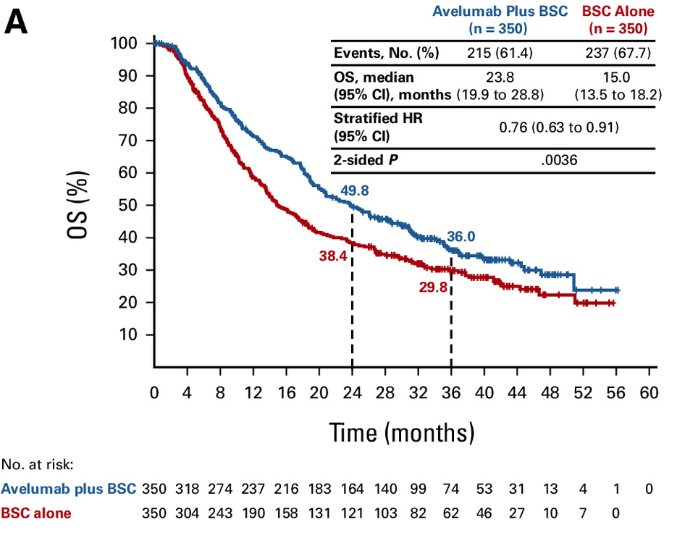
Phase 3 JAVELIN Bladder 100 Trial: Maintenance Avelumab in Patients With No Progression After First-Line Chemotherapy
Endpoints measured post randomization (after chemotherapy)
OS measured from the start of 1L chemotherapy
Unresectable locally
advanced or metastatic UC
CR, PR, or SD with standard
1L chemotherapy
(4-6 cycles)
Cisplatin + gemcitabine
or
Carboplatin + gemcitabine
Avelumab + BSC*
n=350
Primary endpoint
OS
Primary analysis populations
﻿﻿All randomized patients
﻿﻿PD-L1+ population
Secondary endpoints
﻿﻿PFS per RECIST 1.1
﻿﻿Safety
Interval
4-10 weeks
N=700
R
1:1
Until PD, unacceptable
toxicity, or withdrawal
BSC* alone
n=350
Stratification
﻿﻿Best response to IL chemotherapy (CR or PR vs SD)
﻿﻿Metastatic site when initiating 1 L chemotherapy (visceral vs nonvisceral)
Notes:
In the JAVELIN 100 trial, patients responding to frontline platinum therapy were randomized to maintenance avelumab versus best supportive care, leading to modest response and durable survival benefit in the avelumab treated group.

Slide 11
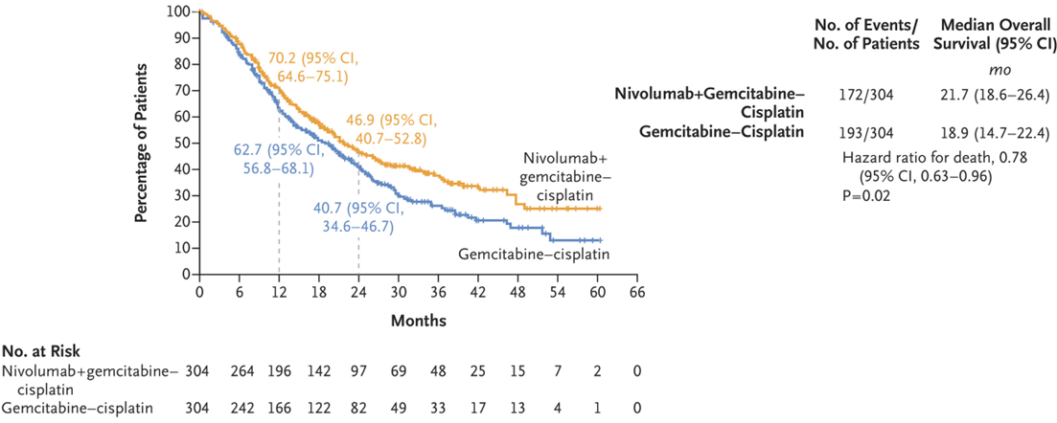
Phase 3 CheckMate 901 Trial: First-Line Cisplatin/Gemcitabine + Nivolumab Followed by Maintenance Nivolumab in Advanced UC
Key inclusion criteria
﻿﻿Age ≥18 years
﻿﻿Previously untreated unresectable or mUC involving the renal pelvis, ureter, bladder, or urethra
﻿﻿Cisplatin eligible
﻿﻿ECOG PS of 0-1
Tumor PD-L1 expression
(≥1% vs <1%)
Liver metastases
(yes vs no)
Combination phase
Monotherapy phase
NIVO 360 mg on D1
+ Gemcitabine 1000 mg/m² on D1/D8
+ Cisplatin 70 mg/m² on D1
Q3W (up to 6 cycles)
NIVO 480 mg Q4W
(until progression, unacceptable toxicity, withdrawal, or up to 24 months)
R
N = 304
Gemcitabine 1000 mg/m² on D1/D8
+ Cisplatin 70 mg/ m² on D1
Q3W (up to 6 cycles)
Primary endpoints: OS, PFS per BICR
Key secondary endpoints: OS and PFS by PD-L1 ≥1%, HRQoL
Key exploratory endpoints: ORR per BICR, safety
N = 304
Median (range) study follow-up, 33.6 (7.4-62.4) months
Notes:
Taking this one step further, platinum combined with checkpoint nivolumab in this study, followed by nivolumab maintenance, led to superior survival outcomes compared to chemotherapy alone in the frontline setting.

Slide 12
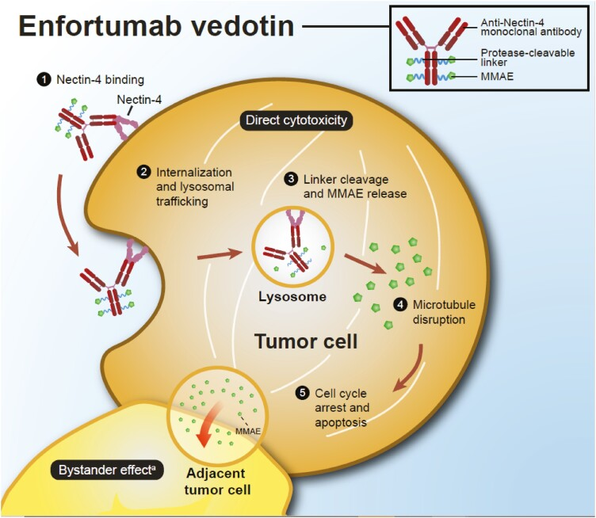
Enfortumab Vedotin (EV): The First ADC Approved in UC
Notes:
Enfortumab vedotin is an antibody-drug conjugate and the first approved for urothelial cancer. The chemotherapy attached to an antibody, I think of it like a heat-seeking missile. So instead of more conventional older types of chemotherapies with relatively even distribution throughout the body, antibody-drug conjugates are really essentially a targeted chemotherapy with the hope, and an idea that more of the drug will be delivered to the site of the cancer and then sparing normal tissues.

Slide 13
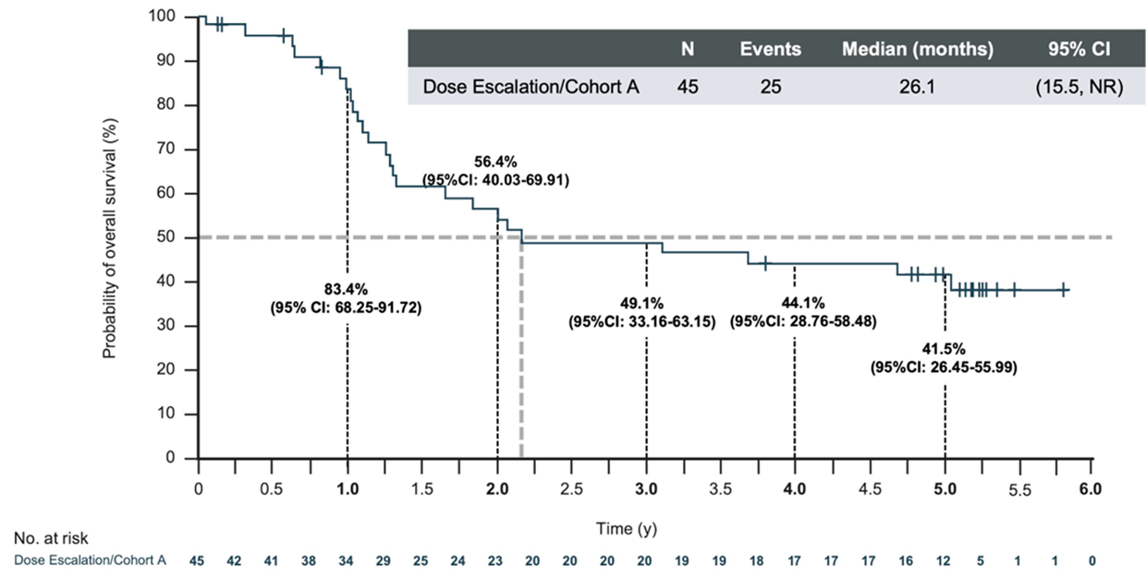
Phase 1/2 EV-103 Trial Cohort A: Frontline EVP in Cisplatin-Ineligible Patients With aUC
Patient
Population
Locally
Advanced
or
Metastatic
Urothelial
Carcinoma
Dose
Escalation
Enfortumab
vedotin +
Pembrolizumab
Cisplatin-ineligible
(n=5)
Dose Expansion
Cohort A
Enfortumab
vedotin +
Pembrolizumab
Cisplatin-ineligible
(n=40)
Dosing: Enfortumab vedotin on days 1 and 8 and pembrolizumab on day 1 of every 3-week cycle
Enfortumab vedotin exposure:
Comparable to enfortumab vedotin monotherapy on 4-week schedule
(Days 1, 8, and 15)
Primary endpoints: Safety and tolerability
Key secondary endpoints: Dose-limiting toxicities, ORR, DOR, PFS, OS
42% of patients were alive at 5 years
Historical data showing <5% 5-year OS rate in a similar patient population
Notes:
So, early phase trial, the EV-103 trial had multiple different cohorts, including enfortumab alone and then enfortumab plus pembrolizumab, which is a checkpoint inhibitor. This was initially done in patients who were cisplatin ineligible with a really tremendous response rate in patients untreated at the time. And interestingly, when we look at the long-term data from that trial, 42% of patients with advanced urothelial cancer who were cisplatin ineligible were alive at five years, and that compares to historic data where less than 5% were alive in a similar population from prior. So definitely a game changer in terms of long-term outcomes for patients with urothelial cancer, particularly those who are cisplatin ineligible.

Slide 14
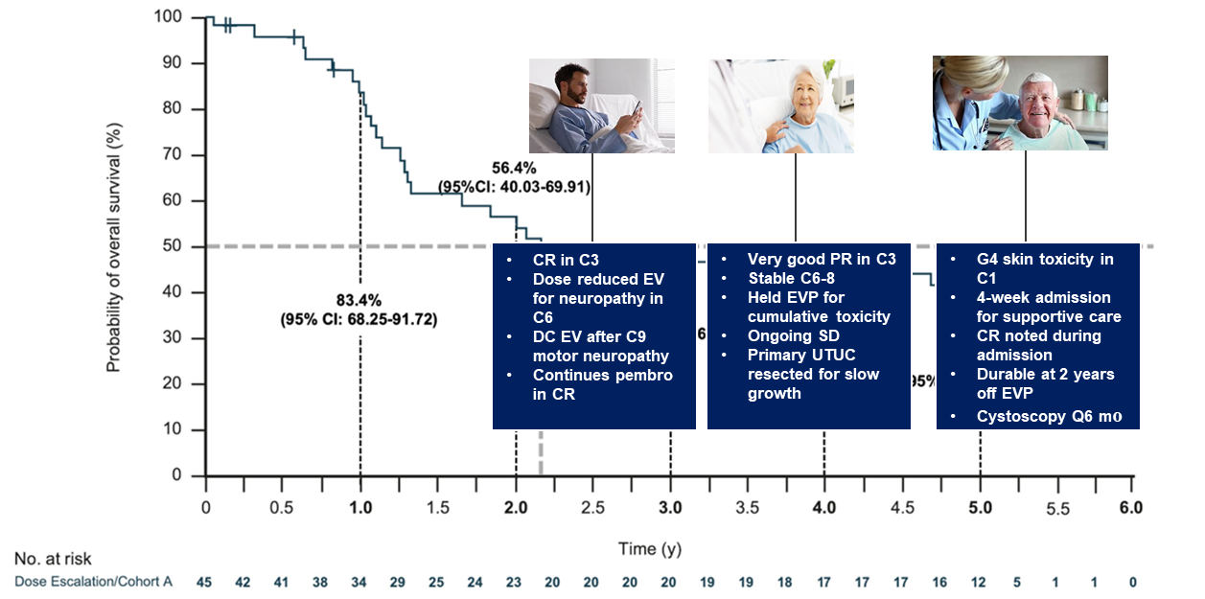
Phase 1/2 EV-103 Trial Cohort A: Story of the Survivals
Notes:
Now, what about the story of the patients who are survivors? Those of you who have used EVP in your practice know that there is really a wide range of outcomes as well as duration of therapy. And so, these are really just not necessarily examples from the trial, but examples from my own practice where you could have a patient who had a complete response in cycle 3, dose reduced for neuropathy and then just continues on pembrolizumab. Or a patient who had a partial response in cycle 3 was then stable, held for cumulative toxicity. And because of slow growth, maybe went on to have a resection. Or patients who have high-grade skin toxicity early on, stop all drugs, and 2 years later, maybe still have a complete response. So there is a lot of variable outcomes that we see in terms of what those survivors look like. And it’s one thing I think we’re lacking from some of these papers is what exactly was the journey that these different patients on this trial actually took to have these great long-term outcomes.

Slide 15
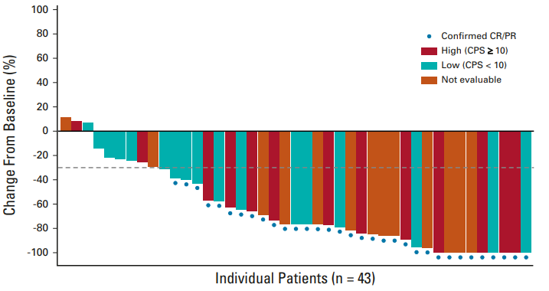
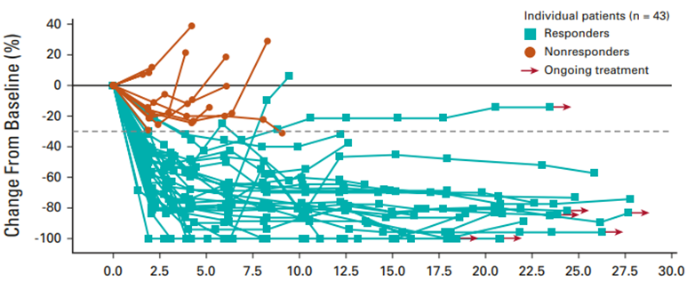
EV-103 Cohort A: Most Patients Responded Regardless of PD-L1 Status and Responses Were Brisk and Durable
Notes:
In addition, again, for those of you who have used EVP, most patients have some degree of response. The response rate is quite high at over 70% regardless of PD-L1 status. Responses are brisk and durable. I tell patients, “Often times, you’ll tell me before I tell you whether or not the medication is working based on how you’re feeling, potentially in narcotic use and other markers.“ And also, you can see here from the spider plot on the right-hand side, that most of these responses in patients who are responders tend to be durable. And it’s regardless of PD-L1 status, so we may or may not check it. But in terms of deciding whether or not a patient should get enfortumab vedotin and pembrolizumab, we give it regardless.

Slide 16
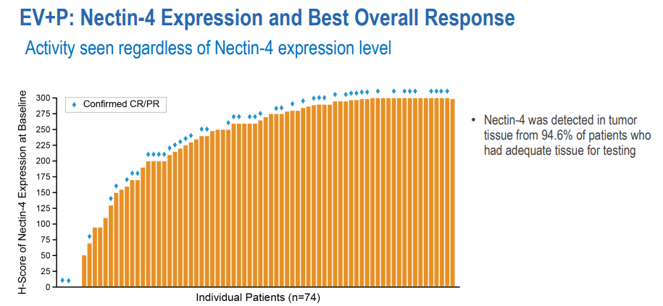
Testing and/or Expression of Nectin-4 Not Required for EVP Activity
Notes:
Enfortumab vedotin is an antibody-drug conjugate that’s targeted against a surface protein on cells called nectin-4. And actually in the early-phase trials of enfortumab, patients had to have nectin-4 testing. In order to even be considered for the trials, nectin-4 was one, felt to be rather ubiquitous, and then two, regardless of nectin-4 expression, patients tended to respond to enfortumab and pembrolizumab. So, it was no longer required. It’s not at all part of standard of care. A patient comes into our office with metastatic urothelial cancer, most of the time patients are generally eligible for the treatment. A few patients may be ineligible, so it’s really the chair time and insurance clearance are the things that we need for the patient to get started. We don’t need nectin-4 testing, nor does it seem to impact outcomes.

Slide 17
Phase 3 EV-302 Trial: Frontline Enfortumab Vedotin Plus Pembrolizumab (EVP) in aUC
Previously untreated la/mUC
Eligible for platinum, EV, and pembrolizumab
PD-1/L1 inhibitor naïve
GFR ≥30 mL/min
ECOG PS 0-2
EV + Pembro (n = 442)
EV 1.25 mg/kg on Days 1 and 8
Pembro 200 mg on Day 1
3-week cycle
No maximum treatment cycles for EV;
maximum 35 cycles for pembro
N = 886
R
1:1
Dual primary endpoints
PFS per BICR
OS
Select secondary endpoints
ORR per RECIST v1.1 by BICR and investigator assessment
Safety
Chemotherapy (n = 444)*
Cisplatin or carboplatin + gemcitabine
Maximum 6 cycles
cisplatin eligibility and assignment/dosing
were protocol defined
Stratification factors
Cisplatin eligibility
PD-L1 expression
Liver metastases
*Maintenance therapy could be used following completion and/or discontinuation of platinum-containing therapy
Notes:
In the same era as the CheckMate 901 trial, when platinum alone was standard, in EV-302, enfortumab and pembrolizumab was tested against platinum. So, the phase 3 trial looking at frontline enfortumab plus pembrolizumab versus chemotherapy in advanced urothelial cancer was the definitive randomized trial that brought this treatment into the frontline standard of care for cisplatin-eligible patients. So, this is a large international phase 3 trial using enfortumab and pembrolizumab. The standard dosing is 1.25 mg/kg on days 1 and 8, capped at 125 mg, and pembrolizumab on day 1. It’s a 3-week cycle versus chemotherapy and the standard at the time was cisplatin or carboplatin and gemcitabine for a maximum of 6 cycles. Now, as the trial was in development, the JAVELIN trial was coming along as well. So, an amendment was made that patients on the chemotherapy arm, if they were eligible, could certainly have gotten a maintenance as part of their standard of care in the control arm. And I think over like 20% of patients actually went on to get that maintenance therapy.

Slide 18
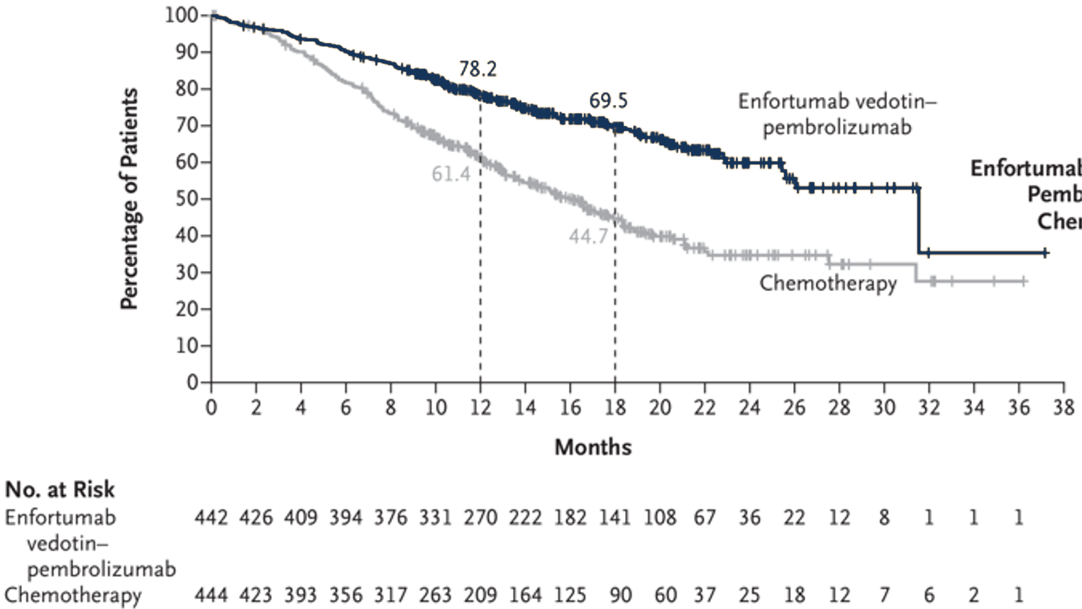
EV-302: Overall Survival
 | Events/Patients | HR (95% CI) | 2-sided P value | mOS (95% CI), mo
EV+P | 133/442 | 0.47 (0.38-0.58) | <0.001 | 31.5 (25.4-NE)
Chemo | 226/444 |  |  | 16.1 (13.9-18.3)
Median duration of survival follow-up: 17.2 mo
Notes:
The overall survival was really unprecedented, 31.5 months in the enfortumab and pembrolizumab arm versus 16.1 months in the control arm. Nothing like we had ever seen before, almost doubling an overall survival in the patients who received enfortumab and pembrolizumab.

Slide 19
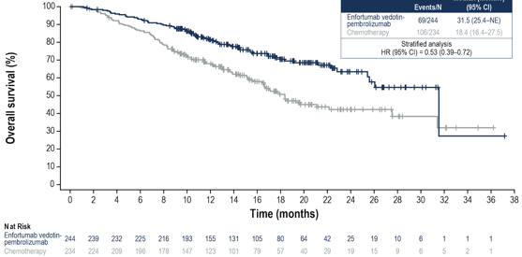
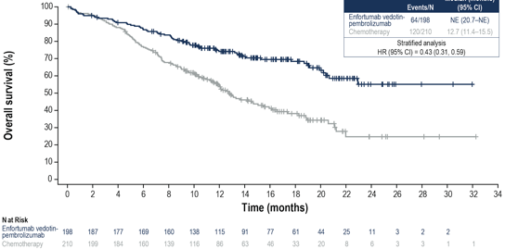
EV-302: Overall Survival by Cisplatin Eligibility
Cisplatin eligible
Cisplatin ineligible
 | Events/N | HR (95% CI) | mOS (95% CI), mo
EV+P | 69/244 | 0.53 (0.39-0.72) | 31.5 (25.4-NE)
Chemo | 106/234 |  | 18.4 (16.4-27.5)
 | Events/N | HR (95% CI) | mOS (95% CI), mo
EV+P | 64/198 | 0.43 (0.31-0.59) | NE (20.7-NE)
Chemo | 120/210 |  | 12.7 (11.4-15.5)
Notes:
And if you look by cisplatin eligibility, if you think about things like peripheral neuropathy and performance status of 2 or patients that had hearing issues, those patients who were eligible or ineligible for cisplatin, both clearly had benefit from enfortumab and pembrolizumab versus chemotherapy.

Slide 20
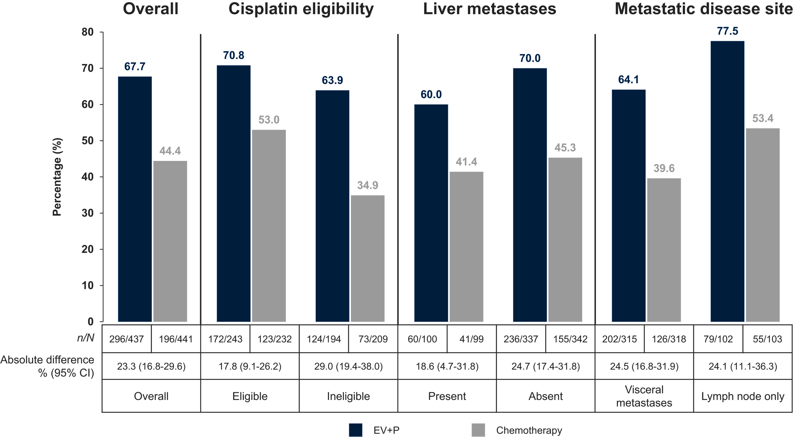
EV-302: EVP Improved ORR vs Chemotherapy Across Subgroups With Poor Prognosis
Overall Response Rate
Notes:
Notably, all patient subgroups fared better with enfortumab and pembrolizumab, even in poor risk patients with liver and visceral metastasis and in frailness defined by cisplatin eligibility.

Slide 21
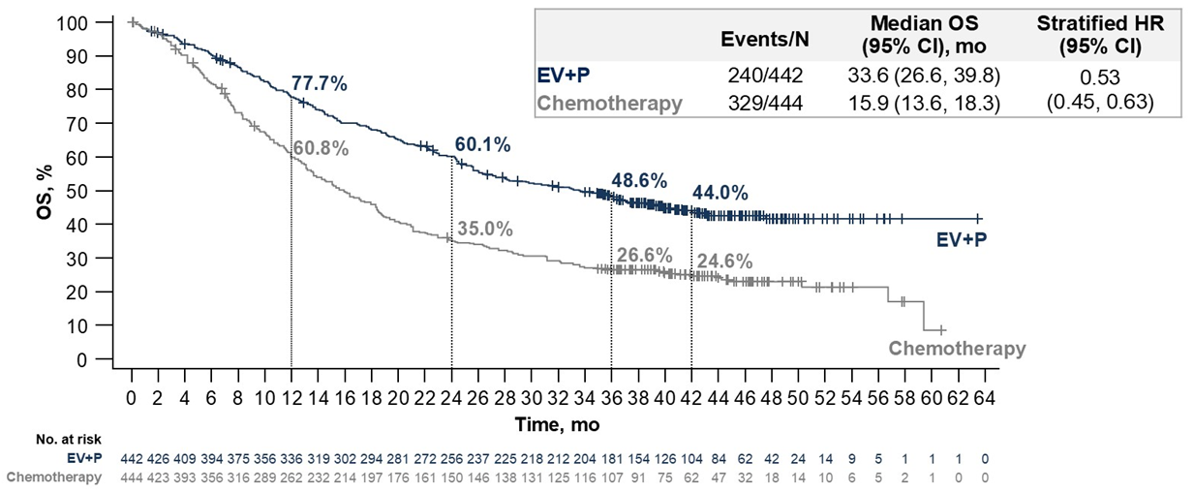
EV-302: OS at 3.5-Year Median Follow-Up
Notes:
This profound survival benefit with EVP in EV-302 was durable at a recent 3.5-year follow-up. And really importantly, the tails of these curves are flattening out over time that we can see. Patients are continuing to live longer on the EVP arm compared to chemotherapy, now out to 33.6 months of overall survival.

Slide 22
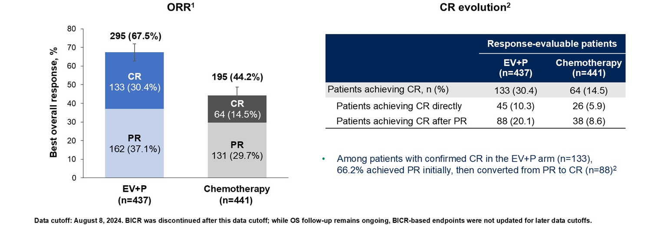
EV-302: ORR at 3.5-Year Median Follow-Up
Notes:
At 3.5-year median follow-up, EVP demonstrated ORRs exceeding those with chemotherapy, with about twice as many patients achieving a CR. Cumulative responses deepened over time, with around 2/3 of patients with CR converting from PR to CR.

Slide 23
  Considerations for Using EVP as Frontline Therapy
First-line treatment for locally advanced and metastatic UC
Start EVP and send for NGS/biomarker testing
What to expect:
  Up to 35 cycles for pembrolizumab and no cycle maximum for enfortumab vedotin
  Median cycles for pembrolizumab: 11 (range, 1 to 35)
  Median cycles for enfortumab vedotin: 9 (range, 1 to 46)
  Dose of enfortumab vedotin capped at 125 mg (1.25 mg/kg)
Notes:
So, some considerations for using enfortumab and pembrolizumab as frontline therapy. So certainly consider EVP as the first-line treatment of choice for locally advanced and metastatic urothelial cancer. In our practice, we’re starting enfortumab and pembrolizumab, and then at the same time, sending off biomarker testing for next-gen sequencing at this point in time. Those are kind of complete packages where we’re also getting PD-L1 testing, even though we’re not necessarily using it, as well as other things like HER2 IHC, which we’ll talk about soon. What to expect? So in the trials, patients were allowed up to 35 cycles of pembrolizumab and no maximum for enfortumab vedotin. Again, those of us who use these medications in practice know that I don’t think we’ve seen anybody that maybe has gone out that long maybe for the immunotherapy.
But in the 302 trial, the median number of cycles for pembro was 11, and the median number of cycles for enfortumab was 9 because of cumulative toxicity. Also, importantly, per standard of care per the package insert that the dose of enfortumab vedotin is capped at 125 mg, And so that is well known I am sure to the oncologists as well as your pharmacy and nursing teams because you can see increased toxicity with higher doses.

Slide 24
Sequencing Therapies Upon Disease Progression: Guideline-Driven Care
Is it really evidence-based?

Slide 25
NCCN Guidelines: Second-Line Therapies Following Frontline EVP or Chemoimmunotherapy
Previous immunotherapy and enfortumab vedotin (no previous chemotherapy)
Preferred
Biomarker-directed therapy
Cisplatin/Gemcitabine
DDMVAC with growth factor support
Carboplatin/Gemcitabine (cat 2B)
Other recommended
Gemcitabine
Paclitaxel or Docetaxel
Useful in certain circumstances
Cisplatin/Gemcitabine + Nivolumab (cat 2B)
NCCN Guidelines for Bladder Cancer (Version 1.2026)
Previous chemotherapy and immunotherapy (no previous enfortumab vedotin)
Second-line systemic therapy for locally advanced or metastatic disease
Preferred
Enfortumab vedotin (cat 1)
Biomarker-directed therapy
Other recommended
Cisplatin/Gemcitabine
DDMVAC with growth factor support
Enfortumab vedotin + Pembrolizumab
Gemcitabine
Paclitaxel or Docetaxel
Doxorubicin/Gemcitabine/
Ifosfamide (cat 2B)
Gemcitabine/Paclitaxel (cat 2B)
Useful in certain circumstances
Sacituzumab govitecan
Notes:
Now, what about the second-line setting? Most patients will derive some clinical benefit from enfortumab and pembrolizumab, and some will even have a durable complete response. But for primary progressors or those who are intolerant or progress after initial response, what's next? For now, there's little data to guide and trials are forthcoming and retrospective experiences are being shared.
But in the meantime, the NCCN has provided a roadmap for options for consideration based on biomarkers and patient comorbidities such as peripheral neuropathy.

Slide 26
  Sequencing Considerations When First-Line EVP Is Used
Second-Line Therapy
Biomarker-Directed Therapy
Biomarker Positive
First-Line Therapy
EV + Pembro
PD
Fresh biopsy of metastatic site for NGS
Biomarker Negative
Consider Platinum
Notes:
When making follow-up treatment decisions, following enfortumab and pembrolizumab, follow-up biopsy, if feasible, could be considered for repeat testing or banking for clinical trials. Many patients have the option for next-line platinum, which has shown some activity in retrospective series. When feasible, biomarker-directed therapy may also be an option, and of course these choices can be made in sequence in later lines of therapies.

Slide 27
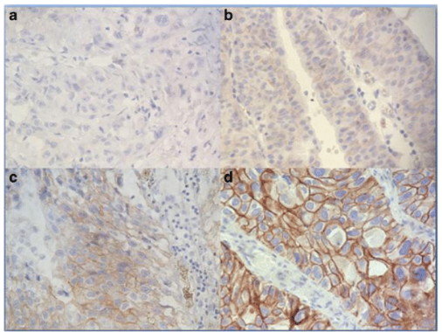
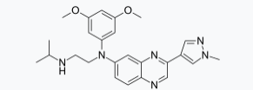
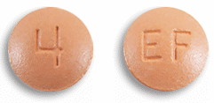
  Biomarker-Directed Therapies
HER2: Trastuzumab Deruxtecan
FGFR3: Erdafitinib
Requires IHC testing (3+ or 2+)
If not automatic, request IHC on gastric scoring
Must have a susceptible FGFR3 mutation (R248C, S249C, G370C, or Y373C) or fusion (TACC3_V1, TACC3_V3, or BAIAP2L1)
10%-15% incidence in UC
0
1+
2+
3+
El Ochi MR, et al. BMC Clin Pathol. 2017;17:3. Loriot Y, et al. N Engl J Med. 2023;389(21):1961-1971.
Notes:
So approved biomarker-directed therapies, and this means where there's tangible proof that the patient provides to us based on their tumor samples, are trastuzumab deruxtecan, a HER2-directed antibody-drug conjugate, as well as erdafitinib, which is an oral targeted therapy against the FGFR3 pathway. Both can be reasonably well tolerated in a late-line setting and effective for patients with treatment-refractory urothelial cancer.

Slide 28
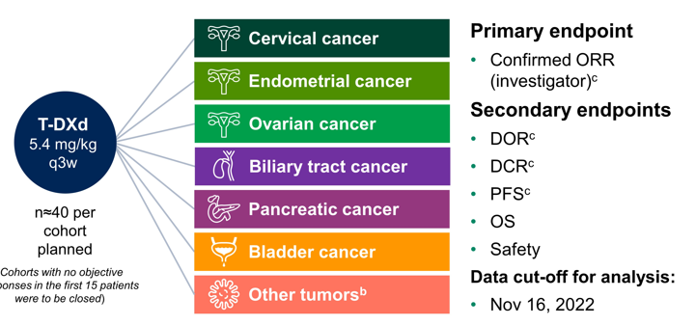
  DESTINY-PanTumor02: Study Design
Advanced solid tumors not eligible for curative therapy
2L patient population
HER2 (IHC 3+ or 2+)
Prior HER2-targeting agents allowed
ECOG PS 0-1
Cohorts with no objective responses in the first 15 patients were to be closed
Meric-Bernstam F, et al. J Clin Oncol. 2024;42(1):47-58.
Notes:
So the data we have for using HER2-directed therapy is, I think really a lovely trial design. The DESTINY-PanTumor02 study looked at the FDA-approved drug trastuzumab deruxtecan, a slightly lower dose than used in breast cancer, in any solid tumor with overexpression of HER2, looking for outcomes like response rate and survival outcomes as well as toxicity.

Slide 29
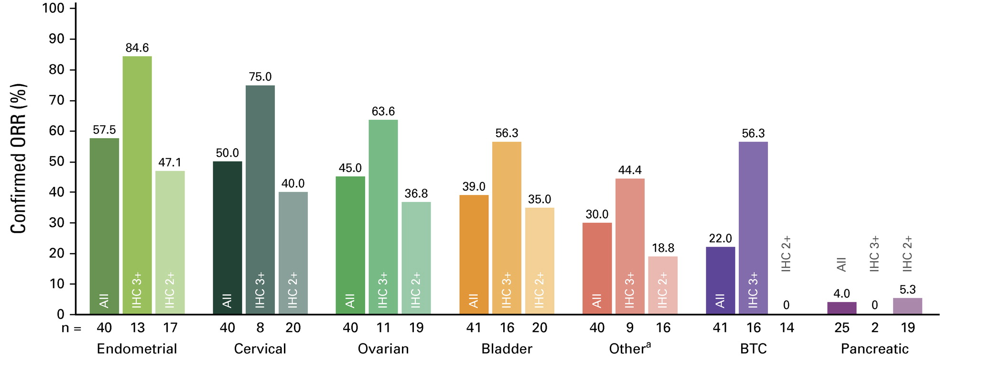
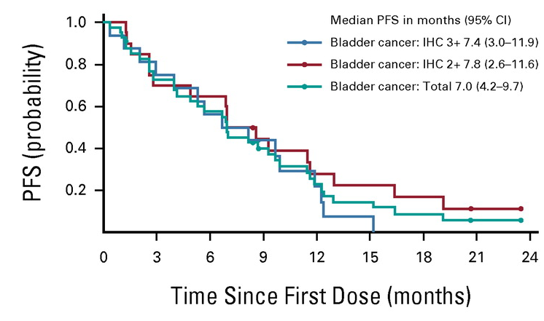
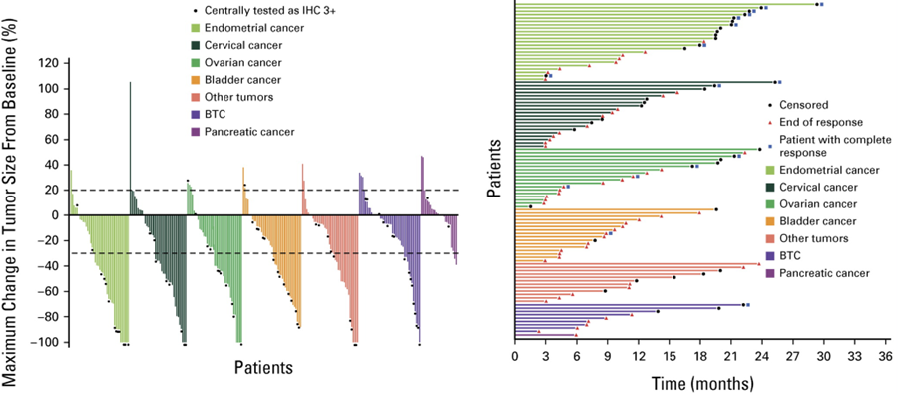
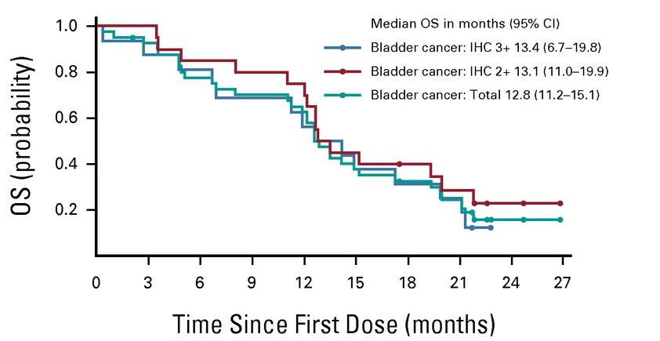
  DESTINY-PanTumor02: Efficacy in Bladder Cancer
Meric-Bernstam F, et al. J Clin Oncol. 2024;42(1):47-58.
Notes:
So, just highlight the bladder cancer cohort, only 41 patients, but you know, particularly for those with overexpression of HER2 by immunohistochemistry, the response rates were relatively impressive, making this a tool that we have in our toolkit for patients with urothelial cancer with progression on EVP.

Slide 30
  Phase 3 THOR Trial: Study Design
RANDOMIZE
Key Inclusion Criteria:
Locally advanced, unresectable, or metastatic UC (minority component histologies allowed)
FGFR inhibitor Clinical Trial Assay to determine molecular eligibility
Only one line of prior systemic therapy
ECOG PS 0, 1, or 2
Cohort 1 – Prior PD-1/PD-L1 treatment
Erdafitinib 8 mg po qd, N = 140
Docetaxel or Vinflunine IV
Day 1 of a 21-day cycle, N = 140
RANDOMIZE
Cohort 2 – No prior PD-1/PD-L1 treatment
Erdafitinib 8 mg po qd, N = 175
Pembrolizumab IV
Day 1 of a 21-day cycle, N = 175
Primary Endpoint: Overall survival
Secondary Endpoints: PFS, ORR, duration of response, safety, patient-reported outcomes, pharmacokinetics
Loriot Y, et al. N Engl J Med. 2023;389(21):1961-1971.
Notes:
What about erdafitinib? It was tested in a single-arm study as well as in this phase 3 THOR trial looking at patients who had previous checkpoint inhibitor or who had not had previous checkpoint inhibitor with 2 arms looking at erdafitinib with modern comparators at the time.

Slide 31
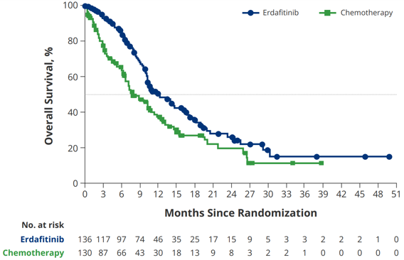
  THOR (Cohort 1): Overall Survival
~20% of patients with advanced UC have FGFR alterations
Erdafitinib is an oral selective pan-FGFR tyrosine kinase inhibitor
 | Median OS
Erdafitinib | 12.1 mo
Chemotherapy | 7.8 mo
HR 0.64 (95% CI, 0.47-0.88), P = 0.005 | HR:
Key eligibility criteria
Unresectable or metastatic UC
Progressed on or after ≥1 prior treatment that included an anti–PD-(L)1
Select FGFR3/2alt (mutation/fusion)
ECOG PS 0-2
Erdafitinib (n = 136)
8 mg PO once daily;
up-titration to 9 mg
Chemo (n = 130)
Docetaxel or vinflunine every 3 weeks
Loriot Y, et al. N Engl J Med. 2023;389(21):1961-1971.
Notes:
Erdafitinib led to improved overall survival versus physician’s choice chemotherapy in the US. We tend to use docetaxel in that setting, with a median overall survival of 12 months.

Slide 32
  EV-302: Subsequent Therapy
 | EVP (n = 442) | Chemo (n = 444)
Patients who received subsequent anticancer therapies, n (%) | 192 (43.4) | 324 (73.0)
First subsequent systemic therapy, n (%)
Platinum-containing chemotherapy | 135 (30.5) | 20 (4.5)
PD-(L)1 inhibitor therapy | 17 (3.8) | 265 (59.7)
Maintenance therapy | 0 | 142 (32.0)
EVP-based therapy | 2 (0.5) | 2 (0.5)
Other | 21 (4.8) | 19 (4.3)
Of those who progressed on EVP and received subsequent therapy, 70% received platinum-based therapy.
Powles TB, et al. ASCO 2026. Abstract 4507.
Notes:
What about subsequent therapies for patients who previously had enfortumab and pembrolizumab? What does the Ev-302 study tell us? For patients who received any therapy after EVP, the majority of them look like they got platinum-based chemotherapy.

Slide 33
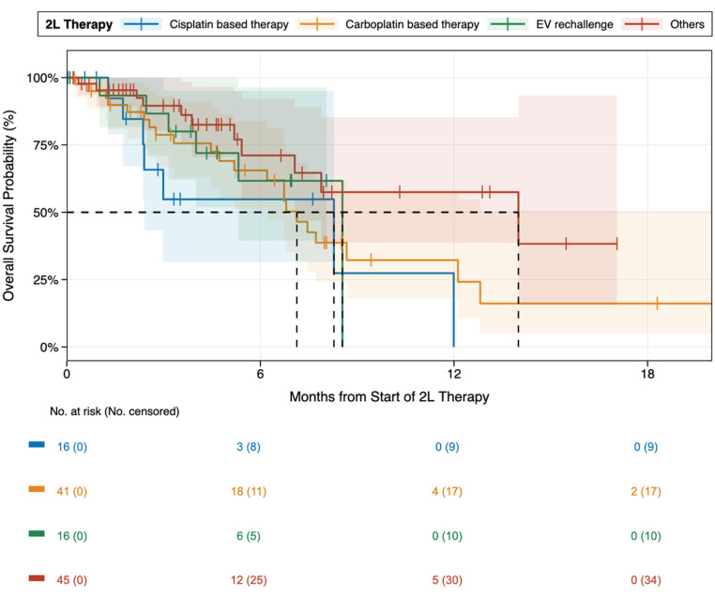
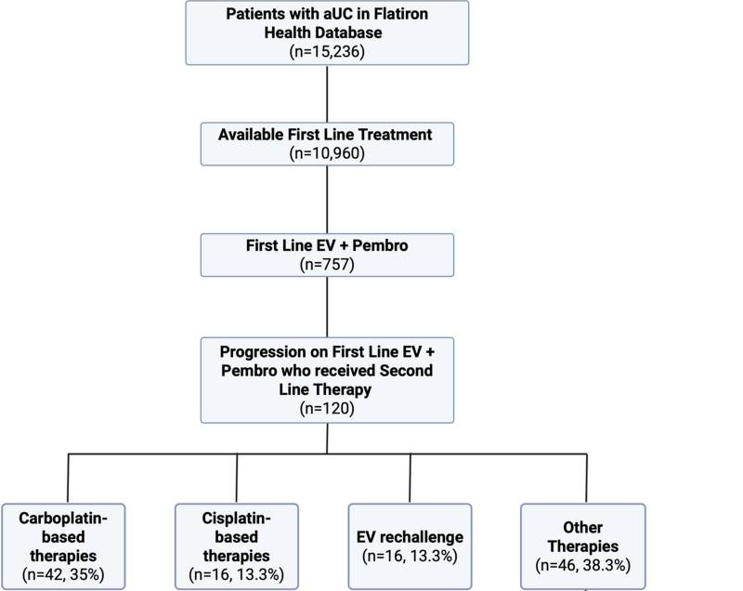
  Real-World Treatment Patterns and Outcomes After First-Line EVP in aUC
Gebrael G, et al. Bladder Cancer. 2026;12(1):23523735261437911.
Notes:
What about some real-world outcomes looking at patients who’ve had enfortumab and pembrolizumab and then moved on to other therapies? So, this was published recently in Bladder Cancer in 2026, looking at the Flatiron database of over 15,000 patients. Over 700 of them or so had gotten first-line EVP, and if they had progressed, what other therapies did they get? So, the majority of the patients either got carboplatin-based chemotherapy, which makes sense again. To not have overlapping toxicity, particularly from neuropathy after EVP or other therapies, which I assume are those biomarker-directed therapies like erdafitinib or T-DXd. And looking at overall survival probability, not insignificant outcomes in terms of those patients who are able to start second-line therapy. So I do think that for patients who have progression on EVP, even though the outcomes from EVP can be so good, if patients are clearly having primary progression, I think it probably makes sense to think about what else is out there and what else they may respond to, either better or have a lower toxicity profile so that they may be able to get additional lines of therapy.

Slide 34
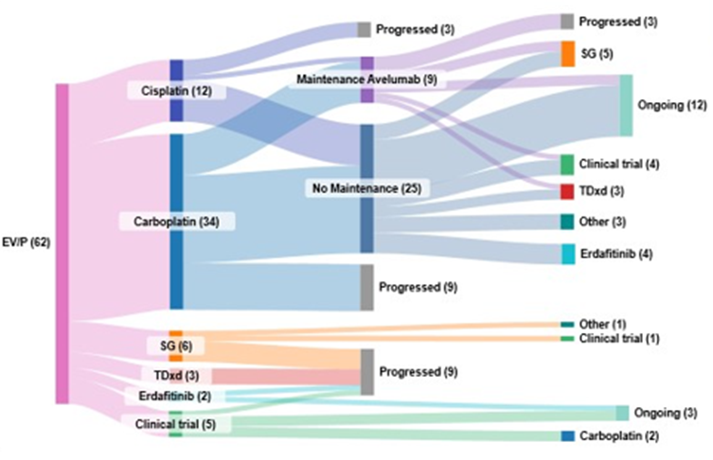
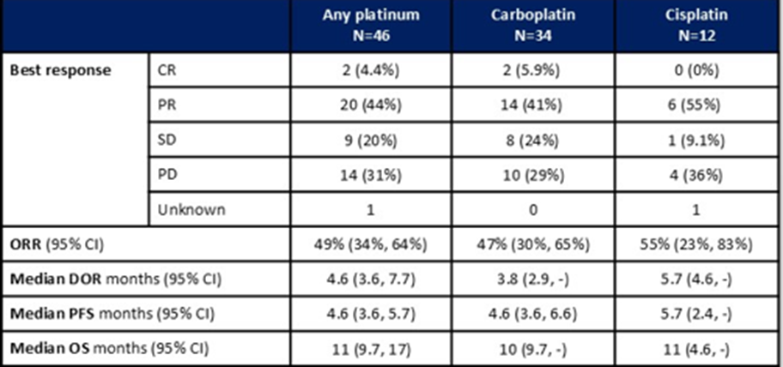
Retrospective Analysis of Treatment Patterns and Outcomes With Platinum Chemotherapy After First-Line EVP in aUC
Treatment Patterns After EVP
Outcomes With Platinum-Based Chemotherapy
Median follow up was 9.5 months (95% CI 8.7, -). At the time of the analysis, 15 patients did not progress on second line treatment.
Sternschuss M, et al. ASCO 2025. Abstract 4573.
Notes:
This was a poster from ASCO 2025. This was an experience paper from Memorial Sloan Kettering, just looking at their patients who had had progression on enfortumab and pembrolizumab. Again, kind of a smattering of treatments they had gotten in the second/third line. But in terms of those patients who had gotten any platinum-based chemotherapy, the response rate was 49% after EVP, which I think is certainly impressive and something to take into consideration for those patients who are progressing on the EVP or need something else.

Slide 35
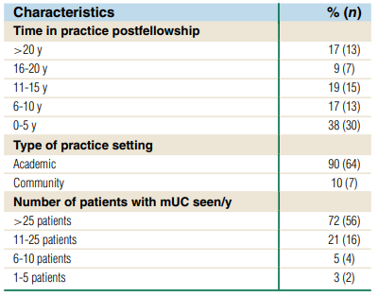
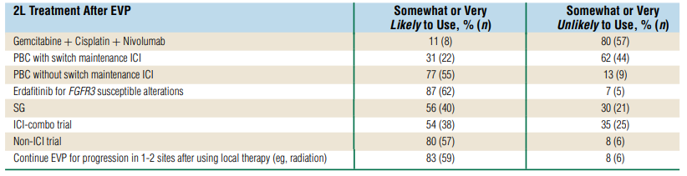
National Survey of GU Oncologists: Questions Remain Regarding Second-Line Therapies After Prior EVP
Respondent Characteristics
Preferred 2L Treatment for mUC After Prior EVP
Tawagi K, et al. Clin Genitourin Cancer. 2026;24(2):102487.
Notes:
This is a national survey of GU oncologists. We survey when we don’t have the data and ask a similar question: what’s your preferred second-line treatment for metastatic urothelial cancer after enfortumab and pembrolizumab? And again, I think importantly these answers were all over the board in terms of any kind of preferred. But what that means is really as a joint decision with the patient and provider in terms of thinking about what their current comorbidity status is and what options here are on the table.

Slide 36
Sequencing Considerations When EVP Is NOT Used in the First Line
Second-Line Therapy
Biomarker-Directed Therapy
Biomarker Positive
First-Line Therapy
Platinum Chemo + ICI
PD
Fresh biopsy of metastatic site for NGS
Biomarker Negative
EV (+ Pembro?)
Notes:
In some instances, like in my clinic for predominantly variant subtypes, like, say, predominantly small squamous cell bladder cancer, I might start with platinum and immune therapy. And in this setting, if there's progression after that first line of therapy with platinum and a checkpoint, what can we use in the second-line and beyond setting? We know that enfortumab alone and potentially in combination has activity, and biomarker-directed therapy is also available.

Slide 37
  Phase 3 EV-301 Trial: Study Design
Adult patients with locally advanced or mUC
﻿﻿ECOG PS ≤1
﻿﻿Prior platinum-containing chemotherapy
﻿﻿PD during or after checkpoint inhibitor treatment
Enfortumab vedotin
1.25 mg/kg IV over 30 min
on D1, 8, and 15 of each
28-D cycle
Treatment with study drug until radiologic disease progression, intolerance, or other discontinuation criterion is met
Radiologic assessment of tumor response status at baseline and every 8 weeks
R
Investigator's choice:
docetaxel, paclitaxel, or vinflunine
(European Union only) IV
on D1 of each 21-d cycle
N = ~550
Primary endpoint: OS
Secondary Endpoints: PFS, DOR, ORR, safety/tolerability, QoL
Rosenberg JE, et al. Ann Oncol. 2023;34(11):1047-1054.
Notes:
So from the phase 3 EV-301 trial, for patients who had prior platinum-based chemotherapy, this was a trial of enfortumab alone. So without pembrolizumab as a partner. The dosing is the same 1.25 mg/kg on days 1, 8, and 15 on a 28-day cycle versus investigator choice chemotherapy.

Slide 38
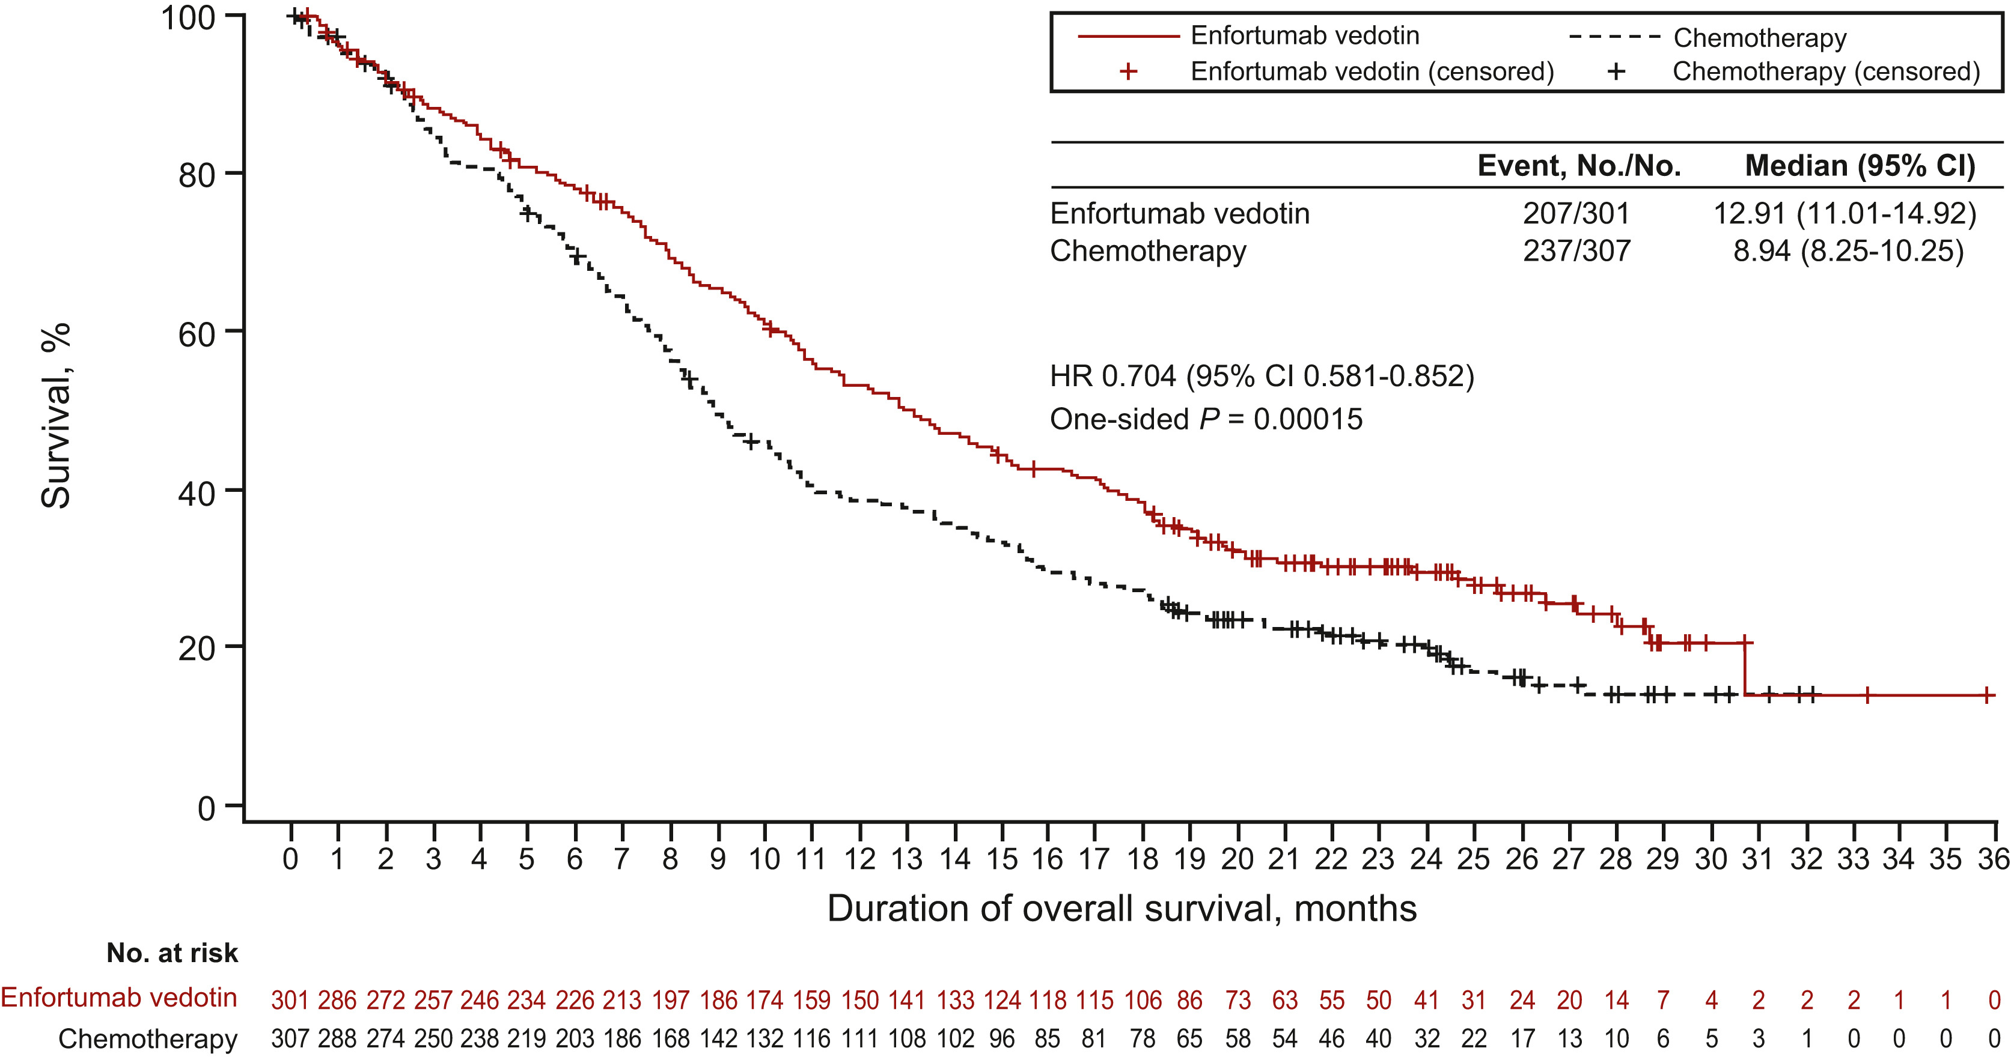
  EV-301: Overall Survival
Rosenberg JE, et al. Ann Oncol. 2023;34(11):1047-1054.
Notes:
Again, enfortumab improved overall survival over single-agent chemotherapy, 12.9 versus 8.9 months.

Slide 39
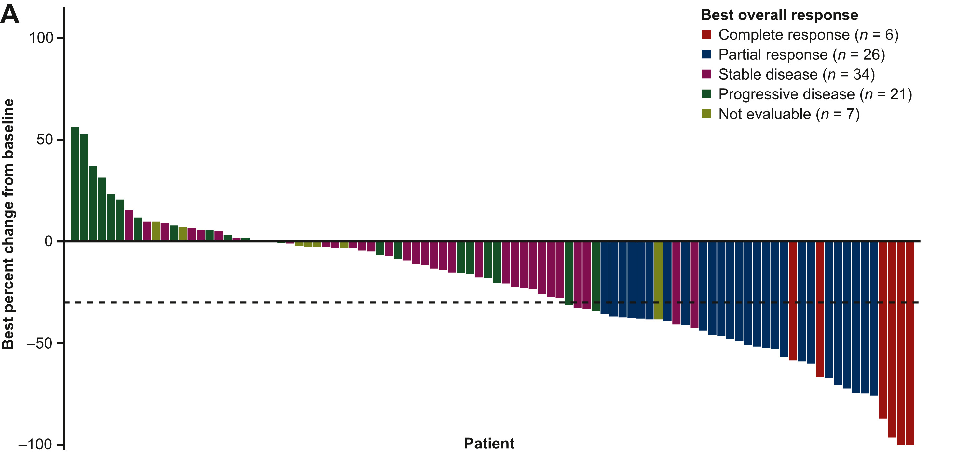
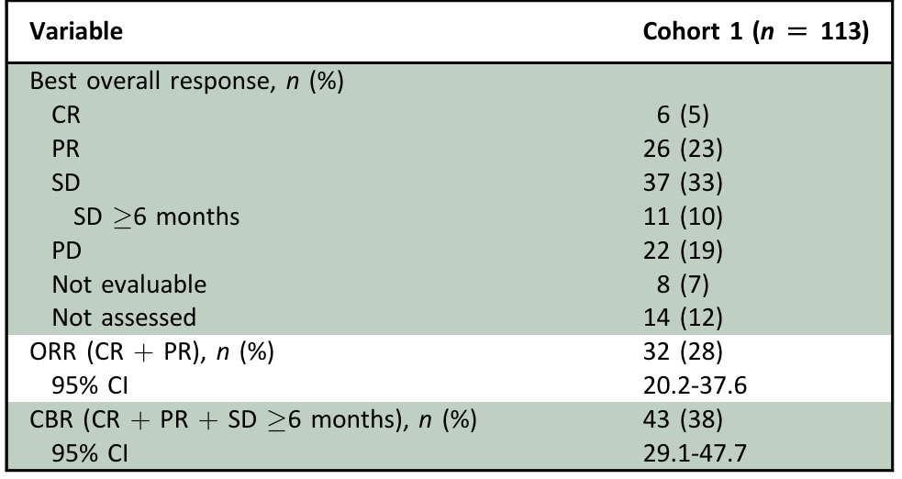
  Phase 2 TROPHY-U-01 Trial: Sacituzumab Govitecan in aUC After First-Line Chemoimmunotherapy
Summary of Treatment Efficacy
Median duration of response was 8.2 months
Median progression-free survival was 5.4 months
Median overall survival was 10.9 months
Loriot Y, et al. Ann Oncol. 2024;35(4):392-401.
Notes:
Other options for treatment that are available in 2026 include sacituzumab govitecan, again another breast cancer drug that had some degree of expanded indication for patients with urothelial cancer. This is still part of the guidelines listed as an option in certain circumstances. So this phase 2 trial showed that SG single-agent therapy for patients with progression on prior chemotherapy led to significant response rates as well as some clinical benefit with a median duration of response of 8.2 months in responders and an overall survival of 10.9 months.

Slide 40
Optimizing Patient Outcomes Through Early AE Recognition and Management
Pearls for you and clinical teams

Slide 41
Enfortumab Vedotin and Pembrolizumab: AEs
Median time since start of treatment (months)
1
2
3
4
5
6
7
Hyperglycemia
0.5 months
(range: 0.3 to 3.5)
Grade ≥3 skin reactions
1.7 months
(range: 0.1 to 17.2)
Grade ≥2
peripheral neuropathy
6 months
(range: 0.3 to 25)
Pneumonitis
4 months
(range: 0.3 to 26)
Hyperglycemia
Skin Toxicity
Neuropathy
Pneumonitis
Notes:
So enfortumab and pembrolizumab, what adverse events we see? So, the adverse events can actually come on quite quickly. These are somewhat averages, but not absolutes in terms of when we see these things. So, hyperglycemia can come on quite quickly as can skin reactions. And some of the most profound skin reactions I’ve seen with EVP have been in cycle 1. Peripheral neuropathy tends to be cumulative, but again, if we’re using enfortumab alone, maybe in a later-line setting after platinum-based chemotherapy or in someone with a preexisting neuropathy, it can come on even sooner. But the average range of time frame that we see these toxicities can be immediate, but they can also be cumulative over time.
Every once in a while, I’ll see a high-grade skin toxicity in later months, but for the most part, we’re seeing it early and then intervening with dose interruption or reduction. Pneumonitis also something to be aware of. And again, as we think about stacking and sequencing other therapies, this also an important adverse event. Either agent alone (enfortumab or pembrolizumab) can cause it. And then of course. A slightly increased risk when the two drugs are together.

Slide 42
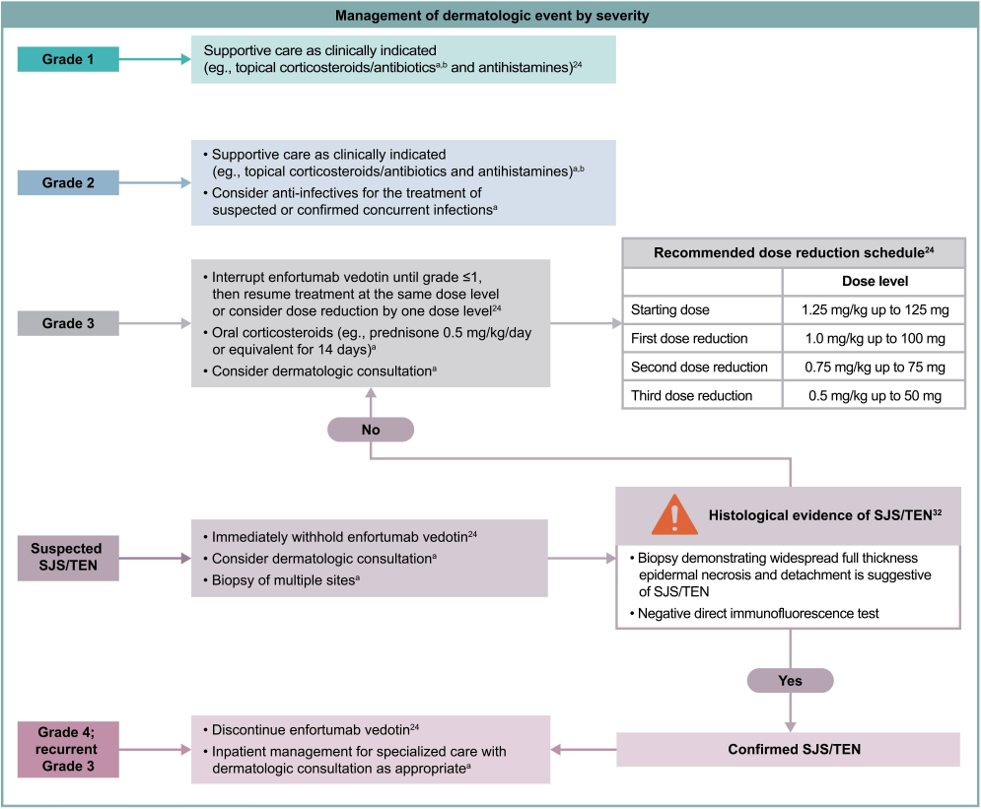
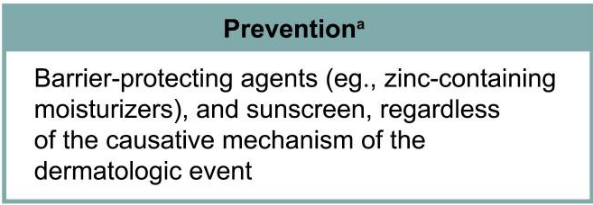
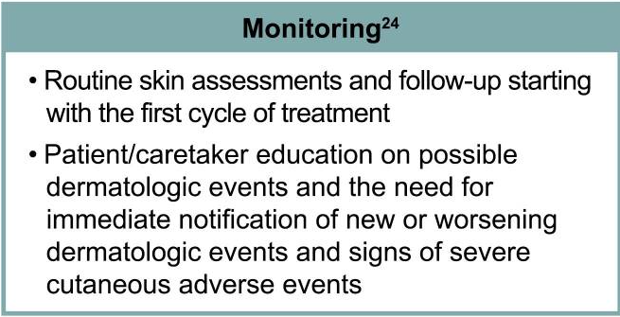
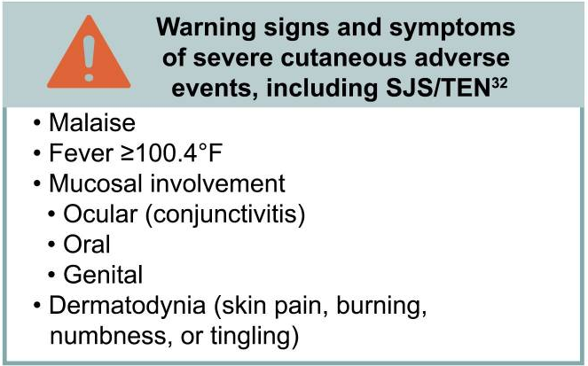
Rash Is a Common AE Associated
With EVP
Lacouture ME, et al. Oncologist. 2022;27(3):e223-e232.
Notes:
Skin toxicity is quite common in the combination and early low-grade skin toxicity is actually even more common. So in our clinic, we are following patients usually for each treatment in early cycles. Because the treatment is usually so effective in the patients that we're giving it to, I tend to hold treatment rather than pushing especially through early skin toxicity. Holding as well as dose reduction can be effective, but we also think about supportive care such as topical steroids through low-grade toxicity. For higher-grade toxicity, if you have to use systemic steroids, you're certainly holding enfortumab and then often referring patients to dermatology for extra help, including consideration of biopsy or the use of biologic therapy.

Slide 43
Enfortumab and Pembrolizumab:
Managing Hyperglycemia and Neuropathy
  Hyperglycemia
    Hold EV if glucose >250
    If severe, consider steroids as could be T1DM from pembro
  Neuropathy
    Dose holds/dose reductions/schedule extension
    Discontinue EV if excellent response and/or neuropathy interfering with ADLs
    Adjunctive therapy for neuropathic pain: gabapentin, pregabalin, duloxetine
Notes:
So the combination can cause hyperglycemia, and we see this in particular in patients that have baseline poorly controlled diabetes. So if possible, they should see their primary care doctor or endocrinologist to optimize management before starting. Hold treatment if the glucose is over 250 and especially if you have to use steroids.
Peripheral neuropathy is also pretty common. In my experience, it tends to happen a little bit later for patients who are doing well on enfortumab and pembrolizumab for a longer period of time, where we tend to hold after they've had some degree of response.
In this situation, if possible, dose reduction again or holding enfortumab altogether for those with great response to therapy can be a strategy where you can keep patients on the therapy for longer just with pembrolizumab maintenance.
Adjunctive therapies for neuropathic pain such as gabapentin, pregabalin, and duloxetine can be helpful. Also we encourage physical therapy and visits with rehabilitation medicine.

Slide 44
Practical Considerations With EVP
  See patients at C1D8 and do not push if rash is persistent
  Rash comes early but neuropathy tends to happen in later cycles and can be dose-limiting in responders
  Very poorly controlled blood glucose can escalate to need for insulin infusion
  Caution with liver dysfunction at baseline
  Cytopenias tend to accompany higher-grade AEs
  Dose reduce by 0.25 mg/kg and be mindful of weight restriction as patients get healthier
  For long-term neuropathy, peel back EV and possibly continue pembro
Notes:
We see patients at cycle 1, day 8, and again don’t push that if the rash is persistent. The rash comes early. We talked about neuropathy being later. We also talked about the glucose control, liver dysfunction at baseline that’s poor can impact metabolism, so something to be watchful for. And patients with very high-grade AEs, we can also sometimes see cytopenias. One of the lovely things about EVP is that white cells, red cells, and platelets don’t tend to be affected for the most part, which is great for patients with gross hematuria that doesn’t necessarily make it worse. And that we’re not seeing thrombocytopenia that may also potentiate that. If anything, we’ll see hemoglobins that start to go up over time.
Because patients are getting a great response and no longer having hematuria, there is predetermined dose reductions. We dose reduced by 0.25 mg/kg and also being mindful of weight restrictions. For long-term neuropathy. Again, dial back the enfortumab and continue the pembrolizumab as an option.

Slide 45
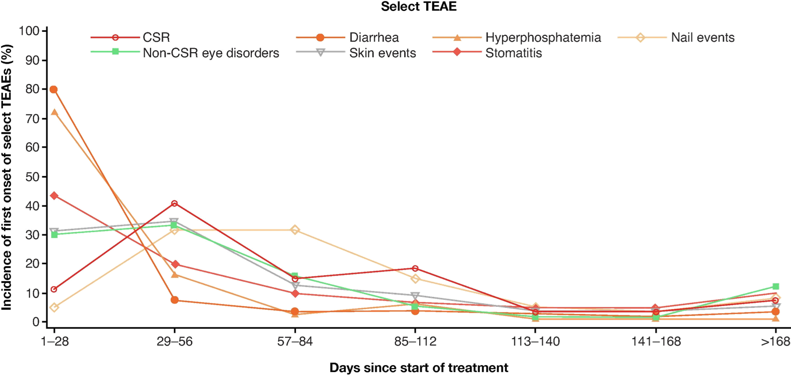
Erdafitinib: Toxicity Profile
Notes:
What about erdafitinib? That’s the oral FGFR3 inhibitor. A unique toxicity profile where we can see central serous retinopathy. So it’s recommended that patients see ophthalmology prior to starting and then on a regular basis. You can also see diarrhea and skin events. Hyperphosphatemia is an on-target event as well as stomatitis and other gastrointestinal toxicity.

Slide 46
Erdafitinib: Managing Hyperphosphatemia and CSR
Hyperphosphatemia
All patients | Restrict phosphate intake to 600-800 mg daily in all patients and conduct frequent serum phosphate checks
<6.99 mg/dL | Continue erdafitinib at current dose
7-8.99 mg/dL | Continue erdafitinib at current dose Start phosphate binder with food until phosphate level is <7 mg/dL Reduce the dose if serum phosphate remains ≥7 mg/dL for a period of 2 months or if clinically necessary
≥9 mg/dL | Withhold erdafitinib until phosphate level is <7 mg/dL and restart at the same dose (9-10 mg/dL) or first reduced dose (>10 mg/dL); if serum phosphate with life-threatening consequences requiring urgent intervention, discontinue erdafitinib permanently
Central Serous Retinopathy (CSR)
All patients | Perform monthly ophthalmological examinations during the first 4 months of treatment and every 3 months afterwards, and urgently at any time for visual symptoms
Any grade | Withhold erdafitinib and perform an ophthalmic evaluation within 2 weeks • If improving within 14 days, restart erdafitinib at the current dose • If not improving within 14 days, withhold erdafitinib until improving; once improving, may resume at the next lower dose level Upon restarting erdafitinib, monitor for recurrence every 1 to 2 weeks for a month; if recurs or has not improved after 4 weeks of withholding erdafitinib, consider permanent discontinuation
Notes:
Patients starting erdafitinib should have baseline and close follow-up with ophthalmology evaluations to evaluate for the development of central serous retinopathy, as well as close follow-up and electrolyte management for on-target hyperphosphatemia. Modifications such as modification in diet and phosphate binders can be considered for the patients, and dose modifications are well outlined in the package insert.

Slide 47
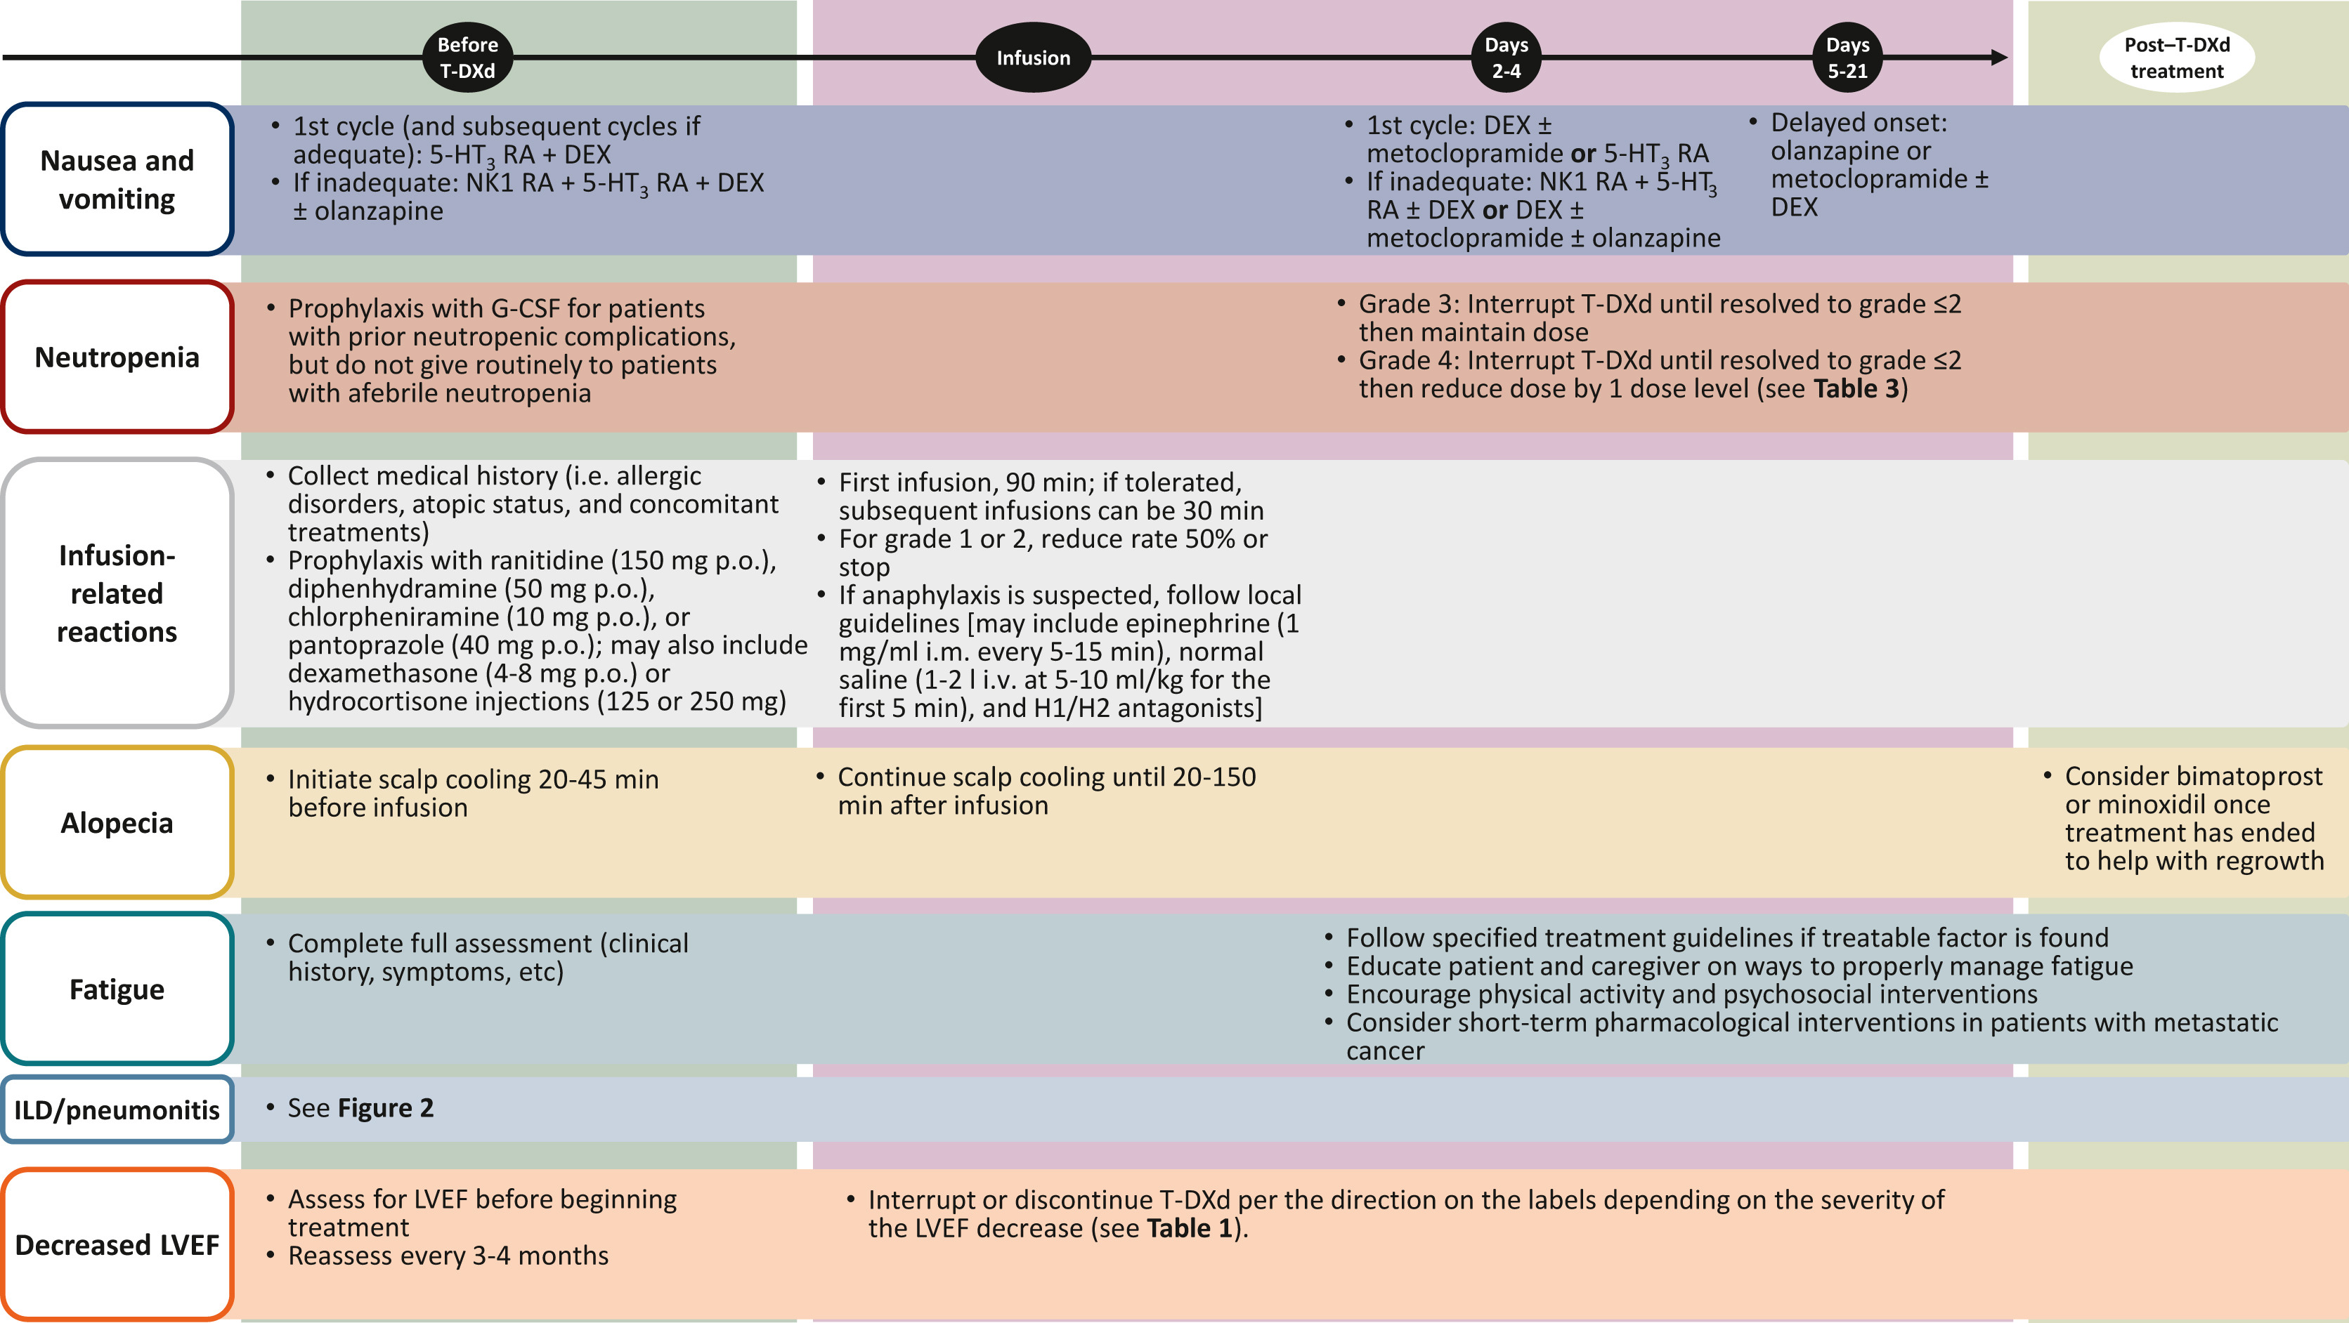
Trastuzumab Deruxtecan: AE Management
See next slide
Notes:
For trastuzumab deruxtecan, the lower dose 5.4 mg/kg was tested in treatment-refractory solid tumors expressing HER2. Nevertheless, the following should be closely managed, including baseline and follow-up echocardiogram. Because of infusion reactions, nausea and vomiting and neutropenia, we use prophylaxis for patients as we would per the NCCN guidelines.

Slide 48
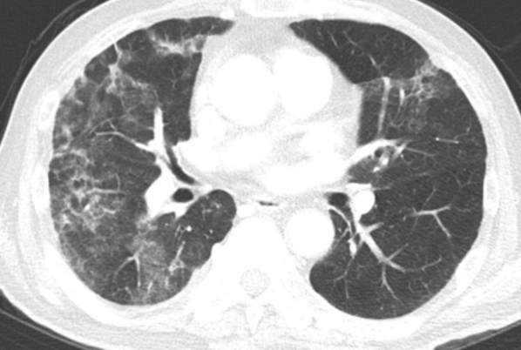
Trastuzumab Deruxtecan:
ILD/Pneumonitis Management
Radiologic Findings
Symptoms include:
  Hypoxia
  Cough
  Dyspnea
No symptoms: Hold and recheck scan in 28 days; can restart if resolved
With symptoms: Use steroids and discontinue permanently
ILD/Pneumonitis
(10%)
Notes:
And because of the risk of pneumonitis with trastuzumab deruxtecan, close monitoring of any new pulmonary symptoms or new findings on imaging concerning for pneumonitis should be taken quite seriously.

Slide 49
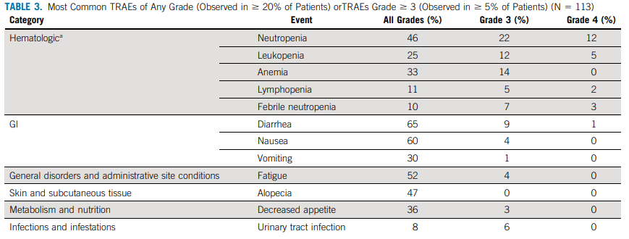
Sacituzumab Govitecan: AE Management
  Most Common TRAEs of Any Grade (Observed in ≥20% of Patients) or TRAEs Grade ≥3 (Observed in ≥5% of Patients) (N = 113)
Neutropenia and diarrhea are the most common heme and GI toxicity, respectively
Consider cycle 1 dose reduction and add myeloid growth factor as needed
Conduct weekly labs in cycle 1
Notes:
What about sacituzumab govitecan? So sacituzumab can cause pretty profound cytopenias and neutropenic fever. We still think that this drug has a place, particularly for those patients who don’t have an FGFR3 alteration or fusion, or don’t have HER2 overexpression. We really still need medications in our toolkit in addition to clinical trials. So, in our practice, I still use this medication sparingly but still use it. I’ll dose reduce and also use growth factor upfront for patients starting sacituzumab.

Slide 50
Best Practices for Multidisciplinary Care
It takes a village to manage patients!

Slide 51
Multidisciplinary Team Is Critical for Oncology Care
Physician extenders/infusion room nurses – non-day 1 visits
Phone triage with qualified nurses
Collaboration among dermatology, pulmonology,
ophthalmology, endocrinology, PM&R, pain and
palliative care, cardiology, hepatology/GI, and PCP
Social workers, healthcare navigators, nurse educators,
and pharmacists
Oncology urgent care
Support infrastructure for managing irAEs
Notes:
Multidisciplinary care of patients with locally advanced and metastatic urothelial cancer in oncology is a team effort. So it's not just the physician that the patient sees, but a team of people that include physician extenders, nurse practitioners, and infusion room nurses that see the patient on a much more regular basis, and they can provide follow-up to us, ask questions, discuss management with patients on non-day 1 visits. Our telephone triage systems throughout oncology practices are robust, and it's important to keep them educated into some of the side effects that we're particularly looking out for, especially high-grade rashes when we're starting enfortumab and pembrolizumab.
Multidisciplinary care including consultants in dermatology, pulmonary, ophthalmology, endocrinology, physical medicine and rehab, pain and palliative care, cardiology, hepatology and GI as well as primary care providers are integral to the care of our patients.
Other team members such as social workers, nurse navigators, educators and pharmacists also play a really key role, especially with oral targeted therapy. Many centers now also have oncology urgent care to help with symptom management and hopefully prevent admissions to the hospital.
And finally, many centers over the last decade have developed a robust infrastructure for multidisciplinary management of immune-related adverse events for any kind of checkpoint toxicity, including in combination with enfortumab.

Slide 52
  Navigating Transitions From Local Therapy to Systemic Therapy and Back to Local Therapy
Patients are living longer with highly effective systemic therapy
Questions about local management in the metastatic setting remain unclear
Urology role is shifting and expanding – consideration of palliative surgery in patients who are stable on therapy
Radiation can be considered during treatment breaks and/or to treat
primary cancer
This may allow for extended use of each line of treatment vs switching therapy
Palliative/supportive role of interventional radiology beyond PCN and management
Notes:
Now, what about navigating transitions from local to systemic therapy and then back again? As a medical oncologist with expertise in treating locally advanced and metastatic urothelial cancer, I partner very closely with urologists who are often referring patients with locally advanced or metastatic urothelial cancer to clinic. But it’s different now than my relationship with our urology colleagues maybe 5 or 10 years ago, patients are living a lot longer with this very highly effective systemic therapy that we give either in the frontline or in sequence.
The urology role is shifting and expanding, and our urologists are considering palliative surgery for patients with later-stage disease, for a patient that's been stable on therapy but maybe with a late growth in a primary tumor. Radiation has again taken on an additional role, either during treatment breaks or to a tumor where an oligometastatic lesion is growing and the rest of the tumor is remaining stable on frontline therapy.
We often will hold therapy and consider radiation and maybe restart. This can allow for a longer duration on each line of therapy versus switching to a completely different regimen. And palliative and supportive role of IR, interventional radiology, has really developed beyond just percutaneous nephrostomy tube management, which is a common procedure for patients with urothelial cancer, into considering things like vertebroplasty or even again local management to an oligo progressing lesion in the setting of otherwise stable disease.

Slide 53

Team Coordination
Establish best lines
of communication
Introduce key team members
Assess language barriers
Review patient portals
Promote communication among caregivers
Define role of primary
care provider
Notes:
Team coordination involves great lines of communication between all these different teams. For patients, really all this is kind of flying at them, so introduction of team members and assessing language barriers are of course important to think about. Patient portals, we’re using those portals a lot. More and more patients are becoming more facile with computers, thank goodness. Communication among caregivers is important and then also involve as much as we can primary care physicians.

Slide 54
Shared Decision-Making in the New Era of aUC Care
Understanding patients’ goals and preferences

Slide 55
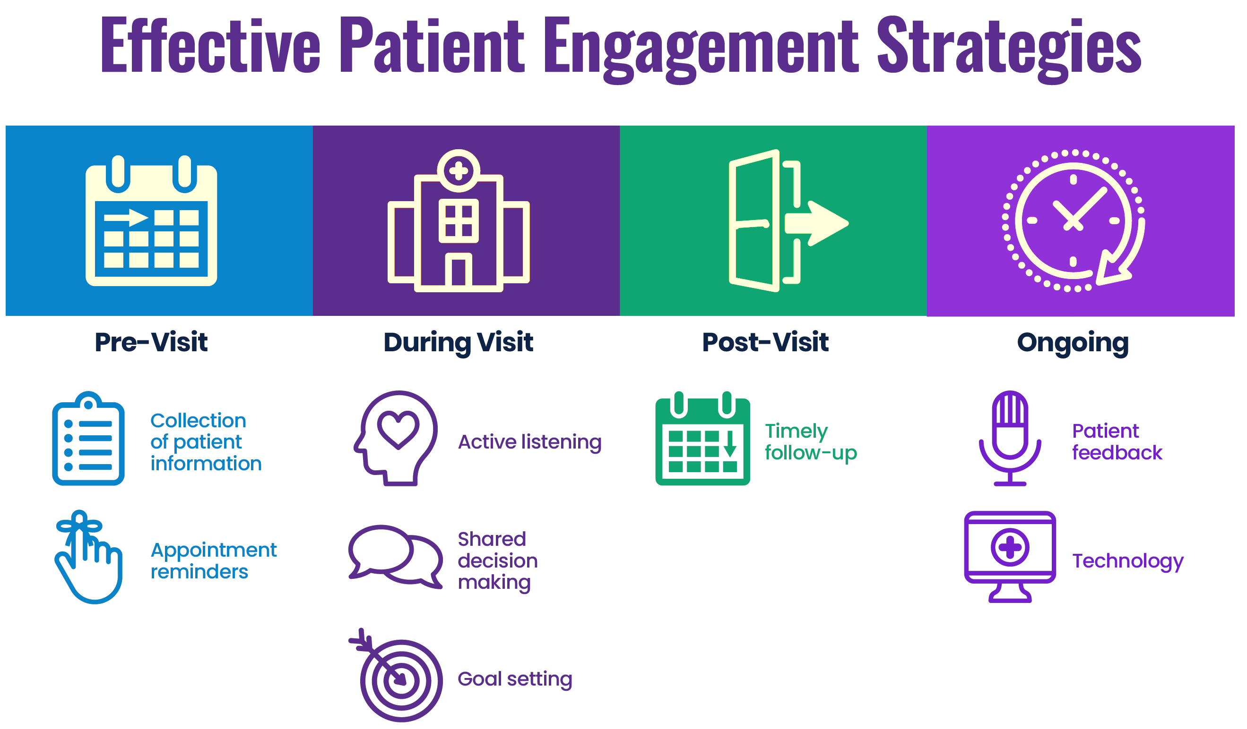
Patient Engagement Is Integral to Treatment Planning
  Engaging patients
  in the full range of treatment options
  Integrating patient preferences into treatment planning
Notes:
Shared decision-making in urothelial cancer is understanding the patient’s goals and preferences. Absolutely important engaging patients and families in all the different treatment options and integrating patient preferences into treatment planning. At Hopkins, we also engage a lot with patient advocacy network called BCAN, the Bladder Cancer Advocacy Network, which is I think a great partner in helping in terms of framing some of these discussions.

Slide 56
Shared Decision-Making (SDM) in Cancer Care
SDM is a fundamental method of care that is central to individualizing treatment
It involves a multidisciplinary team approach to ensure optimal care for and communication with the patient and their family
The initial step involves promoting productive dialogues that encourage active patient-clinician collaboration, facilitating the process of care plan development and supporting the cocreation of a comprehensive care plan
SDM is crucial to ensure that the patient’s goals of therapy
are included when selecting treatment
Shickh S, et al. Am Soc Clin Oncol Educ Book. 2023;43:e389516.
Notes:
Shared decision-making in cancer care is vital, particularly for patients with advanced urothelial cancer. It's a fundamental method of care that's central to individualizing treatment. It involves a multidisciplinary team approach to ensure optimal care for and communication with the patient and their family. The initial step involves promoting productive dialogs that encourage active patient-clinician collaboration, facilitating the process of a care plan development, and supporting the co-creation of a comprehensive care plan. It's crucial to ensure that the patient's goals of therapy are included when selecting treatment.

Slide 57
The Role of SDM in Planning Treatment Regimens
In recent years, treatment options for advanced UC have rapidly expanded to include antibody–drug conjugates, immunotherapies, targeted therapies, and combinations, as well as multidisciplinary approaches
Patients and their families are bombarded by a glut of information about cancer, especially through social media and the internet
The complexity of cancer care and the abundance of cancer-related information can complicate the development of individualized care plans
Shickh S, et al. Am Soc Clin Oncol Educ Book. 2023;43:e389516.
Notes:
The role of shared decision-making in planning treatment regimens is incredibly important because, in part, the treatment options in urothelial cancer have expanded so rapidly to include ADCs, immunotherapies, targeted therapies and combinations. Patients are really have so much information and especially those who are coming in with information from the internet.

Slide 58
Practical Application:
Case-Based Learning Lab
How to apply clinical data to daily practice?

Slide 59
Borderline Cisplatin-Eligible Patient With aUC
74-YEAR-OLD MAN
Presentation
Medical History
History of pT2N0 UTUC 4 years ago, presents with gross hematuria
Seen by urology 14 months ago for surveillance cystoscopy, missed last few due to caretaking role
New tumor found on cystoscopy > TURBT with MIBC
CT CAP shows metastasis to lung and liver without impact on liver function
LUTS with intermittent hematuria
Narcotic PRN for pain
Your local urology partner ordered NGS and IHC tests (HER2 equivocal; FGFR3 mutated)
Hypertension
Diabetes, on metformin
Grade 1 neuropathy
CKD following RNU – GFR stable at 40 ml/min
PS 1
Quit smoking 4 years ago
Retired woodworker
No family history of cancer

Slide 60
Case Study Polling Question #1
Which first-line treatment would you recommend?
  Erdafitinib
  Trastuzumab deruxtecan
  Cisplatin + gemcitabine + nivolumab
  Enfortumab vedotin + pembrolizumab
  Unsure
Notes:
Correct answer: d) Enfortumab vedotin + pembrolizumab

Slide 61
Borderline Cisplatin-Eligible Patient With aUC
74-YEAR-OLD MAN
Treatment Outcomes After First-Line Therapy
He proceeds with enfortumab vedotin 1.25 mg/kg days 1 and 8 and pembrolizumab 200 mg day 1
He presents at day 12 to oncology urgent care with fatigue and grade 2 rash
Laboratory studies are stable from baseline

Slide 62
Case Study Polling Question #2
Which of the following approaches would be most appropriate?
  Start high-dose steroids 1 mg/kg
  Start cycle 2 early
  Consult dermatology for biopsy
  Start supportive topical steroid and oral antihistamine
  Unsure
Notes:
Correct answer: d) Start supportive topical steroid and oral antihistamine

Slide 63
Borderline Cisplatin-Eligible Patient With aUC
74-YEAR-OLD MAN
Treatment Outcomes After AE Management
Skin toxicity manageable with supportive care, and dose reduction to 1 mg/kg EV in cycle 3 and beyond
He completes 8 EVP cycles with best response of PR
Grade 2 neuropathy and fatigue precludes maintenance pembrolizumab
3-month follow-up – NED
6-month follow-up – PD in LN and liver; bone lesions remain well controlled
Repeat molecular testing still shows FGFR3 mutation

Slide 64
Case Study Polling Question #3
Which second-line treatment would you recommend?
  Rechallenge with enfortumab vedotin and pembrolizumab
  Cisplatin + gemcitabine + nivolumab
  Erdafitinib
  Trastuzumab deruxtecan
  Unsure
Notes:
Correct answer: c) Erdafitinib

Slide 65
There Are MANY Second-Line Options
  Rechallenge with enfortumab
  vedotin and pembrolizumab
  Enfortumab
  Pembrolizumab
  Cisplatin + gemcitabine + nivolumab
  Carboplatin + gemcitabine
  Carboplatin + gemcitabine + nivolumab
  Erdafitinib
  Trastuzumab deruxtecan
  Sacituzumab govitecan
  Taxane
  Radiation
  Metastasectomy
  Clinical Trials
  Other

Slide 66
Key Takeaways
What are the take-home messages?

Slide 67
Key Takeaways
Patients with advanced are living longer than ever before
Platinum eligibility no longer directs first-line treatment decisions
More patients (with markers of frailty) will be eligible for first-line EVP
  Outcomes can be durable – even with EV discontinuation/pembrolizumab hold
  Most patients will respond – see how they tolerate C1D1 before making additional decisions
Early toxicity management and dose modification/supportive care is paramount
No clear dogmatic second-line sequencing strategy as of now
  Treatment choice based on comorbidities (neuropathy), PS, and GOC
  Biomarker-directed care is generally second line and beyond
Multidisciplinary care and shared decision-making are critical to ensure optimal
patient outcomes
Notes:
So for key takeaways, patients with advanced urothelial cancer are living longer than ever before. Platinum eligibility no longer directs first-line treatment decisions. More patients, even with those with markers of frailty, will be eligible for first line enfortumab and pembrolizumab. Outcomes can be durable with this regimen, even with enfortumab discontinuation and/or pembrolizumab hold. And most patients will have some degree of clinical benefit or response, but we’d like to see how they're tolerating their early cycles before making treatment decisions.
Early toxicity management with dose modification and supportive care in the management of enfortumab and pembrolizumab is absolutely paramount. If patients have progression after enfortumab and pembrolizumab, there are no clear dogmatic second-line go-to options, but there are treatments available.
Treatment choice is predicated on patient comorbidities such as neuropathy, functional status as well as goals of care. Platinum-based therapy as well as biomarker-directed care are options in the second-line and beyond.
Multidisciplinary care and shared decision-making are critical to ensure optimal patient outcomes.

Slide 68
Glossary
ADL, activities of daily living aUC, advanced urothelial carcinoma
BSC, best supportive care
CR, complete response
DDMVAC, dose dense methotrexate, vinblastine, doxorubicin, cisplatin
DOR, duration of response
ECOG PS, Eastern Cooperative Oncology Group performance score
EVP, enfortumab vedotin + pembrolizumab
GI, gastrointestinal
ICI, immune checkpoint inhibitor
IHC, immunohistochemistry
ILD, interstitial lung disease
LVEF, left ventricular ejection fraction
mUC, metastatic urothelial carcinoma
NGS, next-generation sequencing
ORR, overall response rate
PD-L1, programmed cell death–ligand 1
PD, progressive disease
PFS, progression-free survival
PO, orally
PR, partial response
SD, stable disease
T1DM, type 1 diabetes mellitus
UTUC, upper tract urothelial carcinoma

