Slide 1
HER2 in Solid Tumors: From Pathology to Personalized Treatment Plans

Slide 2
DISCLAIMER
This slide deck in its original and unaltered format is for educational purposes and is current as of May 2026. All materials contained herein reflect the views of the faculty, and not those of AXIS Medical Education, the CME provider, or the commercial supporter. Participants have an implied responsibility to use the newly acquired information to enhance patient outcomes and their own professional development. The information presented in this activity is not meant to serve as a guideline for patient management. Any procedures, medications, or other courses of diagnosis or treatment discussed or suggested in this activity should not be used by clinicians without evaluation of their patients’conditions and possible contraindications and/or dangers in use, review of any applicable manufacturer’s product information, and comparison with recommendations of other authorities.

Slide 3
DISCLOSURE OF UNLABELED USE
This activity may contain discussion of published and/or investigational uses of agents that are not indicated by the FDA. The planners of this activity do not recommend the use of any agent outside of the labeled indications.
The opinions expressed in the activity are those of the faculty and do not necessarily represent the views of the planners. Please refer to the official prescribing information for each product for discussion of approved indications, contraindications, and warnings.
USAGE RIGHTS
This slide deck is provided for educational purposes and individual slides may be
used for personal, non-commercial presentations only if the content and references
remain unchanged. No part of this slide deck may be published in print or
electronically as a promotional or certified educational activity without prior written
permission from AXIS. Additional terms may apply. See Terms of Service on
www.axismeded.com for details.

Slide 4
Learning Objectives
Upon completion of this activity, participants should be better able to:
Identify patients with advanced solid tumors who may benefit from HER2-targeted ADCs by testing HER2 expression at metastatic onset or disease progression, ensuring adherence to optimal testing methodologies
Develop team-based strategies for regimen selection and sequencing in advanced HER2-positive tumors, incorporating emerging data and guideline updates
Formulate comprehensive strategies for monitoring and managing both common and rare treatment-related adverse events for HER2-targeted ADCs, incorporating established guidelines, manufacturer recommendations, and emerging data to optimize patient safety and therapeutic outcomes

Slide 5
HER2 Expression and Testing

Slide 6
Timeline of FDA Tumor-Agnostic Approvals in Solid Tumors
Characterizing tumors based on genetic abnormalities rather than tissue origin represents a paradigm shift in oncology
Targeted therapies have been approved in tumor-agnostic indicationsª
May 2017
Pembrolizumab in dMMR/MSI-H cancers
Aug 2019
Entrectinib in NTRK fusion positive cancers
Aug 2021
Dostarlimab in dMMR/MSI-H solid tumors
Sep 2022
Selpercatinib in RET fusion positive solid tumors
June 2024
Repotrectinib in NTRK gene fusion-positive solid tumors
Nov 2018
Larotrectinib in NTRK fusion positive cancers
Jun 2020
Pembrolizumab in TMB-high cancers
Jun 2022
Dabrafenib/trametinib
in BRAF^{V600E} mutant solid tumors
Apr 2024
Trastuzumab deruxtecan
in HER2-positive solid tumors
Notes:
It's been an exciting time over the past 10 years with the rapid development and approval of targeted therapies, some of which have been truly targeted, what we call tissue-agnostic, really just if we have the mutation, if we have the expression, we have the fusion, whatever tumor type, we can access these novel and active medications.
This slide just summarizes some of that exciting development released since 2017, with the approval of pembrolizumab in deficient mismatch repair or microsatellite unstable tumors, all the way to our most recent—what we're going to focus on today—in 2024, the approval of trastuzumab deruxtecan in HER2-positive solid tumors. So this is an exciting time for our patients.

Slide 7
History of Approvals for HER2-Targeted Therapies for Cancer
HER2 protein expression, gene amplification, and gene mutation are therapeutic targets in several types of tumors
HER2-directed therapy is the standard of care for HER2-expressing unresectable or metastatic breast cancer, HER2-positive locally advanced or metastatic gastric cancers, CRC and GEJ adenocarcinomas, and HER2-mutant NSCLC
T-DXd (HER2-low or HER2-ultralow MBC)
Tucatinib +
Neratinib (MBC)
Trastuzumab (RASwt mCRC)
Approval of anti-HER2 therapeutics in the USA
Lapatinib (MBC)
Trastuzumab (mG/GEJ)
Neratinib (adj BC)
Tucatinib (MBC)
T-DXd (mG/GEJ)
1998 1999 2000 2001 2002 2003 2004 2005 2006 2007 2008 2009 2010 2011 2012 2013 2014 2015 2016 2017 2018 2019 2020 2021 2022 2023 2024 2025
Trastuzumab (MBC)
Trastuzumab (adj BC)
Pertuzumab (MBC)
Pertuzumab (adj BC)
Margetuximab (MBC)
TKI
Pertuzumab–
trastuzumab–
hyaluronidase-zzxf (MBC, adj BC)
Pertuzumab (neoadj BC)
T-DXd (solid tumors)
mAb
ADC
T-DXd (HER2-mutant mNSCLC)
T-DM1 (MBC)
T-DM1 (adj BC)
T-DXd (2L MBC)
T-DXd (3L MBC)
T-DXd (HER2-low MBC)
Notes:
Focusing just on HER2, this is a long story. This story and the remarkable evolution of the identification of HER2, first in breast and ovarian cancer. And you can see this trajectory with monoclonal antibodies, trastuzumab, pertuzumab, transitioning into tyrosine kinase inhibitors, lapatinib, neratinib, tucatinib, and then into the antibody-drug conjugate era, first with T-DM1 and now T-DXd, and even others in development. And this has been a rapidly evolving story with benefit to many patients with solid tumors.

Slide 8
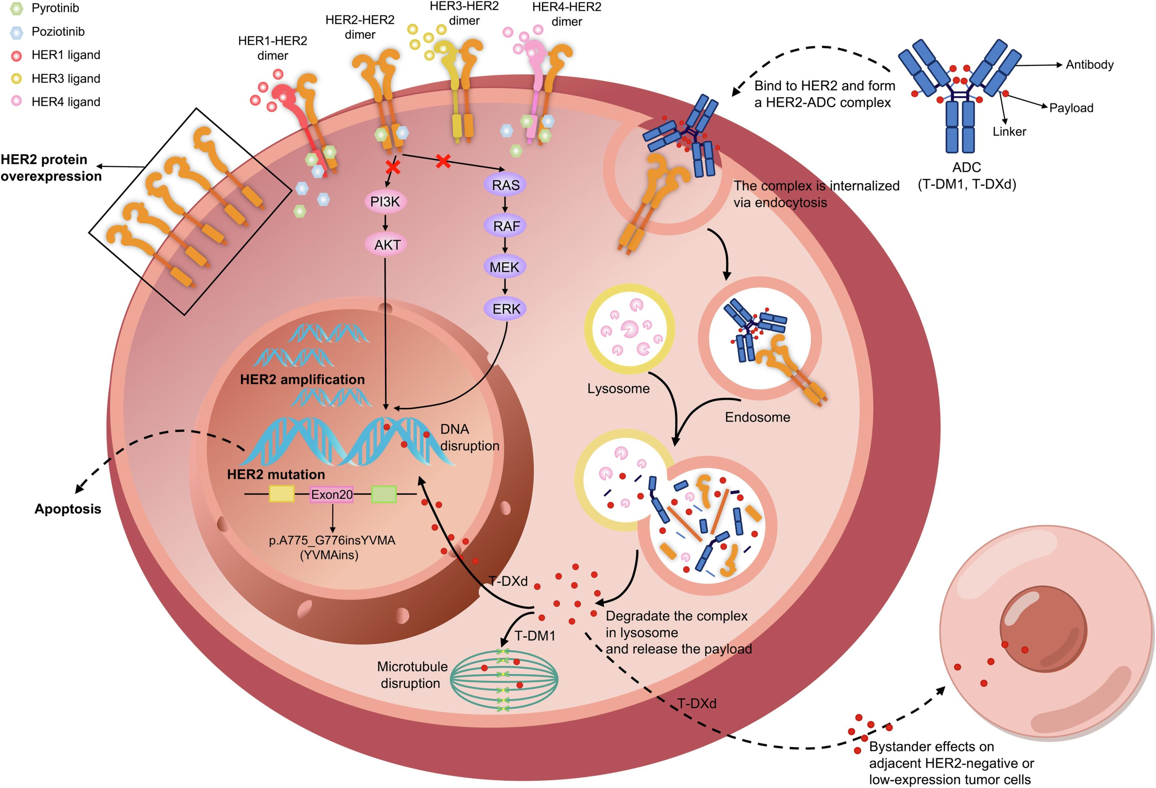
HER2 Alterations
HER2 alterations include:
Gene amplification
Abnormally high number of HER2 (ERBB2) gene copies
Detected by: ISH or NGS, PCR can be used
Gene mutation
Mutation in HER2 (ERBB2) gene
Detected by: NGS
Protein overexpression
Overabundance of HER2 receptors on cell surface
Detected by: IHC
Notes:
When we talk about HER2 alterations, in the past, we were really just talking about what we used for identification, mainly in breast and gastric cancers, around immunohistochemistry and amplification. And that has broadened quite a bit, especially with the recent tumor-agnostic approval for trastuzumab deruxtecan.
What we're talking about when we're assessing a patient who has cancer, assessing their tumor for HER2 alterations, we're looking at all three of these categories now. We're looking for gene amplification. We're also looking for gene mutations, and these are incredibly important, for example, in lung cancer, breast cancer, a little less common but no less important in other solid tumors. This is detected by next-generation sequencing. Most commonly now our eyes are scanning pathology reports, and you know if we send things out for panel testing, we're looking for that immunohistochemistry, which is an overabundance of HER2 receptors on the cell surface, and this is detected by immunohistochemistry. In large part we're really testing the tumor for these alterations in our patients with solid tumors.

Slide 9
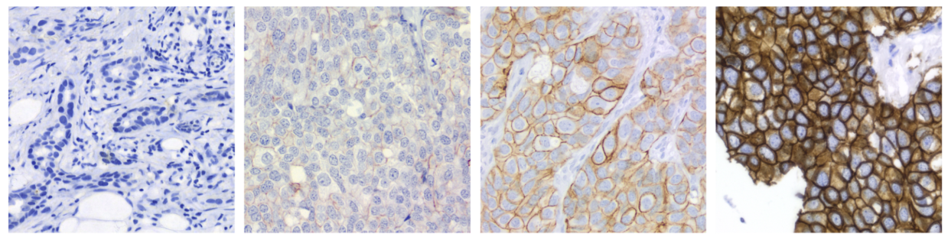
Evolving Categories of HER2 Expression
IHC 0
IHC 1+
IHC 2+
IHC 3+
ISH
Initial 2-category system
ISH-
ISH+
HER2-Negative
HER2-Positive
Updated 4-category system
IHC 0
HER2-Ultralow
HER2-Low
HER2-Positive
Membrane staining
Faint, incomplete staining in ≤10% tumor cells
Faint, incomplete staining in >10% tumor cells
Weak to moderate complete staining in >10% tumor cells
Absent
Notes:
Focusing on the IHC component a little bit more, this is really an evolving landscape. In the past, we had a two-category system. It's either HER2-positive or negative, but that's really how a lot of us categorized the tumor in our notes. We would just say HER2-positive, indicating it was either 3+ or 2+ ISH, or negative everything else. And now, because of the rapid evolution of trastuzumab deruxtecan, mainly in breast cancer, demonstrating efficacy at these other categories, HER2-low, HER2-ultralow, and I would say even 0, but that's a breast cancer story, now we're all having to go back and make sure if we said someone's tumor was HER2-negative, we know exactly what we're talking about there.
So it's kind of a catch-up phase right now to make sure that we're appropriately classifying our patients' tumors so we can assess whether or not T-DXd is an appropriate therapy for them.

Slide 10
How Did HER2 Testing Start?
1998 – HER2 gene amplification and protein over-expression associated with adverse breast cancer outcomes
1998 – Trastuzumab fast-tracked by FDA for approval for metastatic breast cancer treatment
2007 – “Retrospective subgroup analyses of the early trastuzumab trials suggest that the antibody was most active in patients with tumors that showed 3+ HER2 staining intensity [by IHC] or had HER2 gene amplification on FISH. No patient with only 2+ staining had a response unless gene amplification was detected.”

Slide 11
Based on all these results, IHC and FISH became the tests of choice for measuring biomarker HER2 in order to determine efficacy of anti-HER2 treatment in breast cancer
But this is all based on responses of breast cancer to trastuzumab –
how and what do need to know now in the era of ADCs and beyond?
Notes:
IHC and FISH became the tests of choice for measuring biomarker HER2 in order to determine efficacy of anti-HER2 treatment in breast cancer.

Slide 12
Only Breast and Gastric Cancers Have CAP HER2 Guidelines
 | Breast (ASCO/CAP 2007) | Breast (ASCO/CAP 2013) | Breast (ASCO/CAP 2018) | Gastric (ASCO/CAP 2016) | Colorectal (HERACLES trial) | UPSC (Fader et al.)
HER2 IHC 3+ | >30% strong, uniform, complete | >10% circumferential, strong, complete | >10% circumferential, strong, complete | ≥10%, strong complete or basolateral/lateral | ≥50% strong, complete or basolateral/lateral | >30% strong complete or basolateral/lateral
HER2 FISH amplification | HER2/CEPT17 ratio >2.2 Patients with HER2/CEPT17 ratio 2-2.2 eligible | HER2/CEPT17 ratio ≥2.0 OR ratio <2.0 and HER2 signal ≥6.0/nucleus | HER2/CEPT17 ratio ≥2.0 OR ratio <2.0 and HER2 signal ≥6.0/nucleus (if IHC 2+ or 3+) | HER2/CEPT17 ratio ≥2.0 OR ratio <2.0 and HER2 signal ≥6.0/nucleus | HER2/CEPT17 ratio ≥2.0 in ≥50% of cells | HER2/CEPT17 ratio ≥2.0
Notes:
The CAP guidelines for HER2 expression are always under evolution, but it's important to remember, even though we have this new approval based on gastric scoring, breast and gastric and colorectal, to some extent, via the HERACLES trial, are really the only tumors that have CAP guidelines.
And the breast guidelines, are always under evolution. For UPSC, which is uterine serous carcinoma, we don't have CAP guidelines; we have suggestions. But you can see how these differ, which is quite a challenge for our pathologists and for physicians in making sure that we're ordering you know the right assessment in the right patient setting, so that we know exactly what that tumor HER2 positivity or lack thereof correlates with in terms of the drugs we might use for that patient.
So this is really a complicated space and requires a lot of multidisciplinary interaction with our pathology colleagues to make sure that we get this right, depending on the tumor that we are assessing.

Slide 13
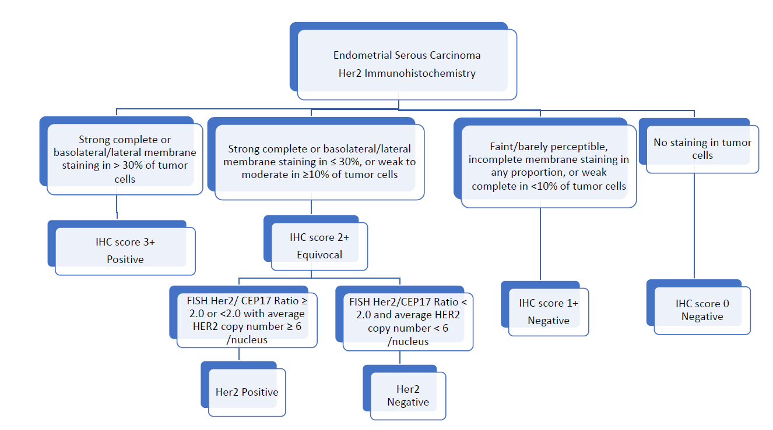
Endometrial Cancer Suggested Scoring
Addition of trastuzumab to paclitaxel and carboplatin was endorsed by the NCCN in 2019
Pathologic evaluation of tumor HER2 protein expression and gene amp is a critical part of therapeutic decision making
HER2 IHC score incorporates both staining intensity and percentage of tumor cell staining
Both complete and basolateral/lateral staining patterns count towards percentage staining
cut-off

Slide 14
Testing for HER2 Alterations (IHC/FISH) Was Largely Limited to the Few Indications for Trastuzumab and/or Pertuzumab, Until…
January 19, 2023 — The Food and Drug Administration (FDA) granted accelerated approval to tucatinib in combination with trastuzumab for RAS wild-type HER2-positive unresectable or metastatic colorectal cancer that has progressed following fluoropyrimidine-, oxaliplatin-, and irinotecan-based chemotherapy.
Notes:
Testing for HER2 alterations (IHC/FISH) was largely limited to the few indications for trastuzumab and/or pertuzumab, until…

Slide 15
Testing for HER2 Alterations (IHC/FISH) Was Largely Limited to the Few Indications for Trastuzumab and/or Pertuzumab, Until…
January 19, 2023 — The Food and Drug Administration (FDA) granted accelerated approval to tucatinib in combination with trastuzumab for RAS wild-type HER2-positive unresectable or metastatic colorectal cancer that has progressed following fluoropyrimidine-, oxaliplatin-, and irinotecan-based chemotherapy.
April 5, 2024 — The Food and Drug Administration (FDA) granted accelerated approval to fam-trastuzumab deruxtecan-nxki for adult patients with unresectable or metastatic HER2-positive (IHC 3+) solid tumors who have received prior systemic treatment and have no satisfactory alternative treatment options.
Notes:
…The 2024 FDA-approval of fam-trastuzumab deruxtecan-nxki for adult patients with unresectable or metastatic HER2-positive (IHC 3+) solid tumors who have received prior systemic treatment and have no satisfactory alternative treatment options.

Slide 16
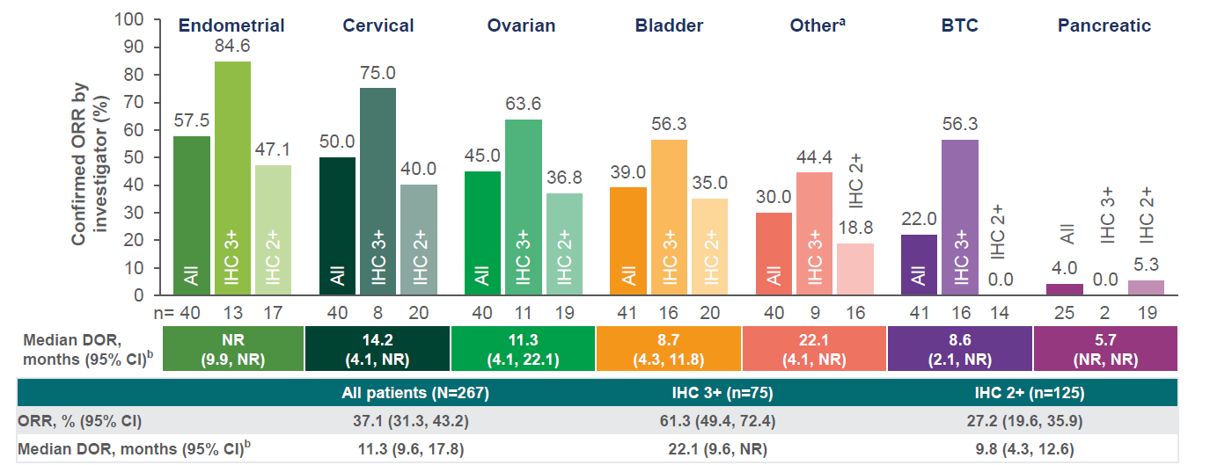
And Further Evidence That HER2-Targeting ADCs and TKIs May Benefit Beyond Current Indications
Trastuzumab deruxtecan in gastric scoring HER2-positive disease (IHC 2+ and 3+)
Notes:
Further evidence that HER2-targeting ADCs and TKIs may benefit beyond current indications.

Slide 17
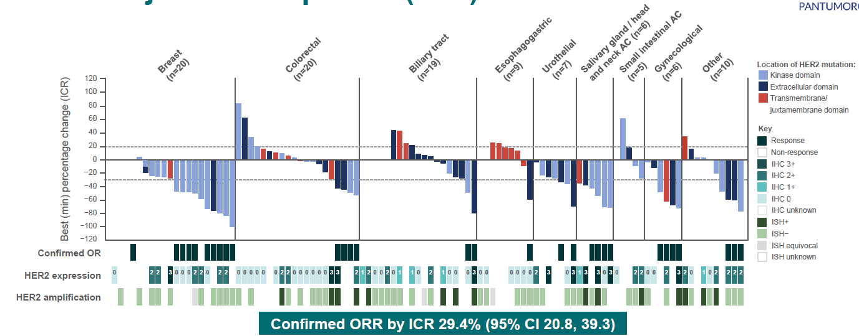
And Further Evidence That HER2-Targeting ADCs and TKIs May Benefit Beyond Current Indications
Trastuzumab deruxtecan in HER2 mutations

Slide 18
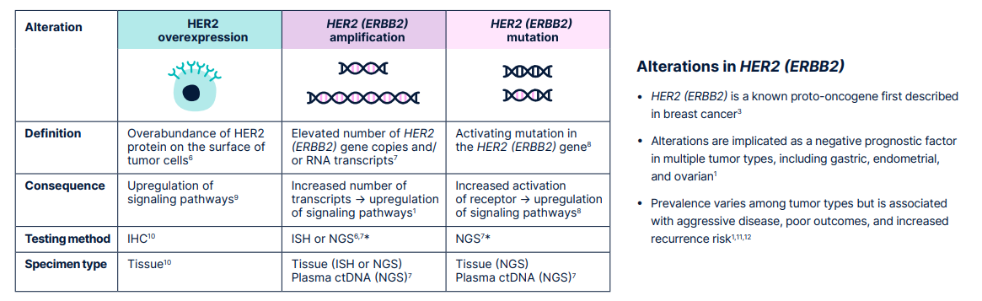
We Are Identifying More Alterations in HER2 With Common Use of NGS Plus Panels of IHC
Notes:
But again, what we're looking for here are HER2 expression which is from the tissue immunohistochemistry, and basically this was referring to an overabundance of HER2 protein on the surface of tumor cells. We're looking at amplification, which is an elevated number of HER2 or ERBB2 gene copies. Why? Because an increased number of transcripts leads to upregulation of signaling pathways. And then we're looking for HER2 mutations, which are activating mutations in the HER2 or again ERBB2 gene, which are less common but are targetable.

Slide 19
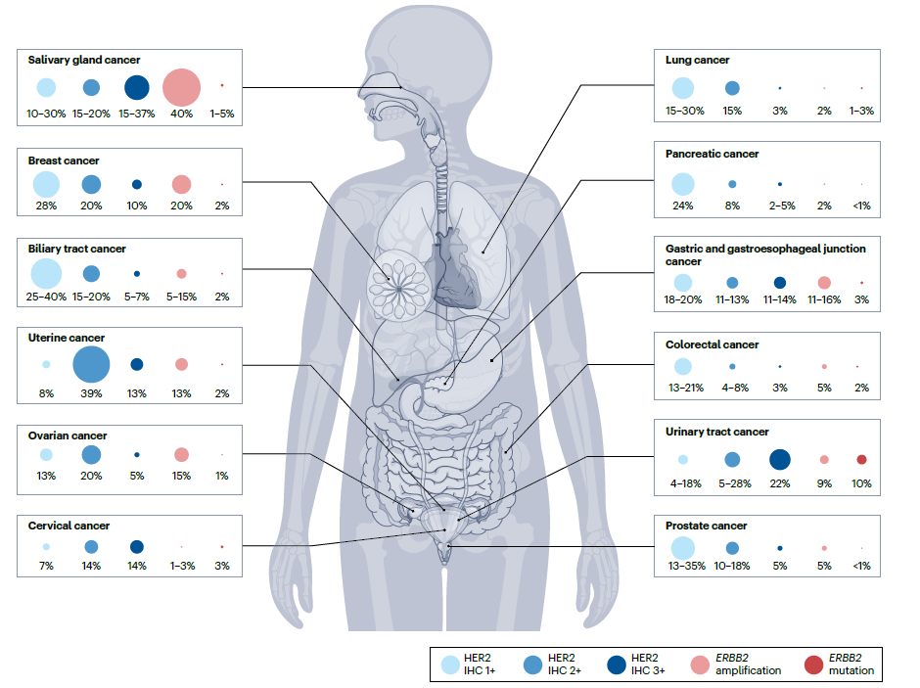
HER2 IHC, Amplification, and Mutations by Disease Type: What Is the Predictive Value of Each of These Across Solid Tumors?
Notes:
So we're looking for all of these for our patients. And when we look across tumor types, the size of the circle gives you the kind of highest prevalence of findings in that tumor. So for example, at the top here you can see salivary gland cancer. You'll find ERBB2 amplification in 40%, you'll find HER2 IHC 3+ in 15 to 37%, you'll find very few mutations, and that's kind of across the board what we see with mutations outside of like urinary tract cancer, for example. Uterine cancer, which is my world, we find HER2 2+ — that's what this group is—pretty commonly, especially in TP53-altered tumors, 3+ less so mutations almost never.
So this gives you a sense of how common some abnormality in HER2 testing is. The big question is, okay, if I find a 2+, if I find an amplification, if I find a mutation, what's the predictive value that that has so I can tell my patient the expectation that that medication will benefit him or her is really what's under sort of rapid discovery.

Slide 20
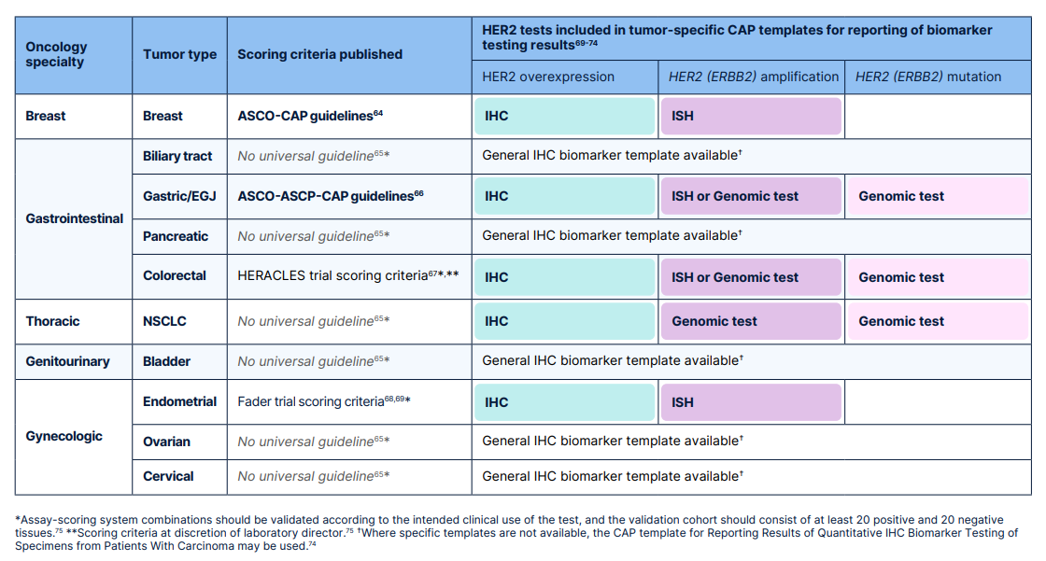
Still, Only Breast and Gastric Have CAP Guidelines—
We Have a Lot to Learn in Order to Effectively Guide Therapy Across Other Solid Tumors
Notes:
So this just sort of reiterates the point that to this day, we only have CAP guidelines for breast and gastric cancer, and because of T-DXd’s approval in pan-tumor, outside of established CAP guidelines, like for all of gynecologic cancers as an example, we're using gastric scoring in most settings, in addition to the next-gen sequencing, to really assess for whether or not our patients are candidates for some of these HER2-targeting agents.

Slide 21
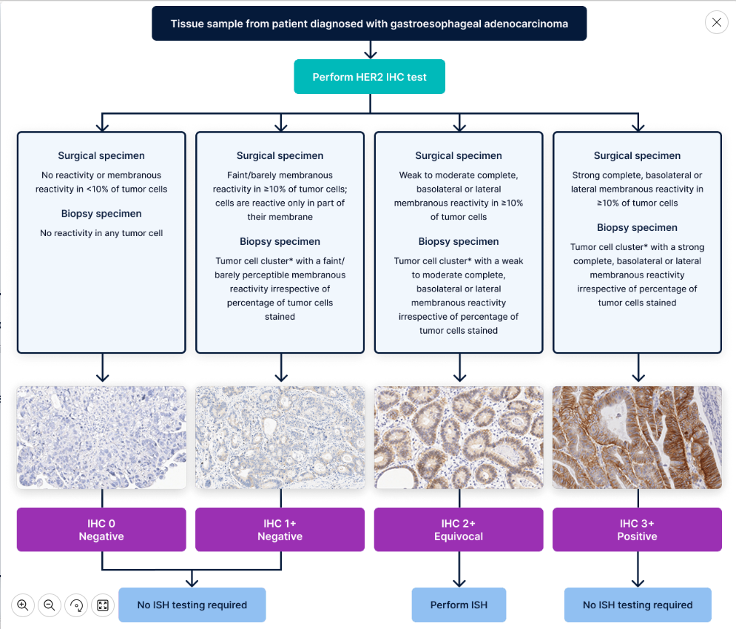
Gastric HER2 IHC Scoring Algorithm

Slide 22
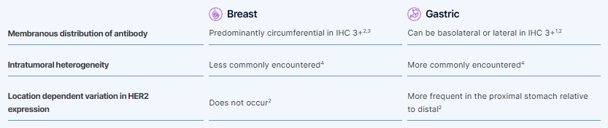
How Does HER2 in Gastric Cancers Differ From Breast?

Slide 23
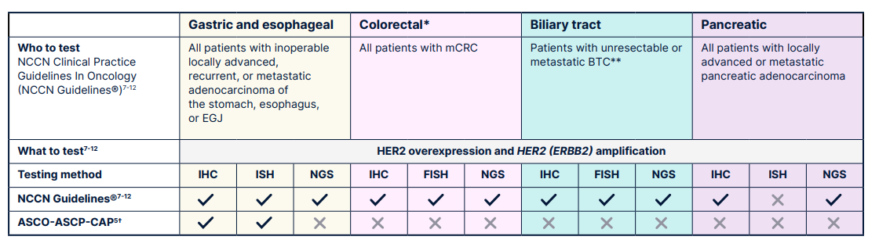
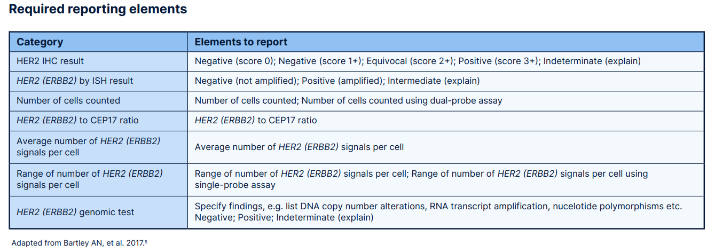
Testing in Gastrointestinal Cancers: A Closer Look

Slide 24
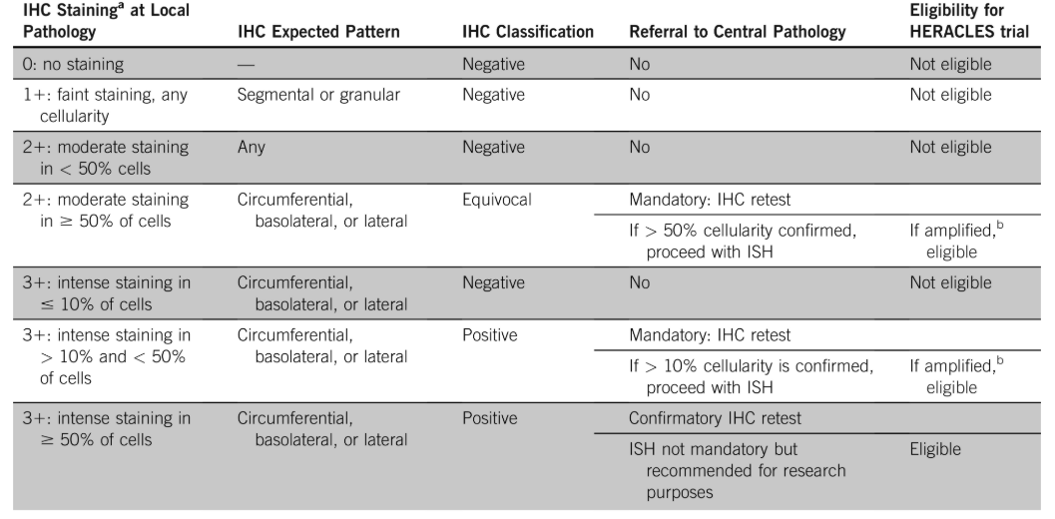
Developed HERACLES Diagnostic Criteria for CRC

Slide 25
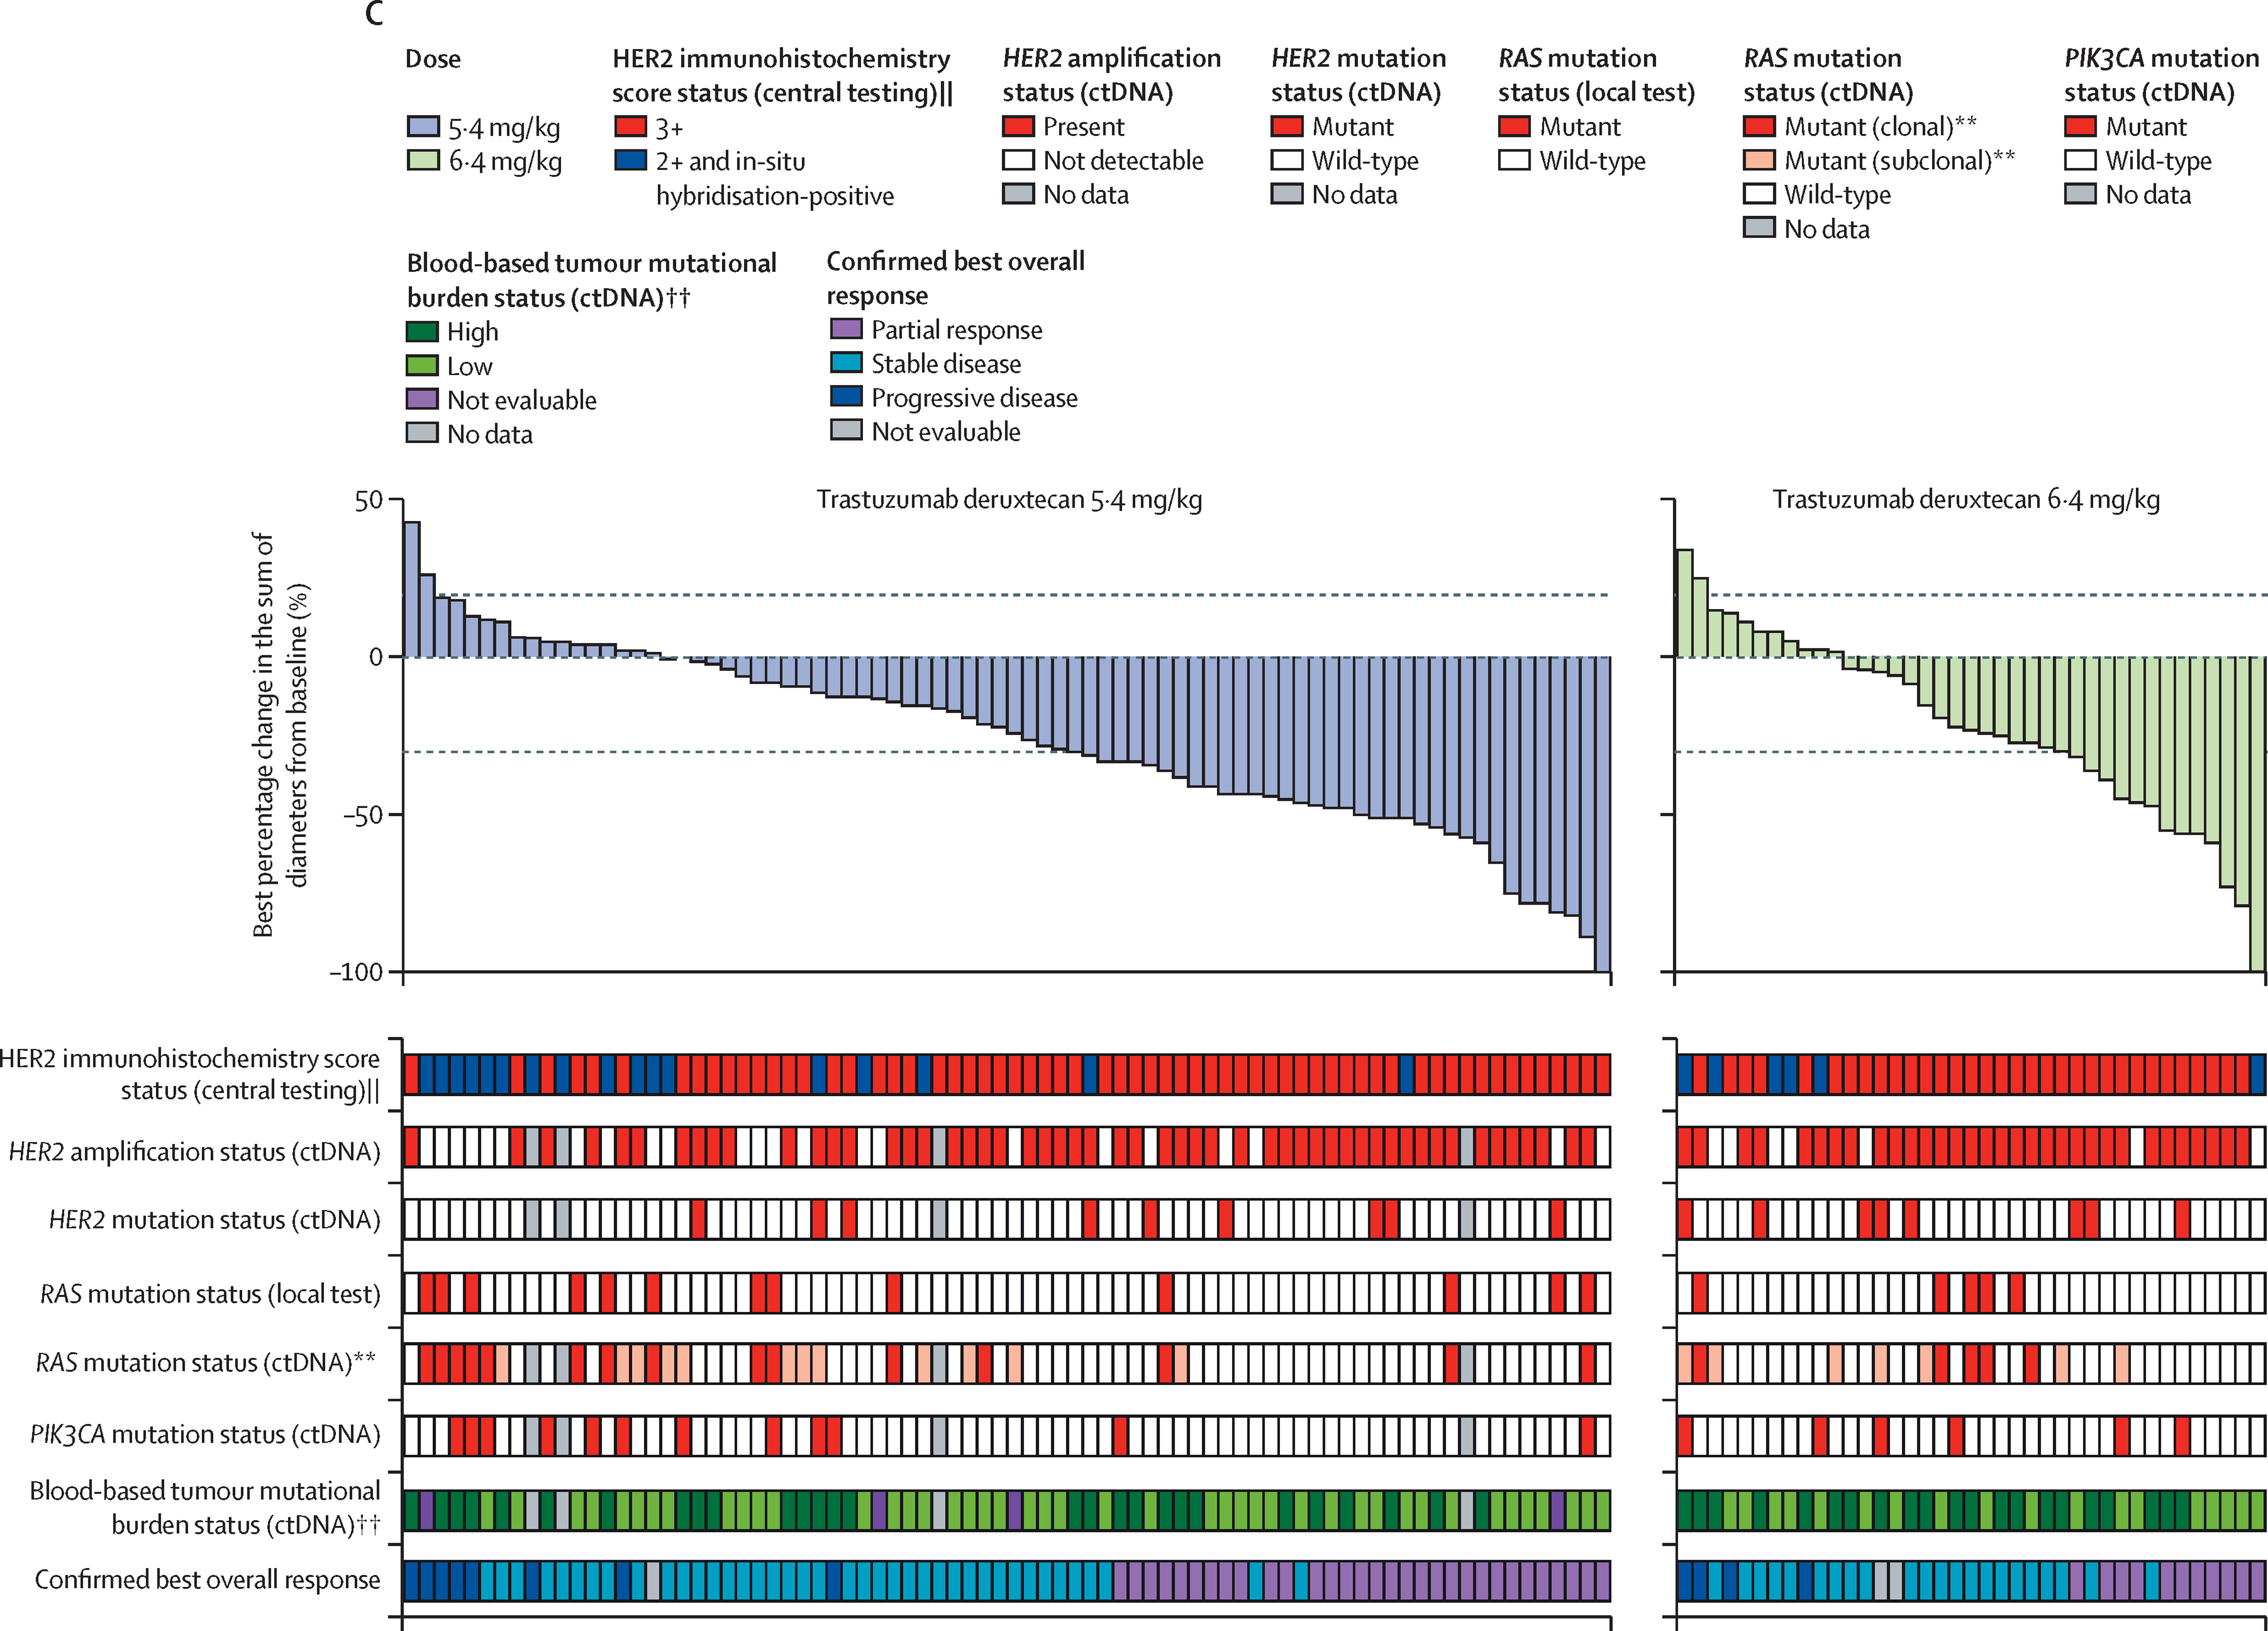
DESTINY-CRC02: Trastuzumab Deruxtecan in HER2 3+ or 2+ ISH
Again – we see at both dose levels – the 2+/ISH do not appear to respond as well

Slide 26

Best Practices for HER2 IHC Testing in Solid Tumors
Identify all patients with a HER2+ (IHC 3+) metastatic solid tumor to inform treatment decisions
Perform HER2 IHC testing in all metastatic solid tumors to identify candidates for HER2-directed therapy (eg, T-DXd)
  Include HER2 IHC testing as part of initial biomarker workup for all patients with metastatic solid tumors
Utilize FDA-approved tests for HER2 protein expression
Follow CAP guidance for reporting HER2 IHC results
Ideal tissue samples in DESTINY-PanTumor02
Acquired from non-target lesions
Collected via a core needle biopsy if possible
  Not >3 years old, preferably no older than 1 year
  Archival tissue if fresh biopsy not available, or FNA
Biliary tract
Salivary gland
Pancreatic
Endometrial
NSCLC
Bladder
Colorectal
Cervical
Ovarian
And other rare tumor types
Notes:
So best practices right now at this point, we do want to identify all patients who may be eligible really for any of our HER2-targeting agents, but the most common one that our patients are eligible for right now is trastuzumab deruxtecan based on the recent FDA approval, and also NCCN listing in some tumors for 2+ and 3+.
We want to make sure we're doing IHC testing in all of our patients’ tumors that are metastatic and potentially candidates for T-DXd, and have it ideally as a part of the initial biomarker workup, so we don't get into the position of having exhausted blocks or no access to tissue to do this testing. We can do biopsies, of course, but if we can avoid that for our patients unless necessary, that is ideal. And we want to make sure we're utilizing FDA-approved tests and following CAP guidance for reporting these tests out.

Slide 27
HER2 Overexpression: Clinical Trials
DESTINY PanTumor-02
DESTINY CRC-02
DESTINY Lung-01
Notes:
Let's just turn to how we got to the point of the approval in T-DXd in solid tumors, and it comes from three studies.

Slide 28

DESTINY PAN TUMOR-02: A Phase 2, Open-Label, Multicenter Study of T-DXd in Patients With HER2-Expressing Solid Tumors (NCT04482309)^{a,1,2}
Part 1^{1,2}
Key eligibility criteria^{1,2}
Advanced solid tumors not eligible for curative therapy
2L+ patient population
HER2 expression (IHC 3+ or 2+)
  Local test or central test by HercepTest if local test
  not feasible (ASCO/CAP gastric cancer scoring²)^{b}
Prior HER2-targeted therapy allowed
WHO/ECOG PS 0-1
Baseline characteristics^{1,2}
267 patients received treatment; 202 (75.7%) based on local HER2 testing
  111 (41.6%) patients were IHC 3+ based on HER2 test (local or central) at enrollment, primary efficacy analysis (all patients)
  75 (28.1%) patients were IHC 3+ on central testing, sensitivity analysis on efficacy endpoints (subgroup analyses)
Median age was 62 years (23-85), and 109 (40.8%) patients had received ≥3 lines of therapy
 | Cervical cancer
 | Endometrial cancer
 | Ovarian cancer
 | Bladder cancer
 | Other tumors^{d,4}
 | Biliary tract cancer
 | Pancreatic cancer
Primary endpoint
Confirmed ORR
(investigator)
Secondary endpoints
DoR, DCR, PFS, OS
Safety
Exploratory analysis
Subgroup analyses by HER2 status
T-DXd^{1,2}
5.4 mg/kg Q3W
n≈40 per cohort
planned^{c}
Primary analysis data cutoff: June 8, 2023
Median follow up: 12.75 months
ªWhile the data included in DP-02, DC-02, and DL-01 are for HER2-overexpressing tumors (IHC 3+/2+), the approved tumor-agnostic indication is for patients with HER2-positive IHC 3+ solid tumors only.³ ^{b}Patients were eligible for either test. All patients were centrally confirmed. ^{c}Cohorts with no objective responses in the first 15 patients were to be closed. ^{d}Patients with HER2-expressing tumors, excluding tumors in the tumor-specific cohorts, and breast cancer, NSCLC, gastric cancer, and colorectal cancer. Includes patients with salivary gland cancer, malignant neoplasm of unknown primary site, extramammary Paget’s disease, cutaneous melanoma, oropharyngeal neoplasm, adenoid cystic carcinoma, adenocarcinoid tumor of the appendix, head and neck cancer, intestinal adenocarcinoma, lip and/or oral cavity cancer, esophageal adenocarcinoma, esophageal squamous cell carcinoma, testis and vulva cancer.^{1,4}
1. Meric-Bernstam F, et al. ESMO 2023. LBA34. 2. Hofmann M, et al. Histopathology. 2008;52(7):797-805. 3. Fam-trastuzumab deruxtecan-nxki. Prescribing information. Daiichi Sankyo; 2024.
4. Meric-Bernstam F, et al. J Clin Oncol. 2024;42(1):47-58.
Notes:
The first is DESTINY-PanTumor. This was a basket study of T-DXd 5.4 mg/kg in seven tumor cohorts, each about 40 patients. They were eligible if they had local testing for HER2 and it was 2+ or 3+.

Slide 29
DESTINY PAN TUMOR-02: A Phase 2, Open-Label, Multicenter Study of T-DXd in Patients With HER2-Expressing Solid Tumors (NCT04482309)^{a,1,2}
Part 2^{1,2}
Key eligibility criteria^{1,2}
Locally advanced, unresectable, or metastatic solid tumors not eligible for curative therapy
2L+ patient population
HER2 expression (IHC and ISH)ª
Prior HER2-targeted therapy allowed
WHO/ECOG PS 0-1
 | HER2+ Cervical cancer (IHC 2+/1+)
 | HER2+ Endometrial cancer (IHC 2+/1+)
 | HER2+ Ovarian cancer (IHC 2+/1+)
 | HER2+ tumors^{b} (IHC 3+)
 | HER2+ tumors^{c} (IHC 2+/ISH+)
Primary endpoint
Confirmed ORR
(investigator)
Secondary endpoints
DoR, DCR, PFS, OS
Safety
T-DXd¹
5.4 mg/kg Q3W
Study status: Ongoing
Estimated Primary Completion data: July 30, 3027
Data readout: None
ªBy central assessment (ASCO/CAP gastric cancer scoring^{1,2}) as predefined in each cohort. ^{b}Any metastatic or advanced solid tumor that is HER2 IHC 3+ excluding breast, gastric, or colorectal cancer. Patients with NSCLC could be included. ^{c}Any metastatic or advanced solid tumor that is HER2 IHC 2+/ISH+ excluding breast, gastric, or colorectal cancer. Patients with NSCLC could be included.
1. ClinicalTrials.gov identifier: NCT04482309. 2. Hofmann M, et al. Histopathology. 2008;52(7):797-805.
Notes:
Part 2, which has not been reported out yet, is looking at 1+ and 2+, and so we're very excited about this and hopefully we'll see results of the study maybe in 2026.

Slide 30
DP-02: Demographics and Baseline Clinical Characteristics^{1,a}
 | Cervical cancer (n = 40) | Endometrial cancer (n = 40) | Ovarian cancer (n = 40) | Bladder cancer (n = 41) | Other tumors (n = 40) | Biliary tract cancer (n = 41) | Pancreatic cancer (n = 25)
Centrally confirmed HER2 IHC status, n (%)
IHC 3+ | 8 (20.0) | 13 (32.5) | 11 (27.5) | 16 (39.0) | 9 (22.5) | 16 (39.0) | 2 (8.0)
IHC 2+ | 20 (50.0) | 17 (42.5) | 19 (47.5) | 20 (48.8) | 16 (40.0) | 14 (34.1) | 19 (76.0)
IHC 1+ | 8 (20.0) | 4 (10.0) | 5 (12.5) | 2 (4.9) | 2 (5.0) | 3 (7.3) | 1 (4.0)
IHC 0 | 4 (10.0) | 5 (12.5) | 5 (12.5) | 2 (4.9) | 4 (10.0) | 7 (17.1) | 3 (12.0)
Unknown^{b} | 0 | 1 (2.5) | 0 | 1 (2.4) | 9 (22.5) | 1 (2.4) | 0
Prior therapy lines
Median (range) | 2 (1-6) | 2 (0-7) | 3 (1-12) | 2 (0-9) | 2 (0-8) | 2 (1-5) | 2 (1-4)
0, n (%) | 0 | 1 (2.5) | 0 | 1 (2.4) | 1 (2.5) | 0 | 0
1, n (%) | 6 (15.0) | 8 (20.0) | 8 (20.0) | 13 (31.7) | 15 (37.5) | 14 (34.1) | 7 (28.0)
2, n (%) | 15 (37.5) | 18 (45.0) | 8 (20.0) | 8 (19.5) | 9 (22.5) | 15 (36.6) | 11 (44.0)
3, n (%) | 9 (22.5) | 6 (15.0) | 5 (12.5) | 10 (24.4) | 10 (25.0) | 9 (22.0) | 6 (24.0)
4, n (%) | 6 (15.0) | 3 (7.5) | 5 (12.5) | 4 (9.8) | 0 | 2 (4.9) | 1 (4.0)
≥5, n (%) | 4 (10.0) | 4 (10.0) | 14 (35.0) | 5 (12.2) | 5 (12.5) | 1 (2.4) | 0
Prior HER2 therapy, n (%) | 1 (2.5) | 9 (22.5) | 2 (5.0) | 3 (7.3) | 14 (35.0) | 7 (17.1) | 2 (8.0)
Trastuzumab | 1 (2.5) | 5 (12.5) | 2 (5.0) | 3 (7.3) | 14 (35.0) | 6 (14.6) | 2 (8.0)
Pertuzumab | 1 (2.5) | 0 | 0 | 1 (2.4) | 2 (5.0) | 1 (2.4) | 0
Zanidatamab | 0 | 2 (5.0) | 0 | 0 | 1 (2.5) | 1 (2.4) | 0
Trastuzumab emtansine | 1 (2.5) | 1 (2.5) | 0 | 1 (2.4) | 0 | 0 | 0
Trastuzumab duocarmazine | 0 | 1 (2.5) | 0 | 0 | 0 | 0 | 0
Tucatinib | 0 | 0 | 0 | 0 | 0 | 0 | 1 (4.0)
Notes:
But let's focus on the original study, which was just in patients with 2+ and 3+ local testing. One interesting thing just to be aware of is many of these tumors had had prior exposure to a HER2-targeting therapy. For example, endometrial cancer, almost 1/4 of patients had received prior therapy, mostly trastuzumab, and those can be assumed to be those that were 3+ or 2+ ISH, because that was the recommendation in that setting. Other tumors, it was about 35%, biliary tract about 17%, so many of these patients had had prior exposure to a monoclonal antibody or an agent, but not an antibody-drug conjugate with a topoisomerase payload.

Slide 31
DP-02: Durable and Clinically Meaningful Responses Were Seen Particularly in Patients With HER2 IHC 3+ Status^{1,2,a,b}
IHC 2+
All
IHC 3+
IHC 2+
IHC 2+
All
IHC 3+
IHC 2+
All
IHC 3+
IHC 2+
All
IHC 3+
IHC 2+
All
IHC 3+
IHC 2+
All
IHC 3+
All
IHC 3+
n=
40
8
20
40
13
17
40
11
19
41
16
20
40
9
16
41
16
14
25
2
19
Cervical
Endometrial
Ovarian
Bladder
Other^{b}
BTC
Pancreatic
DoR, median (95% CI), months | 14.2 (4.1-NR) | NR (9.9-NR) | 11.3 (4.1-22.1) | 8.7 (4.3-11.8) | 22.1 (4.1-NR) | 8.6 (2.1-NR) | 5.7 (NR-NR)
 | All patients (N = 267) | IHC 3+ (n = 75) | IHC 2+ (n = 125)
ORR, % (95% CI) | 37.1 (31.3-43.2) | 61.3 (49.4-72.4) | 27.2 (19.6-35.9)
DoR, median (95% CI), months | 11.3 (9.6-17.8) | 22.1 (9.6-NR) | 9.8 (4.3-12.6)
Notes:
Here are the responses, and you can see that in the 3+, this is why the approval is in 3+, the response rate was 62%, with a duration of response that was almost 2 years, so pretty remarkable across the board responses except for pancreas cancer, that led to a lot of interest in getting this approved and available for our patients.

Slide 32
DP-02: The Clinically Meaningful PFS Outcomes With T-DXd Were Observed Across Various HER2-Expressing Solid Tumors^{1,2,a,b}
1.0
Median PFS in months (95% CI)
1.0
Median PFS in months (95% CI)
All cohorts: IHC 3+ 11.9 (8.2-13.0)
Endometrial cancer: IHC 3+ NR (7.3-NR)
0.8
All cohorts: IHC 2+ 5.4 (4.2-6.0)
0.8
Endometrial cancer: IHC 2+ 8.5 (4.6-15.1)
All cohorts¹
All cohorts: Total 6.9 (5.6-8.0)
Endometrial
cancer²
Endometrial cancer: Total 11.1 (7.1-NR)
0.6
0.6
Probability of PFS
Probability of PFS
0.4
0.4
0.2
0.2
0.0
0.0
No. of patients
at risk
0
3
6
9
12
15
18
21
24
27
30
33
No. of patients
at risk
0
3
6
9
12
15
18
21
24
27
30
33
Time from first dose, months
Time from first dose, months
All cohorts: IHC 3+
75
63
51
39
34
23
19
12
1
0
Endometrial cancer: IHC 3+
All cohorts: IHC 2+
125
78
50
31
20
18
13
9
3
1
0
13
12
11
10
10
9
8
5
0
Endometrial cancer: IHC 2+
All cohorts: Total
267
185
132
89
68
51
39
25
6
2
1
0
Endometrial cancer: Total
17
14
11
7
5
5
4
2
1
0
40
31
27
21
17
16
14
8
2
1
1
0
Median PFS in months (95% CI)
Median PFS in months (95% CI)
1.0
Cervical cancer: IHC 3+ NR (3.9-NR)
1.0
Ovarian cancer: IHC 3+ 12.5 (3.1-NR)
0.8
Cervical cancer: IHC 2+ 4.8 (2.7-5.7)
0.8
Ovarian cancer: IHC 2+ 4.1 (2.3-12.6)
Cervical
cancer²
Cervical cancer: Total 7.0 (4.2-11.1)
Ovarian
cancer²
Ovarian cancer: Total 5.9 (4.0-8.3)
0.6
0.6
Probability of PFS
Probability of PFS
0.4
0.4
0.2
0.2
0.0
0.0
No. of patients
at risk
0
3
6
9
12
15
18
21
24
27
No. of patients
at risk
0
3
6
9
12
15
18
21
24
27
30
Time from first dose, months
Time from first dose, months
Cervical cancer: IHC 3+
8
8
7
6
5
3
3
1
1
0
Ovarian cancer: IHC 3+
11
10
6
5
5
4
4
3
0
Cervical cancer: IHC 2+
20
12
5
3
0
Ovarian cancer: IHC 2+
19
11
6
5
5
4
2
2
1
1
0
Cervical cancer: Total
40
28
20
14
9
6
3
1
1
0
Ovarian cancer: Total
40
28
17
12
11
9
7
6
1
1
0
Notes:
The clinically meaningful PFS outcomes with T-DXd were observed across various HER2-expressing solid tumors.

Slide 33
DP-02: The Clinically Meaningful PFS Outcomes With T-DXd Were Observed Across Various HER2-Expressing Solid Tumors^{1,a,b} (cont’d)
Median PFS in months (95% CI)
Median PFS in months (95% CI)
1.0
Bladder cancer: IHC 3+ 7.4 (3.0-11.9)
1.0
Other tumors: IHC 3+ 23.4 (5.6-NR)
0.8
Bladder cancer: IHC 2+ 7.8 (2.6-11.6)
0.8
Other tumors: IHC 2+ 5.5 (2.8-8.7)
All cohorts¹
Bladder cancer: Total 7.0 (4.2-9.7)
Other
tumors
Other tumors: Total 8.8 (5.5-12.5)
Bladder
cancer
0.6
0.6
Probability of PFS
Probability of PFS
0.4
0.4
0.2
0.2
0.0
0.0
0
3
6
9
12
15
18
21
24
0
3
6
9
12
15
18
21
24
27
No. of patients
at risk
Time from first dose, months
No. of patients
at risk
Time from first dose, months
Bladder cancer: IHC 3+
16
12
9
6
3
1
0
Other tumors: IHC 3+
9
9
8
7
6
3
2
1
0
Bladder cancer: IHC 2+
20
14
13
8
5
4
3
1
0
Other tumors: IHC 2+
16
9
6
3
2
2
1
1
1
0
Bladder cancer: Total
41
29
23
14
8
5
3
1
0
Other tumors: Total
40
31
24
18
15
9
7
4
2
0
1.0
Median PFS in months (95% CI)
Median PFS in months (95% CI)
Biliary tract cancer: IHC 3+ 7.4 (2.8-12.5)
1.0
Pancreatic cancer: IHC 3+ 5.4 (2.8-NR)
0.8
Biliary tract cancer: IHC 2+ 4.2 (2.8-6.0)
0.8
Pancreatic cancer: IHC 2+ 2.8 (1.4-9.1)
Biliary tract cancer: Total 4.6 (3.1-6.0)
Pancreatic
cancer
Pancreatic cancer: Total 3.2 (1.8-7.2)
Biliary tract
cancer
0.6
Ovarian
cancer²
0.6
Probability of PFS
Probability of PFS
0.4
0.4
0.2
0.2
0.0
0.0
No. of patients
at risk
0
3
6
9
12
15
18
21
24
No. of patients
at risk
0
3
6
9
12
15
18
21
24
Time from first dose, months
Time from first dose, months
Pancreatic cancer: IHC 3+
Biliary tract cancer: IHC 3+
2
1
1
0
16
11
9
5
5
3
2
2
0
Pancreatic cancer: IHC 2+
Biliary tract cancer: IHC 2+
19
8
6
4
2
2
2
2
0
14
10
3
1
1
1
1
1
0
Pancreatic cancer: Total
Biliary tract cancer: Total
41
27
14
6
6
4
3
3
0
25
11
7
4
2
2
2
2
0
Notes:
The clinically meaningful PFS outcomes with T-DXd were observed across various HER2-expressing solid tumors.

Slide 34
DP-02: The Clinically Meaningful OS Outcomes With T-DXd Were Observed Across Various HER2-Expressing Solid Tumors^{1,2,a,b}
Median OS in months (95% CI)
Median OS in months (95% CI)
1.0
All cohorts: IHC 3+ 21.1 (15.3-29.6)
1.0
Endometrial cancer: IHC 3+ 26.0 (18.9-NR)
All cohorts: IHC 2+ 12.3 (10.7-13.5)
Endometrial cancer: IHC 2+ 16.4 (8.0-NR)
0.8
All cohorts: Total 13.4 (11.9-15.5)
0.8
Endometrial cancer: Total 26.0 (12.8-NR)
All cohorts¹
Endometrial
cancer²
Probability of OS
0.6
0.6
Probability of OS
0.4
0.4
0.2
0.2
0.0
75%
56%
39%
30%
0.0
No. of patients
at risk
0
3
6
9
12
15
18
21
24
27
30
33
No. of patients
at risk
0
3
6
9
12
15
18
21
24
27
30
33
Time from first dose, months
Time from first dose, months
Endometrial cancer: IHC 3+
All cohorts: IHC 3+
75
69
61
56
51
45
39
29
13
4
2
0
13
13
12
12
12
11
11
9
4
0
Endometrial cancer: IHC 2+
All cohorts: IHC 2+
125
113
88
75
62
43
31
22
12
2
0
Endometrial cancer: Total
17
15
15
11
10
9
5
6
3
0
All cohorts: Total
267
239
194
165
143
108
86
65
34
10
4
0
40
36
33
28
27
24
23
19
9
1
1
0
1.0
Median OS in months (95% CI)
1.0
Median OS in months (95% CI)
Cervical cancer: IHC 3+ NR (3.9-NR)
Ovarian cancer: IHC 3+ 20.0 (3.8-NR)
0.8
Cervical cancer: IHC 2+ 11.5 (5.1-NR)
0.8
Ovarian cancer: IHC 2+ 13.0 (4.7-21.9)
Cervical
cancer²
Cervical cancer: Total 13.6 (11.1-NR)
Ovarian
cancer²
Ovarian cancer: Total 13.2 (8.0-17.7)
0.6
0.6
Probability of OS
Probability of OS
0.4
0.4
0.2
0.2
0.0
0
3
6
9
12
15
18
21
24
27
30
33
0.0
0
3
6
9
12
15
18
21
24
27
30
33
No. of patients
at risk
Time from first dose, months
No. of patients
at risk
Time from first dose, months
Cervical cancer: IHC 3+
8
8
7
7
6
5
5
3
2
1
1
0
Ovarian cancer: IHC 3+
11
11
9
8
7
7
6
4
3
2
1
0
Cervical cancer: IHC 2+
20
18
15
14
7
3
3
0
Ovarian cancer: IHC 2+
19
18
13
12
11
8
6
6
4
1
0
Cervical cancer: Total
40
37
32
29
21
11
9
4
3
2
1
0
Ovarian cancer: Total
40
38
30
25
22
17
13
11
8
3
1
0
Notes:
The clinically meaningful OS outcomes with T-DXd were observed across various HER2-expressing solid tumors.

Slide 35
DP-02: The Clinically Meaningful OS Outcomes With T-DXd Were Observed Across Various HER2-Expressing Solid Tumors^{1,a,b} (cont’d)
Median OS in months (95% CI)
1.0
Bladder cancer: IHC 3+ 13.4 (6.7-19.8)
1.0
0.8
Bladder cancer: IHC 2+ 13.1 (11.0-19.9)
Bladder
cancer
Bladder cancer: Total 12.8 (11.2-15.1)
Other
tumors
0.8
Probability of OS
0.6
0.6
Probability of OS
Median OS in months (95% CI)
0.4
0.4
Other tumors: IHC 3+ 24.3 (11.1-NR)
0.2
0.2
Other tumors: IHC 2+ 14.6 (6.8-22.4)
0.0
0.0
Other tumors: Total 21.0 (12.9-24.3)
0
3
6
9
12
15
18
21
24
27
0
3
6
9
12
15
18
21
24
27
30
33
No. of patients
at risk
Time from first dose, months
No. of patients
at risk
Time from first dose, months
Bladder cancer: IHC 3+
16
14
13
11
9
6
5
4
0
Other tumors: IHC 3+
9
9
9
9
8
8
7
5
3
1
0
Bladder cancer: IHC 2+
20
20
17
16
15
9
7
5
2
0
Other tumors: IHC 2+
16
16
13
10
9
6
4
2
1
0
Bladder cancer: Total
41
37
31
28
25
15
12
9
2
0
Other tumors: Total
40
39
35
30
27
23
19
13
7
2
1
0
Median OS in months (95% CI)
Median OS in months (95% CI)
1.0
Biliary tract cancer: IHC 3+ 12.4 (2.8-NR)
1.0
Pancreatic cancer: IHC 3+ 12.4 (8.8-NR)
Biliary tract cancer: IHC 2+ 6.0 (3.7-11.7)
0.8
Pancreatic cancer: IHC 2+ 4.9 (2.4-15.7)
0.8
Biliary tract cancer: Total 7.0 (4.6-10.2)
Pancreatic
cancer
Pancreatic cancer: Total 5.0 (3.8-14.2)
Biliary tract
cancer
0.6
0.6
Probability of OS
Probability of OS
0.4
0.4
0.2
0.2
0.0
0.0
No. of patients
at risk
0
3
6
9
12
15
18
21
24
27
30
0
3
6
9
12
15
18
21
24
27
30
Time from first dose, months
No. of patients
at risk
Time from first dose, months
Biliary tract cancer: IHC 3+
Pancreatic cancer: IHC 3+
2
2
2
1
1
1
0
16
12
9
8
8
7
5
4
1
0
Biliary tract cancer: IHC 2+
Pancreatic cancer: IHC 2+
19
14
8
8
8
6
2
2
1
1
0
Biliary tract cancer: Total
14
12
7
4
2
2
1
1
1
0
Pancreatic cancer: Total
25
20
12
10
9
7
2
2
1
1
0
41
32
21
15
12
11
8
7
4
1
0
Notes:
The clinically meaningful OS outcomes with T-DXd were observed across various HER2-expressing solid tumors.

Slide 36
DESTINY CRC-02: Randomized, Blinded, 2-Stage, 2-Arm, Multicenter, Global, Phase 2 Study (NCT04744831)—Study Design^{1,a}
Stage 1 (randomized) was followed by Stage 2 (nonrandomized), which enrolled an additional 42 patients
Stage 1
Stage 2
Arm 1:
T-DXd
T-DXd
5.4 mg/kg
5.4 mg/kg
Primary endpoint:
Q3W IV
Q3W IV
•
cORR by BICR
n = 40
n = 42
Patients with HER2+,
RAS wild-type or mutant,
BRAF wild-type, unresectable,
recurrent, or mCRC
Secondary endpoints^{c}:
R
•
cORR by investigator
Primary analysis^{d}
•
DoR
(Data cutoff:
November 1, 2022)
1:1
•
DCR
•
CBR
Arm 2:
•
PFS
T-DXd
•
OS
Stratified by:
6.4 mg/kg
•
Safety and tolerability
•
ECOG PS 0 or 1
Q3W IV
•
Centrally confirmed HER2 status:
IHC 3+ or IHC 2+/ISH+^{b}
N = 40
•
RAS status (wild-type or mutant)
This study was not powered to statistically compare the 2 arms.
Notes:
The second study that contributed to the approval was DESTINY CRC-02. This was a randomized phase 2 dose-optimization study of 6.4 mg/kg versus 5.4. Really, we can talk all day about the importance of dose optimization, but this is an example of where the lower dose was better. So it was randomized initially and then expanded in stage II to get almost over 80 patients at 5.4.
Patients had received previous chemotherapy (fluoropyrimidine, oxaliplatin, and irinotecan, unless contraindicated), and previous anti-EGFR, anti-VEGF, or anti-PD-L1 therapy (if tumour is microsatellite instability high, mismatch-repair deficient, or tumour mutational burden-high), if clinically indicated.

Slide 37
DC-02: Demographics and Baseline Characteristics (T-DXd 5.4 mg/kg)^{1,a}
 | T-DXd 5.4 mg/kg Q3W | HER2 IHC 2+/ISH– Cohort B (n = 15) | HER2 IHC 1+ Cohort C (n = 18)
 | Stage 1, n = 40 | Stage 2, n = 42 | Total, N = 82
Median age, years (range) | 58.2 (26-78) | 60.6 (30-84) | 59.1 (26-84)
Male sex, n (%) | 21 (52.5) | 24 (57.1) | 45 (54.9)
Region, n (%) Asia-Pacific United States Europe | 25 (62.5) 5 (12.5) 10 (25.0) | 22 (52.4) 1 (2.4) 19 (45.2) | 47 (57.3) 6 (7.3) 29 (35.4)
HER2 status, n (%) IHC 3+ IHC 2+/ISH+ | 32 (80.0) 8 (20.0) | 32 (76.2) 10 (23.8) | 64 (78.0) 18 (22.0)
ECOG PS, n (%) 0 1 | 22 (55.0) 18 (45.0) | 24 (57.1) 18 (42.9) | 46 (56.1) 36 (43.9)
RAS status, n (%) Wild-type Mutant | 34 (85.0) 6 (15.0) | 34 (81.0) 8 (19.0) | 68 (82.9) 14 (17.1)
HER2/RAS status, n (%) IHC 2+ ISH+/wild-type IHC 2+ ISH+/mutant IHC 3+/wild-type IHC 3+/mutant | 7 (17.5) 1 (2.5) 27 (67.5) 5 (12.5) | 5 (11.9) 5 (11.9) 29 (69.0) 3 (7.1) | 12 (14.6) 6 (7.3) 56 (68.3) 8 (9.8)
Liver metastases at baseline, n (%) | 29 (72.5) | 30 (71.4) | 59 (72.0)
CNS metastases at baseline, n (%) | 3 (7.5) | 0 | 3 (3.7)
Primary tumor site, n (%) Left colon^{b} Rectum Right colon^{c} | 32 (80.0) 15 (37.5) 8 (20.0) | 29 (69.0) 12 (28.6) 13 (31.0) | 61 (74.4) 27 (32.9) 21 (25.6)
Notes:
And this is that cohort, 5.4, you can see here the majority of patients were IHC 3+, almost 70%, and RAS wild-type, but there was a smattering of other cases. The majority of patients had metastatic tumors from the left colon, but you can see rectum and you can see right colon. So testing, irrespective of this, is important to identify the patients who may benefit.

Slide 38
DC-02: Efficacy Results (T-DXd 5.4 mg/kg)^{1,a}
 | T-DXd 5.4 mg/kg Q3W | HER2 IHC 2+/ISH– Cohort B (n = 15) | HER2 IHC 1+ Cohort C (n = 18)
 | Stage 1 n = 40 | Stage 2 n = 42 | Total N = 82
cORR, n (%) [95% CI] | 18 (45.0) [29.3-61.5] | 13 (31.0) [17.6-47.1] | 31 (37.8) [27.3-49.2]
CR | 0 | 0 | 0
PR | 18 (45.0) | 13 (31.0) | 31 (37.8)
SD | 20 (50.0) | 20 (47.6) | 40 (48.8)
PD | 2 (5.0) | 6 (14.3) | 8 (9.8)
NE | 0 | 3 (7.1) | 3 (3.7)
Confirmed DCR, n (%) [95% CI] | 38 (95.0) [83.1-99.4] | 33 (78.6) [63.2-89.7] | 71 (86.6) [77.3-93.1]
Median (95% CI) DoR, months | 8.1 (4.2-NE) | 4.6 (4.1-7.0) | 5.5 (4.2-8.1)
Median follow-up (range), months | 10.6 (2.9-17.1) | 7.7 (0.5-10.3) | 8.9 (0.5-17.1)
Median treatment duration (range), months | 5.5 (1.4-13.2) | 4.8 (0.7-10.8) | 5.5 (0.7-13.2)
Median (range) total dose, mg/kg | 39.6 (10.5-96.8) | 37.4 (5.4-81.3) | 37.8 (5.4-96.8)
Median (range) number of cycles initiated | 8.0 (2-19) | 7.0 (1-15) | 7.0 (1-19)
Notes:
And then when we look at efficacy here, you can see amongst this population, the response rate in patients who had received appropriate prior therapy was almost 40%, which is quite a nice signal.

Slide 39
DC-02: Best Overall Response by BICR by Subgroup With T-DXd 5.4 mg/kg^{1,a}
ORR, % (n/N)
95% CI^{b}
All patients (5.4 mg/kg)
N = 82
37.8 (31/82)
27.3-49.2
HER2 status
IHC 3+
46.9 (30/64)
34.3-59.8
IHC 2+/ISH+
5.6 (1/18)
0.1-27.3
RAS status
Wild-type
39.7 (27/68)
28.0-52.3
Mutant^{c}
28.6 (4/14)
8.4-58.1
ECOG PS
0
39.1 (18/46)
25.1-54.6
1
36.1 (13/36)
20.8-53.8
Left colon^{d}
39.3 (24/61)
27.1-52.7
Primary tumor site
Right colon^{e}
33.3 (7/21)
14.6-57.0
No
36.9 (24/65)
25.3-49.8
Prior anti-HER2 treatment
Yes
41.2 (7/17)
18.4-67.1
0
10
20
30
40
50
60
70
80
ORR, %
Notes:
But what you can see here is that it's mainly in the 3+. The 2+’s, these are very small numbers, though, only 18 patients. So we have to take it with a grain of salt, but this really is a 3+, again pointing to why the FDA approval was limited to 3+.

Slide 40
DC-02: Median PFS by BICR With T-DXd 5.4 mg/kg^{1,a}
T-DXd 5.4 mg/kg Q3W total (N = 82)
1.0
Median PFS
5.8 months (95% CI, 4.6-7.0)
0.8
0.6
PFS
0.4
0.2
Censor
0.0
95% CI
0
1
2
3
4
5
6
7
8
9
10
11
12
13
14
No. of patients
at risk
Time, months
No. of patients
at risk
82
79
69
60
58
43
27
21
16
7
3
3
0
Data cutoff: November 1, 2022.
ªWhile the data included in DP-02, DC-02, and DL-01 are for HER2-overexpressing tumors (IHC 3+/2+), the approved tumor-agnostic indication is for patients with HER2-positive IHC 3+ solid tumors only.²
1. Raghav K, et al. ASCO 2023. Abstract 3501. 2. Fam-trastuzumab deruxtecan-nxki. Prescribing information. Daiichi Sankyo; 2024.

Slide 41
DC-02: Median OS With T-DXd 5.4 mg/kg^{1,a}
T-DXd 5.4 mg/kg Q3W total (N = 82)
1.0
Median (95% CI) OS
0.8
13.4 (12.5-16.8) months
0.6
OS
0.4
0.2
Censor
0.0
95% CI
0
1
2
3
4
5
6
7
8
9
10
11
12
13
14
15
16
17
18
No. of patients
at risk
Time, months
82
80
78
76
73
68
64
61
52
41
30
18
13
6
5
3
2
1
0
Data cutoff: November 1, 2022.
ªWhile the data included in DP-02, DC-02, and DL-01 are for HER2-overexpressing tumors (IHC 3+/2+), the approved tumor-agnostic indication is for patients with HER2-positive IHC 3+ solid tumors only.²
1. Raghav K, et al. ASCO 2023. Abstract 3501. 2. Fam-trastuzumab deruxtecan-nxki. Prescribing information. Daiichi Sankyo; 2024.

Slide 42
DESTINY LUNG-01: An Open-Label, Multicenter, Phase 2 Study (NCT03505710)^{1,2,a,b}
Key eligibility criteria
Unresectable/metastatic nonsquamous NSCLC
Relapsed following, or is refractory to, standard treatment
Measurable disease by RECIST v1.1
Asymptomatic CNS metastases allowed^{c}
ECOG PS 0 or 1
Locally reported HER2 mutant
(for the HER2 mutant cohort)^{d}
Cohort 1:
HER2-overexpressing^{e}
(IHC 3+ or IHC 2+)
T-DXd 6.4 mg/kg Q3W
n = 49
Cohort 1a:
HER2-overexpressing^{e}
(IHC 3+ or IHC 2+)
T-DXd 5.4 mg/kg Q3W
n = 41
Primary endpoint
Confirmed ORR by ICR^{f}
Secondary endpoints
Confirmed ORR by INV^{f}
DoR by ICR and INV
DCR by ICR and INV
PFS by ICR and INV^{f}
OS
Safety
Exploratory endpoint
Biomarkers of response
HER2-mutant cohort
T-DXd 6.4 mg/kg Q3W
n = 42
HER2-mutant cohort
T-DXd 6.4 mg/kg Q3W
n = 49
Cohort 1 analysis data cutoff:
December 3, 2021¹
2 (4.1%) and 5 (12.2%) patients were receiving ongoing treatment in Cohorts 1 and 1a, respectively
HER2-mutant cohort updated cutoff (and post hoc subgroup analysis): December 3, 2021²
11 out of 91 patients (12.1%) remained on treatment
80 patients (87.9%) discontinued, primarily for progressive disease (40.7%) and AEs (30.8%)
Notes:
And then the third study is DESTINY-Lung01, another randomized phase 2 clinical trial. I'm looking at cohort 1A, which is just the HER2 overexpressing 2+ or 3+.

Slide 43
DL-01 HER2-Overexpressing Cohort (1a): Demographic and Baseline Characteristics (T-DXd 5.4 mg/kg)^{1,a}
 | Cohort 1a (5.4 mg/kg) n = 41
Age, median (IQR), years | 62.0 (56.0-66.0)
Female, n (%) | 19 (46)
Region, n (%) Asia North America Europe | 3 (7) 13 (32) 25 (61)
HER2 status, n (%) IHC 3+ IHC 2+ | 17 (41) 24 (59)
ECOG PS 0/1, n (%) | 5 (12) / 36 (88)
Presence of CNS metastases, n (%) | 12 (29)
Smoking status, n (%) Never Former Current | 9 (22) 30 (73) 2 (5)
 | Cohort 1a (5.4 mg/kg) n = 41
No history of prior lung resection,^{b} n (%) | 34 (83)
Renal function at baseline,^{c} n (%) Normal renal function Mild renal impairment Moderate renal impairment Severe renal impairment | 13 (32) 17 (41) 11 (27) 0
Prior therapies, % Platinum-based Anti–PD-1/anti–PD-L1 Docetaxel | 41 (100) 40 (98) 33 (80) 9 (22)
Prior lines of treatment, median (IQR) | 3 (2-4)
Other gene abnormality status, % EGFR mutations KRAS mutations EGFR and KRAS mutations KRAS and BRAF mutations HER2 activating mutations | n = 39 15 33 3 0 0
Notes:
And here what you can see, again, these patients had received appropriate prior therapies, including platinum, immune checkpoint inhibitor, and docetaxel.

Slide 44
DL-01 HER2-Overexpressing Cohort (1a):
Efficacy Results (T-DXd 5.4 mg/kg)^{1,a}
 | Cohort 1a (5.4 mg/kg) n = 41
ORR by ICR, n (% [95% CI]) | 14 (34.1 [20.1-50.6)]
CR | 2 (5)
PR | 12 (29)
SD | 18 (44)
PD | 4 (10)
NE | 5 (12)
DCR, n (% [95% CI]) | 32 (78.0 [62.4-89.4])
DoR, median (95% CI), months | 6.2 (4.2-9.8)
Primary endpoint of ORR by ICR was achieved by 34.1% (95% CI, 20.1-50.6) of patients in Cohort 1a
The median duration of follow-up was 10.6 months (IQR, 4.5-13.5) in Cohorts 1a
T-DXd 5.4 mg/kg showed encouraging and consistent antitumor activity in heavily pretreated patients with HER2-overexpressing NSCLC
Notes:
They had a response rate of 34%, which was felt to be superior to what would be considered standard of care.

Slide 45
DL-01 HER2-Overexpressing Cohort (1a): Response by HER2 IHC Status (T-DXd 5.4 mg/kg)^{1,a}
No. of
responders
Confirmed ORR
(95% CI)
Confirmed ORR
(95% CI)
Cohort 1a (all patients)
14/41
34.1 (20.1-50.6)
HER2 IHC 3+
9/17
52.9 (27.8-77.0)
HER2 IHC 2+
5/24
20.8 (7.1-42.2)
0
10
20
30
40
50
60
70
80
ORR (%)
In this exploratory analyses, efficacy was observed across patients with HER2 IHC 3+ and HER2 IHC 2+
Notes:
Once again, though, the biggest driver of this were the 3+, where you have a response rate of 52% and only 20% for 2+, really justifying the FDA’s decision to allow this really only in 3+.

Slide 46
DL-01 HER2-Overexpressing Cohort (1a):
OS (T-DXd 5.4 mg/kg)^{1,a}
T-DXd 5.4 mg/kg Q3W total (N = 41)
1.0
0.8
Median PFS
6.7 months (95% CI, 4.2-8.4 months)
0.6
PFS probability
0.4
0.2
 | Upper limit of 95% CI
 | K-M estimates of survival
 | Lower limit of 95% CI
0.0
0
1
2
3
4
5
6
7
8
9
10
11
12
13
14
15
16
Months
No. at risk:
41
38
30
28
27
21
18
16
12
9
9
8
6
4
3
1
0
Data cutoff: December 3, 2021.
PD was assessed by ICR using RECIST v1.1. Median was based on Kaplan-Meier estimate and 95% CI for median was computed using the Brookmeyer-Crowley method.
ªWhile the data included in DP-02, DC-02, and DL-01 are for HER2-overexpressing tumors (IHC 3+/2+), the approved tumor-agnostic indication is for patients with HER2-positive IHC 3+ solid tumors only.²
1. Smit EF, et al. Lancet Oncol. 2024;25(4):439-454. 2. Fam-trastuzumab deruxtecan-nxki. Prescribing information. Daiichi Sankyo; 2024

Slide 47
DL-01 HER2-Overexpressing Cohort (1a):
OS (T-DXd 5.4 mg/kg)^{1,a}
T-DXd 5.4 mg/kg Q3W total (N = 41)
1.0
Median OS
11.2 months (95% CI, 8.4-NE)
0.8
0.6
OS probability
0.4
0.2
 | Upper limit of 95% CI
 | K-M estimates of survival
 | Lower limit of 95% CI
0.0
0
1
2
3
4
5
6
7
8
9
10
11
12
13
14
15
16
17
Months
No. at risk:
41
39
35
33
32
30
29
26
26
25
23
19
17
14
10
5
2
0
Data cutoff: December 3, 2021.
Median was based on Kaplan-Meier estimate and 95% CI for median was computed using the Brookmeyer-Crowley method.
ªWhile the data included in DP-02, DC-02, and DL-01 are for HER2-overexpressing tumors (IHC 3+/2+), the approved tumor-agnostic indication is for patients with HER2-positive IHC 3+ solid tumors only.²
1. Smit EF, et al. Lancet Oncol. 2024;25(4):439-454. 2. Fam-trastuzumab deruxtecan-nxki. Prescribing information. Daiichi Sankyo; 2024.

Slide 48
DESTINY-Lung03 Part 1: T-DXd Monotherapy
Patients with HER2-OE unresectable, locally advanced, or metastatic NSCLC with disease progression on or after 1 or 2 prior regimens
  HER2-OE defined as: ≥25% of tumor cells with IHC 2+ or 3+ by central testing using the DAKO HER2-low IHC assay
36 patients received T-DXd 5.4 mg/kg intravenously every 3 weeks
T-DXd monotherapy (5.4 mg/kg) demonstrated encouraging antitumor activity in patients with pretreated advanced or metastatic HER2-OE NSCLC
  Consistent with results from DESTINY-Lung01
  Reinforce HER2 expression as an actionable biomarker in NSCLC
  Need for HER2 IHC testing in NSCLC
 | T-DXd Monotherapy (N = 36) | HER2 IHC 3+ (n = 16) | HER2 IHC 2+ (n = 20)
Confirmed ORR, % (n) | 44.4 (16) | 56.3 (9) | 35.0 (7)
DCR at 12 weeks, % | 77.8 | 81.3 | 75.0
Median DOR, months | 11.0 | 12.5 | 6.6
Median PFS, months | 8.2 | 6.9 | 8.2
Median OS, months | 17.1 | 16.4 | 17.1

Slide 49
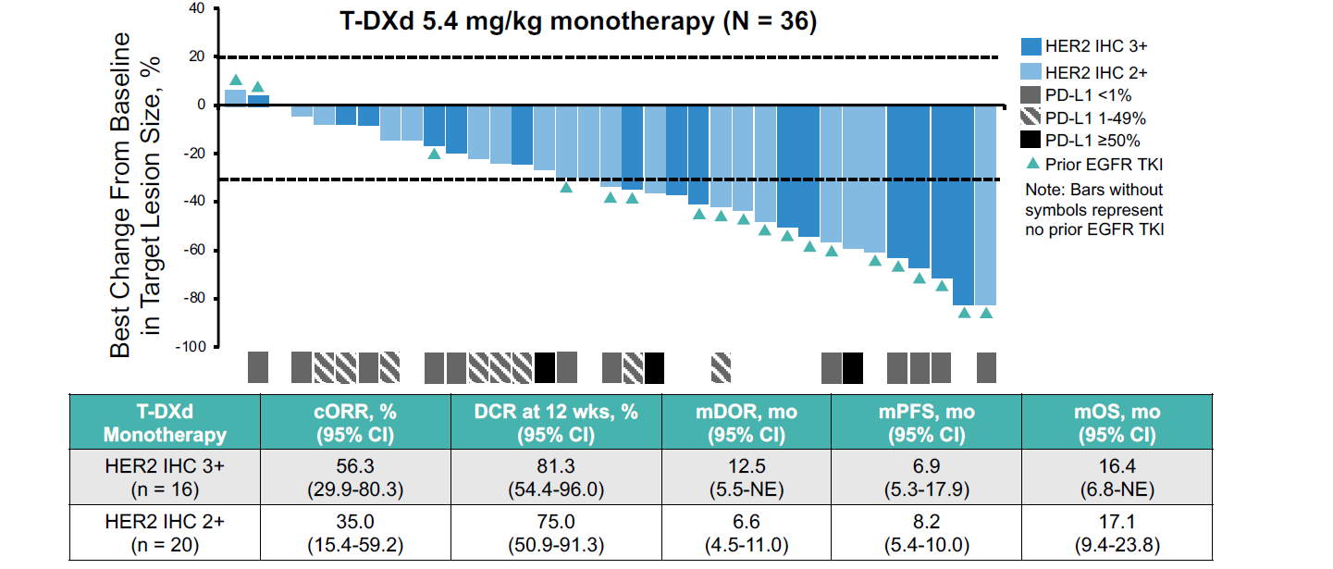
DESTINY-Lung03: Efficacy With T-DXd in
HER2-OE Tumors

Slide 50
T-DXd Is Now Approved in the United States as the First Tumor-Agnostic HER2-Directed Therapy for Previously Treated Patients With Metastatic HER2-Positive Solid Tumors¹
T-DXd (5.4 mg/kg) is the first tumor-agnostic HER2-directed therapy and antibody drug conjugate (ADC) to be approved by the US Food and Drug Administration (as of April 2024) for the treatment of adult patients with unresectable or metastatic HER2-positive (IHC 3+) solid tumors who have received prior systemic treatment and have no satisfactory alternative treatment options¹
This indication was based on results from patient subgroups with HER2-positive IHC 3+ tumors in the Phase 2 studies¹:
DESTINY-PanTumor02 (DP-02)
DESTINY-CRC02 (DC-02)
DESTINY-Lung01 (DL-01)
While the data included in DP-02, DC-02, and DL-01 are for HER2-overexpressing tumors (IHC 3+/2+),
the approved tumor-agnostic indication is for patients with HER2-positive IHC 3+ solid tumors only¹
Notes:
And so these are the three studies that led to the tumor-agnostic approval, and there's a lot of confirmatory trials going on across different tumor types to really see where T-DXd best fits.

Slide 51
Conclusion 1
The availability of HER2 targeting ADCs (T-DXd for now) warrants widespread testing among tumors that are advanced and/or metastatic. The question is how to score and where to prioritize therapy?
Notes:
So conclusion one, the availability of HER2-targeting antibody-drug conjugates justifies the widespread testing, with currently gastric scoring for IHC unless otherwise indicated. Colorectal, we do need FISH.

Slide 52
Conclusion 2
With T-DXd now established in the recurrent setting, does it move to earlier lines, and which criteria should we use in the future to optimally sequence? (PROC example)
1L
2L PSOC
PROC
Induction
Maintenance
Induction
Maintenance
T-DXd (approved)
T-DXd in PSOC?
T-DXd in 1L?
Criteria to consider:
Efficacy of the ADC
Tolerance profile of the ADC
Expression of the target/biomarker
Tolerance to prior lines of treatment
Type of ADCs received before (same payload/
different payload; same target/different target)
Patient preference
Notes:
The question is, where do we prioritize this therapy in the lineup of available things for our patients? Given to that point we've got it in the recurrent setting, does it start to move up into earlier lines of therapy? Many trials—I'm just showing you an example in ovarian cancer—have moved T-DXd up into frontline maintenance in HER2-expressing tumors as an example.
And there's other examples in other solid tumors as well. Is this something that's relegated to the recurrent resistance setting, or do we move it up? And if so, in what population can we perhaps convert more patients to cure? So this is an exciting time.

Slide 53
Personalized Care Plans: Managing Treatment-Related Adverse Effects

Slide 54
DP-02: Safety in DP-02 Was Generally Consistent With the Established Safety Profile of T-DXd^{1,2,a}
Most common drug-related TEAEs (>10%)
n (%) | All patients (N=267)
Any drug-related AEs | 226 (84.6)
Drug-related AEs Grade ≥3 | 109 (40.8)
Serious drug-related AEs | 36 (13.5)
Drug-related AEs associated with dose discontinuations | 23 (8.6)
Drug-related AEs associated with dose reductions | 54 (20.2)
Drug-related AEs associated with deaths | 4 (1.5)^{b}
Nausea
Fatigue^{c}
Neutropenia^{d}​
Anemia​
Diarrhea​
Vomiting​
Decreased appetite
Thrombocytopenia^{e}​
Alopecia​
Increased transaminases^{f}
Leukopenia^{g}
55.1
40.1
32.6
27.7
25.8
1.5
24.7
1.5
17.6
17.2
Grade ≥3
16.9
Any grade
0.4
10.1
10.1
Patients experiencing drug-related TEAEs, %
ILD/pneumonitis adjudicated as T-DXd–related, n (%) | Grade 1 | Grade 2 | Grade 3 | Grade 4 | Grade 5 | Any grade
All patients​ (N = 267) | 7 (2.6) | 17 (6.4) | 1 (0.4) | 0 | 3 (1.1) | 28 (10.5)
Median follow-up duration: 12.75 months (range, 0.4−31.6)
Median number of 21-day treatment cycles: 8
Analyses were performed in patients who received ≥1 dose of T-DXd (N = 267).
ªWhile the data included in DP-02, DC-02, and DL-01 are for HER2-overexpressing tumors (IHC 3+/2+), the approved tumor-agnostic indication is for patients with HER2-positive IHC 3+ solid tumors only.³ ^{b}AEs associated with death included pneumonia (n = 1), organizing pneumonia (n = 1), pneumonitis (n = 1), and neutropenic sepsis (n = 1). ^{c}Category includes the preferred terms fatigue, asthenia, and malaise. ^{d}Category includes the preferred terms neutrophil count decreased and neutropenia. ^{e}Category includes the preferred terms platelet count decreased and thrombocytopenia. ^{f}Category includes the preferred terms aspartate aminotransferase increased, alanine aminotransferase increased, gamma-glutamyltransferase increased, and hypertransaminasemia. ^{g}Category includes the preferred terms white blood cell count decreased and leukopenia.
1. Meric-Bernstam F, et al. J Clin Oncol. 2024;42(1):47-58. 2. Meric-Bernstam F, et al. ESMO 2023. Oral presentation LBA34. 3. Fam-trastuzumab deruxtecan-nxki. Prescribing information. Daiichi Sankyo; 2024.
Notes:
The side effects haven't differed from breast cancer and gastric cancer. We see common but low-grade GI side effects. We see hematologic side effects that are probably modest, 30% all grades, relatively low rates of high-grade bone marrow suppression. The highest would be about 30% of patients with neutropenia, 20% with grade 3 or higher. And then ILD, which is, of course, the rare or uncommon side effect that we worry most about, sits around 10 to 14%, predominantly grade 1 and 2, because of advanced mitigation and detection training and strategy.

Slide 55
T-DXd Adverse Event Summary
ILD and Pneumonitis
Neutropenia
Left Ventricular Dysfunction
Monitor for and promptly investigate signs and symptoms including cough, dyspnea, fever, and other new or worsening respiratory symptoms
  Early identification is key
Interrupt treatment until resolved for asymptomatic patients (Grade 1); consider corticosteroid treatment
Permanently discontinue in all patients with Grade 2 or higher ILD/ pneumonitis; promptly initiate corticosteroid treatment
Advise patients of the risk and to immediately report symptoms
Monitor complete blood counts prior to initiation and prior to each dose, and as clinically indicated
Manage through treatment interruption or dose reduction
Assess left ventricular ejection fraction (LVEF) prior to initiation and at regular intervals during treatment as clinically indicated
Manage through treatment interruption or discontinuation
Permanently discontinue in patients with symptomatic congestive heart failure (CHF)
Notes:
This is an adverse event summary for T-DXd. We monitor ILD/pneumonitis, neutropenia, and left ventricular dysfunction.

Slide 56
Management of ILD: The 5 “S” Rules
Tarantino P, Tolaney SM. JCO Oncol Pract. 2023;19(8):526-527.

Slide 57
It Is Recommended That Patients Treated With T-DXd Have HRCT Scans at Least Every 12 Weeks and Every 6-9 Weeks for Those With Respiratory Symptoms¹
Complete history and physical
HRCT
Baseline SpO₂
Consider pulmonary consult for patients with significant lung comorbidities
Provide patient education on risk and symptom identification
Pre–T-DXd treatment
On T-DXd treatment
HRCT at least every 12 weeks, or every 6-9 weeks with baseline respiratory symptoms
Vital signs including SpO₂ and symptom assessment with treatment visits
T-DXd–related ILD/pneumonitis should be suspected when:
Radiographic changes potentially consistent with ILD/pneumonitis are seen
Patient experiences acute onset of new or worsening pulmonary signs/symptoms, such as dyspnea, cough, or fever
If ILD suspected
Immediately hold T-DXd therapy and proceed with diagnostic workup
Vitals and SpO₂, HRCT, blood tests
If clinically indicated, consider PFTs, ABG, and bronchoscopy/BAL
Consider:
Consultation of a pulmonologist
Treatment with corticosteroids as clinically indicated
1. Rugo HS, et al. JCO Oncol Pract. 2023;19(8):539-546.

Slide 58
Management Strategies for ILD/Pneumonitis With T-DXd
Monitoring¹
Confirm²
Dose Interruptions¹
Patients should be advised to report cough, dyspnea, fever, and/or any new or worsening respiratory symptoms immediately
Promptly investigate evidence of ILD
Evaluate patients with suspected ILD by radiographic imaging
Consider consultation with a pulmonologist
Evaluations may include:
High-resolution CT
Pulmonologist consultation
Blood culture and CBC
Consider bronchoscopy
PFTs and pulse oximetry
For Grade 1 (asymptomatic):
Interrupt dose until recovery (Grade 0)
For Grade ≥2 (symptomatic):
Permanently discontinue
Do not re-escalate the T-DXd dose after a dose reduction is made²
Resume Therapy
(Grade 1 only)¹
Corticosteroid Treatment¹
Initial dose reduction
4.4 mg/kg
If resolved in ≤28 days from date of onset:
Maintain dose
If resolved in >28 days from date of onset:
Reduce dose 1 level
For Grade 1 (asymptomatic):
Consider corticosteroid treatment as soon as ILD
is suspected
(eg, ≥0.5 mg/kg prednisolone or equivalent)
For Grade ≥2 (symptomatic):
Promptly initiate corticosteroid treatment as soon
as ILD/pneumonitis is suspected
(eg, ≥1 mg/kg prednisolone or equivalent)
Upon improvement, follow by gradual taper (eg, 4 weeks)
Final dose reduction
3.2 mg/kg
Requirement for
further dose reduction
Discontinue treatment
1. Fam-trastuzumab deruxtecan-nxki. Prescribing information. Daiichi Sankyo; 2024. 2. Meyer KC. Transl Respir Med. 2014;2:4.
Notes:
The ILD strategies here are really developed from breast cancer and serve all solid tumors very well. Patients have to be made aware of what we're worried about. So if they have any new cough, any new respiratory symptom at all, they have to let us know instead of going to an urgent care facility. They need to be brought in. We need to do imaging, which includes a high-res CT and a pulmonology consultation.
And quite frankly, we want to be watching for changes on CT scan long before our patients ever report a symptom. And so this grade 1 identification of inflammatory changes on CT, grade 1 being before a patient has any symptoms, holding, consultation with pulmonology, low-dose steroids if indicated to get it to resolve quicker, is really our best opportunity to prevent high-grade complications from pneumonitis, allow resolution, and hopefully allow our patients to come back on this therapy, especially if it's providing clinical benefit with dose modifications.

Slide 59
Managing Nausea With T-DXd
With T-DXd, consider 3-drug prophylaxis:
  Dexamethasone
  5HT3 receptor antagonist (ondansetron)
  NK1 receptor antagonist (aprepitant)
For delayed nausea:
  Ondansetron prn
  or
  Olanzapine prn
Stankowicz M, et al. Breast Care (Basel). 2021;16(4):408-411.
Notes:
Managing nausea with T-DXd, a highly emetogenic regimen, includes premedication with the dexamethasone, ondansetron, and aprepitant. And if the patient still experiences nausea, olanzapine PRN can be added, and that can work quite nicely at helping patients feel very good while they're taking this medication.

Slide 60
Management of LV Dysfunction With T-DXd
LV Dysfunction Severity | Treatment Approach
LVEF >45%, absolute decrease from baseline 10%-20% | Continue T-DXd
LVEF 40%-45%, absolute decrease from baseline <10% | Continue T-DXd Repeat LVEF assessment within 3 weeks
LVEF 40%-45%, absolute decrease from baseline 10%-20% | Interrupt T-DXd Repeat LVEF assessment within 3 weeks If LVEF has not recovered to within 10% from baseline, permanently discontinue T-DXd If LVEF recovers to within 10% from baseline, resume T-DXd treatment at same dose
LVEF <40% or absolute decrease from baseline is >20% | Interrupt T-DXd Repeat LVEF assessment within 3 weeks If LVEF of <40% or absolute decrease from baseline of >20% is confirmed, permanently discontinue T-DXd
Symptomatic congestive heart failure | Permanently discontinue T-DXd
Fam-trastuzumab deruxtecan-nxki. Prescribing information. Daiichi Sankyo; 2024.
Notes:
Left ventricular dysfunction is pretty uncommon, only about 4%, but we still have to watch for it because you don't want to miss that. And so there's very clear guidance in the package insert on what to do if you see drops in either the left ventricular ejection fraction or decreases from baseline.

Slide 61
Practical Application Case Clinic in Treatment Selection and Sequencing

Slide 62
Case 1
HER2 Testing in Solid Tumors

Slide 63
Case Study Introduction
Newly Diagnosed Metastatic Solid Tumor
Case Details
A patient is newly diagnosed with a metastatic solid tumor, not eligible for curative therapy
The oncology team considers HER2 testing to guide therapy selection

Slide 64
Case Study Audience Question
In general, what would be your next step to determine if the patient is eligible for a HER2-targeted ADC?
  Order NGS only to identify actionable alterations
  Include HER2 IHC testing as part of initial biomarker workup for all patients with metastatic solid tumors
  Wait to test HER2 IHC upon disease progression since HER2 status does not impact first-line treatment at this time
  Unsure
Notes:
Correct answer: b) Include HER2 IHC testing as part of initial biomarker workup for all patients with metastatic solid tumors

Slide 65
Case Study Audience Question
In general, which of the following HER2 IHC testing results is considered HER2+ and eligible for treatment with T-DXd?
  IHC 0
  IHC 1+
  IHC 2+ with negative ISH
  IHC 3+
  Any IHC+
  Unsure
Notes:
Correct answer: d) IHC 3+
*In some cancers, NCCN guidelines support T-DXd in HER2 IHC 2+/ISH+ (outside of the label); check guidelines

Slide 66
Case 2
Gynecologic Cancer

Slide 67
Case Study: Mary
62-YEAR-OLD WOMAN
Presentation
Labs
Retired teacher who presented with progressive abdominal bloating, weight loss, and pelvic discomfort
CA-125: 1545 U/ml
CT: Large volume ascites, adnexal masses, omental disease
Molecular testing: BRCA1/2 wt/HRD negative
Physical Exam
Distended abdomen
PS 1
Vital signs WNL
Staging
Workup revealed high grade serous OC (Figo stage IIIC)

Slide 68
Case Study: Mary
62-YEAR-OLD WOMAN
Management Plan: 1L, March 2021
Management Plan: 2L, November 2023
Primary cytoreductive surgery to NGR
Treatment: 6 cycles of adjuvant therapy with paclitaxel (175 mg/m²), carboplatin (AUC 6) Q3W
Maintenance: Bevacizumab + chemo for 14 months, then observation
Mary presents with increased abdominal girth and elevated CA-125
CT with ascites (Mary does not meet the DESKTOP OVAR criteria for secondary cytoreductive surgery)
Diagnosed with PSOC: Receives 6 cycles of carboplatin/PLD/bevacizumab
Maintenance: Received bevacizumab for 5 months before disease progression

Slide 69
Case Study: Mary
62-YEAR-OLD WOMAN
Management Plan: 3L, July 2024
Management Plan: 4L, January 2025
Recurrence: Abdominal pain, increased ascites, PS-2
CA-125 increased (1850 U/ml); no thoracic disease
Molecular testing: 2+ HER2 expression/amplification and high FRα expression (85% of tumor cells with an intensity of ≥2+ by IHC)
Treatment: MIRV (6 mg/kg AIBW Q3W)
Recurrence after 6 months of MIRV: PS 1
Adverse events: Developed ocular toxicity (grade 2 keratopathy); MIRV was held for 2 weeks and resumed at 5 mg/kg (AIBW); supportive eye care maintained (lubricating drops, steroid eye drops)
T-DXd is NCCN listed for IHC 2+ in the US – Mary started treatment (5.6 mg/kg Q3W)
Partial response after 2 cycles
At cycle 10, a CT scan reveals a pattern of ILD
Mary is asymptomatic

Slide 70
Case Study Audience Question
Which of the following would you do first?
  Monitor the patient closely
  Interrupt treatment
  Continue treatment but adjust dosage
  Permanently discontinue treatment
  Start corticosteroids
  Unsure
Notes:
Correct answer: b) Interrupt treatment

Slide 71
Case Study: Mary
62-YEAR-OLD WOMAN
Management Plan: August 2025
Clinical Action
At cycle 10, a CT scan reveals a pattern of ILD
Mary is asymptomatic
T-DXd held
Prednisone 1mg/kg started
Close outpatient monitoring via frequent phone calls
Repeat scans show clear lungs after 35 days
Prednisone is tapered by 5 mg/day every 5 days
Case resolved to grade 0
Treatment resumed at a lower dose level (4.4 mg/kg) as resolution occurred ≥28 days from date of onset

Slide 72
Phase 3 DESTINY-Ovarian01: T-DXd + Bevacizumab as 1L Maintenance Therapy in HER2-Expressing Ovarian Cancer
Redraw batch 2/3 - done
Adjusted formatting slightly. Should the light blue beva box be orange?
YES
Changed “Key Patient Population” to “Key Eligibility Criteria” to make things consistent
Tissue prescreening
Main screening
Treatment
Follow-up
Key Eligibility Criteria
Epithelial high-grade ovarian, fallopian tube,
or primary peritoneal carcinoma
FIGO stage III or IV
Non-PD after completion front-line carboplatin-paclitaxel ± bevacizumab
Eligible for bevacizumab maintenance as per SOC and investigator discretion and not appropriate for PARPi maintenance as per investigator discretion
N = 562
IHC 3+/2+ = 480 (85%)
IHC 1+ = 82 (15%)
T-DXd
5.4 mg/kg Q3W + bevacizumab
15 mg/kg Q3W
HER2 expression
(IHC 3+/2+/1+) per 2016 ASCO CAP gastric cancer IHC scoring guidelines by central confirmation
Stratification
HER2 IHC 1+ vs 2+ vs 3+
Residual disease after surgery or no surgery vs no residual disease after surgery
Serous vs nonserous histology
40-d (+7 d) follow-up
Long-term survival
follow-up
R
1:1
Bevacizumab
15 mg/kg Q3W
Study intervention
T-DXd until BICR PD or 34 cycles
Bevacizumab until BICR PD or 16 cycles (maximum of 22 cycles including doses given with platinum-based chemotherapy)
ClinicalTrials.gov identifier: NCT06819007.

Slide 73
DESTINY-Endometrial02: T-DXd vs SoC CT With or Without Adjuvant RT for HER2+ Endometrial Cancer
Randomized, multicenter, open-label, phase 3 study
T-DXd
5.4 mg/kg Q3W x 17 cycles
± concomitant or subsequent VCB
Patients with Stage IIC/III EC per FIGO 2023 criteria; HER2 IHC 3+/2+ per 2016 ASCO CAP gastric cancer IHC guidelines by central confirmations; no evidence of disease post-surgery per investigator and BICR; no prior systemic therapy for EC
N = 710
Post-systemic therapy 40-day Visit 1 ±
Optional Predetermined RT with post-RT 40-day Visit 2
Long-term systemic follow-up
SoC Chemotherapy*
± concomitant or subsequent VCB
*SoC Chemotherapy +/- EBRT Options
6 cycles of carboplatin AUC 5 or 6 and paclitaxel 175 mg/m² Q3W followed by EBRT
4 cycles carboplatin AUC 5 or 6 and paclitaxel 175 mg/m² Q3W followed by chemoradiotherapy (EBRT plus cisplatin 50 mg/m² on days 1 and 29)
6 cycles of carboplatin AUC 5 or 6 and paclitaxel 175 mg/m² Q3W
Primary endpoints: Disease-Free Survival as assessed by BICR or local assessment
Secondary endpoints: OS
ClinicalTrials.gov identifier: NCT07022483.

Slide 74
DESTINY-Endometrial01: First-Line T-DXd + Rilvegostomig or Pembrolizumab in HER2+, pMMR EC
Randomized, multicenter, open-label, phase III study
Stratified by: HER2 IHC 3+ vs 2+, PD-L1 TAP ≥1% vs TAP <1%, Asia vs Non-Asia
T-DXd 5.4 mg/kg +
Rilvegostomig 750 mg
Q3W
Patients with Stage III (measurable disease), Stage IV, or recurrent EC excluding sarcoma histology; HER2 expressing (IHC 3+ [25%]/2+ [75%]) and pMMR by central test; ECOG PS 0/1; 1 prior line of adjuvant/neoadjuvant chemotherapy allowed if recurrence ≥6 months after last dose; no prior exposure to ADCs or ICIs
N = 600
T-DXd 5.4 mg/kg +
Pembrolizumab 200 mg
Q3W
Until PD or withdrawal
Carboplatin/Paclitaxel +
Pembrolizumab*
Q3W
Primary endpoints: PFS (BICR) in ITT
Secondary endpoints: OS, PFS per investigator, ORR, PFS2, HRQoL
*Carboplatin AUC5, paclitaxel 175 mg/m2, and pembrolizumab 200 mg IV once Q3W x 6 cycles, followed by maintenance with pembrolizumab 400 mg IV Q6W for up to 20 cycles.
ClinicalTrials.gov identifier: NCT06989112.

Slide 75
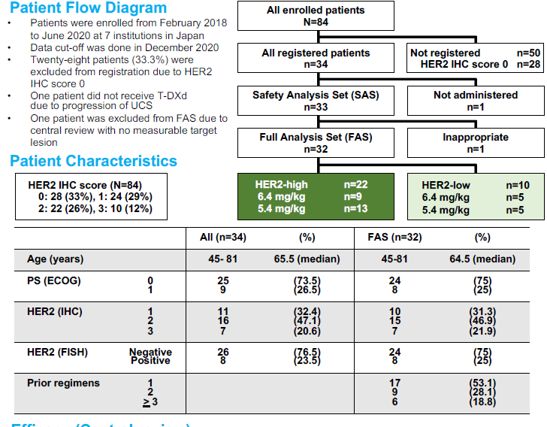
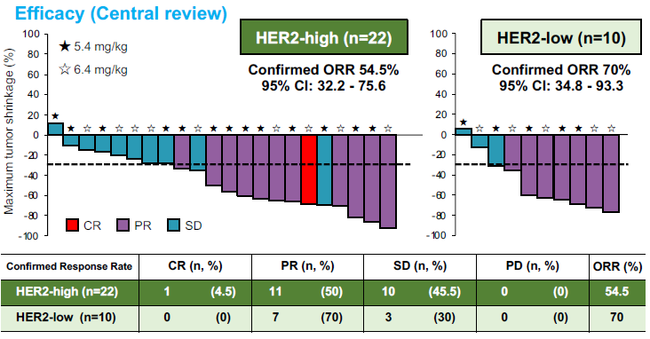
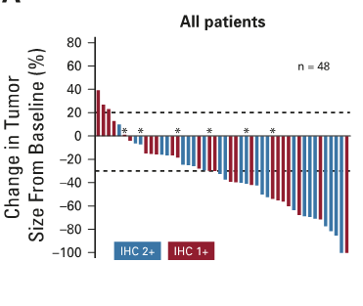
STATICE: T-DXd in Uterine Carcinosarcoma
T-DXd in heavily
pretreated HER2-low MBC
ORR = 37%
mPFS = 11.1 months
Nishikawa T, et al. J Clin Oncol. 2023;41(15):2789-2799.
Modi S, et al. J Clin Oncol. 2020;38(17):1887-1896.

Slide 76
Case 3
Gastrointestinal Cancer

Slide 77
Case Study Introduction
59-YEAR-OLD WOMAN
Presentation
Medical History
Chief Complaint: Progressive right upper quadrant (RUQ) pain for past 6 months + unintended weight loss over 3 months
Presented to her local ED; US concerning for cholelithiasis
Follow-up imaging: Contrast-enhanced CT of the abdomen revealed a 3 cm mass in the gallbladder fundus with direct invasion into liver and suspicious retroperitoneal lymphadenopathy, peritoneal disease, and liver metastases
Biopsy: Core needle biopsy of the liver lesion confirmed adenocarcinoma of gallbladder origin
No prior medical history or history of chronic liver disease or gallstones
Molecular Profiling
MSI-stable; TMB-low (3.4 mut/Mb)
Mutations: No FGFR2 fusions or IDH1 mutations
Amplification: ERBB2 amplification
IHC 3+ (strongly positive)

Slide 78
Case Study Clinical Course
59-YEAR-OLD WOMAN
First-Line Therapy
Gemcitabine + cisplatin + durvalumab
Initially achieved stable disease at 2 and 4 months
Transitioned to maintenance durvalumab after 4 months
7-month follow-up scan showed progression

Slide 79
Case Study Audience Question
Based on current evidence, which of the following would you recommend as next treatment?
  FOLFOX
  Regorafenib
  Nivolumab
  Trastuzumab deruxtecan
  Unsure
Notes:
Correct answer: d) Trastuzumab deruxtecan

Slide 80
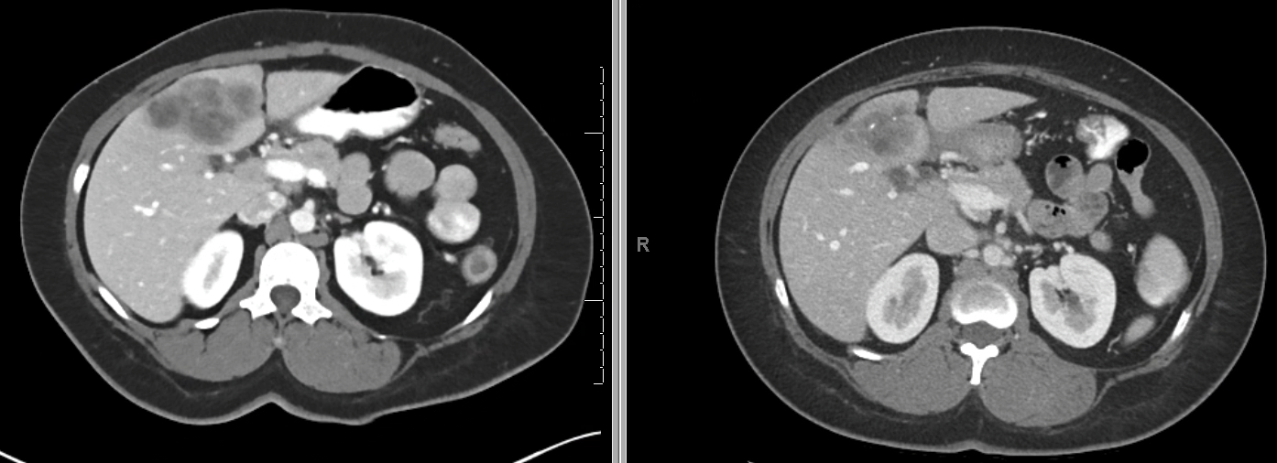
Case Study Conclusion
59-YEAR-OLD WOMAN
Second-Line Therapy
T-DXd: On a clinical trial, based on the HER2 IHC 3+ status
Regimen: Trastuzumab deruxtecan at 5.4 mg/kg administered intravenously every 3 weeks
Dec 2025
Mar 2026

Slide 81
HERB: Investigator-Initiated, Multicenter, Single-Arm, Phase 2 Study Design (NCCH1805, JMA IIA00423; UMIN000036697)—Biliary Tract Cancer
The HERB trial is studying T-DXd in patients from Japan with HER2-expressing BTCs
SCRUM-Japan
30 sites
HERB pre-screening
(N=300 screened)
Key inclusion criteria
Histologically confirmed unresectable or recurrent BTC
Centrally confirmed HER2 expression status
Refractory or intolerant to treatment, including gemcitabine
ECOG PS 0 or 1
HERB trial
(N=32 patients)
T-DXd
5.4 mg/kg IV
Day 1, every 3 weeks
HER2 positive
(IHC 3+ or IHC 2+/ISH+)
Trial sites
(n=5)
Eligible
HER2-low expression
(IHC 2+/ISH−,
IHC 1+/ISH +/−,
IHC 0/ISH+)
Ineligible
Screening sites only
(n=25)
Referred to trial sites
SCRUM-Japan registry study
External control group
HER2 positive
Not referred to trial sites
Primary endpoint: Confirmed ORR by BICR in HER2-positive patients
Secondary endpoints: ORR by LIR, DCR, PFS, and OS in HER2-positive/low patients; safety
Ohba A, et al. ASCO 2022. Presentation 4006.
Ohba A, et al. J Clin Oncol. 2022;40(16):4006.

Slide 82
HERB: T-DXd Phase 2 Data From IIS/ESR in HER2-Expressing Patient Population (2L+)^{1,2}
Tumor Type: Unresectable or Recurrent BTC
Efficacy | n=30
Confirmed ORR % (95% CI) | 30.0 (14.7-49.4) (5.4 mg/kg Q3W)
IHC 3+ or IHC 2+ | 36.4 (17.2-59.3) (IHC 3+ or IHC 2+/ISH+)^{b}
Safety | n=32
TEAEs, n (%) All grades Grade ≥3 | NR 26 (81.3)
Most common AEs (all grades) | Anemia, decreased neutrophil count, decreased white blood cell count
TEAEs leading to treatment discontinuation, n (%) | 8 (25.0)
ILD/pneumonitis,ª n (%) All grades Grade ≥3 Grade 5 | 8 (25.0) 4 (12.5) 2 (25.0
Median treatment duration: not reported
Data cutoff: July 2021
ªILD/pneumonitis events were not adjudicated by an independent committee. ^{b}Confirmed ORR in the HER2-low-expressing subgroup (comprising IHC/ISH 0/+, 1+/-, 1+/+, and 2+/-) in the HERB study was 12.5% (95% CI, 0.3‑52.7).²
1. Ohba A, et al. ASCO 2022. Oral presentation 4006. 2. Ohba A, et al. J Clin Oncol. 2022;40(16):4006.

Slide 83
HERIZON-BTC-01: Study Design
Phase 2b study of zanidatamab monotherapy in patients with HER2-amplified BTC
Key Eligibility Criteria
Locally advanced or metastatic BTC¹
Tissue required to confirm HER2 status by central lab
Progressed after treatment with a gemcitabine-containing regimen
No prior HER2-targeted therapies
ECOG PS of 0 or 1
Primary Endpoint:
(Assessed in Cohort 1)
cORR per ICR
Select Secondary Endpoints:
DOR
DCR
PFS
OS
Frequency & severity of AEs
Frequency of SAEs & deaths
Patient with
HER2-amplified BTC
Cohort 1 (HER2 positive):
IHC 2+ or 3+
Cohort 2:
IHC 0 or 1+
28-Day Cycles
Every 8 weeks:
CT/MRI
Per RECIST v1.1
Day 1
Day 15
Zanidatamab 20 mg/kg IV* (Q2W)
*With mandatory premedication for IRR prophylaxis.
¹Excludes ampullary.
1. Harding JJ, et al. Lancet Oncol. 2023;24(7):772-782. 2. Pant S, et al. J Clin Oncol. 2023;41(16_suppl):4008.

Slide 84
HERIZON-BTC-01: Disease Response in Patients With HER2-Positive BTC (Cohort 1)
Disease Response Endpointsª | Cohort 1 (n = 80)
cORR,^{b} n (%) [95% Cl] | 33 (41.3) [30.4, 52.8]
Complete response, n (%) | 2 (2.5)
Partial response, n (%) | 31 (38.8)
Stable disease, n (%) | 22 (27.5)
Progressive disease, n (%) | 24 (30.0)
DCR,^{c} n (%) [95% Cl] | 55 (68.8) [57.4, 78.7]
CBR,^{d} n (%) [95% Cl] | 38 (47.5) [36.2, 59.0]
cORR by HER2 expression,^{e} % (pre-planned subgroup analysis)
HER2 IHC3+ | 51.6%
HER2 IHC2+ | 5.6%
The median (range) duration of follow-up was 21.9 (16-34) months
Zanidatamab treatment was ongoing for 9 (11%) patients, and 11 (14%) patients were in survival follow-up
Data cutoff for this analysis was July 28, 2023.
ªEfficacy analysis (ie, all patients in cohort 1 who received any dose of zanidatamab) per ICR. ^{b}One patient was not evaluable. ^{c}Best overall response of stable disease or confirmed complete response or partial response. ^{d} Stable disease ≥24 weeks or confirmed best overall response of complete response or partial response. ^{e}The trial was not designed to detect treatment effects by HER2 status, in a preplanned subgroup analysis.
Pant S, et al. ASCO 2024. Abstract 4091.

Slide 85
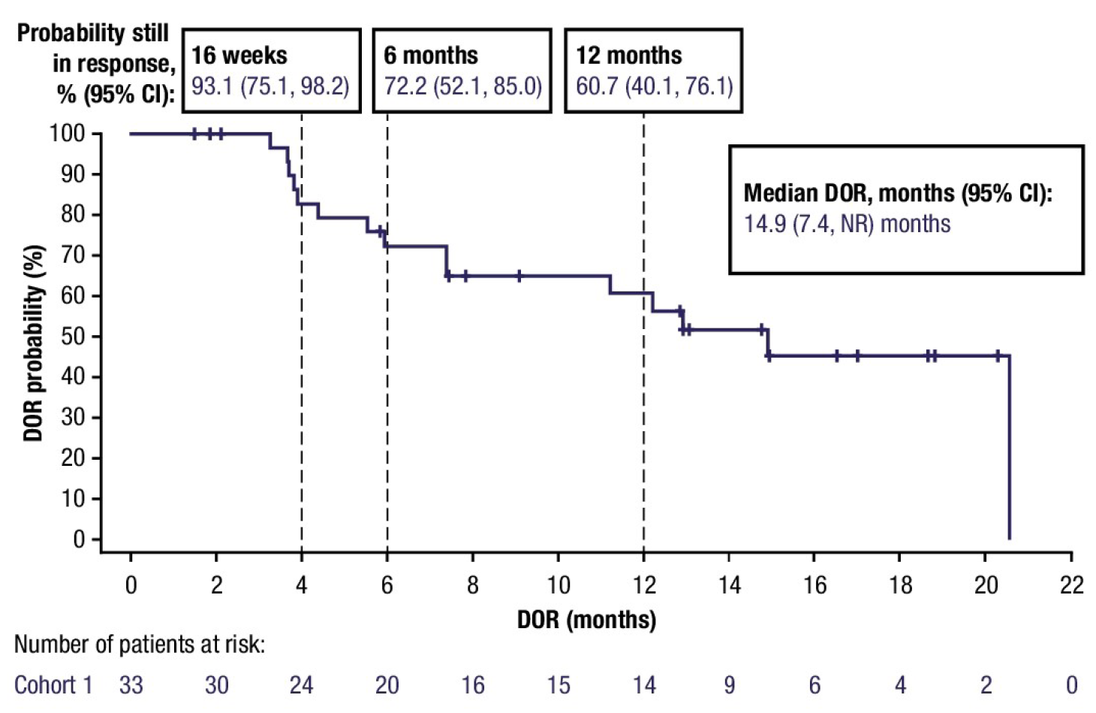
HERIZON-BTC-01: Duration of Response in Patients With HER2-Positive BTC (Cohort 1)
The median DOR, months (95% CI):
14.9 (7.4-NR)
Data cutoff for this analysis was July 28, 2023.
Pant S, et al. ASCO 2024. Abstract 4091.

Slide 86
Additional Studies in HER2-Expressing Patient Populations (2L+): Salivary Gland Carcinoma – Study Design
Therapy/trial name | Study design | Patient population | N (Total / Salivary gland cancer) | Study drug | Key primary endpoints | Key secondary endpoints
DS8201-A-J101 (NCT02564900)^{1,2} | Phase 1, non-randomized, open-label, and multiple-dose study | Patients enrolled into multiple cohorts based on cancer type and HER2 status. One of the cohorts included patients with HER2-expressing solid tumors (non-breast /non-gastric cancer) or mutated solid tumors, including salivary gland cancer | 292/17 | T-DXd 6.4mg/kg for patients with salivary gland cancer | Safety and RP2D | ORR (per RECIST v1.1), DoR, TTR, DCR, PFS, and best percentage change in the sum of diameters of target lesions
DS8201-A-A104 (NCT03383692)^{1,3} | Phase 1, open-label, single-sequence crossover study | Patients with HER2-expressing (IHC 3+/2+/1+) unresectable or metastatic solid tumors, refractory or intolerant to ≥1 prior systemic chemotherapy regimen or for which no standard treatment was available | 40/9 | T-DXd 5.4mg/kg | C_{max} and AUC_{17d} | ORR (per RECIST v1.1), DoR, TTR, DCR, CBR, PFS, best percentage change in the sum of diameters of target lesions, and safety
1. Takahashi S, et al. Jpn J Clin Oncol. 2024;54(4):434-443. 2. Doi T, et al. Lancet Oncol. 2017;18(11):1512-1522. 3. Takahashi S, et al. Clin Cancer Res. 2021;27(21):5771-5780.

Slide 87
T-DXd Data From Additional Studies in HER2-Expressing Patient Populations (2L+): Salivary Gland Carcinoma
Two Phase 1 studies: DS8201-A-J101 and DS8201-A-A104^{1,b}
Efficacy | n=17
Confirmed ORR % (95% CI) | 58.8 (32.9-81.6) (pooled analysis: 5.4 or 6.4 mg/kg Q3W)
Safety | n=17
TEAEs, n (%) All grades Grade ≥3 | 17 (100) 13 (76.5)
TEAEs leading to treatment discontinuation, n (%) | 6 (35.3)
Most common AEs (all grades) | Decreased appetite, nausea, decreased neutrophil count
ILD,ª n (%) All grades Grade ≥3 Grade 5 | 5 (29.4) 1 (5.9%) 0
Median treatment duration: not reported
Median follow-up duration (pooled analysis): 12.0 months (range, 2.3−34.8)
ªILD/pneumonitis events were adjudicated and drug related.
^{b}Patients were not required to have had prior treatment in the pooled analysis; however, the median (range) number of prior systemic therapy lines in the pooled analysis was 1 (0-6).¹
1. Takahashi S, et al. Jpn J Clin Oncol. 2024;54(4):434-443.

Slide 88
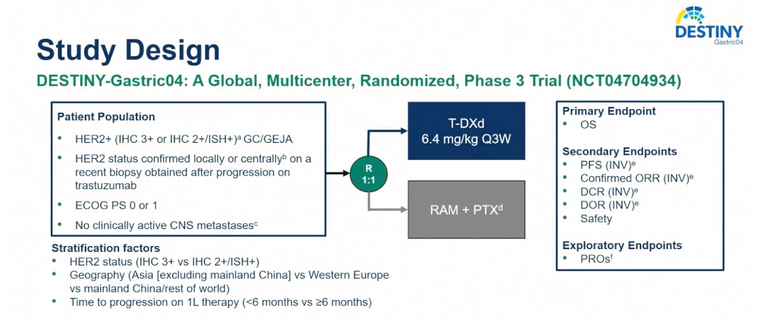
DESTINY-Gastric04

Slide 89
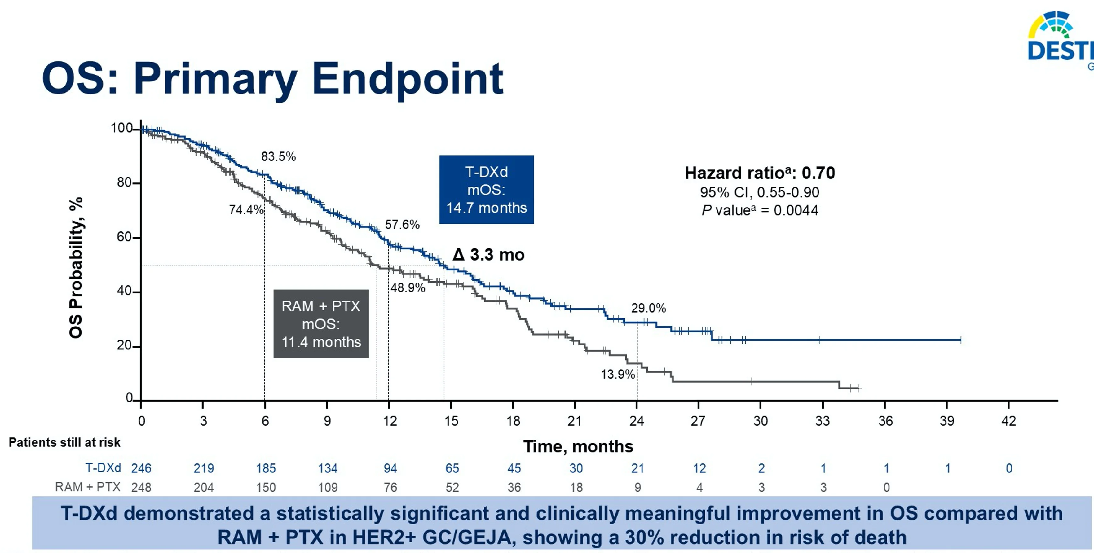
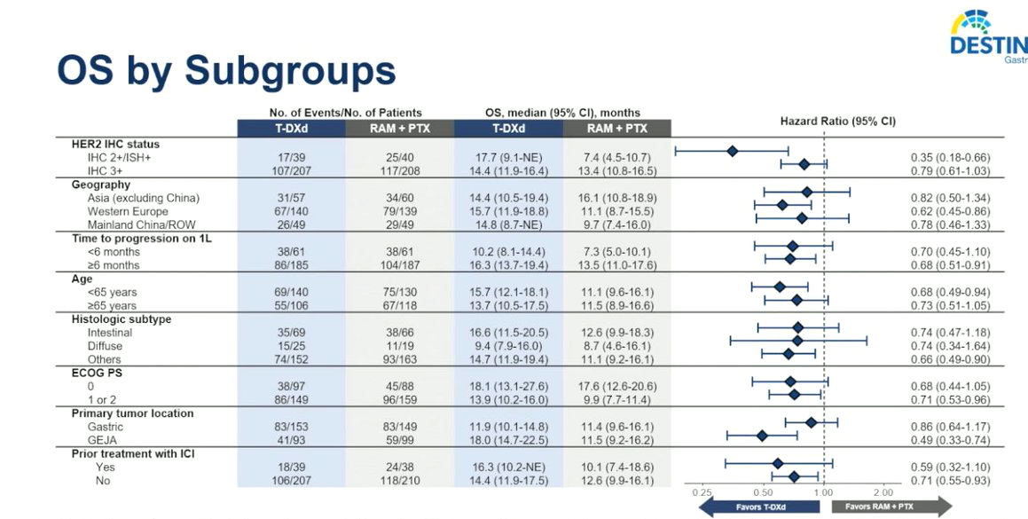
DESTINY-Gastric04

Slide 90
Case 4
Genitourinary Cancer

Slide 91
Case Study Introduction
70-YEAR-OLD PATIENT
Presentation
Past Medical History/Comorbidities
Presented with hematuria and diagnosed with non-muscle invasive bladder cancer (NMIBC)
Initially treated with BCG, but then had a recurrence with muscle-invasive bladder cancer
Scans show no enlarged lymph nodes or distant metastases (cT3N0M0)
Cisplatin/gemcitabine given for 4 cycles as neoadjuvant treatment followed by radical cystectomy (ypT1N0)
Surveillance scans 1-year following radical cystectomy show a new liver lesion suspicious for metastatic disease and enlarged retroperitoneal lymph nodes
Liver lesion biopsy confirms mUC
Hypertension
Hyperlipidemia
Diabetes (not on insulin)
Coronary artery disease (stent placed 7 years ago)
Chronic kidney disease (stage 3)
Pertinent Labs
Hemoglobin 11.7 g/dL
Creatinine 1.5 mg/dL
Rest of CBC and metabolic panel within normal limits
HbA1C (2 months ago): 7.5%

Slide 92
Case Study Clinical Course
70-YEAR-OLD PATIENT
Treatment and Follow-Up
Patient starts treatment with enfortumab vedotin + pembrolizumab
Initial scans shows a partial response and patient continues on treatment
Scans 12 months after start of EV + pembrolizumab unfortunately show disease progression
Patient then starts treatment with carboplatin and gemcitabine chemotherapy but experiences disease progression again following completion of 6 cycles
Metastatic liver lesion is biopsied and HER2 testing in this sample shows IHC 3+ expression; NGS reveals no FGFR3 alterations in the tumor

Slide 93
Case Study Audience Question
Based on current evidence, which of the following would you recommend as the most appropriate next treatment?
  Docetaxel
  Sacituzumab govitecan
  Trastuzumab deruxtecan
  Erdafitinib
  Avelumab
  Unsure
Notes:
Correct answer: c) Trastuzumab deruxtecan

Slide 94
Case Study Rationale for Best/Correct Answer
Trastuzumab deruxtecan is the most appropriate next treatment
This patient has had multiple prior therapies, and the tumor has HER2 IHC 3+ expression
This aligns with the FDA tumor-agnostic indication for HER2-positive solid tumors after prior systemic therapy when there are no satisfactory alternatives

Slide 95
Case Study Conclusion
70-YEAR-OLD PATIENT
Treatment Course
Patient started on treatment with trastuzumab deruxtecan at 5.4 mg/kg IV every 3 weeks
Partial response on scans after 4 cycles (3 months) of treatment
Continues on treatment with trastuzumab deruxtecan
Treatment course complicated by anemia requiring transfusions

Slide 96
Clinical Takeaways from Broad Tumor-Agnostic HER2 Treatment
HER2 IHC testing critical for patient identification
Include HER2 IHC testing as part of initial biomarker workup for all patients with metastatic solid tumors
Consider T-DXd in previously treated patients with HER2+ metastatic solid tumors
  Recommended across multiple metastatic solid tumors in NCCN Guidelines
  Some guidelines allow for T-DXd in HER2 IHC 3+ or IHC 2+/ISH+; check individual guideline recommendations
Notes:
Clinical takeaways are really we want to test everyone. And if we find 3+ IHC, we want to consider T-DXd for our patients once they have received therapies with an expected survival benefit, but before things that clearly don't have a survival benefit. And then trials will hopefully elucidate where to best use this in the future.

Slide 97
Glossary
ADC, antibody-drug congjugate
adj, adjuvant
ASCO, American Society of Clinical Oncology
BTC, biliary tract cancer
CAP, College of American Pathologists
ctDNA, circulating tumor DNA
dMMR, mismatch repair deficient
EBRT, external beam radiation therapy
ECOG PS, Eastern Cooperative Oncology Group performance score
ESMO, European Society for Medical Oncology
FISH, fluorescence in situ hybridization
HER2, human epidermal growth factor receptor 2
IHC, immunohistochemistry
ILD, interstitial lung disease
ISH, in situ hybridization
mAb, monoclonal antibody
mBC, metastatic breast cancer
mCRC, metastatic colorectal cancer
mG/GEJ, metastatic gastric/gastroesophageal junction cancer
mNSCLC, metastatic non-small cell lung cancer
MSI-H, microsatellite instability-high
neoadj, neoadjuvant
NTRK, neurotrophic tyrosine receptor kinase
pRASwt, RAS wild type
PROC, platinum-resistant ovarian cancer
PSOC, platinum-sensitive ovarian cancer
RET, rearranged during transfection
TKI, tyrosine kinase inhibitor
TMB, tumor mutation burden

