Slide 1
Precision in Practice: Advancing EGFR-Altered Metastatic NSCLC Through Guideline-Concordant
Case-Based Learning

Slide 2
DISCLAIMER
This slide deck in its original and unaltered format is for educational purposes and is current as of July 2025. All materials contained herein reflect the views of the faculty, and not those of AXIS Medical Education, the CME provider, or the commercial supporter. Participants have an implied responsibility to use the newly acquired information to enhance patient outcomes and their own professional development. The information presented in this activity is not meant to serve as a guideline for patient management. Any procedures, medications, or other courses of diagnosis or treatment discussed or suggested in this activity should not be used by clinicians without evaluation of their patients’conditions and possible contraindications and/or dangers in use, review of any applicable manufacturer’s product information, and comparison with recommendations of other authorities.

Slide 3
DISCLOSURE OF UNLABELED USE
This activity may contain discussion of published and/or investigational uses of agents that are not indicated by the FDA. The planners of this activity do not recommend the use of any agent outside of the labeled indications.
The opinions expressed in the activity are those of the faculty and do not necessarily represent the views of the planners. Please refer to the official prescribing information for each product for discussion of approved indications, contraindications, and warnings.
USAGE RIGHTS
This slide deck is provided for educational purposes and individual slides may be
used for personal, non-commercial presentations only if the content and references
remain unchanged. No part of this slide deck may be published in print or
electronically as a promotional or certified educational activity without prior written
permission from AXIS. Additional terms may apply. See Terms of Service on
www.axismeded.com for details.

Slide 4
Learning Objectives
Upon completion of this activity, participants should be better able to:
Identify the clinical importance of and optimal timing for molecular testing in patients with metastatic NSCLC
Incorporate guideline-concordant care into the treatment planning for metastatic NSCLC with EGFR exon 20 insertion
Develop evidence-based patient selection and treatment sequencing strategies for metastatic NSCLC with common EGFR mutations
Utilize a multidisciplinary team-based approach in the surveillance and management of adverse events associated with EGFR-targeted therapies

Slide 5
Molecular Testing and EGFR Mutations in Metastatic NSCLC

Slide 6
Common Genomic Alterations in NSCLC
17%
EGFR Mutation
KRAS Mutation
25%
Mutations in the tyrosine kinase domain
Erlotinib, gefitinib, afatinib, dacomitinib, osimertinib, lazertinib, amivantamab
Activation of MAPK pathway
Negative prognostic marker
KRAS^{G12C} – sotorasib, adagrasib
EXON 18
EXON 19
EXON 20
EXON 21
4-8%
Tyrosine kinase domain of EGFR gene
ALK Rearrangement
G719X
Ex 19 deletion
T790M
L858R
Fusion between ALK and EML4
Constitutive ALK kinase activity
Crizotinib, ceritinib, alectinib, brigatinib, lorlatinib, ensartinib
Ex 20 Insertion
ALK
EML4
Unknown
EML4
Kinase domain
ALK-EML4 function oncogene
RET Rearrangement
2%
Fusion between RET tyrosine kinase domain and partner gene
Pralsetinib, selpercatinib
1%
ERBB2 (HER2) Mutation
Trastuzumab deruxtecan
Proliferation
survival
2%
ROS1 Rearrangement
2%
METex14 Skipping Mutation
RET proto
oncogene
MAPK, PI3K,
PLCy pathways
Crizotinib, entrectinib, repotrectinib, taletrectinib
Capmatinib, tepotinib
xxx
2%
BRAF Mutation
1%
CCDC6
xxx
CCDC6+
RET tyrosine
kinase domain
NTRK Rearrangement
Dabrafenib + trametinib, encorafenib + binimetinib
Larotrectinib, entrectinib, repotrectinib
ALK, anaplastic lymphoma kinase; BRAF, B-Raf proto-oncogene, serine/threonine kinase; EGFR, epidermal growth factor receptor; EML4, echinoderm microtubule-associated protein-like 4; ERBB2, Erb-B2 receptor tyrosine kinase 2; HER2, human epidermal growth factor receptor 2; KRAS, KRAS proto-oncogene, GTPase; MAPK, mitogen-activated protein kinase; METex14, mesenchymal–epithelial transition exon 14; NSCLC, non-small cell lung cancer; NTRK, neurotrophic tyrosine receptor kinase; PI3K, phosphatidylinositol 3-kinase; PLC, phospholipase c; RET, rearranged during transfection; ROS1, ROS proto-oncogene 1, receptor tyrosine kinase.
Updated from Loh Z, et al. Intern Med J. 2019;49(12):1541-1545. Gupta R, et al. Am J Clin Oncol. 2019;42(4):337-344.
Notes:
Loh Z, Mitchell P, John T, Arulananda S. RET-rearranged non-small-cell lung cancer and therapeutic implications. Intern Med J. 2019;49(12):1541-1545.
Gupta R, Amanam I, Rahmanuddin S, et al. Anaplastic lymphoma kinase (ALK)-positive tumors: clinical, radiographic and molecular profiles, and uncommon sites of metastases in patients with lung adenocarcinoma. Am J Clin Oncol. 2019;42(4):337-344.
As you know, we've got an incredible wealth of genomic alterations which we can target for our patients with non-small cell lung cancer in advanced disease and even now in early stages. The most common, of course, are EGFR mutations in the tumor for which we have many different targeted therapies and new options. But also, of course, alterations in KRAS, ALK, ERBB2, ROS, BRAF, RET, MET, TRK, and a growing number every year.

Slide 7
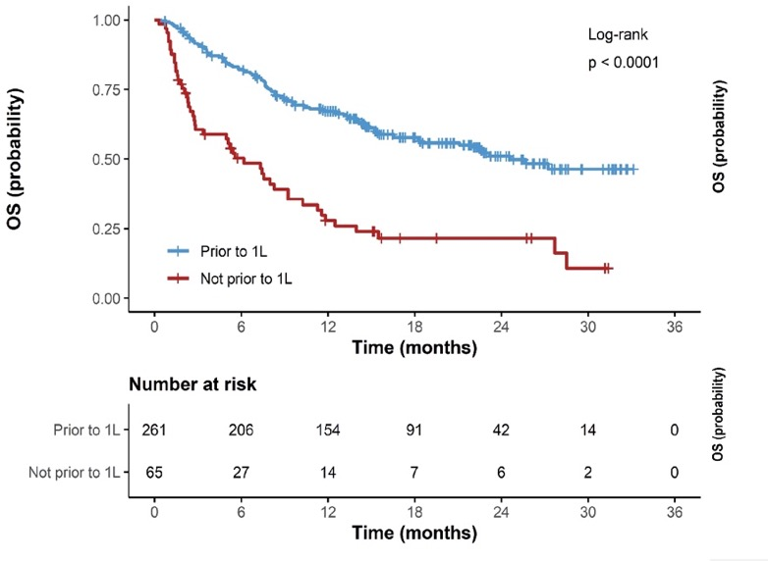
Use of Both Plasma and Tissue CGP Significantly Increases Odds of Complete Genotyping Results Available Prior to 1L Treatment, Which is Associated With Better Survival
Overall Survival (OS) by Availability of Molecular Genotyping Results Prior to 1L Therapy
1L, first-line; CGP, comprehensive genomic profiling; NGS, next-generation sequencing; P, plasma; T, tissue.
Aggarwal C, et al. ASCO 2022. Abstract 9022.
Notes:
Aggarwal C, Marmarelis ME, Hwang W-T, et al. Association of comprehensive molecular genotyping and overall survival in patients with advanced non-squamous non-small cell lung cancer. Abstract presented at: American Society of Clinical Oncology Annual Meeting; Chicago, Illinois; June 3-8, 2022. Abstract 9022.
This was a study that looked at first-line use of tissue or combination of tissue and plasma testing, and what we saw is that when you combine both tissue and plasma molecular testing at initial diagnosis, you increase the yield of identifying potential alterations, and you improve survival. Because patients who have an identified alteration will have better outcomes if you can treat them with the right targeted therapy, testing is incredibly important, not just for EGFR, but for all of the different alterations that are important in lung cancer.

Slide 8
Impact of Molecular Testing on Patient Survival
In a retrospective chart analysis of 1440 patients from 78 academic and community oncology sites across multiple countries, survival rates trended higher in patients receiving EGFR or ALK testing compared with patients without testingª
Overall Survival From Start of First-Line Therapy, Nonsquamous NSCLC (2011-2013)ª
Overall Survival, Months
n=89
n=85
n=154
n=48
n=114
n=36
n=185
n=32
n=130
n=45
n=75
n=100
Italy
Spain
Australia
Korea
Taiwan
Japan
Brazil
Notes:
Lee DH, Tsao MS, Kambartel KO, et al. Molecular testing and treatment patterns for patients with advanced non-small cell lung cancer: PIvOTAL observational study. PLoS One. 2018;13(8):e0202865.
It's so important that we get our molecular testing results before we start treatment for our patients, to make sure that they get the best possible precision therapy. Early studies have shown that doing molecular testing and having the results available before starting first-line therapy are clearly associated with improved outcomes. On this slide, you can see that patients where we even just do EGFR and ALK, have better outcomes than those patients where we don't test, which I think really reflects the impact of receiving targeted therapy. But also, we've learned that having the test results before we start first line versus later on also is significantly associated with survival.

Slide 9
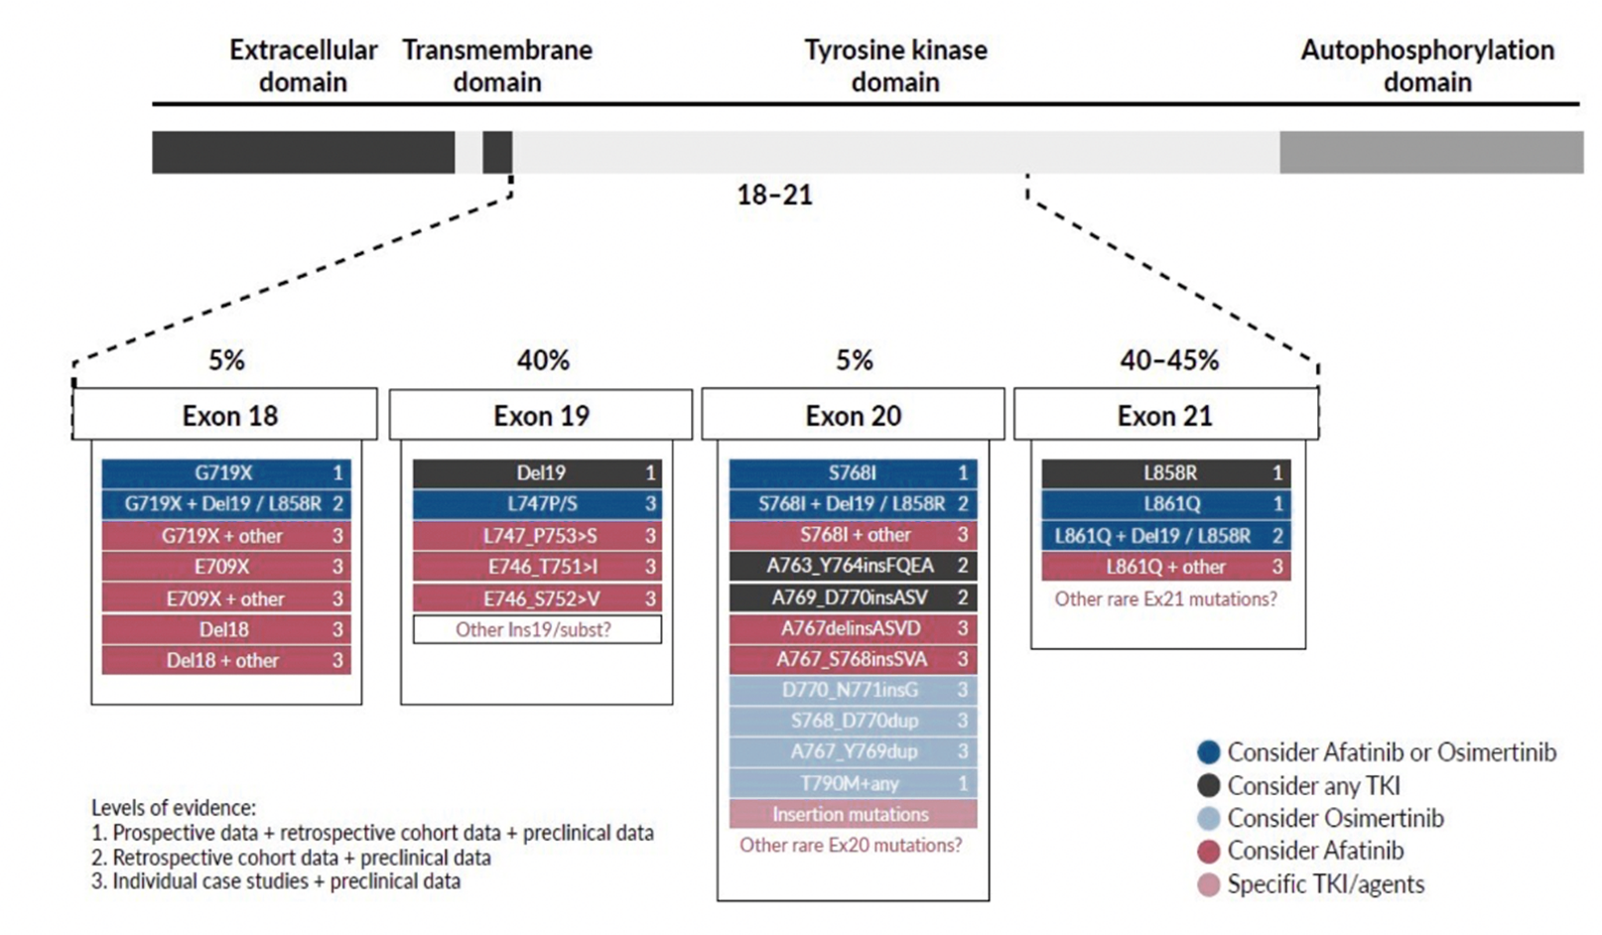
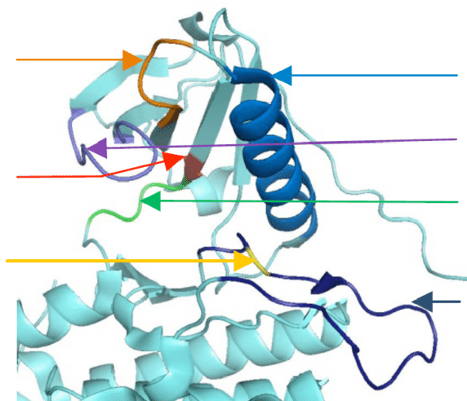
Different Types of EGFR Mutations
Key Mutations:
Key Structures:
Exon 19
C-Helix
G-loop
Thr790
Hinge
Leu858
A-loop
Notes:
Warnault P, Yasri A, Coisy-Quivy M, et al. Recent advances in drug design of epidermal growth factor receptor inhibitors. Curr Med Chem. 2013;20(16):2043-2067.
Passaro A, Mok T, Peters S, Popat S, Ahn MJ, de Marinis F. Recent advances on the role of EGFR tyrosine kinase inhibitors in the management of NSCLC with uncommon, non exon 20 insertions, EGFR mutations. J Thorac Oncol. 2021;16(5):764-773.
When we look at testing, it's so important that we look across exons 18 to 21 with the assays that we use routinely to really make sure that we identify all of the possible mutations. I'm really going to focus on the common, classic sensitizing mutations, representing about 85% of the cases that we see, deletions in exon 19 and point mutations in exon 21, the L858R mutation. But of course, it's so important to remember that with NGS testing, we're much more likely to find exon 20 insertions or alterations in exon 20, as well as alterations in exon 18 or uncommon mutations; all of them so important with new treatment options for our patients.

Slide 10
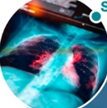


1L EGFR-Mutant Metastatic NSCLC
Small vs non-small cancer cell
Biopsy
Scan
Diagnose
For patients whose tumor responds to 1L EGFR TKIs, progression usually occurs after ~10–19 months⁴
Analyze
~25%–40% of patients receiving 1L EGFR TKI monotherapy do not receive 2L therapy, indicating a
need for improved 1L treatments^{5–7}
Treat
Test
\\
Adapted from O’Sullivan DE, et al.¹
Exon19del
L858R
Exon20ins
Targeted 1L combination therapies
can improve outcomes for patients with EGFR-mutant NSCLC⁸
Prevalence² | 79 | 12 | %
Median rwOS to EGFR TKI³ | 25.5 | 16.2 | months
Median rwPFS to EGFR TKI³ | 10.5 | 2.9 | months
Notes:
1. O'Sullivan DE, Jarada TN, Yusuf A, et al. Prevalence, treatment patterns, and outcomes of individuals with EGFR positive metastatic non-small cell lung cancer in a Canadian real-world setting: a comparison of exon 19 deletion, L858R, and exon 20 insertion EGFR mutation carriers. Curr Oncol. 2022;29(10):7198-7208.
2. Riess JW, Gandara DR, Frampton GM, et al. Diverse EGFR exon 20 insertions and co-occurring molecular alterations identified by comprehensive genomic profiling of NSCLC. J Thorac Oncol. 2018;13(10):1560-1568.
3. Bazhenova L, Minchom A, Viteri S, et al. Comparative clinical outcomes for patients with advanced NSCLC harboring EGFR exon 20 insertion mutations and common EGFR mutations. Lung Cancer. 2021;162:154-161.
4. Soria JC, Ohe Y, Vansteenkiste J, et al; FLAURA Investigators. Osimertinib in untreated EGFR-mutated advanced non-small-cell lung cancer. N Engl J Med. 2018;378(2):113-125.
5. Girard N, Leighl N, Ohe Y, et al. Mortality among EGFR-mutated advanced NSCLC patients after frontline osimertinib treatment: A real-world, US attrition analysis. Abstract presented at: European Lung Cancer Congress; Copenhagen, Denmark; March 29-April 1, 2023. Abstract 19P.
6. Nieva J, Karia PS, Okhuoya P, et al. 1344P A real-world (rw) observational study of long-term survival (LTS) and treatment patterns after first-line (1L) osimertinib in patients (pts) with epidermal growth factor receptor (EGFR) mutation-positive (m) advanced non-small cell lung cancer (NSCLC). Ann Oncol. 2023;34(Supplement 2):S774.
7. Lee JY, Mai V, Garcia M, et al. EP08.02-082 Treatment patterns and outcomes of first-line osimertinib-treated advanced EGFR mutated NSCLC patients: a real-world study. J Thorac Oncol. 2022;17(9):S440.
8. Bertoli E, De Carlo E, Del Conte A, et al. Acquired resistance to osimertinib in EGFR-mutated non-small cell lung cancer: how do we overcome it? Int J Mol Sci. 2022;23(13):6936.
We won't talk so much about the atypical mutations today. We're going to first focus on the classical mutations, exon 19 deletions and L858R mutation, and then touch on exon 20 insertions briefly at the end.

Slide 11
Clinical Decision-Making for
EGFR-Altered Metastatic NSCLC

Slide 12
1L Treatment Landscape in Metastatic NSCLC With Common EGFR Mutations
Intracellular inhibition
Combined intracellular and extracellular inhibition
3G EGFR TKI
1G + 3G EGFR TKI
3G EGFR TKI + ChT
EGFR-MET bsAb + 3G EGFR TKI
Anti-VEGF + 3G EGFR TKI
Osimertinib¹
Icotinib + aumolertinib³
Osimertinib + ChT⁴
Amivantamab + lazertinib⁷
Ramucirumab + osimertinib¹⁰
Anti-EGFR
Anti-MET
Anti-VEGF
EMA & FDA
EGFR
EGFR
EMA & FDA
EGFR
EMA & FDA
EGFR
MET
EGFR
VEGF
EMA & FDA
EMA & FDA
EMA & FDA
APPROVED²
APPROVED^{5,6}
APPROVED^{8,9}
Studies are evaluating EGFR TKIs in various combination regimens
to improve 1L treatment outcomes¹¹
Notes:
1. Soria JC, Ohe Y, Vansteenkiste J, et al; FLAURA Investigators. Osimertinib in untreated EGFR-mutated advanced non-small-cell lung cancer. N Engl J Med. 2018;378(2):113-125.
2. Solassol I, Pinguet F, Quantin X. FDA- and EMA-approved tyrosine kinase inhibitors in advanced EGFR-mutated non-small cell lung cancer: safety, tolerability, plasma concentration monitoring, and management. Biomolecules. 2019;9(11):668.
3. Huang M, Yu M, Gong YL, et al. 2023 World Conference on Lung Cancer; Singapore; September 9-12, 2023. Abstract MA13.05.
4. Planchard D, Jänne PA, Cheng Y, et al; FLAURA2 Investigators. Osimertinib with or without Chemotherapy in EGFR-Mutated Advanced NSCLC. N Engl J Med. 2023;389(21):1935-1948.
5. EMA. TAGRISSO (osimertinib) summary of product characteristics. July 2024. . Accessed March 2025. Available at: https://www.ema.europa.eu/en/documents/product-information/tagrisso-epar-product-information_en.pdf
6. FDA. TAGRISSO (osimertinib) prescribing information. February 2024. Accessed March 2025. Available at: https://www.accessdata.fda.gov/drugsatfda_docs/label/2024/208065s030lbl.pdf
7. Cho BC, Lu S, Felip E, et al; MARIPOSA Investigators. Amivantamab plus lazertinib in previously untreated EGFR-mutated advanced NSCLC. N Engl J Med. 2024;391(16):1486-1498.
8. EMA. RYBREVANT (amivantamab) summary of product characteristics. March 2025. Accessed March 2025. Available at: https://www.ema.europa.eu/
en/documents/product-information/rybrevant-epar-product-information_en.pdf
9. FDA. RYBREVANT (amivantamab) prescribing information. September 2024. Accessed March 2025. Available at: https://www.accessdata.fda.gov/drugsatfda_docs/label/2024/761210s004lbl.pdf
10. Le X, Patel J, Shum E, et al. A multi-centre open-label randomized phase II study of osimertinib with and without ramucirumab in TKI-naive EGFR-mutant metastatic NSCLC (RAMOSE trial interim analysis). Presented at: ESMO Congress 2023; Madrid, Spain; October 21, 2023. Abstract LBA71.
11. Bertoli E, De Carlo E, Del Conte A, et al. Acquired resistance to osimertinib in EGFR-mutated non-small cell lung cancer: how do we overcome it? Int J Mol Sci. 2022;23(13):6936.
So we've seen incredible changes over the last 20 years. Even over the last 1 or 2 years, things have really changed. Today, the first-line standard really around the world has been at least osimertinib or third-generation TKI. This really focuses on intracellular inhibition or targeting that kinase domain which is constitutively activated. But now we of course, have new combination therapies, adding chemotherapy to targeted therapy, for example, chemotherapy and osimertinib. And very exciting, non-chemotherapy-containing combinations such as amivantamab and lazertinib, where we combine extracellular strategies such as an EGFR and MET antibody with the third-generation TKI.

Slide 13
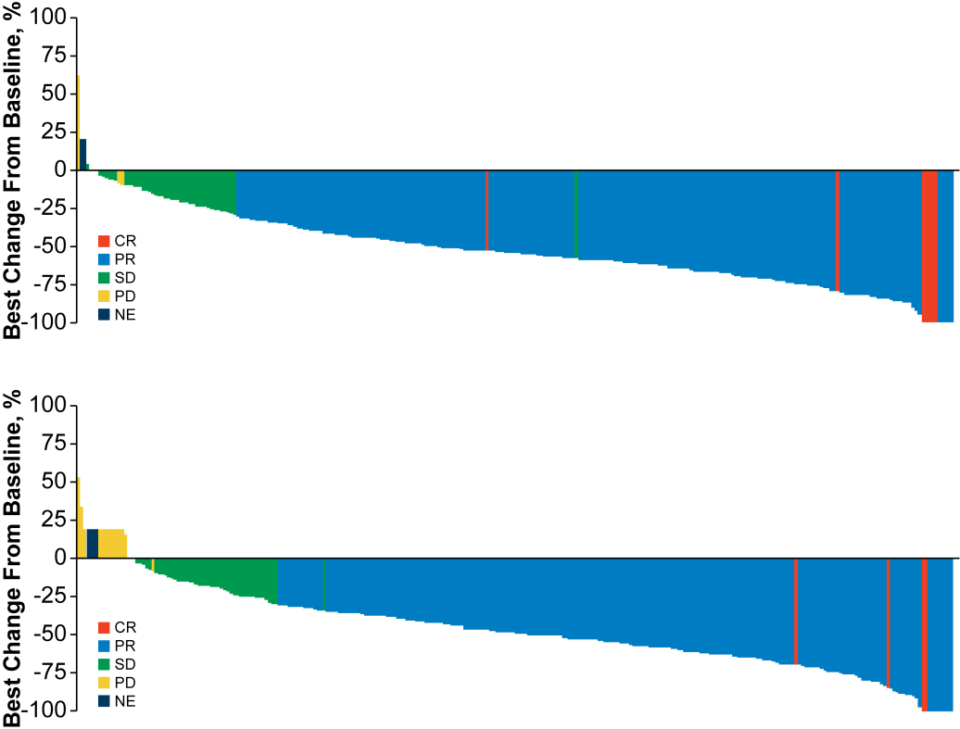
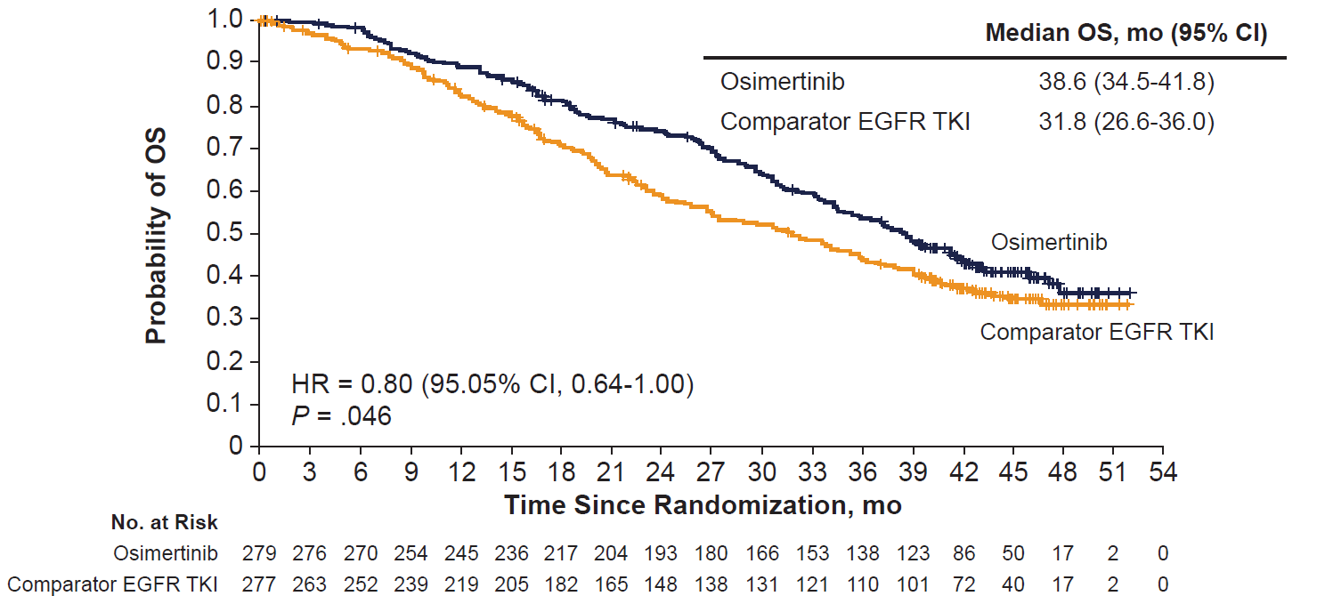
FLAURA: Phase 3 Trial of First-Line Osimertinib vs Erlotinib or Gefitinib in EGFR-Mutated mNSCLC
Best Change From Baseline in Target Lesions
Median PFS: 18.9 months
Improved intracranial penetration vs 1G TKIs
Select AEs: rash, diarrhea, paronychia (low grade), QTc prolongation, and ILD (rare)
Osimertinib
OS
 | mOS, mo (95% CI)
Osimertinib | 38.6 (34.5-41.8)
Comparator EGFR TKI | 31.8 (26.6-36.0)
Gefitinib or Erlotinib
No. at Risk
Osimertinib
Comparator
EGFR TKI
Notes:
Soria JC, Ohe Y, Vansteenkiste J, et al; FLAURA Investigators. Osimertinib in untreated EGFR-mutated advanced non-small-cell lung cancer. N Engl J Med. 2018;378(2):113-125.
Ramalingam SS, Vansteenkiste J, Planchard D, et al; FLAURA Investigators. Overall survival with osimertinib in untreated, EGFR-mutated advanced NSCLC. N Engl J Med. 2020;382(1):41-50.
So this, really, for many of us, is where we start. For those with access to third-generation TKIs, the FLAURA study, I think, really did a great job of highlighting how third-generation kinase inhibitors can outperform first- and second-generation TKIs such as gefitinib or erlotinib, and likely even drugs like afatinib. We saw that although response rates were the same, progression-free survival was significantly longer. A median PFS of 18.9 months, almost double what we saw with the first-gen TKIs. And I think a little bit to everyone's surprise, we saw improved survival 38.6 months, compared to 31.8 months with many patients crossing over. In particular, the intracranial activity of third-gen TKIs like osimertinib has really been so important for our patients, that ability to treat brain metastases in our patients and to prevent or delay progression of disease.
Very, very manageable in terms of toxicity, rash, diarrhea, uncommonly low-grade paronychia. But also, we do need to remember that there can be some cardiac effects, such as QTc prolongation. Need to be thoughtful about concurrent medications and cardiac impact. So we do need to keep an eye on our patient's cardiac function. Interstitial lung disease and pneumonitis, thankfully, very, very uncommon. Again, something that we do need to educate our patients about and recognize early.

Slide 14
FLAURA2: Study Design
Phase 3 study of osimertinib + ChT vs osimertinib as 1L treatment for EGFR-mutant advanced NSCLC*
Key inclusion criteria
Aged ≥18 years
(Japan: ≥20 years)
Pathologically confirmed
nonsquamous NSCLC
EGFR exon19del/L858R (local/central test)
WHO PS 0 or 1
No prior systemic therapy for advanced NSCLC
Stable CNS metastases
were allowed†
Brain scans at baseline (MRI/CT)
Stratification by
Race (Chinese Asian/non-Chinese Asian/non-Asian)
EGFR mutation (local/central test)
WHO PS (0/1)
Osimertinib 80 mg (QD) + pemetrexed 500 mg/m² + carboplatin AUC5 or cisplatin 75 mg/m² (Q3W for 4 cycles for platinum-based treatments)
Maintenance osimertinib 80 mg (QD) + pemetrexed (Q3W)‡
Follow-up
RECIST v1.1 assessment at 6
and 12 weeks, then every 12 weeks until RECIST v1.1 defined radiological PD or other withdrawal criteria were met
1:1 R (N=557)
Osimertinib 80 mg (QD)
Primary endpoint
PFS by INV assessment per RECIST v1.1§||
  Sensitivity analysis: PFS by BICR assessment per RECIST v1.1
Secondary endpoints
OS, ORR, DoR, DCR, HRQoL, safety (AEs by CTCAE v5.0), and PFS2§
Among patients with brain metastases or a history of brain
metastases at baseline:
Brain MRI/CT at baseline and at 6 and 12 weeks, then every 12 weeks until RECIST v1.1 defined PD
Among patients without brain metastases or a history of brain metastases at baseline:
Brain MRI/CT at baseline and then only performed when there is a suspected CNS progression and at the point of RECIST v1.1 defined extracranial progression
Notes:
Planchard D, Jänne PA, Cheng Y, et al; FLAURA2 Investigators. Osimertinib with or without chemotherapy in EGFR-mutated advanced NSCLC. N Engl J Med. 2023;389(21):1935-1948.
Jänne PA, Planchard D, Cheng Y, et al. Osimertinib with / without platinum-based chemotherapy as first-line treatment in patients with EGFRm advanced NSCLC (FLAURA2). Presented at: International Association for the Study of Lung Cancer 2023 World Conference on Lung Cancer; Singapore; September 9-12, 2023. Abstract PL03.13.
In FLAURA2, chemotherapy, which is normally our subsequent or second-line treatment, was added to osimertinib and compared to osimertinib monotherapy alone in patients with common sensitizing mutations. Classic inclusion criteria, performance status 0 or 1, the classic sensitizing mutations, and patients with stable brain metastases were allowed. Now, they did do brain scans at baseline, but not necessarily regularly, routinely after that, especially for patients without brain metastases.
And patients were stratified by whether they were Chinese, non-Chinese Asian, or non-Asian, the type of EGFR mutation, and performance status. Patients were randomized to osimertinib plus pemetrexed and carboplatin chemotherapy or cisplatin for up to 4 cycles with maintenance compared to standard dose osimertinib alone.
The primary endpoint was progression-free survival, but secondary endpoints include the very important survival, which, of course, means so much to our patients and to us, as well as response rate, duration of response, and others.

Slide 15
FLAURA2: PFS (Primary Endpoint)
PFS by Investigator Assessment
 | Median PFS, mo (95% CI)
Osimertinib + chemo | 25.5 (24.7-NC)
Osimertinib | 16.7 (14.1-21.3)
HR (95% CI) | 0.62 (0.49-0.79)
P | <.0001
Clinically meaningful PFS benefit observed across predefined subgroups, including patients with CNS metastases and EGFR L858R mutation
Median OS (2nd interim analysis): NR vs 36.7 mo, HR, 0.75 (95% CI, 0.57-0.97; P = 0.0280)
+
+
+
+
+
+
+
+
+
+
80%
+
+
+
+
+
+
+
+
+
+
+
+
+
+
+
+
+
+
57%
+
+
+
+
+
+
+
+
+
66%
+
+
+
+
+
+
+
+
+
+
+
+
PFS, Proportion
+
+
+
+
+
+
+
+
+
Osimertinib + chemo
+
+
+
+
+
+
+
+
+
+
+
+
+
+
+
+
+
+
+
+
+
+
+
+
+
+
+
+
+
+
+
+
+
41%
+
+
+
+
+
Osimertinib
Time Since Randomization, mo
No. at Risk
Osimertinib + chemo | 279 | 254 | 241 | 225 | 207 | 187 | 165 | 133 | 84 | 42 | 21 | 3 | 0
Osimertinib | 278 | 246 | 227 | 203 | 178 | 148 | 119 | 94 | 67 | 48 | 21 | 1 | 0
Notes:
Jänne PA, Planchard D, Cheng Y, et al. Osimertinib with / without platinum-based chemotherapy as first-line treatment in patients with EGFRm advanced NSCLC (FLAURA2). Presented at: International Association for the Study of Lung Cancer 2023 World Conference on Lung Cancer; Singapore; September 9-12, 2023. Abstract PL03.13.
Planchard D, Jänne PA, Cheng Y, et al. LBA68 FLAURA2: Safety and CNS outcomes of first-line (1L) osimertinib (osi) ± chemotherapy (CTx) in EGFRm advanced NSCLC. Ann Oncol. 2023;34 (suppl_2):S1311-S1312.
Planchard D, Jänne PA, Cheng Y, et al; FLAURA2 Investigators. Osimertinib with or without chemotherapy in EGFR-mutated advanced NSCLC. N Engl J Med. 2023;389(21):1935-1948.
Valdiviezo Lama NI, Okamoto I, Hughes BGM, et al. 4O First-line (1L) osimertinib (osi) ± platinum-pemetrexed in EGFR-mutated (EGFRm) advanced NSCLC: FLAURA2 post-progression outcomes. ESMO Open. 2024;9(Supplement 3):102583.
As we heard reported last year, we saw a marked improvement which was clinically meaningful in terms of progression-free survival, a hazard ratio of 0.62 with the addition of chemotherapy, compared to osimertinib alone. Median PFS of 25.5 months, compared to 16.7, so of course, very similar to what we saw with osimertinib alone in the original FLAURA trial, in the control arm.
Patient subgroups really benefited across the board, in particular those patients with CNS metastases and EGFR L858R mutations. We've heard about median survival in terms of the second interim analysis. We're still awaiting final data. So far, a median survival not reached in the combination arm, 36.7 months in the osimertinib arm, and a hazard ratio of 0.75, which we hope in future will be significant. But of course, the final survival data are not yet mature.

Slide 16
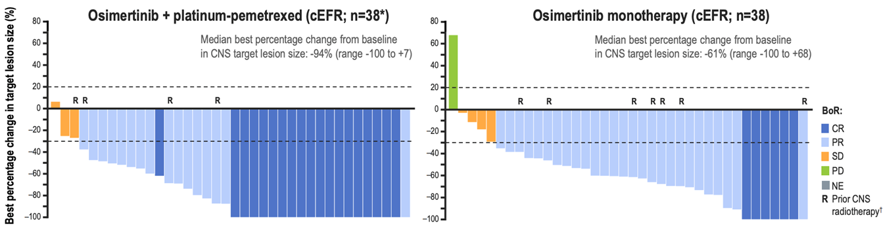
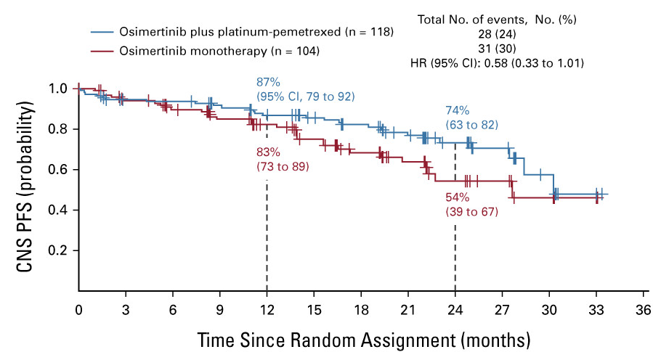
FLAURA2: CNS Activity
 | Osimertinib + Chemotherapy (n=118) | Osimertinib Monotherapy (n=104)
icORR | 73% (59% CR) | 69% (43% CR)
DoR | Not reached | 26.2 months
Notes:
Jänne PA, Planchard D, Kobayashi K, et al. CNS efficacy of osimertinib with or without chemotherapy in epidermal growth factor receptor-mutated advanced non-small-cell lung cancer. J Clin Oncol. 2024;42(7):808-820.
When we look at subgroups of patients with baseline brain metastases, they have a particular benefit from osimertinib plus chemotherapy. It's interesting because osimertinib by itself is a fairly CNS penetrant therapy, and so we certainly feel happy to start patients with baseline brain metastases on osimertinib. But here in these waterfall plots, you can see that adding chemotherapy actually leads to deeper responses than osimertinib monotherapy. We see more patients with complete responses, and we can see an improvement in CNS progression-free survival. Overall, patients with baseline brain metastases benefit from the addition of chemotherapy to osimertinib.

Slide 17
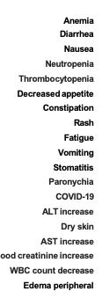
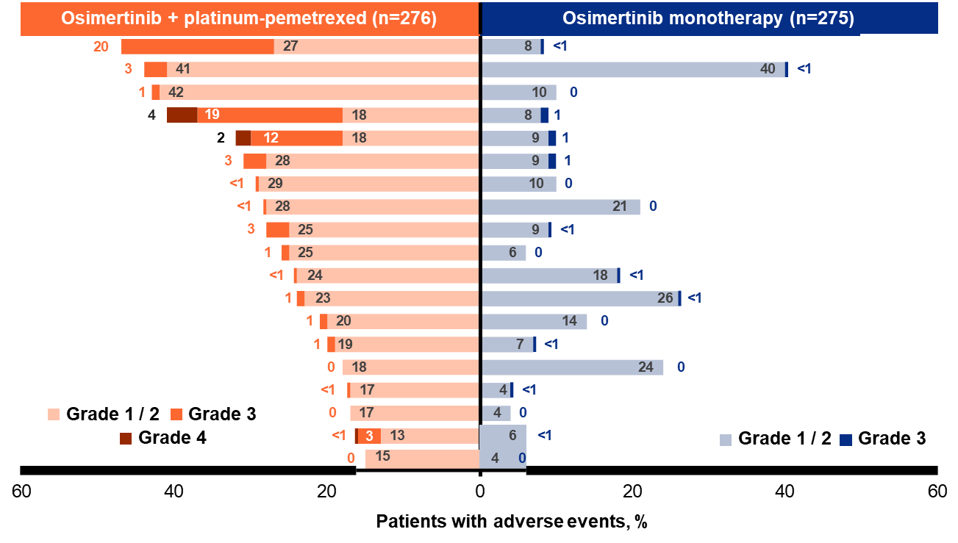
FLAURA2: Safety Summary and Adverse Events
Safety Summary
Common Adverse Events
Patients with AEs, n (%) | Osimertinib + Chemo (n=276) | Osimertinib (n=275)
AE of any cause | 276 (100) | 268 (97)
Any grade ≥3 AE | 176 (64) | 75 (27)
Any AE leading to death | 18 (7) | 8 (3)
Any serious AE | 104 (38) | 53 (19)
Any AE leading to discontinuation | 132 (48) | 17 (6)
Notes:
Jänne PA, Planchard D, Cheng Y, et al. Osimertinib with / without platinum-based chemotherapy as first-line treatment in patients with EGFRm advanced NSCLC (FLAURA2). Presented at: International Association for the Study of Lung Cancer 2023 World Conference on Lung Cancer; Singapore; September 9-12, 2023. Abstract PL03.13.
Planchard D, Jänne PA, Cheng Y, et al. LBA68 FLAURA2: Safety and CNS outcomes of first-line (1L) osimertinib (osi) ± chemotherapy (CTx) in EGFRm advanced NSCLC. Ann Oncol. 2023;34 (suppl_2):S1311-S1312.
Planchard D, Jänne PA, Cheng Y, et al; FLAURA2 Investigators. Osimertinib with or without chemotherapy in EGFR-mutated advanced NSCLC. N Engl J Med. 2023;389(21):1935-1948.
When we look at toxicities, you can see that overall, when you add chemotherapy, you do add toxicities. You add the toxicities that we're used to seeing with chemotherapy, myelosuppression, anemia, thrombocytopenia, and neutropenia. These are important to be aware of because they are more common and more significant with TKI plus chemotherapy than we're used to seeing with carboplatin/pemetrexed alone. But for the most part, these are manageable. You can see the types of toxicities here with osimertinib monotherapy including some diarrhea, some rash, but most of these are relatively mild. And again, when we add in chemotherapy, we see an increase in the prevalence predominantly of fatigue and myelosuppression. What we do know also is that this is most common during the first few months of treatment when patients are receiving the carboplatin portion of the regimen and seems to taper off once they're on pemetrexed. This does require careful monitoring.

Slide 18
MARIPOSA: Study Design
Phase 3 study of amivantamab + lazertinib vs osimertinib as 1L treatment for EGFR-mutant advanced NSCLC*
Amivantamab + lazertinib
(n=429; open label)
Key eligibility criteria
Locally advanced or
metastatic NSCLC
Treatment-naïve for
advanced disease
Documented EGFR
exon19del or L858R
ECOG PS 0 or 1
Stratification factors
EGFR mutation type
(exon19del or L858R)
Asian race (yes or no)
History of brain metastases† (yes or no)
Primary endpoint
PFS† by BICR per
RECIST v1.1
Secondary endpoints
OS†, ORR, DoR, PFS2, symptomatic PFS, intracranial PFS, safety
2:2:1 R
(N=1074)
Osimertinib
(n=429; blinded)
Lazertinib
(n=216; blinded)
Median follow-up of 22.0 months
Dosing (in 28-day cycles):
Amivantamab: 1050 mg (1400 mg if ≥80 kg) weekly for the first 4 weeks, then every 2 weeks
Lazertinib: 240 mg QD
Osimertinib: 80 mg QD
Among patients with a history of brain metastases at screening:
Brain MRI (or CT if MRI contraindicated) at baseline and every
8 weeks (±1 week) for the first 30 months, then every 12 weeks
(±1 week) until PD by BICR
Among patients without a history of brain metastases at screening:
Brain MRI (or CT if MRI contraindicated) at baseline and every
24 weeks (±1 week) until PD by BICR
Notes:
Cho BC, Lu S, Felip E, et al; MARIPOSA Investigators. Amivantamab plus lazertinib in previously untreated EGFR-mutated advanced NSCLC. N Engl J Med. 2024;391(16):1486-1498.
Cho BC, Felip E, Spira AI, et al. LBA14 Amivantamab plus lazertinib vs osimertinib as first-line treatment in patients with EGFR-mutated, advanced non-small cell lung cancer (NSCLC): primary results from MARIPOSA, a phase III, global, randomized, controlled trial. Ann Oncol. 2023;34(Supplement 2):S1306.
In the MARIPOSA study, this looked at a non-chemotherapy-based approach, so combining amivantamab plus lazertinib, which was compared to osimertinib. And in order to evaluate the contribution of lazertinib, or the contribution of the different components to the amivantamab and lazertinib combination, there's also a small number of patients randomized to the lazertinib arm 2:2:1. Again, same eligibility criteria for this trial, same stratification factors, although the history of brain metastases yes or no was also included in the stratification.
The primary endpoint was progression-free survival by blinded, independent radiology review and survival, response and other endpoints also looked at as secondary endpoints. In particular, patients with and without brain metastases did have routine imaging of the brain.

Slide 19
MARIPOSA: PFS (Primary Endpoint)
 | Median PFS, mo (95% CI)
Amivantamab + lazertinib | 23.7 (19.1-27.7)
Osimertinib | 16.6 (14.8-18.5)
Primary Endpoint: PFS by BICRª
Median OS (interim analysis): HR, 0.77 (95% CI, 0.61-0.96; P = .019); did not reach prespecified level of statistical significance
I
I
I
I
I
I
I
I
HR, 0.70 (95% CI, 0.58-0.85; P < 0.001)
I
I
I
I
I
73
I
I
Median follow-up: 22.0 mo
I
I
I
I
I
I
I
I
I
I
PFS, %
I
I
I
I
65
I
I
I
48
I
I
I
I
I
I
I
I
I
I
I
I
I
I
I
I
I
I
I
I
I
I
I
I
I
I
I
I
I
I
I
I
I
I
I
I
I
Amivantamab + lazertinib
I
I
I
I
I
I
I
I
I
I
I
I
I
I
I
34
I
I
Osimertinib
Time, mo
No. at Risk
Amivantamab + lazertinib | 429 | 391 | 357 | 332 | 291 | 244 | 194 | 106 | 60 | 33 | 8 | 0
Osimertinib | 429 | 404 | 358 | 325 | 266 | 205 | 160 | 90 | 48 | 28 | 10 | 0
Notes:
Cho BC, Felip E, Spira AI, et al. LBA14 Amivantamab plus lazertinib vs osimertinib as first-line treatment in patients with EGFR-mutated, advanced non-small cell lung cancer (NSCLC): primary results from MARIPOSA, a phase III, global, randomized, controlled trial. Ann Oncol. 2023;34(Supplement 2):S1306.
Cho BC, Lu S, Felip E, et al; MARIPOSA Investigators. Amivantamab plus lazertinib in previously untreated EGFR-mutated advanced NSCLC. N Engl J Med. 2024;391(16):1486-1498.
Gadgeel S, Cho BC, Lu S, et al. Amivantamab plus lazertinib vs osimertinib in first-line EGFR-mutant advanced NSCLC: longer follow-up of the MARIPOSA study. Presented at: 2024 World Conference on Lung Cancer; San Diego, California; September 8, 2024. Abstract OA02.03.
We saw that for this study, also, with the combination of amivantamab and lazertinib, PFS was meaningfully improved. A hazard ratio of 0.70, median of 23.7 months with the combination amivantamab and lazertinib, and again osimertinib performing as expected, a median of 16.6 months for progression-free survival. We've also heard about the overall survival analysis. Although initially the interim did not meet the prespecified boundary, we have heard now that overall survival has reached statistical significance. The interim analysis showed an OS hazard ratio of 0.77, and we've seen further maturation of the data from there.

Slide 20
MARIPOSA: Overall Survival
 | Median OS (95% CI)
Amivantamab + lazertinib | Not reached (42.9–NR)
Osimertinib | 36.7 mo (33.4–41.0)
HR, 0.75 (95% CI, 0.61–0.92); P<0.005ª
75%
70%
60%
56%
Amivantamab + lazertinib
Participants who are surviving (%)
51%
44%
Osimertinib
OS was significantly longer with amivantamab + lazertinib
OS curves continue to widen over time with a projected
>1-year median OS benefit*
Median follow-up: 37.8 mo
No. at risk
Amivantamab + lazertinib
Osimertinib
Months
429
429
404
416
390
409
383
396
375
374
363
354
343
333
328
311
310
291
287
270
277
251
232
201
168
132
111
87
61
49
18
15
1
0
0
0
*Based on an exponential distribution assumption of OS in both arms, the improvement in median OS is projected to exceed 1 year.
Notes:
Yang JCH, Kim YJ, Lee SH, et al. Amivantamab plus lazertinib vs osimertinib in first-line (1L) EGFR-mutant (EGFRm) advanced NSCLC: final overall survival (OS) from the phase III MARIPOSA study. Presented at: European Lung Cancer Congress; Paris, France; March 26-29, 2025. Abstract 4O.
These were the survival data that I was referring to. These are now mature, and this was presented at ELCC in 2025 with a significant hazard ratio of 0.75 favoring amivantamab and lazertinib. Median survival not yet reached, but in the osimertinib arm, 36.7 months. Again, performing as we would expect, and these survival curves continue to widen over time.

Slide 21
MARIPOSA: CNS Activity
icPFS
icDoR
Amivantamab + lazertinib
Amivantamab + lazertinib
Osimertinib
Osimertinib
51%
Participants with
intracranial response (%)
Participants who were
progression-free intracranially (%)
36%
48%
Median follow-up: 37.8 months
18%
Median follow-up: 37.8 months
Months
Months
No. at risk:
No. at risk:
178
173
165
164
151
151
139
142
123
126
112
110
102
98
90
83
82
69
70
59
63
47
49
29
31
15
17
8
8
0
2
0
0
0
125
130
123
128
110
113
102
103
89
87
79
70
73
59
62
49
57
32
50
24
39
16
32
10
18
7
11
2
7
0
0
0
Median icPFS, months (95% CI)
Amivantamab + lazertinib | 25.4 (20.1–29.5) | HR, 0.79 (95% CI, 0.61–1.02); p=0.07
Osimertinib | 22.2 (18.4–26.9)
Median icDoR, months (95% CI)
Amivantamab + lazertinib | 35.7 (25.8–NR)
Osimertinib | 29.6 (23.9–34.1)
icORR was 78% in the amivantamab + lazertinib arm and 77% in the osimertinib arm.
Notes:
Yang JCH, Kim YJ, Lee SH, et al. Amivantamab plus lazertinib vs osimertinib in first-line (1L) EGFR-mutant (EGFRm) advanced NSCLC: final overall survival (OS) from the phase III MARIPOSA study. Presented at: European Lung Cancer Congress; Paris, France; March 26-29, 2025. Abstract 4O.
Here, looking at the CNS activity of the MARIPOSA regimen, presented a little bit differently. We compare the intracranial progression-free survival on the left and intracranial duration of response on the right here. What you can see is that they're equivalent initially, but there is kind of in later time points, a slight separation of these curves with perhaps some more long-term durability in the brain with amivantamab. Although these are relatively small numbers here at these later time points, nevertheless, we certainly do see that amivantamab/lazertinib is also a very CNS active treatment regimen for these patients and a good option for patients with baseline brain metastases. And I'll note that in both of these studies, about 40% of patients had baseline brain metastases. So this is really a common problem for patients with EGFR-mutated lung cancer.

Slide 22
MARIPOSA: Adverse Events
TEAE, n (%) | Amivantamab + Lazertinib (n=421) | Osimertinib (n=428)
Any AE | 421 (100) | 425 (99)
Grade ≥3 AEs | 316 (75) | 183 (43)
AEs leading to death | 34 (8) | 31 (7)
Any AE leading to treatment:
Interruptions of any agent | 350 (83) | 165 (39)
Reductions of any agent | 249 (59) | 23 (5)
Discontinuations of any agent | 147 (35) | 58 (14)
Discontinuation of all agents | 10% | 3%
Any VTE*, n (%) | 157 (37) | 39 (9)
Median onset to first VTE | 84 days | 194 days
Within first 4 months, n (%) | 97 of 157 (62) | 13 of 39 (33)
AEs by preferred term (≥20% of participants in either group) | Amivantamab + lazertinib (n=421) |  | Osimertinib (n=428)
 | Any grade | Grade ≥3 | Any grade | Grade ≥3
Related to EGFR inhibition
Paronychia | 291 (69) | 49 (12) | 127 (30) | 2 (<1)
Rash | 271 (64) | 73 (17) | 136 (32) | 3 (<1)
Diarrhea | 133 (32) | 9 (2) | 200 (47) | 4 (<1)
Dermatitis acneiform | 127 (30) | 37 (9) | 55 (13) | 0
Stomatitis | 126 (30) | 5 (1) | 92 (21) | 1 (<1)
Pruritus | 107 (25) | 2 (<1) | 75 (18) | 1 (<1)
Related to MET inhibition
Hypoalbuminemia | 216 (51) | 26 (6) | 29 (7) | 0
Peripheral edema | 162 (38) | 8 (2) | 29 (7) | 1 (<1)
Other
Infusion-related reaction | 275 (65) | 27 (6) | 0 | 0
ALT increased | 170 (40) | 28 (7) | 66 (15) | 8 (2)
AST increased | 139 (33) | 15 (4) | 68 (16) | 6 (1)
Constipation | 130 (31) | 0 | 70 (16) | 0
COVID-19 | 125 (30) | 8 (2) | 112 (26) | 9 (2)
Anemia | 114 (27) | 20 (5) | 112 (26) | 10 (2)
Decreased appetite | 114 (27) | 4 (1) | 84 (20) | 7 (2)
Nausea | 99 (24) | 5 (1) | 65 (15) | 1 (<1)
Hypocalcemia | 96 (23) | 11 (3) | 37 (9) | 0
Asthenia | 84 (20) | 13 (3) | 54 (13) | 7 (2)
Muscle spasms | 84 (20) | 3 (<1) | 36 (8) | 0
Thrombocytopenia | 74 (18) | 4 (1) | 92 (21) | 6 (1)
Median duration of treatment was 27.0 months for amivantamab + lazertinib and 22.4 months for osimertinib
AEs were mostly EGFR- and MET-related and grades 1–2
Notes:
Cho BC, Felip E, Spira AI, et al. LBA14 Amivantamab plus lazertinib vs osimertinib as first-line treatment in patients with EGFR-mutated, advanced non-small cell lung cancer (NSCLC): primary results from MARIPOSA, a phase III, global, randomized, controlled trial. Ann Oncol. 2023;34(Supplement 2):S1306.
Yang JCH, Kim YJ, Lee SH, et al. Amivantamab plus lazertinib vs osimertinib in first-line (1L) EGFR-mutant (EGFRm) advanced NSCLC: final overall survival (OS) from the phase III MARIPOSA study. Presented at: European Lung Cancer Congress; Paris, France; March 26-29, 2025. Abstract 4O.
The MARIPOSA regimen also increases toxicities compared to the TKI alone, but there are different types of toxicities. So with the addition of amivantamab to a third generation EGFR inhibitor, you can bucket the types of toxicities that are seen to those related to more potent inhibition of EGFR. So these are skin toxicities, paronychia, and rash being the most common. Some diarrhea as well, though that wasn't as increased with the combination. But certainly the paronychia, the rash, scalp folliculitis can be a problem. We can see some cumulative edema related to the MET inhibition. And then with the IV formulation of amivantamab, the majority of patients, about 65%, will have an infusion-related reaction, which requires split dosing over the first two days of treatment. Fortunately, even when patients do have an IRR, they tend to subsequently do well. But this is something that requires a long chair time and careful monitoring. The last thing I'll highlight here on the left is that you can also see that venous thromboembolism, so blood clots, were increased in the amivantamab/lazertinib combination, 37% of patients developed a VTE on the combo vs 9% with osimertinib alone. Median onset here was about 84 days. And I'll show you in a couple of slides, but this has actually necessitated the use of prophylactic anticoagulation when giving amivantamab/lazertinib. So that does seem to mitigate the risk of VTE, but it's important to be aware of.

Slide 23
First-Line EGFR-Targeted Therapy Options for mNSCLC With Common EGFR Mutations: NCCN Guidelines
EGFR Exon 19 Deletion or Exon 21 L858R Mutation
1L Tx
Preferred/Recommended
Osimertinibª (category 1)
Amivantamab + lazertinibª (category 1)
Osimertinib + pemetrexed + (cisplatin or carboplatin) (nonsquamous)ª (category 1)
Useful in Certain Circumstances
Afatinibª (category 1)
Dacomitinibª (category 1)
Erlotinibª (category 1)
Erlotinib + ramucirumabª
Erlotinib + bevacizumab
Gefitinibª (category 1)
Notes:
Riely GJ, Wood DE, Aisner DL, et al. NCCN Clinical Practice Guidelines in Oncology (NCCN Guidelines®) for Non-Small Cell Lung Cancer (Version 4.2025). © 2025 National Comprehensive Cancer Network, Inc. To view the most recent and complete version of the NCCN Guidelines®, go online to NCCN.org.
So this makes things a little complex. Now we talk about osimertinib, which is a preferred option, and also intensified therapy, amivantamab plus lazertinib, or osimertinib plus pemetrexed-based platinum chemotherapy.
And so, of course, there are a number of key questions. Who should get which? How do we decide? And I think we'll talk a little bit more about how do we choose intensified therapy for a select group of patients? How do we present this discussion? And then the much more difficult challenge of how do we choose between intensified regimens?

Slide 24
Weighing First-Line Options: Shared Decision-Making
Favoring Combination Therapy
Favoring Monotherapy
CNS and/or Liver Metastases
High-Volume Disease
Baseline ctDNA Positive
TP53 Co-mutation
NSCLC
Factors
Low-Volume Disease
Baseline ctDNA Negative
Poor Functional Status
Patient Preference for Quality of Life
Medical Comorbidities
Social Barriers to Care
Good Functional Status
Patient Preferences for Combination Therapy
Patient
Factors
Notes:
Those patients that probably benefit from combination to a greater extent include those with CNS metastases, those with high-volume disease, those with ctDNA in plasma at baseline, so those with a positive liquid biopsy, patients with co-alterations, such as TP53 or PIK3CA, and patients with liver metastases or other high-risk areas of disease. Patients where probably oncologists and patients are much more comfortable with monotherapy: patients with lung-only, low-volume disease, perhaps just a pleural effusion or small bilateral, minimally symptomatic lesions; patients who have a good prognosis and have negative liquid biopsies at baseline, we know that's associated with good outcome.
Now, of course, there are many important patient factors. In order to get intensified therapy, your patient needs to have a good functional status, and they need to want to have this intensified therapy, the potential for better outcomes with the risk of more toxicity and more intense treatment burden. Our patients that have lower functional status, patients that are much more interested in quality and minimal visits to the hospital and minimal treatment burden, those with comorbidities so potential contraindications to chemotherapy, and those where you know coming to the cancer center frequently and being able to have that circle of care to help manage toxicity is a challenge, those with social barriers, these might be patients that we really do recommend monotherapy for.

Slide 25
Impact of 1L Combinations on Resistance Mechanisms
MARIPOSA¹
FLAURA2²
~3-fold reduction
Functional groups | Acquired gene alteration, n (%) | FLAURA osimertinib monotherapy (n=109) | FLAURA2 osimertinib monotherapy (n=73) | FLAURA2 osimertinib + platinum-pemetrexed (n=53)
EGFR mutations | C797S | 7 (6) | 9 (12) | 2(4)
 | Other Uncommon | 5 (5) | 3 (4) | ND
RTK amplifications | MET amplification | 17 (16) | 10 (14) | 5 (9)
 | ERRB2 amplification | 2 (2) | 1 (1) | 3 (6)
МАРК/PIЗK mutations | BRAF V600E | 3 (3) | 4 (5) | ND
 | KRAS mutation | 3 (3) | 6 (8) | 3 (6)
 | PIK3CA mutation | 6 (6) | 6 (8) | 2(4)
 | ERBB2 mutation | ND | 1 (1) | ND
Cell cycle gene amplifications | CCND1/E1 amplification | 7 (6) | 1 (1) | 3 (6)
 | CDK4/6 amplification | 7 (6) | 4 (5) | 3 (6)
Fusions | RET | ND | 3 (4) | 1 (2)
 | BRAF | ND | 3 (4) | 1 (2)
 | ALK | 1 (1) | 2 (3) | ND
 | Other | NR | 5 (7) | 2 (4)
RB1 loss (with TP53) |  | NR | 4 (5) | ND
No known resistance alteration detected |  | NR | 36 (49) | 40 (75)
p=0.017
~8-fold reduction
p=0.014
Patients (%)
Osimertinib (n=140)
Amivantamab + lazertinib (n=113)
Notes:
1. Besse B, Lee SH, Lu S, et al. LBA55 Mechanisms of acquired resistance to first-line amivantamab plus lazertinib versus osimertinib in patients with EGFR-mutant advanced non-small cell lung cancer: An early analysis from the phase III MARIPOSA study. Ann Oncol. 2024;35(Supplement 2):S1245-S1246.
2. Lee CK, et al. Acquired mechanisms of resistance to first-line (1L) osimertinib with or without platinum-based chemotherapy (CT) in EGFR-mutated (EGFRm) advanced NSCLC: Preliminary data from FLAURA2. Presented at: ESMO Asia Congress 2023; Singapore; December 1-3, 2023. Abstract 514MO.
A related question is how does the choice of first-line therapy impact resistance mechanisms that we see? And this data is still emerging. We do have some data from the MARIPOSA study, although I'll warn you that this is all largely done based on liquid biopsies. So not on tumor biopsies. But what we saw is that there are lower rates of both MET amplification and secondary EGFR resistance mutations seen after the MARIPOSA regimen than after osimertinib. I think that helps prove that we delay or prevent this type of resistance from emerging, but it also takes away from potentially targetable findings at resistance. With the FLAURA2 data, we saw that overall, there wasn't a big difference in the types of resistance mechanisms that we're seeing, whether you used osimertinib monotherapy or osimertinib plus chemotherapy. I think our key point here is that no matter what the type of treatment option that you choose, I still think it's well worth considering a repeat tissue biopsy at progression if you are able, specifically because we know that some of these patients can still develop histologic transformation, where they go from a non-small cell lung cancer to a small cell carcinoma.

Slide 26

≥2L Treatment Landscape in Metastatic NSCLC With Common EGFR Mutations
On-target inhibition
Off-target inhibition
Combined on- and
off-target inhibition
Targeting tumor-associated antigens
4G EGFR TKI
VEGF-PD-1 bsAb + ChT
3G EGFR TKI + MET TKI
EGFR-MET bsAb + ChT
HER3 ADC
MET ADC
TROP2 ADC
BBT-176¹
BBT-207²
JIN-A02³
Ivonescimab + ChT⁴
Osimertinib + tepotinib⁵
Osimertinib + savolitinib¹
Amivantamab + ChT⁶
Patritumab
deruxtecan¹
Telisotuzumab
vedotin⁹
Datopotamab
deruxtecan¹⁰
Anti-PD-1
Anti-VEGF
Anti-EGFR
Anti-MET
EMA & FDA
EMA & FDA
EGFR
PD-1
VEGF
EGFR
APPROVED^{7,8}
MET
EGFR
MET
HER2
HER3
MET
TROP2
Testing for resistance mechanisms and assessing the possible therapeutic options available upon progression is critical to define an optimal management approach for patients^{11,12}
Notes:
Lim SM, Kim CG, Lee JB, Cho BC. Patritumab deruxtecan: paving the way for EGFR-TKI-resistant NSCLC. Cancer Discov. 2022;12(1):16-19.
First-in-human study of BBT-207 in advanced non-small cell lung cancer harboring EGFR mutation after treatment with EGFR TKI. ClinicalTrials.gov identifier: NCT05920135. Updated April 27, 2025. https://www.clinicaltrials.gov/ct2/show/NCT05920135
Lim SM, Cho BC, Han JY, et al. Phase 1/2 clinical trial of JIN-A02, a 4th generation EGFR-TKI, in patients with 3rd generation EGFR-TKI resistance in EGFR mutated advanced/metastatic non-small cell lung cancer (NSCLC). J Clin Oncol. 2024;42(suppl_16):TPS8658.
Zhang L, Fang W, Zhao Y, et al. Ivonescimab combined with chemotherapy in patients with EGFR-mutant non-squamous non-small cell lung cancer who progressed on EGFR tyrosine-kinase inhibitor treatment (HARMONi-A): A randomized, double-blind, multi-center, phase 3 trial. J Clin Oncol. 2024;42(suppl_16):8508.
Kim TM, Guarneri V, Jye VP, et al. Tepotinib + osimertinib in EGFR-mutant NSCLC with MET amplification following 1L osimertinib: INSIGHT 2 primary analysis. 2023 World Conference on Lung Cancer; Singapore; September 9-12, 2023. Abstract OA21.05.
Passaro A, Wang J, Wang Y, et al; MARIPOSA-2 Investigators. Amivantamab plus chemotherapy with and without lazertinib in EGFR-mutant advanced NSCLC after disease progression on osimertinib: primary results from the phase III MARIPOSA-2 study. Ann Oncol. 2024;35(1):77-90.
FDA. RYBREVANT (amivantamab) prescribing information. September 2024. Accessed March 2025. Available at: https://www.accessdata.fda.gov/drugsatfda_docs/label/2024/
761210s004lbl.pdf
EMA. RYBREVANT (amivantamab) summary of product characteristics. March 2025. Accessed March 2025. Available at: https://www.ema.europa.eu/
en/documents/product-information/rybrevant-epar-product-information_en.pdf
Goldman JW, Horinouchi H, Cho BC, et al. Phase 1/1b study of telisotuzumab vedotin (Teliso-V) + osimertinib (Osi), after failure on prior Osi, in patients with advanced, c-Met overexpressing, EGFR-mutated non-small cell lung cancer (NSCLC). J Clin Oncol. 2022;40(suppl_16):9013.
Paz-Ares L, Ahn MJ, Lisberg AE, et al. 1314MO TROPION-Lung05: datopotamab deruxtecan (Dato-DXd) in previously treated non–small cell lung cancer (NSCLC) with actionable genomic alterations (AGAs). Ann Oncol. 2023;34(suppl 2):S755-S756.
Hendriks LE, Kerr KM, Menis J, et al; ESMO Guidelines Committee. Oncogene-addicted metastatic non-small-cell lung cancer: ESMO Clinical Practice Guideline for diagnosis, treatment and follow-up. Ann Oncol. 2023;34(4):339-357.
Bertoli E, De Carlo E, Del Conte A, et al. Acquired resistance to osimertinib in EGFR-mutated non-small cell lung cancer: how do we overcome it? Int J Mol Sci. 2022;23(13):6936.
And once patients progress on these great new treatments, you know what's next? It really has become incredibly challenging. And we've moved from that old paradigm of third-generation TKI or osimertinib to platinum-based chemotherapy to a number of different options. There's a lot of interest in development still looking at fourth-generation kinase inhibitors and really looking at accelerating on-target inhibition. So perhaps adding a MET TKI, if there's a new and emergent alteration, such as MET amplification or a new fusion. And also off-target strategies. So adding VEGF and PD-1 to chemotherapy, adding chemotherapy. There's some clinical trials in both of these spaces. And we've heard about some data now with ADCs, HER3 ADCs, MET ADCs and potentially continuing the targeted therapy, and TROP2. And while these consistently improve progression-free survival, we are looking to hear more about the overall survival data and looking at potential approvals in this untargeted approach and space. So lots to watch out for here. Definitely, I think the essential factors are that it's really important to do molecular testing and it's really important to participate in trials.
But there is a treatment that's been clearly shown to do better than platinum-based chemotherapy alone after osimertinib failure, and this is now approved around the world, and this comes from the MARIPOSA-2 study, adding amivantamab to chemotherapy.

Slide 27
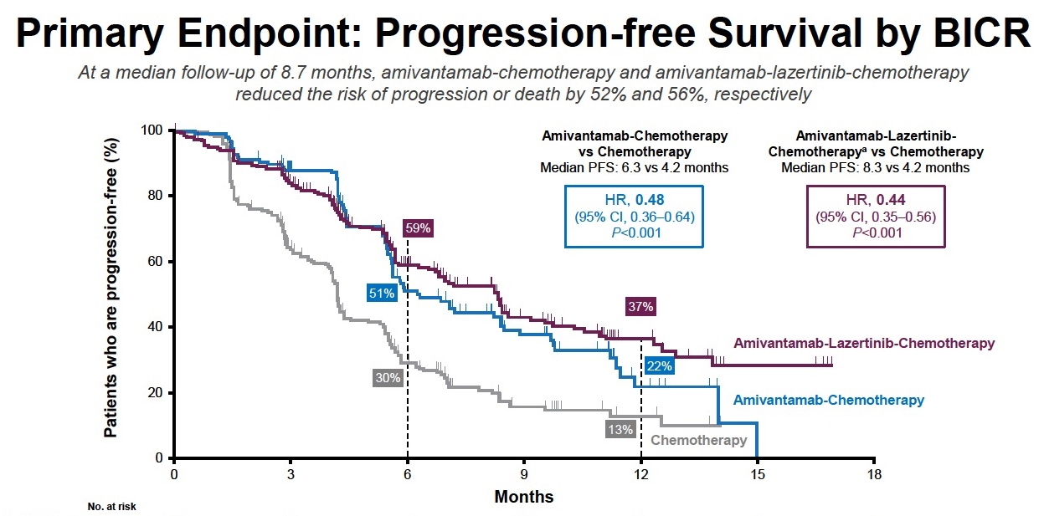
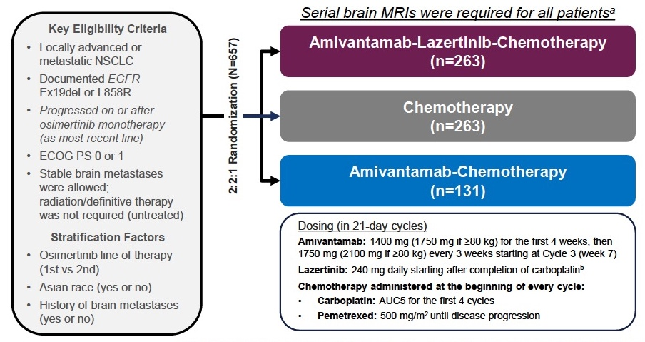
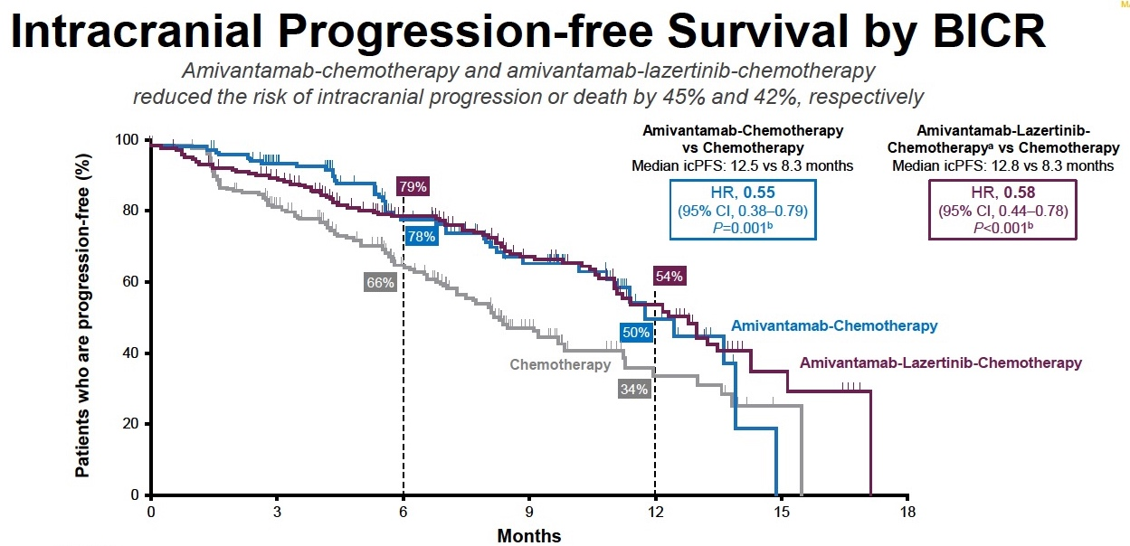
MARIPOSA-2: Phase 3 Trial of Amivantamab + Chemo ± Lazertinib vs Chemo in Patients With EGFRmut Advanced NSCLC Post-Osimertinib
Primary endpoint: PFS by BICR per RECIST 1.1
Secondary endpoints: ORR, DoR, OS, intracranial PFS, safety
Notes:
Passaro A, Wang J, Wang Y, et al. Amivantamab plus chemotherapy (with or without lazertinib) vs chemotherapy in EGFR-mutated advanced NSCLC after progression on osimertinib: MARIPOSA-2, a phase III, global, randomized, controlled trial. ESMO Congress 2023; Madrid, Spain; October 20-24, 2023. Abstract LBA15.
Passaro A, Wang J, Wang Y, et al; MARIPOSA-2 Investigators. Amivantamab plus chemotherapy with and without lazertinib in EGFR-mutant advanced NSCLC after disease progression on osimertinib: primary results from the phase III MARIPOSA-2 study. Ann Oncol. 2024;35(1):77-90.
So the original study looked at a 4-drug combination, amivantamab, lazertinib, pemetrexed, and platinum, compared to chemotherapy alone. And then a 3-drug arm—this was a much smaller arm—again, to look at the contribution of amivantamab to chemotherapy without lazertinib. So again, it was a 2:2:1 randomization. And the, again, eligibility criteria, patients were to have progressed after osimertinib, a good performance status, stable brain metastases, and again, common sensitizing mutations.
Stratification included how recently patients received osimertinib as first- or second-line therapy, whether patients were of Asian ethnicity, and whether or not patients had a history of brain metastases.
And the main endpoint was progression-free survival by blinded, independent radiology review. But many other secondary outcomes, including ORR, overall survival and intracranial PFS.
So as you can see, progression-free survival was significantly improved when we added amivantamab or amivantamab and lazertinib to chemotherapy. But the differences between the 2 arms where we added treatment really weren't very different. Now, these aren't direct comparisons, but the hazard ratio for adding amivantamab 0.48 compared to chemotherapy alone, and for adding amivantamab, lazertinib, and chemotherapy 0.44. And of course, at the risk of increased toxicity, which has led to the drug approval around the world of amivantamab plus chemotherapy as the new standard after patients progress on osimertinib.
What was very interesting was that when we looked at intracranial progression-free survival, amivantamab, of course, a large molecule, we didn't think that it would really improve intracranial progression-free survival compared to chemotherapy. But what was interesting was that both the 4-drug arm, including lazertinib, and the 3-drug arm, not including a TKI, so just amivantamab and chemotherapy, had better intracranial PFS. A hazard ratio of 0.55 for amivantamab plus chemotherapy, and 0.58 for the combination of 4 drugs, including the TKI.
So this is really quite interesting, and I think speaks to the importance of really understanding that perhaps the blood-brain barrier is not as intact as we think in these patients with brain metastases and prior radiation and other treatments. But also that controlling extracranial disease probably is very important to improving progression throughout the body, including intracranially. And so based on these data, this is a new and very important standard for our patients.

Slide 28
MARIPOSA-2: Safety Summary
TEAEs, n (%) | Chemotherapy (n = 243) | Amivantamab + Chemotherapy (n = 130) | Amivantamb + Lazertinib + Chemotherapy (n = 263)
Any event | 227 (93) | 130 (100) | 263 (100)
Grade ≥3 | 117 (48) | 94 (72) | 242 (92)
Any serious AE | 49 (20) | 42 (32) | 137 (52)
AE resulting in death | 3 (1) | 3 (2) | 14 (5)
Any event leading to Interruption of any study drug Reduction of any study drug Discontinuation of any study drug | 81 (33) 37 (15) 9 (4) | 84 (65) 53 (41) 24 (18) | 202 (77) 171 (65) 90 (34)
Select adverse events in the amivantamab arms included cytopenias, IRR, paronychia, rash, diarrhea, stomatitis, and peripheral edema.
Notes:
Passaro A, Wang J, Wang Y, et al; MARIPOSA-2 Investigators. Amivantamab plus chemotherapy with and without lazertinib in EGFR-mutant advanced NSCLC after disease progression on osimertinib: primary results from the phase III MARIPOSA-2 study. Ann Oncol. 2024;35(1):77-90.
When we look at the toxicity profiles of these regimens, essentially the bottom line is that the four drug regimen, amivantamab, lazertinib, and chemotherapy, led to obsessive toxicities. Ninety-two percent of these patients had a grade 3 or greater treatment emergent adverse event. So while they're still kind of exploring ways to potentially dose these therapies, maybe adding in the TKI later, what we have leaned towards and what we reach for commonly in the clinic now is chemotherapy plus amivantamab as a second-line treatment strategy for our patients who progress on TKI. And that still does combine the side effects of amivantamab, the dermatologic toxicities, the infusion-related reactions with those of chemotherapy, but I do think it's better tolerated than the four-drug regimen here.

Slide 29
PALOMA-3: Phase 3 Trial of Amivantamab SC + Lazertinib Amivantamab IV + Lazertinib in Refractory EGFR-Mutated Advanced NSCLC
 | Amivantamab SC (n = 206) | IV Amivantamab (n = 212) | Amivantamab IV (n = 212)
ORR, % (95% CI)
All responders | 30 (24-37) | 33 (26-39) | 33 (26-39)
 | Relative risk, 0.92 (0.70-1.23); P = 0.001
Confirmed responders | 27 (21-33) | 27 (21-33) | 27 (21-33)
 | Relative risk, 0.99 (0.72-1.36); P < 0.001
Best response, n (%) CR PR SD PD NE | 1 (0.5) 61 (30) 93 (45) 37 (18) 14 (7) | 1 (0.5) 68 (32) 81 (38) 42 (20) 20 (9)
DCR, % (95% CI) | 75 (69-81) | 71 (64-77)
Median TTR (range), mo | 1.5 (1.2-6.9) | 1.5 (1.2-9.9)
Amivantamab SC + lazertinib demonstrated PK and ORR noninferiority compared with amivantamab IV + lazertinib in patients with EGFR-mutated advanced NSCLC with disease progression on or after osimertinib
and chemotherapy
Compared with the IV arm, amivantamab SC also showed:
  Numerically longer DOR (11.2 vs 8.3 mo) and PFS (6.1 vs 4.3 mo)
  Significant improvement in OS
  (HR = 0.62; nominal P = 0.02)
Notes:
Leighl NB, Akamatsu H, Lim SM, et al. Subcutaneous amivantamab vs intravenous amivantamab, both in combination with lazertinib, in refractory EGFR-mutated, advanced non-small cell lung cancer (NSCLC): primary results, including overall survival (OS), from the global, phase 3, randomized controlled PALOMA-3 trial. J Clin Oncol. 2024;42(17_suppl):LBA8505.
Leighl NB, Akamatsu H, Lim SM, et al. PALOMA-3 Investigators. Subcutaneous versus intravenous amivantamab, both in combination with lazertinib, in refractory epidermal growth factor receptor-mutated non-small cell lung cancer: primary results from the phase III PALOMA-3 study. J Clin Oncol. 2024;42(30):3593-3605.
So how do we make it easier? And so in the PALOMA program, we looked at, how do we make the journey better for patients? And can subcutaneous delivery improve things? So I had the honor of presenting the PALOMA-3 study at ASCO in 2024 and we published this in the Journal of Clinical Oncology, and we showed that subcutaneous amivantamab and lazertinib after osimertinib and chemotherapy in patients with advanced EGFR-mutated lung cancer has the same outcomes clinically, is really non-inferior, to intravenous amivantamab and lazertinib. We showed the same response rate. We showed actually slightly better PFS with subq amivantamab compared to IV. And in particular, we showed better tolerability. And I'll talk a little bit more about that.
One of the things that we didn't expect to see was a difference in overall survival, but we actually did see a significant difference in overall survival. This was one of our secondary endpoints with a hazard ratio of 0.62.
Very exciting, because this is a potentially better way, of course, to deliver the treatment, and may lead to downstream benefits for patients for reasons that we are still exploring.

Slide 30
PALOMA-3: IRRs and VTE
Incidence of IRRs and IRR-Related Symptoms
Rates of VTE by Treatment Arm and Prophylaxis Status
SC amivantamab (n=206)
IV amivantamab (n=210)
IRRs, all grades
SC Ami
IV Ami
IRRs, grade 3
Grade ≥3
Infusion-related AEs (≥2%)
Grade 2
Chills
Patients With VTE, %
Pyrexia
Grade 1
26
Dyspnea
Nausea
Vomiting
14
17
Cough
9
12
Hypoxia
7
Hypotension
Sinus tachycardia
Erythema
Chest discomfort
Hypertension
All Patients
On Prophylactic Anticoagulation
No Prophylactic Anticoagulation
Flushing
Dizziness
Rash
Hyperhidrosis
The safety profile of amivantamab SC was consistent with IV, with fewer IRRs (13% vs 66%) and VTE (9% vs 14%)
Increased heart rate
%
Notes:
Leighl NB, Akamatsu H, Lim SM, et al. Subcutaneous amivantamab vs intravenous amivantamab, both in combination with lazertinib, in refractory EGFR-mutated, advanced non-small cell lung cancer (NSCLC): primary results, including overall survival (OS), from the global, phase 3, randomized controlled PALOMA-3 trial. J Clin Oncol. 2024;42(17_suppl):LBA8505.
Leighl NB, Akamatsu H, Lim SM, et al. PALOMA-3 Investigators. Subcutaneous versus intravenous amivantamab, both in combination with lazertinib, in refractory epidermal growth factor receptor-mutated non-small cell lung cancer: primary results from the phase III PALOMA-3 study. J Clin Oncol. 2024;42(30):3593-3605.
Also, very importantly, it improves the patient journey. So we showed that the incidence of infusion-related reactions really decreases, 13% compared to the usual 66%. But again, you know even if you're using IV amivantamab, it's really in that first hour of the first dose on the first day, and often we're able to just interrupt the treatment, let things settle down, and then resume with more premedication.
The other interesting thing we found was that venous thrombotic events, of course a concern with amivantamab and lazertinib, was actually lower when we used subcutaneous treatments. So is it that there's some intravenous or direct irritation when we give the antibody? That might be part of it. But clearly this is an exciting way to move forward, although I think in the meantime, we do recommend that we give prophylactic anticoagulation, both for our patients receiving IV and subcutaneous amivantamab, although you know, clearly subcutaneous is associated with a better safety profile.

Slide 31
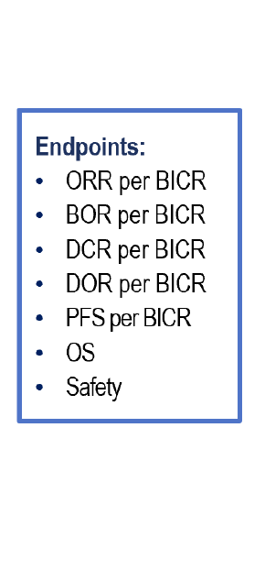
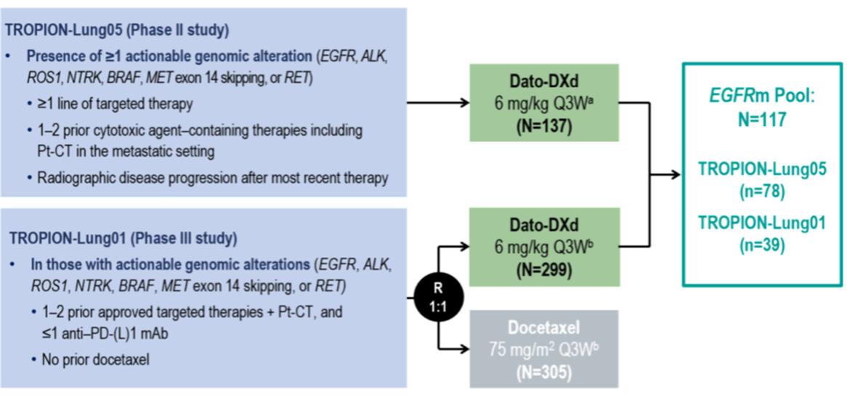
Pooled Analysis of TROPION-Lung01 and TROPION-Lung05:
Study Design
BICR, blinded independent central review; BOR, best overall response; Dato-DXd, datopotamab deruxtecan; DCR, disease control rate; DOR, duration of response; EGFR, epidermal growth factor receptor; EGFRm, EGFR mutated; mAb, monoclonal antibody; ORR, overall response rate; OS, overall survival; PD-(L)1, programmed death (ligand) 1; PFS, progression-free survival; Pt-CT, platinum-based chemotherapy; Q3W, once every 3 weeks; R, randomized.
Ahn MJ, et al. ESMO Asia 2024. Abstract LBA7.
Notes:
Ahn MJ, Sands J, Lisberg AE, et al. Efficacy and safety of datopotamab deruxtecan (Dato-DXd) in patients (pts) with previously-treated EGFR-mutated advanced non-small cell lung cancer (NSCLC): A pooled analysis of TROPION-Lung01 and TROPION-Lung05. Presented at: ESMO Asia Congress 2024; Singapore; December 6-8, 2024. Abstract LBA7.
We've heard a lot about the TROP2 ADCs in this space, all oncogene-addicted lung cancers. And there was a nice pooled analysis of datopotamab deruxtecan, which is a TROP2 ADC from the TROPION-Lung01 and Lung05 studies. And these pooled patients had actual genomic alterations, including EGFR, ALK and others, and had received prior treatments, including prior target therapies. And this was looking at the dose of 6 mg/kg every 3 weeks.

Slide 32
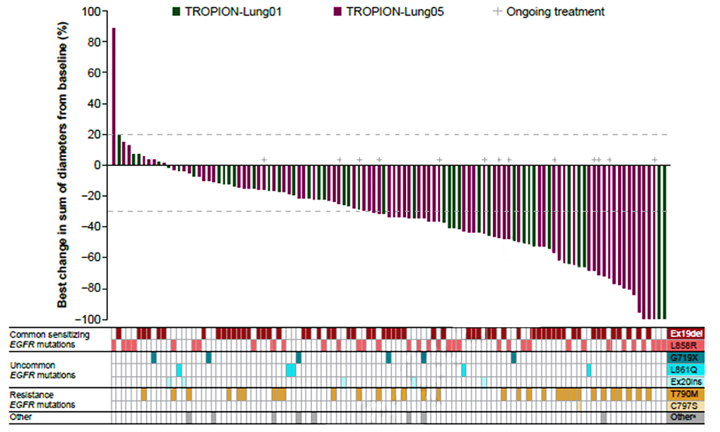
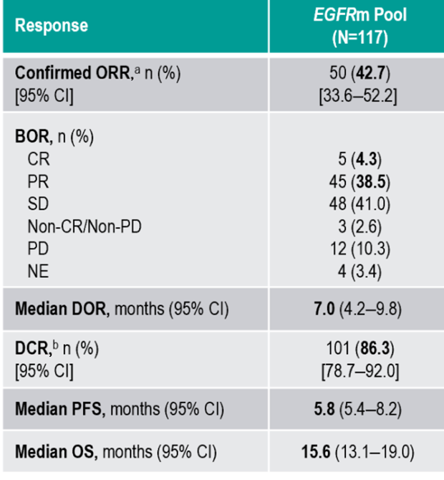
Pooled Analysis of TROPION-Lung01 and TROPION-Lung05: Efficacy and Safety
Adverse events of interest included stomatitis/oral mucositis (69% [9% grade 3]), ocular surface events (32% [3% grade 3]), and ILD (4% [1% grade 3]).
BOR, best overall response; CR, complete response; DCR, disease control rate; DOR, duration of response; EGFR, epidermal growth factor receptor; EGFRm, EGFR mutated; ILD, interstitial lung disease; NE, not evaluable; ORR, overall response rate; OS, overall survival; PD, progressive disease; PFS, progression-free survival; PR, partial response; SD, stable disease.
Ahn MJ, et al. ESMO Asia 2024. Abstract LBA7. Ahn MJ, et al. J Thorac Oncol. 2025;[online ahead of print].
Notes:
Ahn MJ, Sands J, Lisberg AE, et al. Efficacy and safety of datopotamab deruxtecan (Dato-DXd) in patients (pts) with previously-treated EGFR-mutated advanced non-small cell lung cancer (NSCLC): A pooled analysis of TROPION-Lung01 and TROPION-Lung05. Presented at: ESMO Asia Congress 2024; Singapore; December 6-8, 2024. Abstract LBA7.
Ahn MJ, Lisberg A, Goto Y, et al. A pooled analysis of datopotamab deruxtecan in patients with EGFR–mutated NSCLC. J Thorac Oncol. 2025;[online ahead of print].
And they showed that in patients with EGFR-mutant lung cancer, the overall response rate was 42.7%, some patients achieving a complete response and a median duration of response of 7 months, a median PFS of 5.8 months. So, very interesting in the pretreated or third-line population.
Very important to remember with all new drugs, new toxicities, stomatitis, in particular, ocular events, and we do need to be very mindful of interstitial lung disease.

Slide 33
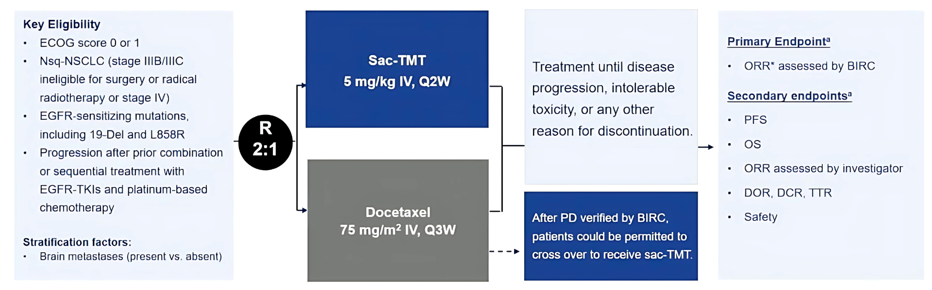
Phase 2 OptiTROP-Lung03: Study Design
Notes:
Zhang L, Fang W, Li X, et al. Sacituzumab tirumotecan (sac-TMT) in patients (pts) with previously treated advanced EGFR-mutated non-small cell lung cancer (NSCLC): results from the randomized OptiTROP-Lung03 study. Presented at: American Society of Clinical Oncology Annual Meeting; Chicago, Illinois; May 30-June 3, 2025. Abstract: 8507.
At ASCO this year, we saw the results of the study from China called OptiTROP-Lung03. This was a study of a new TROP2 antibody-drug conjugate called sacituzumab tirumotecan or Sac-TMT, which is a novel TROP2 antibody-drug conjugate, which was tested in a randomized study in China. All patients with EGFR sensitizing mutations who had progressed on platinum-based chemotherapy and prior TKIs. And here, it was randomized Sac-TMT to docetaxel.

Slide 34
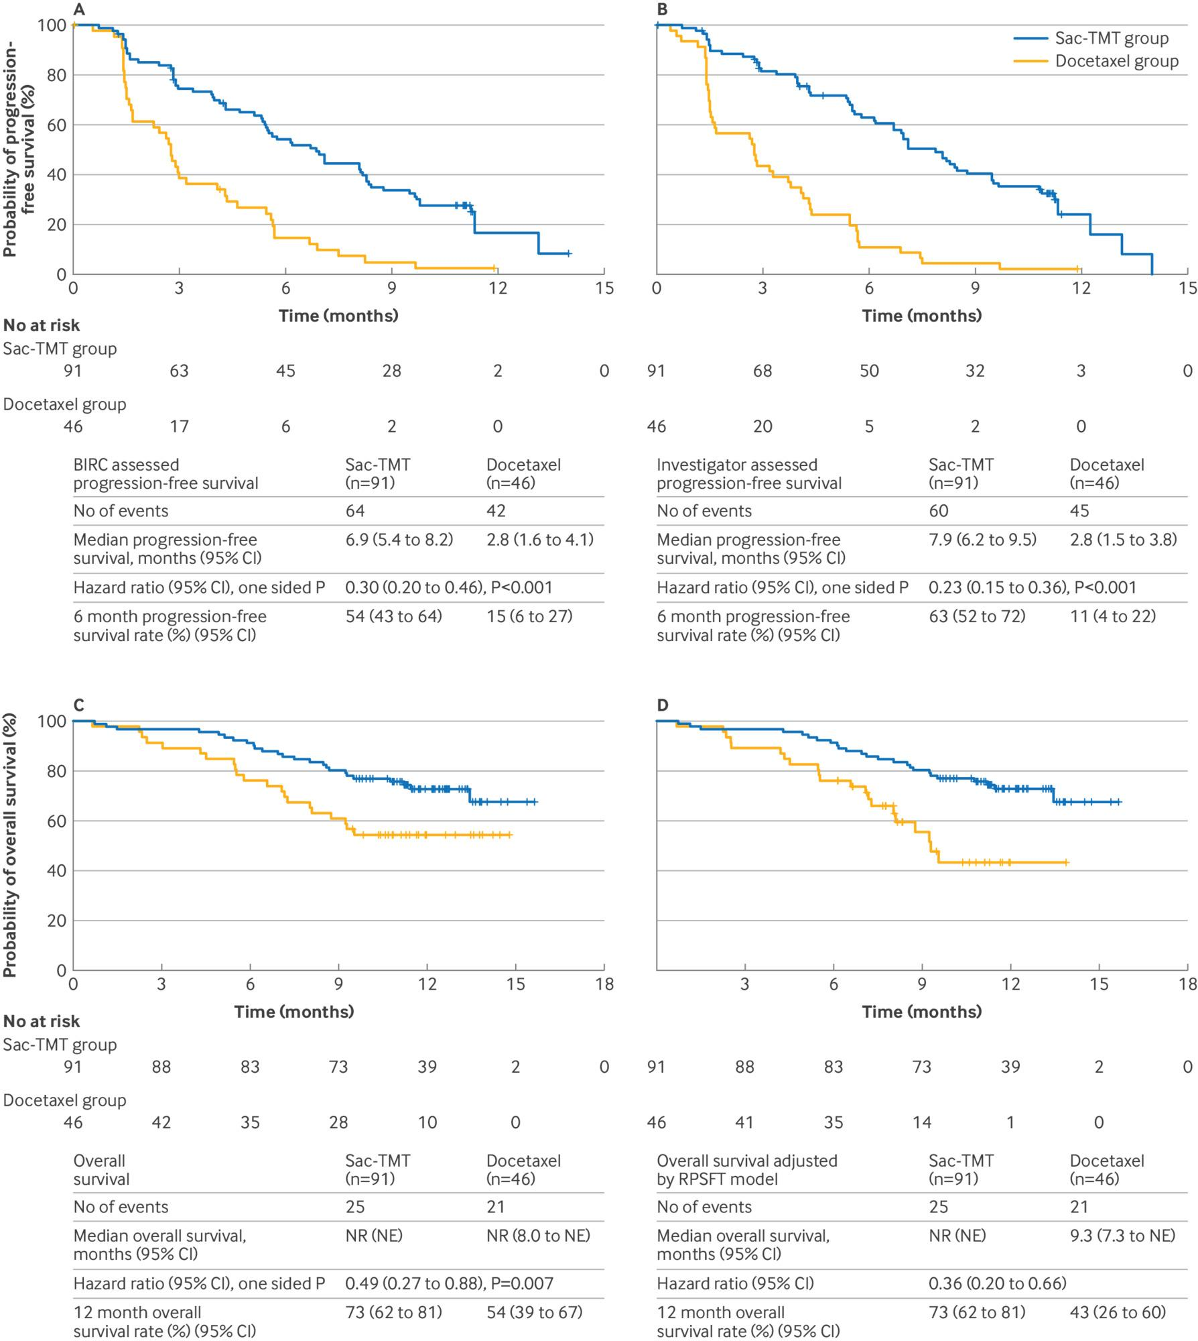
OptiTROP-Lung03: Efficacy and Safety
PFS
OS
ORR: 45% vs 16%,
P < 0.001
Toxicities: stomatitis (64% vs 7% [grade ≥3: 16% vs 2%]); ocular surface toxicity (2% vs 0%); pneumonitis (1% vs 0%)
BIRC, blinded independent central review; NE, not estimable; NR, not reached; ORR, overall response rate; OS, overall survival; PFS, progression-free survival; Sac-TMT, sacituzumab tirumotecan.
Zhang L, et al. ASCO 2025. Abstract 8507. Fang W, et al. BMJ. 2025;389:e085680.
Notes:
Zhang L, Fang W, Li X, et al. Sacituzumab tirumotecan (sac-TMT) in patients (pts) with previously treated advanced EGFR-mutated non-small cell lung cancer (NSCLC): Results from the randomized OptiTROP-Lung03 study. Presented at: American Society of Clinical Oncology Annual Meeting; Chicago, Illinois; May 30-June 3, 2025. Abstract: 8507.
Fang W, Li X, Wang Q, et al. Sacituzumab tirumotecan versus docetaxel for previously treated EGFR-mutated advanced non-small cell lung cancer: multicentre, open label, randomised controlled trial. BMJ. 2025;389:e085680.
And we saw that there was an improvement in progression-free survival and even overall survival with Sac-TMT compared to docetaxel. In terms of toxicities here, stomatitis was seen, just as we see with Dato-DXd, relatively low rates of ocular surface toxicity or pneumonitis, which was reassuring. But again, the response rate here was 45% vs 16%, which is on par with what we expect with docetaxel. And so, I think this was a really good study. I think this is an exciting compound that we should have an eye out for.

Slide 35


Current Approved Agents for mNSCLC With EGFR Exon 20 Insertions
May 2021
Dec 2021
Mar 2024
Jul 2024
July 2025
CHRYSALIS
Amivantamab
PAPILLON
Amivantamab + CT
WU-KONG1B
Sunvozertinib
Notes:
So it's been a very exciting time for our patients with common alterations, but also for our patients with less common and more challenging alterations, including our patients with exon 20 insertions. We've seen now that there have been 2 drug approvals, one dating back to 2021 with second-line amivantamab, based on the outcomes of the CHRYSALIS study. We were really honored to be part of that program. And more recently, in the first-line setting, moving amivantamab up to first line and adding it to platinum chemotherapy, which up until now was the standard of care for these patients.

Slide 36
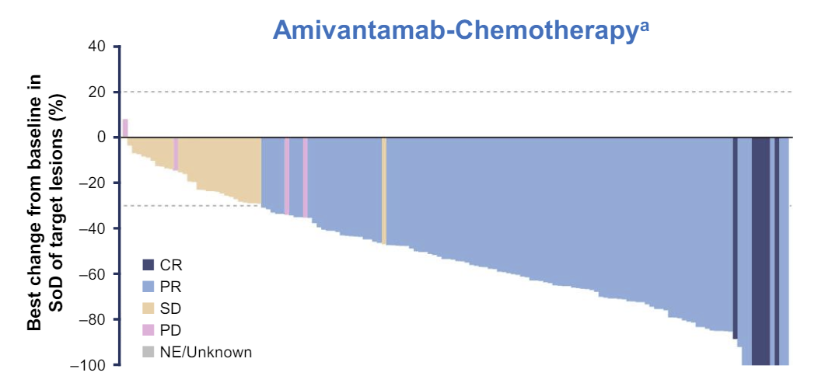
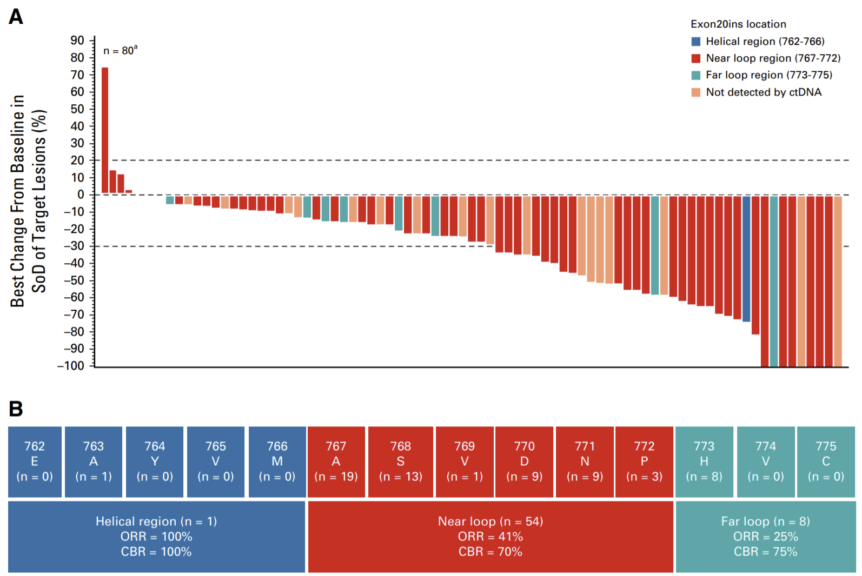
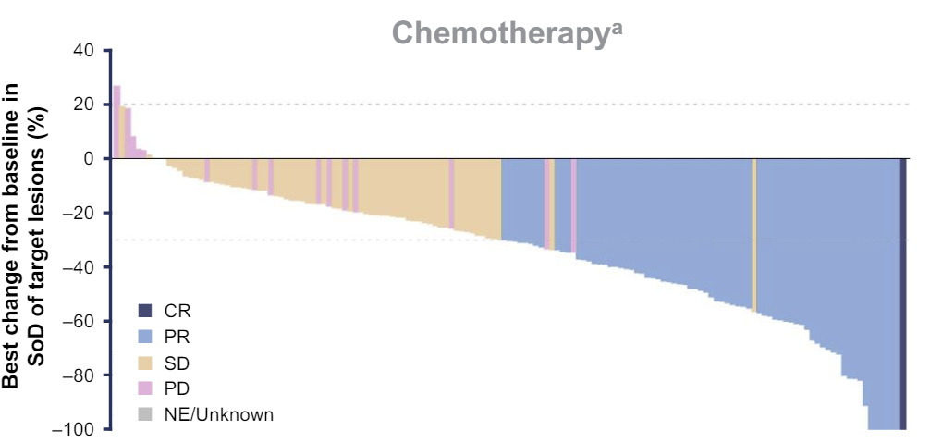
Amivantamab ± Chemotherapy for EGFR Exon20 Insertions
1L Amivantamab + Chemotherapy (PAPILLON)²
Amivantamab Monotherapy 2L+
(CHRYSALIS)¹
ORR 73%
PFS 11.4 months
ORR 47%
PFS 6.7 months
ORR 40%, PFS 8.3 months
Post-Platinum Chemotherapy
Notes:
Park K, Haura EB, Leighl NB, et al. Amivantamab in EGFR exon 20 insertion-mutated non-small-cell lung cancer progressing on platinum chemotherapy: initial results from the CHRYSALIS phase I study. J Clin Oncol. 2021;39(30):3391-3402.
Zhou C, Tang KJ, Cho BC, et al. PAPILLON Investigators. Amivantamab plus chemotherapy in NSCLC with EGFR exon 20 insertions. N Engl J Med. 2023;389(22):2039-2051.
And these are some of the data in pretreated patients from the CHRYSALIS study. We showed that amivantamab monotherapy in our patients that were pretreated with exon 20 insertion mutations, the overall response rate was 40%, the median duration of response now closing in on 12-plus months, and the median PFS across all patients 8.3 months. In the first-line setting in the PAPILLON study, again, we heard about this at ESMO in 2023. Very exciting. When we add amivantamab to chemotherapy and compare it to chemotherapy in the first-line in these patients, higher response rates, 73%, greater progression-free survival 11 months compared to 6.7 months, and also better overall survival.

Slide 37
Phase 3 PAPILLON Trial: Study Design
Key Eligibility Criteria
Treatment-naïve,ª locally advanced, or metastatic NSCLC
Documented
EGFR exon 20 insertion mutations
ECOG PS 0 or 1
Stratification Factors
ECOG PS
History of brain metastases^{b}
Prior EGFR TKI useª
1:1 Randomization (N=308)
Amivantamab-Chemotherapy
(n=153)
Primary endpoint: Progression-free survival (PFS) by BICR according to RECIST v1.1^{c}
Secondary endpoints:
Objective response rate (ORR)^{c}
Duration of response (DoR)
Overall survival (OS)^{c}
PFS after first subsequent therapy (PFS2)
Symptomatic PFS^{d}
Time to subsequent therapy^{d}
Safety
Chemotherapy
(n=155)
Dosing (in 21-day cycles)
Amivantamab: 1400 mg (1750 mg if ≥80 kg) for the first 4 weeks, then 1750 mg (2100 mg if ≥80 kg) every 3 weeks starting at week 7 (first day of cycle 3)
Chemotherapy on the first day of each cycle:
Carboplatin: AUC5 for the first 4 cycles
Pemetrexed: 500 mg/m² until disease progression
Optional crossover to 2nd-line amivantamab monotherapy^{e}
Notes:
Zhou C, Tang KJ, Cho BC, et al. PAPILLON Investigators. Amivantamab plus chemotherapy in NSCLC with EGFR exon 20 insertions. N Engl J Med. 2023;389(22):2039-2051.
And I'll go into some of the details with the PAPILLON study that's really helped us establish the first line of treatment. These patients, of course, are treatment naïve. They have documented exon 20 insertions, good performance status 0 or 1, and they were stratified by performance status, the presence of brain metastases, which was allowed, and prior TKI use. Amivantamab was given weekly. The dose a little different, a little higher than what we use in sensitizing mutations. Chemotherapy given in standard doses for the first 4 cycles with pemetrexed and carboplatin. And the primary endpoint, progression-free survival. Again, important secondary endpoints, including response, PFS2, and overall survival. These patients were allowed to cross over to second-line amivantamab, which had reflected the standard of care until this time.

Slide 38
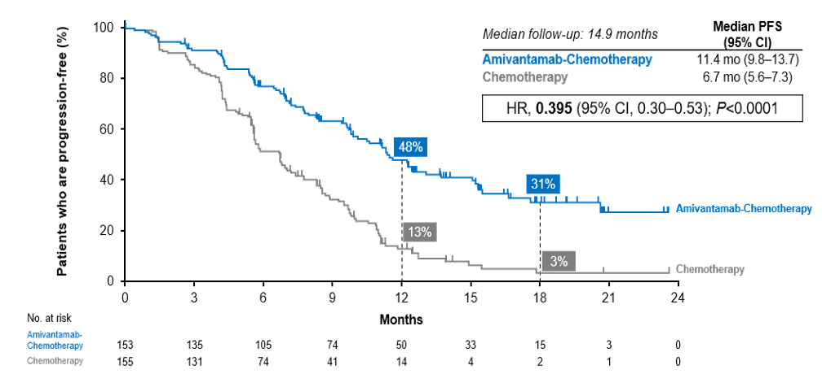
PAPILLON: PFS by BICR (Primary Endpoint)
Consistent PFS benefit by investigator: 12.9 vs 6.9 mo (HR, 0.38; 95% CI, 0.29–0.51; P<0.0001ª)
Notes:
Zhou C, Tang KJ, Cho BC, et al; PAPILLON Investigators. Amivantamab plus chemotherapy in NSCLC with EGFR exon 20 insertions. N Engl J Med. 2023;389(22):2039-2051.
And we can see that in PAPILLON, we saw a dramatic benefit in terms of progression-free survival benefit, a hazard of 0.395, associated with the addition of amivantamab first line. And again, as I mentioned, a median PFS of 11.4 compared to 6.7 months.

Slide 39
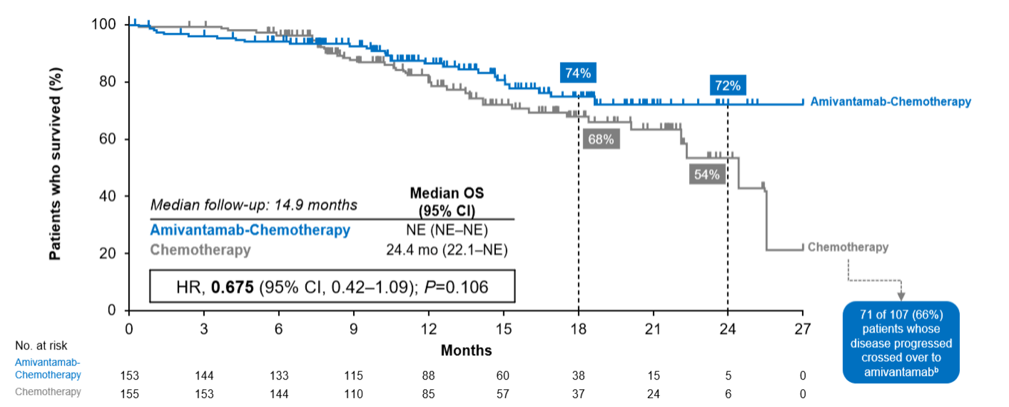
PAPILLON: Overall Survival
Notes:
Zhou C, Tang KJ, Cho BC, et al; PAPILLON Investigators. Amivantamab plus chemotherapy in NSCLC with EGFR exon 20 insertions. N Engl J Med. 2023;389(22):2039-2051.
And also improved overall survival, this sort of with longer follow-up, but a hazard of 0.675, a P value of 0.10. So a very clear trend. And this has really led to the regulatory approval around the world.

Slide 40
PAPILLON: Safety Summary
Safety Summary, n (%) | Amivantamab + Chemotherapy (n = 151) | Chemotherapy (n = 155)
Any AEs | 151 (100) | 152 (98)
Grade ≥3 AEs | 114 (75) | 83 (54)
Serious AEs | 56 (37) | 48 (31)
AEs leading to death | 7 (5) | 4 (3)
Any AE leading to: Interruption of any agent Interruption of amivantamab Dose reduction of any agent Dose reduction of amivantamab Discontinuation of any agent Discontinuation of amivantamab | 104 (69) 63 (42) 73 (48) 54 (36) 36 (24) 10 (7) | 56 (36) — 35 (23) - 16 (10) —
Discontinuation of all study agents due to AEs | 12 (8) | 12 (8)
Treatment Exposure | Amivantamab + Chemotherapy (n = 151) | Chemotherapy (n = 155)
Median treatment duration, mo (range) | 9.7 (0.1-26.9) | 6.7 (0-25.3)
Median number of chemotherapy cycles, # (range) Carboplatin Pemetrexed | 4 (1-4) 13 (1-34) | 4 (1-5) 10 (1-37)
Discontinuation rates of all study agents due to AEs were identical between the 2 arms (8%)
Treatment-related serious AEs and AEs leading to deaths were comparable between arms
Select adverse events in the amivantamab arm included cytopenias, IRR, paronychia, rash, diarrhea, nausea, stomatitis, and peripheral edema
Notes:
Girard N, Park K, Tang K, et al. LBA5 Amivantamab plus chemotherapy vs chemotherapy as first-line treatment in EGFR exon 20 insertion-mutated advanced non-small cell lung cancer (NSCLC): primary results from PAPILLON, a randomized phase III global study. Ann Oncol. 2023;34(Supplement 2):S1304.
Zhou C, Tang KJ, Cho BC, et al; PAPILLON Investigators. Amivantamab plus chemotherapy in NSCLC with EGFR exon 20 insertions. N Engl J Med. 2023;389(22):2039-2051.
The safety summary, I won't belabor too much here because this is really similar to what we talked about already with MARIPOSA and MARIPOSA-2. What we can see here is that you're kind of combining the toxicities of amivantamab with those of chemotherapy. But one important kind of pearl to keep in mind is that the risk of clots of VTE is actually unique to the combinations of amivantamab plus an EGFR inhibitor. And so VTE does not seem to be as common when amivantamab is given alone or even with chemotherapy. But all the other dermatologic toxicities and infusion-related reactions and others still are unfortunately quite common.

Slide 41
Ongoing Frontline Phase 3 RCTs in mNSCLC with EGFR Exon 20 Insertions
REZILIENT3
WU-KONG28
FURVENT
NCT5767892
Zipalertinib + chemotherapy
Sunvozertinib
Furmonertinib
YK-029A
Chemotherapy
Chemotherapy
Chemotherapy
Chemotherapy
Furmonertinib
240 mg QD
(n=125)
FURVENT accrual completed,
rest ongoing
PFS endpoint
crossover
R
1:1:1
Furmonertinib
160 mg QD
(n=125)
N=375
Platinum Chemotherapy + Pemetrexed
(n=125)
Notes:
Piotrowska Z. Making progress along the challenging road of drug development for patients with EGFR exon 20 insertion-positive non-small cell lung cancer. J Clin Oncol. 2025;43(13):1523-1526.
On the horizon, though, we have a number of exciting new agents with ongoing frontline trials comparing to chemotherapy. These include drugs like zipalertinib, which is being added to chemotherapy versus chemotherapy alone, and a number of exciting new kinase inhibitors, such as sunvozertinib, furmonertinib, and others, where they're being compared in the first-line setting to chemotherapy. One of these, the furmonertinib, FURVENT study, has completed approval, and we hope the others will complete soon. Of course, this is on the background of the recent publication of mobocertinib versus chemotherapy first line in these patients where we did not improve outcome and this had toxicity. But I think we're all very, very hopeful that these new agents, which have superior efficacy and less toxicity, may present new hope and competition on the horizon.

Slide 42
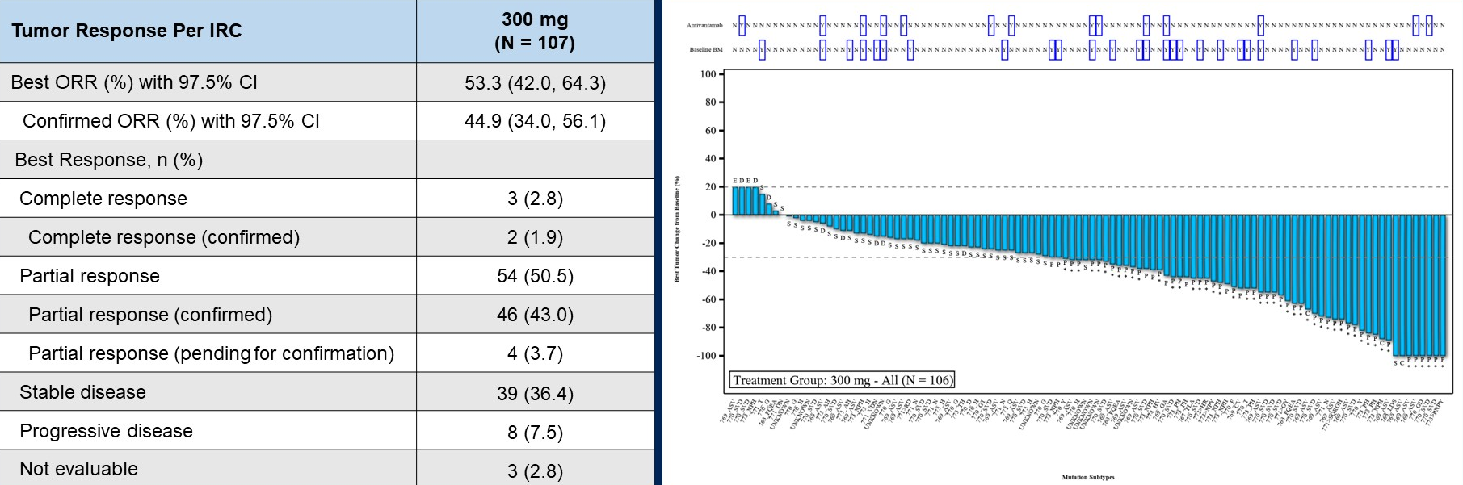
Pivotal Phase 2 WU-KONG1B Trial of Sunvozertinib in Progressive mNSCLC With EGFR Exon 20 Insertions
Tumor Response per IRC | Sunvozertinib (N = 107)
Best ORR (%) with 97.5% Cl | 53.3 (42.0, 64.3)
Confirmed ORR (%) with 97.5% Cl | 44.9 (34.0, 56.1)
Best Response, n (%)
Complete response | 3 (2.8)
Complete response (confirmed) | 2 (1.9)
Partial response | 54 (50.5)
Partial response (confirmed) | 46 (43.0)
Partial response (pending for confirmation) | 4 (3.7)
Stable disease | 39 (36.4)
Progressive disease | 8 (7.5)
Not evaluable | 3 (2.8)
The median DoR has not been reached, and
the 9-month DoR rate was 57%
ORR was comparable in patients with or without prior amivantamab treatment
Common grade ≥3 TRAEs included diarrhea (17.1%) and increased blood CPK (10.8%)
Notes:
Yang JCH, Doucet L, Wang M, et al. A multinational pivotal study of sunvozertinib in platinum pretreated non-small cell lung cancer with EGFR exon 20 insertion mutations: Primary analysis of WU-KONG1 study. Presented at: American Society of Clinical Oncology Annual Meeting; Chicago, Illinois; May 31-June 4, 2024. Abstract: 8513.
Sunvozertinib is approved as a post-chemotherapy option for our patients. And then hopefully one of these oral agents will soon move to a frontline indication as well.

Slide 43
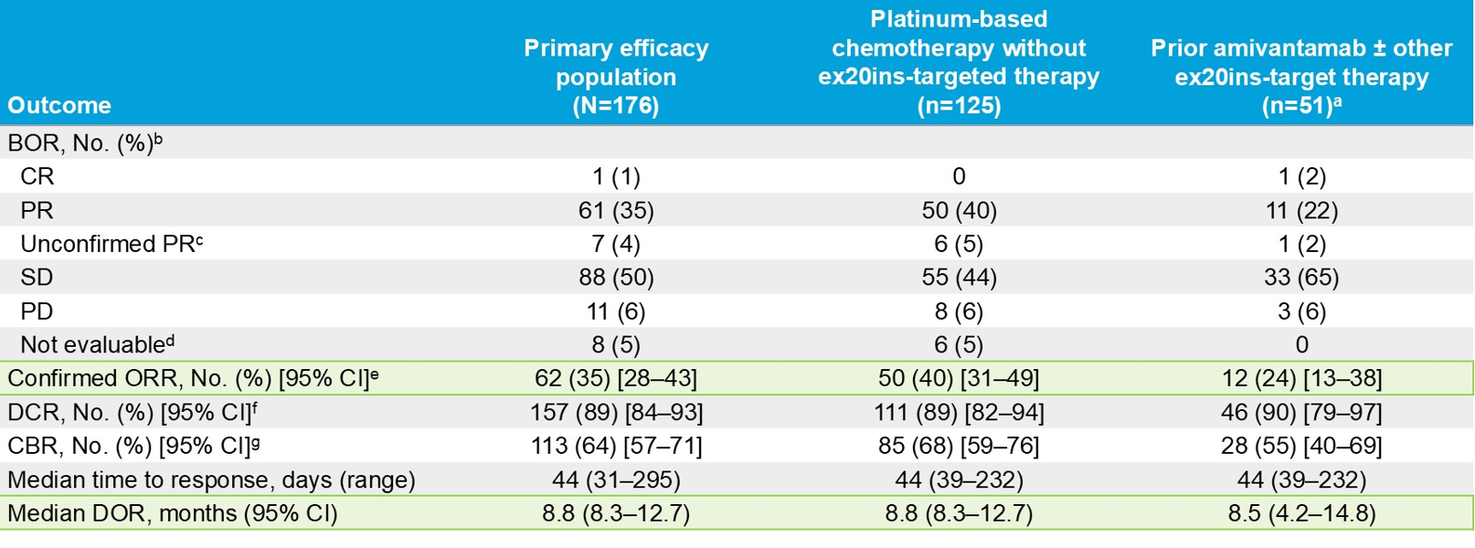
Pivotal Phase 2b REZILIENT1 Trial of Zipalertinib in Progressive mNSCLC With EGFR Exon 20 Insertions
Common grade ≥3 adverse events included anemia (7%), pneumonitis (2.5%), rash (2.5%), elevated ALT (2%), diarrhea (2%), and thrombocytopenia (2%).
Notes:
Yu H, Nguyen D, Ruiter G, et al. Efficacy of zipalertinib in NSCLC patients with EGFR exon 20 insertion mutations who received prior platinum-based chemotherapy with or without amivantamab. Presented at: American Society of Clinical Oncology Annual Meeting; Chicago, Illinois; May 30-June 3, 2025. Abstract: 8503.
We did hear some updated data from the zipalertinib program at ASCO this past year, presented by Dr. Helena Yu and colleagues, where they demonstrated a confirmed response rate of 35% in their primary efficacy population. In patients that had not had prior exon 20 insertion directed targeted therapy, it was higher at 40%. But in patients who had had prior amivantamab or other exon 20-targeting therapy, it was 24%. So I think this is promising. The median duration of response, about 8.8 months. So very, very durable. Very well tolerated. The most common adverse events, 7% of patients with anemia, low rate of pneumonitis 2.5%, low rate of severe rash 2.5%, and transaminase, and diarrhea. So really looking forward to these new TKIs entering the therapeutic arena.

Slide 44
Treatment-Related Adverse Events With EGFR Inhibitors

Slide 45











Clinically Relevant AEs Associated With
EGFR Inhibition
GI disorders
ILD
  Clinically relevant AEs associated with EGFR inhibition should be managed
  effectively to optimize patient QoL
Dermatologic AEs
Peripheral edema
Ocular AEs
Stomatitis/oral mucositis
Neutropenia
IRRs
Cardiac AEs
VTEs
Notes:
So across all of these agents, be they TKIs, monoclonal antibodies, all of these are associated with some clinically relevant EGFR inhibition-associated AEs, whether it's skin, which is of course the most common, lung, GI disorders, ocular. With the addition of chemotherapy, of course, we need to be mindful of blood counts. Cardiac events also with targeted therapy like osimertinib. And we also need to be mindful of things like stomatitis, edema with MET-targeted therapies, infusion-related reactions, and VTEs. And so it's really important that all of our patients have very specialized care to support toxicity management.

Slide 46
Expert Opinion: Prophylactic and Preemptive Management of Dermatologic AEs
Management principles: Targeting skin inflammation, infection, and skin barrier defect
Management objective: Prevent dose reduction or dose discontinuation
For all patients
For selected patients
Appropriate patient education: Avoid hot water, skin irritants, solvents, skin manipulation…
Washing with lukewarm water and non-irritating soap-free cleansing products
Fragrance-free topical moisturisers
No excessive UV exposure
Treat any underlying skin conditions
Screening for S. aureus colonization (if needed)
If history of severe acneiform rash
Or monoclonal antibodies (cetuximab, panitumumab, amivantamab)
Or combination with radiotherapy/ChT
Or no dermatologic follow-up
Medium-potency topical steroids
No topical antibiotics
Prophylactic treatment with doxycycline
(100 mg/day)
Discontinuation after 6 weeks maximum
Notes:
So prophylaxis has really emerged as something that we should all be doing. Not only do we want to make sure that patients have great skin care and great teaching in your clinic as they start these new agents, we also really want to decrease the risk of inflammation, decrease the risk of infection, and really try and keep skin intact to prevent dose reduction, to prevent holding the dose or stopping treatment, and, of course, to improve the journey for our patients. So of course, avoiding hot water and irritants, not scratching, making sure that cleansing products and moisturizers are nontoxic or nonirritating, avoiding the sun, treating underlying skin conditions, and being mindful of things like Staph aureus colonization and treating for that if we need to. Steroids, as we need to. Usually, for most patients, we don't need topical antibiotics, but we'll talk a little bit more about some of the prophylactic strategies that we've taken, for example, with amivantamab and lazertinib. And of course, for patients with severe toxicity, we do want to make sure that they have either prophylactic treatment with doxycycline. We do want to make sure that they have dermatologic follow-up, and that we do follow these patients very closely.

Slide 47
COCOON: Study Design
Prospectively evaluate whether a prophylactic dermatologic regimen in combination with 1L amivantamab + lazertinib can prevent moderate to severe EGFR-related dermatologic AEs
Key inclusion criteria
Locally advanced or
metastatic NSCLC
Treatment-naïve for
advanced disease
Documented EGFR
exon19del or L858R
ECOG PS 0 or 1
Stratification factors
Race (Asian vs non-Asian)
Age (<65 years vs ≥65 years)
COCOON DM
Amivantamab + lazertinib + enhanced dermatologic management (n=99)
COCOON DM
Oral doxycycline or minocycline for 12 weeks
  Followed by topical clindamycin lotion
  on the scalp
Chlorhexidine on the nails
Ceramide-based moisturiser on the
body and face†
SoC DM
General skin prophylaxis per local practice
and reactive treatment, such as topical corticosteroids and systemic antibiotics
1:1 randomization (N=201)*
SoC DM
Amivantamab + lazertinib + standard dermatologic management (n=102)
VTE prophylaxis was mandatory for the first 4 months
Primary endpoint
Incidence of Grade ≥2 dermatologic AEs‡ in the first 12 weeks after initiation of amivantamab + lazertinib treatment§
Key secondary endpoints
Number of Grade ≥2 dermatologic AEs‡ per participant, incidence and severity of paronychia,§ incidence and severity of scalp rash,§ frequency of dose reductions, interruptions, and discontinuations due to AEs
Interim analysis planned for when ~70% of participants completed Week 12 assessments‖
Notes:
Girard N, Li W, Spira A, et al. Preventing moderate to severe dermatologic adverse events in first-line EGFR-mutant advanced NSCLC treated with amivantamab plus lazertinib: early success of the COCOON trial. Presented at: European Lung Cancer Congress 2025; Paris, France; March 27, 2025. Abstract 10MO.
This study was called COCOON, and it took patients with newly diagnosed EGFR-mutant lung cancer, all of whom were getting amivantamab/lazertinib, and randomized them to either this enhanced dermatologic management or just standard whatever the provider wanted to do in terms of dermatologic management. The enhanced dermatologic management included oral antibiotics, so doxycycline or minocycline for 12 weeks. When they started on treatment, later clindamycin lotion on the scalp, chlorhexidine to the nails, aggressive moisturizers, whereas standard of care was basically whatever the patient and provider were doing already. And the primary endpoint here was to see whether this kind of enhanced dermatologic management can lead to a decrease in the incidence of grade 2 or greater dermatologic adverse events.

Slide 48
COCOON: Grade ≥2 Dermatologic AEs
Incidence of Grade ≥2 dermatologic AEs
P < 0.0001;
OR, 0.19 (0.09–0.40)*
100
In the first 12 weeks:
2-fold reduction in Grade ≥2 dermatologic AEs with COCOON DM vs SoC DM (38.6% vs 76.5%)
2-fold reduction in Grade 3 dermatologic AEs with COCOON DM vs SoC DM (4.3% vs 8.8%)
3-fold reduction in the number of participants
who reported 2 or more different Grade ≥2 dermatologic AEs with COCOON DM vs SoC DM (6% vs 18%)
80
76.5%
COCOON DM: Grade 2
8.8%
COCOON DM: Grade 3
SoC DM: Grade 2
60
SoC DM: Grade 3
Participants (%)
38.6%
40
4.3%
67.6%
20
34.3%
0
COCOON DM (n/N=27/70)
SoC DM (n/N=52/68)
A 50% reduction in Grade ≥2 dermatologic AEs was observed
with COCOON DM vs SoC DM
Notes:
Girard N, Li W, Spira A, et al. Preventing moderate to severe dermatologic adverse events in first-line EGFR-mutant advanced NSCLC treated with amivantamab plus lazertinib: early success of the COCOON trial. Presented at: European Lung Cancer Congress 2025; Paris, France; March 27, 2025. Abstract 10MO.
So here you can see that with the COCOON regimen, the grade 2 or greater dermatologic AEs were about half, 38.6% vs 76.5%.

Slide 49
COCOON: Grade ≥2 Dermatologic AEs by
Body Location
Incidence of Grade ≥2 dermatologic AEs by body location
100
COCOON DM: Grade 2
~65% reduction
COCOON DM: Grade 3
SoC DM: Grade 2
80
SoC DM: Grade 3
62%
(n=42)
60
~70% reduction
Participants (%)
~25% reduction
40
29%
(n=20)
23%
(n=16)
21%
(n=14)
16%
(n=11)
20
9%
(n=6)
0
Facial/body dermatologic AEs
(excluding scalp)
Scalp dermatologic AEs
Paronychia
In the first 12 weeks, substantial reductions in Grade ≥2 dermatologic AEs were observed on different body locations with COCOON DM vs SoC DM
Notes:
Girard N, Li W, Spira A, et al. Preventing moderate to severe dermatologic adverse events in first-line EGFR-mutant advanced NSCLC treated with amivantamab plus lazertinib: early success of the COCOON trial. Presented at: European Lung Cancer Congress 2025; Paris, France; March 27, 2025. Abstract 10MO.
One particularly important finding is that the scalp folliculitis, which really for some of these patients can be quite challenging to manage and really quite uncomfortable, was significantly decreased by about 70%. We also saw a decrease in the facial and body rash that you can see. A little bit less of a decrease. A little bit less of an impact on paronychia, but still a reduction as well. So across the board, I think prophylaxis really helps here, both in terms of the topical regimens, but also those oral antibiotics.

Slide 50
COCOON: Dose Modifications of Amivantamab or Lazertinib Due to AEs
Dermatologic AEs
Any AEs
AE, adverse event; DM, dermatologic management; SoC, standard of care.
100
100
COCOON DM
COCOON DM
80
SoC DM
80
SoC DM
COCOON
60
60
Participants (%)
Participants (%)
40
40
20
20
0
0
Dose interruption
Dose reduction
Discontinuation
Dose interruption
Dose reduction
Discontinuation
COCOON DM had lower rates of amivantamab or lazertinib discontinuations
due to any AEs vs SoC DM (11% vs 19%)
Notes:
Girard N, Li W, Spira A, et al. Preventing moderate to severe dermatologic adverse events in first-line EGFR-mutant advanced NSCLC treated with amivantamab plus lazertinib: early success of the COCOON trial. Presented at: European Lung Cancer Congress 2025; Paris, France; March 27, 2025. Abstract 10MO.
Dose modifications of amivantamb due to dermatologic AEs also decreased with the COCOON approach. Patients on the COCOON arm also had lower rates of amivantamab or lazertinib discontinuations due to any AEs.

Slide 51
Early-Onset AEs Can Be Significantly Reduced With Prophylactic Approaches
COCOON DM regimen substantially
reduced grade ≥2 dermatologic AEs¹
SKIPPirr regimen
substantially reduced IRRs²
Prophylactic anticoagulation
substantially reduced VTEs³
~2-fold reduction in dermatologic AEsª
COCOON DM
SoC
DM
Grade 3
Grade 2
~3-fold reduction in amivantamab IRRs
76.5%
8.8%
67.4%
~2-fold reduction
in VTEs
Participants with dermatologic AE (%)
Participants with IRR (%)
Participants with VTE (%)
38.6%
67.6%
20.0%
4.3%
34.3%
22.5%
11.4%
COCOON DM
SoC DM
Dexamethasone
8-mg IRR prophylaxis
Standard IRR
management
Any prophylactic anticoagulation
No prophylactic anticoagulation
Early onset AEs can be reduced using simple and accessible preventative approaches
Notes:
1. Girard N, Li W, Spira A, et al. Preventing moderate to severe dermatologic adverse events in first-line EGFR-mutant advanced NSCLC treated with amivantamab plus lazertinib: early success of the COCOON trial. Presented at: European Lung Cancer Congress 2025; Paris, France; March 27, 2025. Abstract 10MO.
2. Spira AI, Paz-Ares L, Han JY, et al. Preventing infusion-related reactions with intravenous amivantamab-results from SKIPPirr, a phase 2 study: a brief report. J Thorac Oncol. 2025;20(6):809-816.
3. Leighl NB, Akamatsu H, Lim SM, et al; PALOMA-3 Investigators. Subcutaneous versus intravenous amivantamab, both in combination with lazertinib, in refractory epidermal growth factor receptor-mutated non-small cell lung cancer: primary results from the phase III PALOMA-3 study. J Clin Oncol. 2024;42(30):3593-3605.
We've learned in the COCOON study earlier this year that prophylaxis can go a long way to really helping prevent toxicity for our patients. The COCOON regimen, which involved prophylactic antibiotics for 12 weeks, steroid cream, also vinegar and water soaks, or chlorhexidine soaks for patients’ nails that were receiving amivantamab and lazertinib really can decrease the risk of skin adverse events and really decrease the severity by more than 50%.
We found that using dexamethasone prophylaxis 8 mg twice a day, starting 2 days before and then ending with 1 dose prior to the usual dexamethasone given with IV amivantamab, really decreased the rate of infusion-related reactions. So if you are using IV amivantamab, until we get access to sub-q, the SKIPPirr regimen really helps. Published by Dr. Spira and colleagues earlier this year in the Journal of Thoracic Oncology.
Also, we've shown that prophylactic anticoagulation really can substantially decrease the risk of VTEs by almost 50% with very minimal increased risk to patients.

Slide 52

Prevention of AEs Is Key to Better Patient Outcomes
Begin amivantamab + lazertinib
IRR prophylactic regimen (SKIPPirr)¹
VTE prophylactic regimen
(PALOMA-2, PALOMA-3)^{2,3}
2 days to 1 hour before start
Oral 8 mg dexamethasone BID
2 days and 1 day prior and
1 hour before first infusion*
First 4 months
Oral anticoagulants as per
NCCN or local guidelines
Dermatologic prophylactic regimen (COCOON)^{†4}
Antibiotic
prophylaxis
Weeks 1–12
100 mg BID doxycycline
or minocycline
Weeks 13+
1% topical clindamycin lotion
on the scalp daily
Nail cleaning agent
Weeks 1+
4% chlorhexidine on the fingernails and toenails daily for 12 months
Long-acting
skin hydration
Weeks 1+
Ceramide-based moisturiser at least daily for 12 months‡
Continuing to improve the patient journey is key to optimize outcomes
Notes:
Spira AI, Paz-Ares L, Han JY, et al. Preventing infusion-related reactions with intravenous amivantamab-results from SKIPPirr, a phase 2 study: a brief report. J Thorac Oncol. 2025;20(6):809-816.
Lim SM, Tan JL, Dias JM, et al. Subcutaneous amivantamab and lazertinib as first-line treatment in patients with EGFR-mutated, advanced non-small cell lung cancer (NSCLC): results from the phase 2 PALOMA-2 study. Presented at: American Society of Clinical Oncology Annual Meeting; Chicago, Illinois; May 31-June 4, 2024. Abstract LBA8612.
Leighl NB, Akamatsu H, Lim SM, et al; PALOMA-3 Investigators. Subcutaneous versus intravenous amivantamab, both in combination with lazertinib, in refractory epidermal growth factor receptor-mutated non-small cell lung cancer: primary results from the phase III PALOMA-3 study. J Clin Oncol. 2024;42(30):3593-3605.
Girard N, Li W, Spira A, et al. Preventing moderate to severe dermatologic adverse events in first-line EGFR-mutant advanced NSCLC treated with amivantamab plus lazertinib: early success of the COCOON trial. Presented at: European Lung Cancer Congress 2025; Paris, France; March 27, 2025. Abstract 10MO.
So very important to prevent all these with simple and accessible preventative approaches. And I really think that prevention of AEs and patient education and really making sure the whole team is on board to help prevent AEs is the key to better patient outcomes. The SKIPPirr regimen, as I talked about, dexamethasone 8 mg BID, 2 days and 1 day, and then 1 hour before the first infusion. VTE prophylaxis, according to your local guidelines. Dermatologic prophylaxis, 12 weeks of antibiotics, then topical clindamycin lotion, chlorhexidine or vinegar soaks for the nails, and, of course, moisturizer. And so I think this is really important as we move into some of these novel regimens such as amivantamab and lazertinib, which have great anti-cancer benefit but also can cause some more toxicity. And so preventing these is so important.

Slide 53
Expert Opinion: Managing Grade 2/3 Dermatologic AEs
Grade 2/3: Papules and/or pustules covering 10%–30% BSA, which may or may not be associated with symptoms of pruritus or tenderness; psychosocial impact; limiting instrumental ADL; >30% with or without mild symptoms)
Reinforces photoprotective measures (especially if treated with cyclines, radiotherapy, or cytostatic antineoplastic agents)
Topical emollients
High-potency topical steroids +/- metronidazole +/- tacrolimus/pimecrolimus
No topical antibiotics
Screening for S. aureus superinfection
Obtain bacterial cultures if infection is suspected
If infection, begin oral antibiotics with
anti-S. aureus and Gram + coverage (according to antibiogram) +/- topical mupirocin for nasal colonization and antiseptics (shower)
Resume cyclines, according to sensitivities
For refractory cases: Doxycycline (200 mg/day) or isotretinoin (0.3 mg/kg)
Continue drug at standard dose and monitor for change in severity (grade 2)
Dose adjustment, or treatment interruption (grade 3)
Notes:
I think for grade 2 and grade 3 toxicity, it's really important that we're always thinking a little bit ahead. When your patient has a grade 1, colleagues like Nicolas Girard, he really says treat it like a grade 2 rash. If your patient has a grade 2 rash, already start treating it like a grade 3 rash so that we can get ahead of this. Really important to remember that the grade of rash is related to the surface area that it covers, not necessarily the severity. And so of course, if your patient has a more severe grade 1 rash, you're going to want to be escalating the treatment.
So, again, really be very careful. Make sure your patients have moisturizers. Stay away from the sun, high-potency steroids, make sure you look for a Staph aureus superinfection. And for patients that have challenges with this, do involve expert dermatology help. Treat them, for example, with doxycycline or minocycline or other antibiotics as important, as relevant. And then some dermatologists will even be recommending things such as isotretinoin or other things. And so, again, we do try and maintain drug doses through grade 1 and grade 2. But of course, for grade 3, you're going to need to give your patient a treatment break while we get things under control.

Slide 54
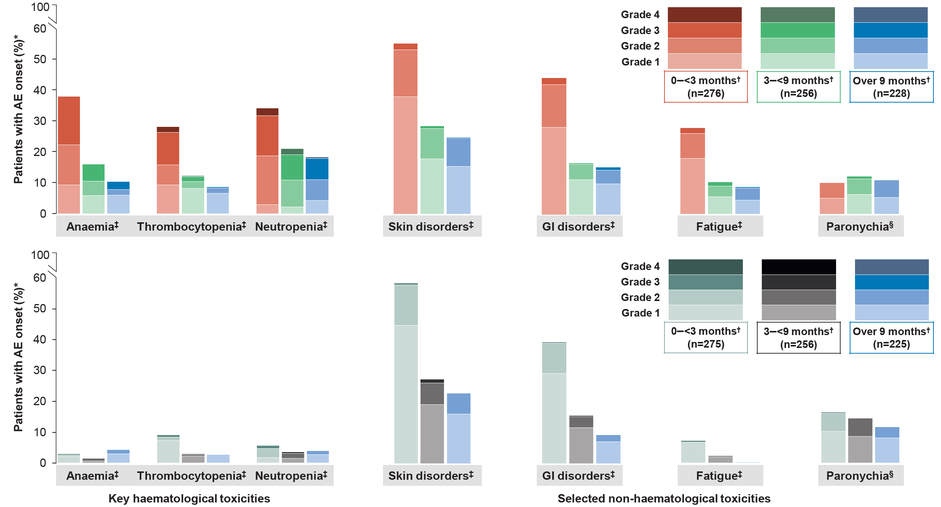
Osimertinib + ChT: GI Disorders
100
Grade 4
60
Grade 3
50
Grade 2
Grade 1
0–<3
months
(n=276)
3–<9
months
(n=256)
Over 9
months
(n=228)
Osimertinib + ChT (n=276)
40
Patients with AE onset (%)
30
20
10
0
Anaemia
Thrombocytopenia
Neutropenia
Skin disorders
GI disorders
Fatigue
Paronychia
100
Grade 4
60
Grade 3
50
Grade 2
40
Grade 1
0–<3
months
(n=275)
3–<9
months
(n=256)
Over 9
months
(n=225)
Osimertinib
(n=275)
Patients with AE onset (%)
30
20
10
0
Anaemia
Thrombocytopenia
Neutropenia
Skin disorders
GI disorders
Fatigue
Paronychia
Key haematological toxicities
Selected non-haematological toxicities
The onset and severity of most AEs in the osimertinib + ChT arm were highest during the induction period (~0–<3 months), with clear reductions over time during maintenance (>3 months)
Notes:
Lee CK, Planchard D, Fan Y, et al. 10P Safety and tolerability of first-line (1L) osimertinib (osi) ± platinum-pemetrexed in EGFRm advanced NSCLC: data from FLAURA2. ESMO Open. 2024;9(Supplement 3):102589.
Chemo/osimertinib has its own toxicities. The ones that are most important to be aware of, again, are the hematologic toxicities, which occur mostly during those first few months when they get carboplatin administration. We can also see GI disorders. We can see nausea. Also, these patients can develop diarrhea from the osimertinib. So really important to be in close touch with these patients as they're going through this treatment. And then fatigue, that can certainly be a cumulative toxicity. The other one that I will monitor really closely for all of my patients on FLAURA2 is nephrotoxicity.

Slide 55
ESMO Guidelines: Managing GI Disorders Associated With EGFR Inhibition
Uncomplicated diarrhea*
Oral hydration
Dietary modification
Loperamide (4 mg initially, 2 mg after every loose stool to maximum of 16 mg/day)
Avoid skin irritation
Notify treating physician
Complicated diarrhea†
(eg, fluid depletion, vomiting, fever)
Administer:
Loperamide (4 mg initially,
2 mg after every loose stool to maximum of 16 mg/day)
IV fluids and electrolytes
Daily evaluation:
CBC
Electrolytes
Urinary output
Consider octreotide:
SC 100–150 μg tid
or
IV 25–50 μg tid
Escalation up to 500 μg tid
Consider antibiotics:
Fluoroquinolones
Metronidazole
Broad spectrum
Stool evaluation:
Blood and stool microbiology testing‡
Notes:
Bossi P, Antonuzzo A, Cherny NI, Rosengarten O, Pernot S, Trippa F, Schuler U, Snegovoy A, Jordan K, Ripamonti CI; ESMO Guidelines Committee. Diarrhoea in adult cancer patients: ESMO Clinical Practice Guidelines. Ann Oncol. 2018;29(Suppl 4):iv126-iv142.
There are many other things, of course, that our patients get. They can get diarrhea. Hydrate, give anti-diarrheals. Be very mindful of diet. Sometimes patients, by watching fruit or watching fiber or coffee, for example, they may be able to control their own diarrhea. But do be mindful of this. Make sure that your patients get hydrated as needed. Make sure that you monitor their electrolytes. Octreotide can be helpful, and even things like antibiotics. And of course, always remember your patients are at risk of other things, so always check for C. difficile and other stool pathogens.

Slide 56











Management of Other AEs Associated With EGFR/MET Inhibition
Neutropenia
Administration
of G-CSF
Stomatitis/oral mucositis
Steroid mouth wash
Laser
AE, adverse event; G-CSF, granulocyte-colony stimulating factor; ILD, interstitial lung disease.
Ocular AEs
Artificial tears
Peripheral edema
Compression socks
Cardiac AEs
Cardio-oncology assessment
ILD
Grading
Differential diagnosis
  Implementation of practical management beyond theory
  Role of
  specialists, pharmacists, and nurses
  Use of
  surveillance tools
Notes:
And of course, there are many other things: stomatitis, neutropenia, ocular events, cardiac events, lung toxicity, and peripheral edema, most commonly with amivantamab, for example. We'll manage that with compression stockings. But it's really important that you and your team and your patient be very aware of what can happen, to recognize toxicity and to act early, and to really have a network that you can work with to make sure that your patient gets the best possible care. In particular, I really believe here in Toronto that our nursing colleagues are among the best people to really help us keep an eye on this and help us manage. In other jurisdictions, it'll also be led by pharmacists as well. But I think there's really a role for a much bigger team than just you and the oncology team to help with this.

Slide 57
Summary on Managing AEs Associated With EGFR Inhibitors
A comprehensive approach to integrate prophylaxis, early identification, and
care of key AEs is crucial
AE, adverse event; DM, dermatologic management; GI, gastrointestinal; QoL, quality of life.
The prophylactic COCOON DM regimen, with widely available and easy-to-use agents, significantly reduced the incidence and severity of dermatologic AEs with
amivantamab + lazertinib¹
Effective management of GI disorders and other AEs associated with EGFR inhibition leads
to improved treatment adherence and QoL for patients²
Proactive, multidisciplinary care is key to effectively manage AEs in patients
with EGFR-mutant NSCLC
AE, adverse event; DM, dermatologic management; EGFR, epidermal growth factor receptor; GI, gastrointestinal; NSCLC, non-small cell lung cancer; QoL, quality of life.
1. Girard N, et al. ELCC 2025. Abstract 10MO. 2. Cárdenas-Fernández D, et al. Ther Adv Med Oncol. 2023;15:17588359231192396.
Notes:
Girard N, Li W, Spira A, et al. Preventing moderate to severe dermatologic adverse events in first-line EGFR-mutant advanced NSCLC treated with amivantamab plus lazertinib: early success of the COCOON trial. Presented at: European Lung Cancer Congress 2025; Paris, France; March 27, 2025. Abstract 10MO.
Cárdenas-Fernández D, Soberanis Pina P, Turcott JG, et al. Management of diarrhea induced by EGFR-TKIs in advanced lung adenocarcinoma. Ther Adv Med Oncol. 2023;15:17588359231192396.
Both prophylaxis and careful, proactive management of toxicities are important. I think working with our nurses in our clinic can be really important, both in terms of education and then follow-up, and then engaging with specialists across the continuum of different specialties that need to be involved here. When we first saw the MARIPOSA results, I think there was a lot of hesitance, myself included, to use these regimens because yes, they helped, but patients were really having a lot of dermatologic toxicities. And I'm happy to say that all of this prophylaxis, while it's a little bit cumbersome, has really improved the quality of life of patients. These are drugs that are widely available they're relatively easy to use and they do seem to really work in terms of decreasing both the incidence and severity of these toxicities that we see with the MARIPOSA regimen. Multidisciplinary care is always the best way to ensure the successful administration of these regimens and to ensure that patients are able to stay on these therapies for the llong time that we hope that they will stay.

Slide 58
Practical Application: Case-Based Learning Lab

Slide 59
Case Study #1
Mr. Thompson, a 64-year-old man and former smoker, presents with persistent dry cough
Chest CT – 4.2 cm RUL mass with bulky mediastinal adenopathy
PET/CT – bone metastases (T8, left iliac crest)
Brain MRI – negative for brain metastases
Biopsy – lung adenocarcinoma
NGS – EGFR exon 19 deletion
ECOG PS is 1
Comorbidities include mild CKD, controlled T2D, and peripheral neuropathy from prior surgery
Patient prefers a treatment option that can most likely help him live a longer life

Slide 60
Case Study #1: Audience Question
What first-line therapy would you recommend?
  Amivantamab + pemetrexed/carboplatin
  Amivantamab + lazertinib
  Osimertinib monotherapy
  Osimertinib + pemetrexed/cisplatin
  Unsure
Notes:
Correct answer: b) Amivantamab + lazertinib

Slide 61
Case Study #1: Management and Outcome
Mr. Thompson starts on amivantamab plus lazertinib
Supportive care includes premedication for IRRs, topical skin care for rash, and loperamide for GI side effects
Cycle 1 – mild infusion reaction resolved with slower infusion rate
Cycle 2 – grade 1 acneiform rash; no interruption needed
Week 12 CT scan – PR with >45% shrinkage in target lesions
ECOG PS improves to 0
Patient continues to receive treatment

Slide 62
Case Study #2
Ms. Lee, a 71-year-old woman and never-smoker, presents with persistent dry cough and fatigue
Chest CT – 3.8 cm LUL mass with bilateral hilar and mediastinal lymphadenopathy
PET/CT – liver metastases
Brain MRI – negative for brain metastases
Biopsy – lung adenocarcinoma
NGS – EGFR L858R mutation
ECOG PS is 1
Comorbidities include hypertension and mild COPD
Patient receives osimertinib and achieves a PR at 12 weeks
At 15 months, PET/CT reveals progression of liver lesions and multiple symptomatic bone lesions
Liquid biopsy – no secondary EGFR resistance mutations or MET amplification detected

Slide 63
Case Study #2: Audience Question
What second-line therapy would you recommend?
  Amivantamab + pemetrexed/carboplatin
  Amivantamab + lazertinib
  Continue osimertinib monotherapy
  Continue osimertinib and add chemotherapy
  Unsure
Notes:
Correct answer: a) Amivantamab + pemetrexed/carboplatin

Slide 64
Case Study #2: Management and Outcome
Mr. Lee starts on amivantamab plus pemetrexed/carboplatin
Supportive care includes premedication for IRRs, folic acid, B12, and dexamethasone with pemetrexed
Cycle 1 – mild infusion reaction resolved with slower infusion rate
Cycle 2 – grade 2 fatigue and mild neutropenia; no dose delays
Week 8 CT scan – PR with >30% reduction in liver and bone lesions; stable lung disease
ECOG PS improves to 0
Patient continues to receive treatment

Slide 65
Conclusions and Key Takeaways

Slide 66
Key Takeaways
It is critical to conduct comprehensive molecular profiling prior to initiating 1L therapy in patients with advanced NSCLC
The 1L treatment landscape for advanced NSCLC with common EGFR mutations has evolved, including guideline-recommended combination therapies which demonstrate improved outcomes vs EGFR TKI monotherapy
  FLAURA2: osimertinib + chemotherapy improved PFS, CNS PFS compared to osimertinib
  MARIPOSA: amivantamab + lazertinib improved PFS, CNS PFS and OS compared to osimertinib
Amivantamb + chemotherapy is the current standard of care 1L treatment for advanced NSCLC with EGFR exon 20 insertions
A multidisciplinary approach and a close follow-up with patients is crucial for the effective management of adverse events associated with EGFR inhibitors
Shared decision-making is essential as we weigh what is important to our patients
Notes:
So my key takeaways. It’s really critical to conduct comprehensive molecular testing before your patients start first-line treatment. And you really need to work with your colleagues, whether it's the people who get the tissue sample, your pathologists, or your molecular team, to really make sure that you get that for every patient, every time. First-line treatment landscape for our patients with advanced EGFR-mutant lung cancer has really evolved. So many great options and a number of guideline-recommended combination therapies that show improved outcomes compared to monotherapy. Of course, adding chemotherapy improves progression-free survival and CNS progression-free survival. Amivantamab and lazertinib improve PFS, overall survival, and CNS progression-free survival. And in our patients with sensitizing mutations that progress on osimertinib, we of course have amivantamab plus chemotherapy as a new second-line approach. For our patients with exon 20 insertions, amivantamab plus chemotherapy as the new current standard of care first line. Multidisciplinary management, close follow-up, and education for everyone, the provider teams and the patient really can help us improve the journey for our patients and help us manage adverse events as well as prevent them. Shared decision-making, more important than ever as we weigh what's important to our patients with the treatment that they pursue.

Slide 67
Thank You!
Thank you for participating in this activity

