Slide 1
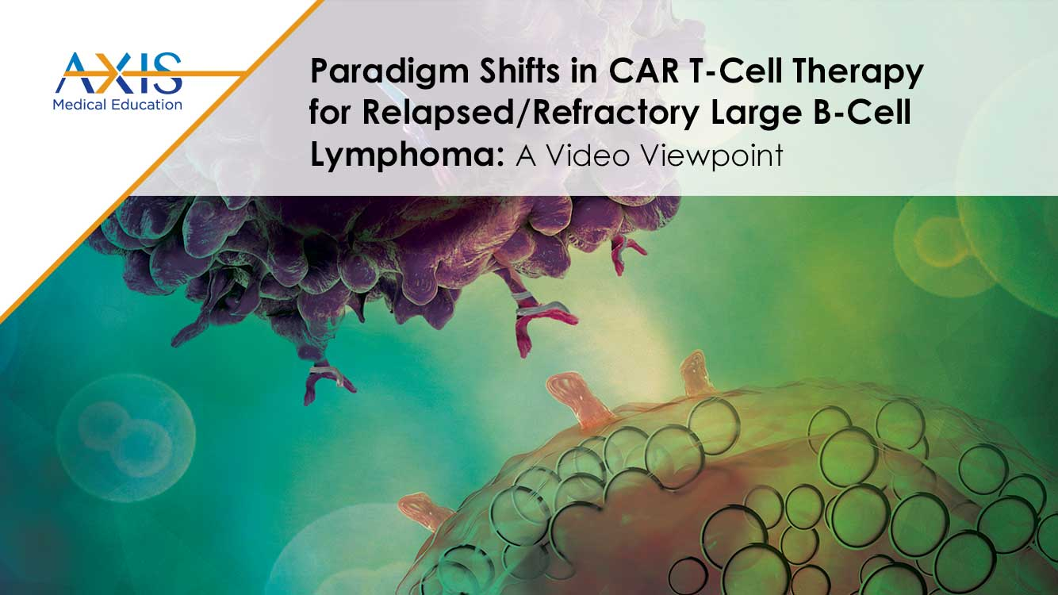

Slide 2
DISCLAIMER
This slide deck in its original and unaltered format is for educational purposes and is current as of January 2023. All materials contained herein reflect the views of the faculty, and not those of AXIS Medical Education, the CME provider, or the commercial supporter. Participants have an implied responsibility to use the newly acquired information to enhance patient outcomes and their own professional development. The information presented in this activity is not meant to serve as a guideline for patient management. Any procedures, medications, or other courses of diagnosis or treatment discussed or suggested in this activity should not be used by clinicians without evaluation of their patients’ conditions and possible contraindications on dangers in use, review of any applicable manufacturer’s product information, and comparison with recommendations of other authorities.

Slide 3
DISCLOSURE OF UNLABELED USE
This activity may contain discussion of published and/or investigational uses of agents that are not indicated by the FDA. The planners of this activity do not recommend the use of any agent outside of the labeled indications.
The opinions expressed in the activity are those of the faculty and do not necessarily represent the views of the planners. Please refer to the official prescribing information for each product for discussion of approved indications, contraindications, and warnings.
USAGE RIGHTS
This slide deck is provided for educational purposes and individual slides may be
used for personal, non-commercial presentations only if the content and references
remain unchanged. No part of this slide deck may be published in print or
electronically as a promotional or certified educational activity without prior written
permission from AXIS. Additional terms may apply. See Terms of Service on
www.axismeded.com for details.

Slide 4
Disclosure of Conflicts of Interest
Caron A. Jacobson, MD, reported a financial interest/relationship or affiliation in the form of Consultant: Kile/Gilead; Novartis Pharmaceuticals Corp; BMS/Celgene; Miltenyi; Ipsen Pharmaceuticals; bluebird bio, Inc; Epizyme; Morphosys; AstraZeneca Pharmaceuticals LP; Instil Bio; Abintus Bio; Caribou Bio; and ImmPACT.
Notes:
Caron A. Jacobson, MD
Assistant Professor of Medicine
Harvard Medical School, Dana-Farber Cancer Institute
Boston, MA

Slide 5
Learning Objectives
Upon completion of this activity, participants should be better able to:
Differentiate factors among various CAR T-cell therapies
Identify patients with LBCL with early relapse from or refractory to frontline chemoimmunotherapy, eligible for CAR T-cell therapy
Compare and contrast the trial designs and outcomes for the phase 3 studies TRANSFORM, ZUMA-7, and BELINDA among others such as the phase 2 PILOT trial

Slide 6
LBCL: Treatment Paradigm 2017-2022
First-line/Induction Chemotherapy
R-CHOP/R-EPOCH SoC
R/R
(~1/3 of patients)
Second-line/
Salvage Chemo
HDT/
Autologous SCT
CAR T-cell Therapy
CHOP, cyclophosphamide, doxorubicin hydrochloride, vincristine sulfate, and prednisone;
EPOCH, etoposide, prednisone, vincristine, cyclophosphamide, hydroxydaunorubicin; HDT, high-dose therapy; LBCL, large B-cell lymphoma;
R, rituximab; R/R, relapsed/refractory; SCT, stem cell transplantation; SoC, standard of care.

Slide 7
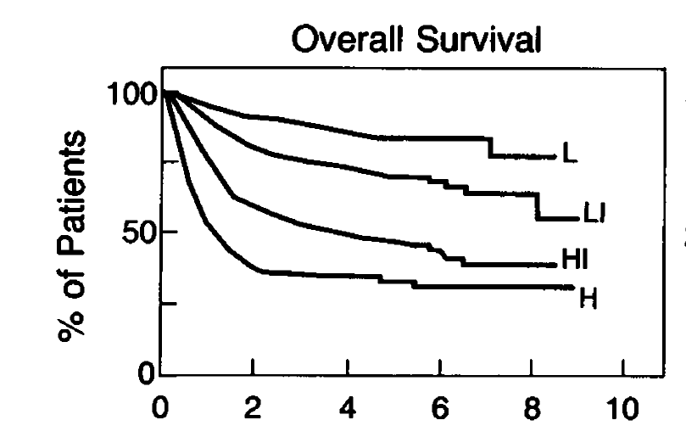
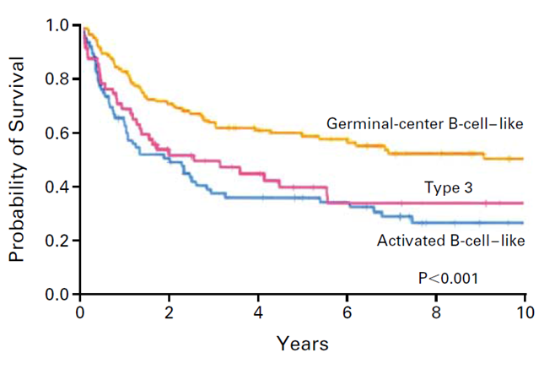
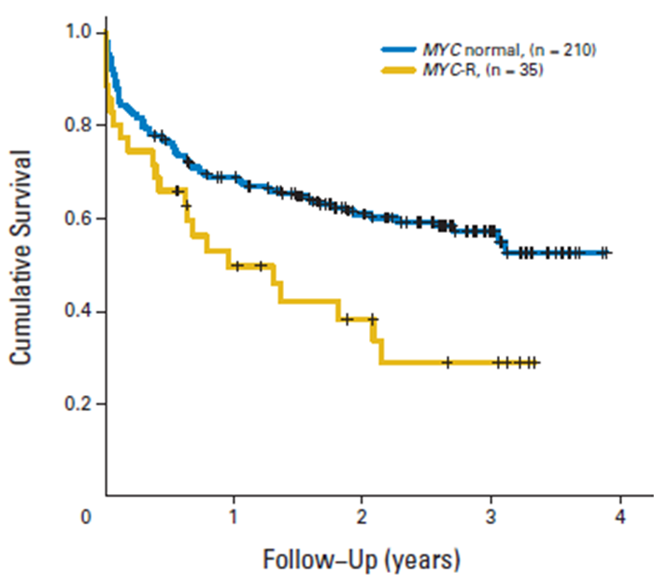
LBCL: How can we determine who will be refractory or will relapse?
International Prognostic Index (IPI)
Gene Expression Profile (GEP) /Genomic Classification
Double/Triple Hit Cytogenetics
  Age >60
  Stage III/IV
  Elevated LDH
  Performance status >1
  Extranodal sites >1
HI, high-intermediate risk; H, high-risk; L, low-risk; LI, low-intermediate risk; LBCL, large B-cell lymphoma; LDH, lactate dehydrogenase.
International Non-Hodgkin’s Lymphoma Prognostic Factors Project, N Engl J Med. 1993;329:987; Ziepert et al. J Clin Oncol. 2010;28:2373;
Rosenwald et al. N Engl J Med. 2002;346:1937; Chapuy et al Nat Med. 2018;24:679-690. Barrans et al. J Clin Oncol. 2021;28:3360-3365.
Notes:
International Non-Hodgkin’s Lymphoma Prognostic Factors Project. A predictive model for aggressive non-Hodgkin's lymphoma. N Engl J Med 1993;329:987.
Ziepert M, Hasenslever D, Kuhnt E, et al. Standard International prognostic index remains a valid predictor of outcome for patients with aggressive CD20+ B-cell lymphoma in the rituximab era. J Clin Oncol 2010;28:2373.
Rosenwald A, Wright G, Chan WC, et al. The use of molecular profiling to predict survival after chemotherapy for diffuse large-B-cell lymphoma. N Engl J Med. 2002;346:1937.
Chapuy B, Stewart C, Dunford AJ, et al. Molecular subtypes of diffuse large B cell lymphoma are associated with distinct pathogenic mechanisms and outcomes. Nat Med. 2018;24:679-690.
Barrans S, Crouch S, Smith A, et al. Rearrangement of MYC is associated with poor prognosis in patients with diffuse large B-cell lymphoma treated in the era of rituximab. J Clin Oncol. 2021;28:3360-3365.

Slide 8
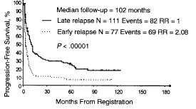
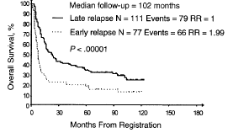
LBCL: Who is at highest risk for relapsed/refractory disease?
LBCL, large B-cell lymphoma; RR, response rate.
Philip et al. N Engl J Med. 1995;333:1540-1545; Guglielmi et al. J Clin Oncol. 1998;16:3264-3269.
Notes:
Philip T, Guglielmi C, Hagenbeek A, et al. Autologous bone marrow transplantation as compared with salvage chemotherapy in relapses of chemotherapy-sensitive non-Hodgkin's lymphoma. N Engl J Med. 1995;333:1540-1545.
Guglielmi C, Gomez F, Philip T, et al. Time to relapse has prognostic value in patients with aggressive lymphoma enrolled onto the Parma trial. J Clin Oncol. 1998;16:3264-3269.

Slide 9
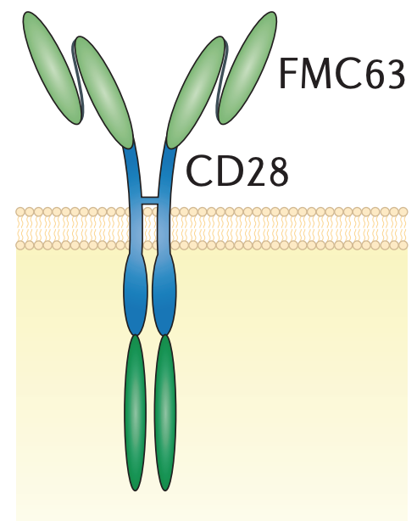
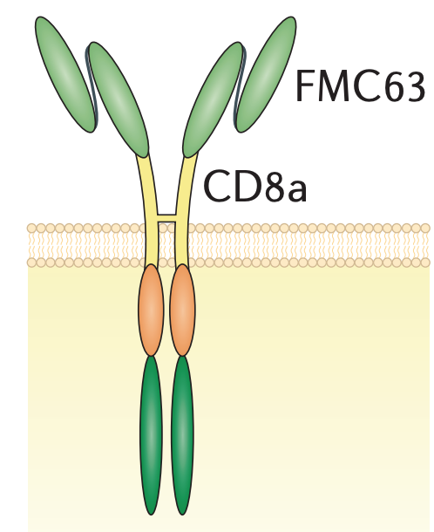
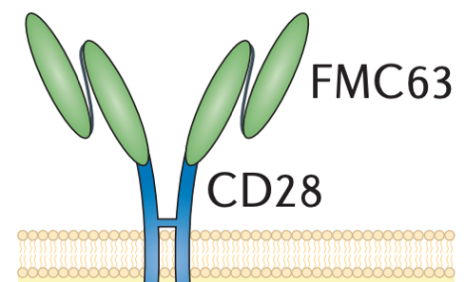
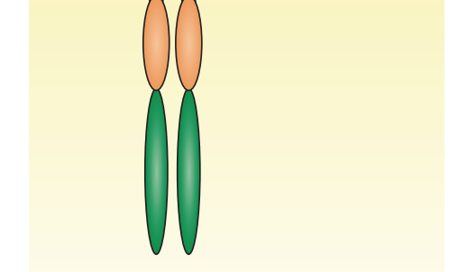
CD19 Chimeric Antigen Receptor T Cells in the Clinic: LBCL
Axicabtagene ciloleucel
(axi-cel)
Tisagenlecleucel
(tisa-cel)
Lisocabtagene maraleucel
(liso-cel)
CD19 Antibody
Hinge
Transmembrane
Costimulatory
domain
CD28
4-1BB
4-1BB
Primary activation
CD3ζ
CD3ζ
CD3ζ
Gene transfer
Retrovirus
Lentivirus
Lentivirus
LBCL, large B-cell lymphoma.
Adapted from van der Stegen et al. Nat Rev Drug Discov. 2015;14(7):499-509.
Notes:
Van der Stegen SJC, Hamieh M, Sadelain M. The pharmacology of second-generation chimeric antigen receptors. Nat Rev Drug Discov. 2015;14(7):499-509.

Slide 10
CD19 CAR T-Cells for DLBCL: Pivotal Trial Results After Two or More Lines of Systemic Therapy
 | ZUMA-1 | JULIET | TRANSCEND CORE
Product | Axi-cel | Tisa-cel | Liso-cel
Costimulatory domain | CD28 | 4-1BB | 4-1BB
# pheresed | 111 | 165 | 344
# treated | 101 | 111 | 269*
ORR, % | 82 | 52 | 73
CR, % | 54 | 40 | 53
6-month ORR, % | 41 | 37 | NR
mOS, months | 27.1 | 12 | 21.1
CRS, % | 93 | 48 | 42
Grade 3+ CRS, % | 13 | 22* | 2
ICANS, % | 64 | 21 | 30
Grade 3+ ICANS, % | 28 | 12 | 10
*n = 256 efficacy-evaluable patients.
Neelapu et al. N Engl J Med. 2017;377:2531-2544; Locke et al. Lancet Oncol. 2019;20:31-42; Schuster et al. N Engl J Med. 2019;380:45-56; Abramson et al. Lancet. 2020;396:839-852.
Axi-cel, axicabtagene ciloleucel; CR, complete response; CRS, cytokine release syndrome; DLBCL, diffuse large B-cell lymphoma; ICANS, immune effector cell-associated neurotoxicity syndrome;
Liso-cel, lisocabtagene maraleucel; mOS, median overall survival; ORR, overall response rate; Tisa-cel, tisagenlecleucel.
Notes:
Neelapu SS, Locke FL, Bartlett NL, et al. Axicabtagene Ciloleucel CAR T-Cell Therapy in Refractory Large B-Cell Lymphoma. N Engl J Med. 2017;377:2531–2544.
Locke FL, Ghobadi A, Jacobson CA, et al. Long-term safety and activity of axicabtagene ciloleucel in refractory large B-cell lymphoma (ZUMA-1): a single-arm, multicentre, phase 1-2 trial. Lancet Oncol. 2019;20:31-42.
Schuster SJ, Bishop MR, Tam CS, et al. Tisagenlecleucel in Adult Relapsed or Refractory Diffuse Large B-Cell Lymphoma. N Engl J Med. 2019;380:45-56.
Abramson JS, Palomba ML, Gordon LI, et al. Lisocabtagene maraleucel for patients with relapsed or refractory large B-cell lymphomas (TRANSCEND NHL 001): a multicentre seamless design study. Lancet 2020;396:839-852.

Slide 11
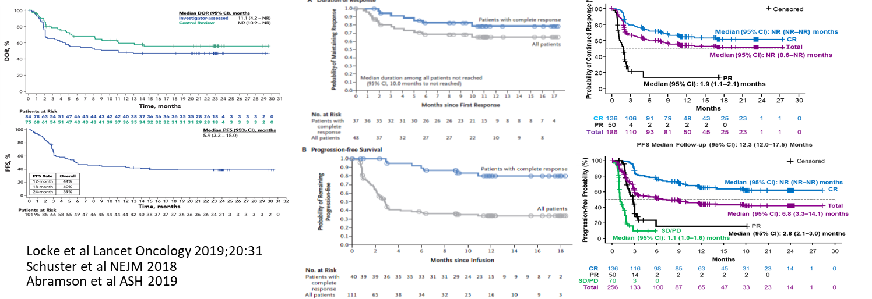
CD19 CAR T-Cells Yield Durable Remission in ~40%
ZUMA-1: axi-cel
JULIET: tisa-cel
TRANSCEND-001: liso-cel
DOR, duration of response; PFS, progression-free survival.
Locke et al. Lancet Oncol. 2019;20:31-42; Schuster et al. N Engl J Med. 2019;380:45-56; Abramson et al. Lancet. 2020;396:839-852.
Notes:
Locke FL, Ghobadi A, Jacobson CA, et al. Long-term safety and activity of axicabtagene ciloleucel in refractory large B-cell lymphoma (ZUMA-1): a single-arm, multicentre, phase 1-2 trial. Lancet Oncol. 2019;20:31-42.
Schuster SJ, Bishop MR, Tam CS, et al. Tisagenlecleucel in Adult Relapsed or Refractory Diffuse Large B-Cell Lymphoma. N Engl J Med. 2019;380:45-56.
Abramson JS, Palomba ML, Gordon LI, et al. Lisocabtagene maraleucel for patients with relapsed or refractory large B-cell lymphomas (TRANSCEND NHL 001): a multicentre seamless design study. Lancet 2020;396:839-852.

Slide 12
LBCL: Challenging the Treatment Paradigm
First-line/Induction Chemotherapy
R-CHOP/R-EPOCH SoC
R/R
(~1/3 of patients)
Question:
Will CAR T-cell therapy beat salvage chemo/auto SCT in second-line setting?
Second-line/
Salvage Chemo
HDT/
Autologous SCT
CAR T-cell Therapy
CHOP, cyclophosphamide, doxorubicin hydrochloride, vincristine sulfate, and prednisone;
EPOCH, etoposide, prednisone, vincristine, cyclophosphamide, hydroxydaunorubicin; HDT, high-dose therapy; HSCT, hematopoietic stem cell transplantation;
LBCL, large B-cell lymphoma; R, rituximab; R/R, relapsed/refractory; SoC, standard of care.

Slide 13
Will CAR T-Cells Be More Effective When Used Earlier and Can It Replace Transplant
ZUMA-7
Axi-cel
High Risk DLBCL
Refractory to first-line treatment
Relapsed within
12 months of
first-line treatment
CAR T
BELINDA
Tisa-cel
Salvage/Auto
TRANSFORM
Liso-cel
Axi-cel, axicabtagene ciloleucel; Liso-cel, lisocabtagene maraleucel; Tisa-cel, tisagenlecleucel; DLBCL, diffuse large B-cell lymphoma.
Notes:
Locke FL, Miklos DB, Jacobson CA, et al. Axicabtagene Ciloleucel as Second-Line Therapy for Large B-Cell Lymphoma. N Engl J Med. 2022;386(7):640-654.
Kamdar M, Solomon SR, Arnason JE, et al. Lisocabtagene maraleucel versus standard of care with salvage chemotherapy followed by autologous stem cell transplantation as second-line treatment in patients with relapsed or refractory large B-cell lymphoma (TRANSFORM): results from an interim analysis of an open-label, randomised, phase 3 trial. Lancet. 2022;399(10343):2294-2308.
Bishop MR, Dickinson M, Purtill D, et al. Second-Line Tisagenlecleucel or Standard Care in Aggressive B-Cell Lymphoma. N Engl J Med. 2022;386(7):629-639.

Slide 14
ZUMA-7, TRANSFORM, BELINDA:
Key Similarities and Differences in Second-Line Treatment
 | ZUMA-7 | TRANSFORM | BELINDA
Product | Axi-cel | Liso-cel | Tisa-cel
Patient Population | primary refractory, early relapsed | primary refractory, early relapsed, PMBCL; upper age limit 75 years | primary refractory, early relapsed
Trial Numbers | 359 | 184 | 322
Timing of apheresis | after enrollment | Prior to enrollment | prior to enrollment
Comparator | SOC (curative) | SOC (curative) | SOC (curative)
Bridging therapy | Corticosteroids | Chemotherapy | Chemotherapy
LD chemotherapy | FC | FC | FC or bendamustine
Crossover | Off protocol | On protocol | On protocol
Primary endpoint | EFS (definition different) | EFS (definition different) | EFS (definition different)
EFS definition | Time from randomization to: earliest date of disease progression as per Lugano Classification (2014) commencement of new lymphoma therapy or death from any cause as determined by blinded central review At day 150 | Time from randomization to: death from any cause PD, failure to achieve a CR or PR or start of new antineoplastic therapy due to efficacy concerns 9-12 weeks | Time from date of randomization to: date of first documented PD/SD at or after the Week 12+/-1 assessment, as assessed by BIRC per Lugano criteria or death due to any cause, at any time At 12 weeks
Secondary endpoints | OS | OS | OS
Locke et al. N Engl J Med. 2022;386(7):640-654; Kamdar et al. Lancet. 2022;399(10343):2294-2308; Bishop et al. N Engl J Med. 2022;386(7):629-639.
Axi-cel, axicabtagene ciloleucel; BIRC, blind independent review committee; CR, complete response; EFS, event-free survival; FC, fludarabine and cyclosphosphamide; Liso-cel, lisocabtagene maraleucel; LD, low-dose; OS, overall survival; PMBCL, primary mediastinal large B-cell lymphoma; PD, progressive disease; PR, partial response; SD, stable disease; SOC, standard of care; Tisa-cel, tisagenlecleucel.
Notes:
Locke FL, Miklos DB, Jacobson CA, et al. Axicabtagene Ciloleucel as Second-Line Therapy for Large B-Cell Lymphoma. N Engl J Med. 2022;386(7):640-654.
Kamdar M, Solomon SR, Arnason JE, et al. Lisocabtagene maraleucel versus standard of care with salvage chemotherapy followed by autologous stem cell transplantation as second-line treatment in patients with relapsed or refractory large B-cell lymphoma (TRANSFORM): results from an interim analysis of an open-label, randomised, phase 3 trial. Lancet. 2022;399(10343):2294-2308.
Bishop MR, Dickinson M, Purtill D, et al. Second-Line Tisagenlecleucel or Standard Care in Aggressive B-Cell Lymphoma. N Engl J Med. 2022;386(7):629-639.

Slide 15
ZUMA-7, TRANSFORM, BELINDA Results:
Second-Line Treatment
 | ZUMA-7 | TRANSFORM | BELINDA
Product | Axi-cel vs SOC | Liso-cel vs SOC | Tisa-cel vs SOC
Costimulatory domain | CD28 | 4-1BB | 4-1BB
ORR (%) | 83% vs 50% | 86% vs 48% | 75% vs 68%
CR (%) | 65% vs 32% | 66% vs 39% | 46% vs 44%
mEFS (months) | 8.3 vs 2.0 | 10.1 vs 2.3 | 3.0 vs 3.0
EFS rate (%) | 2-year: 40.5% vs 16.3% | 12-month: 44.5% vs 23.7% | ---
mPFS (months) | 14.7 vs 3.7 | 14.8 vs 5.7 | ---
PFS rate (%) | 2-year: 46% vs 27% | 12-month: 52.3% vs 33.9% | ---
mOS (months) | NR vs 35.1 | NR vs 16.4 | ---
OS rate (%) | --- | 12-month: 79.1% vs 64.2% | ---
Locke et al. N Engl J Med. 2022;386(7):640-654; Kamdar et al. Lancet. 2022;399(10343):2294-2308; Bishop et al. N Engl J Med. 2022;386(7):629-639.
Axi-cel, axicabtagene ciloleucel; CR, complete response; Liso-cel, lisocabtagene maraleucel; mOS, median overall survival; mEFS, median event-free survival; mPFS, median progression-free survival; NR, not reached; ORR, overall response rate; SOC standard of care; Tisa-cel, tisagenlecleucel.
Notes:
Locke FL, Miklos DB, Jacobson CA, et al. Axicabtagene Ciloleucel as Second-Line Therapy for Large B-Cell Lymphoma. N Engl J Med. 2022;386(7):640-654.
Kamdar M, Solomon SR, Arnason JE, et al. Lisocabtagene maraleucel versus standard of care with salvage chemotherapy followed by autologous stem cell transplantation as second-line treatment in patients with relapsed or refractory large B-cell lymphoma (TRANSFORM): results from an interim analysis of an open-label, randomised, phase 3 trial. Lancet. 2022;399(10343):2294-2308.
Bishop MR, Dickinson M, Purtill D, et al. Second-Line Tisagenlecleucel or Standard Care in Aggressive B-Cell Lymphoma. N Engl J Med. 2022;386(7):629-639.

Slide 16
ZUMA-7, TRANSFORM, BELINDA: EFS
ZUMA-7: axi-cel
TRANSFORM: liso-cel
BELINDA: tisa-cel
Locke et al Blood 2021;138:2; Kamdar et al Blood 2021;138:91; Bishop et al Blood 2021;138:LBA6.
Axi-cel, axicabtagene ciloleucel; EFS, event-free survival; Liso-cel, lisocabtagene maraleucel; SOC standard of care; Tisa-cel, tisagenlecleucel.
Notes:
Locke FL, Miklos DB, Jacobson C, et al. Primary analysis of ZUMA-7: a phase 3 randomized trial of axicabtagene ciloleucel (axi-cel) versus standard-of-care therapy in patients with relapsed/refractory large B-cell lymphoma. Blood 2021;138:2.
Locke FL, Miklos DB, Jacobson CA, et al. Axicabtagene Ciloleucel as Second-Line Therapy for Large B-Cell Lymphoma. N Engl J Med. 2022;386(7):640-654.
Kamdar M, Solomon SR, Arnason JE, et al. Lisocabtagene maraleucel, a CD19-directed chimeric antigen receptor T cell therapy, versus standard of care with salvage chemotherapy followed by autologous stem cell transplantation as second-line treatment in patients with relapsed or refractory large B-cell lymphoma: Results from the randomized phase 3 TRANSFORM study. Blood 2021;138(suppl 1):91.
Kamdar M, Solomon SR, Arnason JE, et al. Lisocabtagene maraleucel versus standard of care with salvage chemotherapy followed by autologous stem cell transplantation as second-line treatment in patients with relapsed or refractory large B-cell lymphoma (TRANSFORM): results from an interim analysis of an open-label, randomised, phase 3 trial. Lancet. 2022;399(10343):2294-2308.
Bishop MR, Dickinson M, Purtill D, Barba P, Santoro A, Hamad N, et al. Tisagenlecleucel vs standard of care as second-line therapy of primary refractory or relapsed aggressive B-cell non-Hodgkin lymphoma: analysis of the phase III Belinda Study. Blood 2021;138(suppl 2):LBA-6.
Bishop MR, Dickinson M, Purtill D, et al. Second-Line Tisagenlecleucel or Standard Care in Aggressive B-Cell Lymphoma. N Engl J Med. 2022;386(7):629-639.

Slide 17
ZUMA-7, TRANSFORM: OS
TRANSFORM: liso-cel
ZUMA-7: axi-cel
Locke et al Blood 2021;138:2. Kamdar et al Blood 2021;138:91.
Axi-cel, axicabtagene ciloleucel; HR, hazard ratio; Liso-cel, lisocabtagene maraleucel; OS, overall survival; SOC, standard of care.
Notes:
Locke FL, Miklos DB, Jacobson C, et al. Primary analysis of ZUMA-7: a phase 3 randomized trial of axicabtagene ciloleucel (axi-cel) versus standard-of-care therapy in patients with relapsed/refractory large B-cell lymphoma. Blood 2021;138:2.
Locke FL, Miklos DB, Jacobson CA, et al. Axicabtagene Ciloleucel as Second-Line Therapy for Large B-Cell Lymphoma. N Engl J Med. 2022;386(7):640-654.
Kamdar M, Solomon SR, Arnason JE, et al. Lisocabtagene maraleucel, a CD19-directed chimeric antigen receptor T cell therapy, versus standard of care with salvage chemotherapy followed by autologous stem cell transplantation as second-line treatment in patients with relapsed or refractory large B-cell lymphoma: Results from the randomized phase 3 TRANSFORM study. Blood 2021;138(suppl 1):91.
Kamdar M, Solomon SR, Arnason JE, et al. Lisocabtagene maraleucel versus standard of care with salvage chemotherapy followed by autologous stem cell transplantation as second-line treatment in patients with relapsed or refractory large B-cell lymphoma (TRANSFORM): results from an interim analysis of an open-label, randomised, phase 3 trial. Lancet. 2022;399(10343):2294-2308.

Slide 18
Randomized Trials: Safety and Tolerability
 | ZUMA-7 | TRANSFORM | BELINDA
Product | Axi-cel vs SOC | Liso-cel vs SOC | Tisa-cel vs SOC
Costimulatory domain | CD28 | 4-1BB | 4-1BB
CRS, any grade | 92% | 49% | 59%
CRS, Grade 3+ | 6% | 1% | 5%
CRS onset, median/range (days) | 3 / 1-10 | 5 / 1-63 | 4 / 1-27
ICANS, any Grade | 60% | 12% | 10%
ICANS, Grade 3+ | 21% | 4% | 2%
ICANS onset, median/range (days) | 7 / 1-133 | 11 / 7-25 | 5 / 3-93
Prolonged cytopenias | NR | 43% | NR
Locke et al Blood 2021;138:2, N Engl J Med. 2022;386:640-654. Kamdar et al Blood 2021;138:91, Lancet 2022;399:2294-2308.
Bishop et al Blood 2021;138:LBA6, N Engl J Med. 2022;386:629-639.
Axi-cel, axicabtagene ciloleucel; Liso-cel, lisocabtagene maraleucel; CRS, cytokine release syndrome;
ICANS, immune effector cell-associated neurotoxicity syndrome; NR, not reported; SOC, standard of care; Tisa-cel, tisagenlecleucel.
Notes:
Locke FL, Miklos DB, Jacobson C, et al. Primary analysis of ZUMA-7: a phase 3 randomized trial of axicabtagene ciloleucel (axi-cel) versus standard-of-care therapy in patients with relapsed/refractory large B-cell lymphoma. Blood 2021;138:2.
Locke FL, Miklos DB, Jacobson CA, et al. Axicabtagene Ciloleucel as Second-Line Therapy for Large B-Cell Lymphoma. N Engl J Med. 2022;386(7):640-654.
Kamdar M, Solomon SR, Arnason JE, et al. Lisocabtagene maraleucel, a CD19-directed chimeric antigen receptor T cell therapy, versus standard of care with salvage chemotherapy followed by autologous stem cell transplantation as second-line treatment in patients with relapsed or refractory large B-cell lymphoma: Results from the randomized phase 3 TRANSFORM study. Blood 2021;138(suppl 1):91.
Kamdar M, Solomon SR, Arnason JE, et al. Lisocabtagene maraleucel versus standard of care with salvage chemotherapy followed by autologous stem cell transplantation as second-line treatment in patients with relapsed or refractory large B-cell lymphoma (TRANSFORM): results from an interim analysis of an open-label, randomised, phase 3 trial. Lancet. 2022;399(10343):2294-2308.
Bishop MR, Dickinson M, Purtill D, Barba P, Santoro A, Hamad N, et al. Tisagenlecleucel vs standard of care as second-line therapy of primary refractory or relapsed aggressive B-cell non-Hodgkin lymphoma: analysis of the phase III Belinda Study. Blood 2021;138(suppl 2):LBA-6.
Bishop MR, Dickinson M, Purtill D, et al. Second-Line Tisagenlecleucel or Standard Care in Aggressive B-Cell Lymphoma. N Engl J Med. 2022;386(7):629-639.

Slide 19
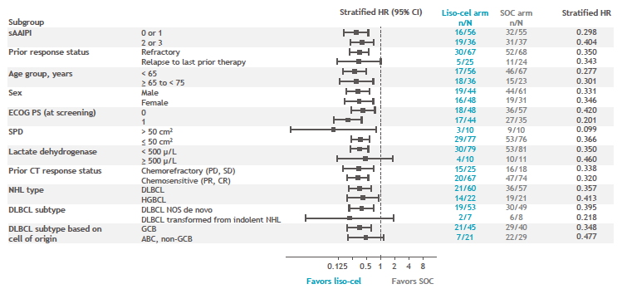
Randomized Trials: Subgroup Analysis
ZUMA-7: axi-cel
TRANSFORM: liso-cel
Locke et al Blood 2021;138:2; Kamdar et al Blood 2021;138:91.
ABC, activated B-cell like; Axi-cel, axicabtagene ciloleucel; CR, complete response; DLBCL, diffuse large B-cell lymphoma; ECOG PS, Eastern Cooperative Oncology Group performance status;
EFS, event-free survival; HGBL, high-grade B-cell lymphoma; GCB, germinal center B-cell like; Liso-cel, lisocabtagene maraleucel; NHL, non-Hodgkin lymphoma; PD, progressive disease;
PR, partial response; sAAIPI, age-adjusted International Prognostic Index at the initiation of second-line therapy; SD, stable disease; SOC standard of care; SPD, sum of the products of diameters.
Notes:
Locke FL, Miklos DB, Jacobson C, et al. Primary analysis of ZUMA-7: a phase 3 randomized trial of axicabtagene ciloleucel (axi-cel) versus standard-of-care therapy in patients with relapsed/refractory large B-cell lymphoma. Blood 2021;138:2.
Kamdar M, Solomon SR, Arnason JE, et al. Lisocabtagene maraleucel, a CD19-directed chimeric antigen receptor T cell therapy, versus standard of care with salvage chemotherapy followed by autologous stem cell transplantation as second-line treatment in patients with relapsed or refractory large B-cell lymphoma: Results from the randomized phase 3 TRANSFORM study. Blood 2021;138(suppl 1):91.

Slide 20
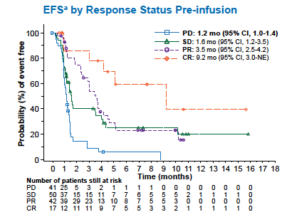
Randomized Trials: Subgroup Analysis
BELINDA: tisa-cel
Bishop et al. Blood 2021;138:LBA6.
CR, complete response; EFS, event-free survival; PD, progressive disease; PR, partial response; SD, stable disease; tisa-cel, tisagenlecleucel.
Notes:
Bishop MR, Dickinson M, Purtill D, Barba P, Santoro A, Hamad N, et al. Tisagenlecleucel vs standard of care as second-line therapy of primary refractory or relapsed aggressive B-cell non-Hodgkin lymphoma: analysis of the phase III Belinda Study. Blood 2021;138(suppl 2):LBA-6.

Slide 21
Randomized Trials:
Unanswered Questions
What to do if a patient starts and is responding to salvage therapy before CAR consult?
Should patients receive bridging therapy? What type?
What to do if a patient responds to bridging therapy?
What to do if a patient relapses after CAR T-cells? Salvage/auto or alternative options?

Slide 22
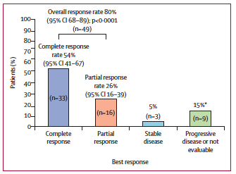
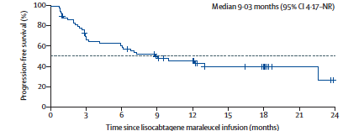
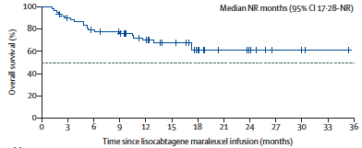
PILOT Study: Liso-cel in Second-line Transplant Ineligible
CRS any/high grade: 38%/2%
ICANS any/high grade: 31%/5%
Sehgal et al. Lancet Oncol. 2022;23:1066-1077.
CRS, cytokine release syndrome; ICANS, immune effector cell-associated neurotoxicity syndrome; Liso-cel, lisocabtagene maraleucel; NR, not reported.
Notes:
Sehgal A, Hoda D, Riedell PA, et al. Lisocabtagene maraleucel as second-line therapy in adults with relapsed or refractory large B-cell lymphoma who were not intended for haematopoietic stem cell transplantation (PILOT): an open-label, phase 2 study. Lancet Oncol. 2022;23:1066-1077.

Slide 23
FDA Approvals: Second-Line Therapy
April 2022:
axicabtagene ciloleucel
June 2022:
lisocabtagene maraleucel
  Adult patients with LBCL that is refractory to first-line chemoimmunotherapy or relapses within 12 months of first-line chemoimmunotherapy
  Adult patients with LBCL who have refractory disease to first-line chemoimmunotherapy or relapse within 12 months of first-line chemoimmunotherapy
  Adult patients with LBCL who have refractory disease to first-line chemoimmunotherapy or relapse after first-line chemoimmunotherapy and are not eligible for HSCT due to comorbidities or age
FDA, US Food and Drug Administration; HSCT, hematopoietic stem cell transplantation; LBCL, large B-cell lymphoma.
Notes:
Food and Drug Administration (FDA). FDA approves axicabtagene ciloleucel for second-line treatment of large B-cell lymphoma. April 1, 2022. https://www.fda.gov/drugs/resources-information-approved-drugs/fda-approves-axicabtagene-ciloleucel-second-line-treatment-large-b-cell-lymphoma
Food and Drug Administration (FDA). FDA approves lisocabtagene maraleucel for second-line treatment of large B-cell lymphoma. June 24, 2022. https://www.fda.gov/drugs/resources-information-approved-drugs/fda-approves-lisocabtagene-maraleucel-second-line-treatment-large-b-cell-lymphoma

Slide 24
LBCL: Continuing to Challenging the Treatment Paradigm with Increasing New Agents
Pola-R-CHP vs R-CHOP
Mosu-pola-CHP vs Pola-R-CHP
Tazemetostat-R-CHOP
Lonca-R-CHOP
Tafa/Len R-CHOP vs Tafa R-CHOP
? CAR T in 1st line
First-line/Induction Chemotherapy
R-CHOP SoC
Refractory or early relapsing disease
Any relapsed disease in a non-auto transplant candidate
Relapsed disease after 12 months in an auto transplant candidate
Lonca-ibrutinib
Lonca-R
Pola-RICE
Tafa-B vs BR
Second-line/
Salvage Chemo
HDT/
Autologous HSCT
CAR T-cell Therapy
Pola-BR
Tafa/Len
Lonca
Lonca-R vs R-GemOx
CD20 bispecifics alone or in combo
3+ Line of Therapy
B, bendamustine; CHP, cyclophosphamide, doxorubicin, and prednisone; CHOP, cyclophosphamide, doxorubicin hydrochloride, vincristine sulfate, and prednisone; GemOx, gemcitabine and oxaliplatin; HDT, high dose therapy; HSCT, hematopoietic stem cell transplantation; LBCL, large B-cell lymphoma; len, lenalidomide; Lonca, loncastuximab tesirine; Mosu, mosunetuzumab; Pola, polatuzumab vedotin; R, rituximab; RICE, rituximab, ifosfamide, carboplatin and etoposide; SoC, standard of care; Tafa, tafasitamab.

Slide 25
Take-Home Points
Relapsed LBCL is still curable!
Late relapsing, transplant eligible patients should get salvage chemo and ASCT (if chemosensitive)
Early relapsing or transplant ineligible patients should get CAR T-cells
Third-line patients should get CAR T-cells
Patients who relapse after CAR T-cells or patients who are transplant and/or CAR ineligible have increasing options for palliation or bridging to alloSCT
Ongoing studies moving all of these therapies into earlier (and even front-line) settings will turn the sequencing of therapies for LBCL on its head
The FDA has approved axi-cel and liso-cel as second-line treatment of LBCL
ASCT, autologous stem cell transplant; axi-cel, axicabtagene ciloleucel; B, bendamustine; LBCL, large B-cell lymphoma; FDA, Food and Drug Administration; liso-cel, lisocabtagene maraleucel; R, rituximab; SCT, stem cell transplantation.

